Slide 1
Universal Windows Platform (UWP)

Slide 2
Agenda
Overview
Background & Ecosystem
.NET Native - What it is for UWP???
Advantages
Limitations
Pre Requisites
Deployment
Live Demo

Slide 3
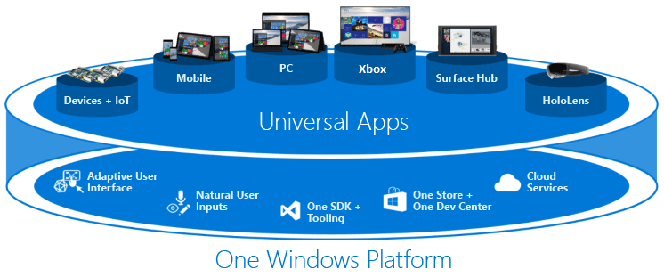
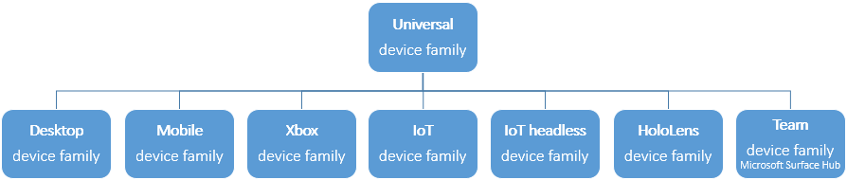
Overview
Device Families
Extension SDK’s
Universal Controls
Adaptive UI
Adaptive Scaling
Adaptive Coding
Notes:
Refs:
1. https://docs.microsoft.com/en-us/windows/uwp/get-started/universal-application-platform-guide

Slide 4
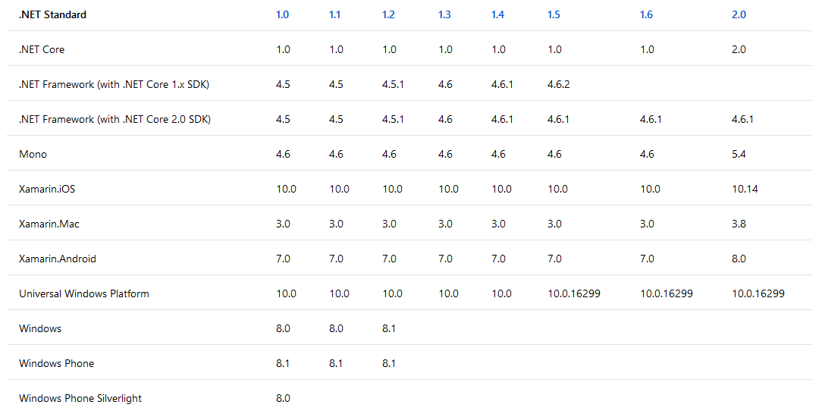
Background & Ecosystem
.NET Standard
Notes:
Refs:
1. https://docs.microsoft.com/en-us/dotnet/standard/net-standard

Slide 5
Background & Ecosystem (Contd…)
What’s New?
.NET Core
.NET Native
.NET Native Analyzer
.NET for UWP
Nuget Package Manager
Notes:
Refs:
https://msdn.microsoft.com/en-us/magazine/mt590967.aspx
http://www.c-sharpcorner.com/article/difference-between-net-framework-and-net-core/
https://blogs.windows.com/buildingapps/2015/08/20/net-native-what-it-means-for-universal-windows-platform-uwp-developers/#eA8QI46eXIOqskIe.97
https://blogs.msdn.microsoft.com/dotnet/2017/10/10/announcing-uwp-support-for-net-standard-2-0/
https://msdn.microsoft.com/library/mt185501.aspx

Slide 6
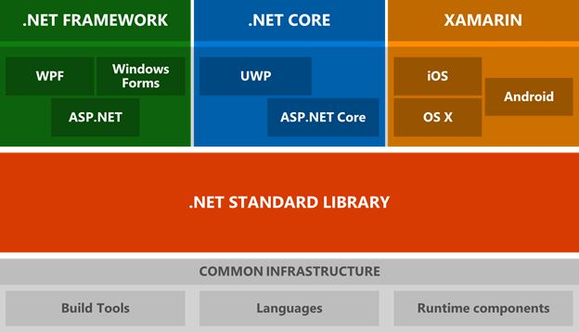
Background & Ecosystem (Contd…)
Notes:
Refs:
http://www.c-sharpcorner.com/article/difference-between-net-framework-and-net-core/

Slide 7
.NET Native - What it is for UWP???
Less memory consumption due native compilation
No dependencies on the desktop .NET Runtime installed on the system
Since your app is compiled natively, you get the performance benefits associated with native code (think C++ performance)
You can still take advantage of the industry-leading C# or VB programming languages, and the tools associated with them
You can continue to use the comprehensive and consistent programming model available with .NET– with extensive APIs to write business logic, built-in memory management, and exception handling.
You get the best of both worlds, managed development experience with C++ performance.
60% performance improvement on cold startup times
40% performance improvement on warm startup times
Notes:
Refs:
1. https://blogs.windows.com/buildingapps/2015/08/20/net-native-what-it-means-for-universal-windows-platform-uwp-developers/#eA8QI46eXIOqskIe.97

Slide 8
Advantages
Universal Platform
Target Multiple Device Families
Multiple Programming Language Support
C# or VB with XAML
JavaScript with HTML
C++ with DirectX and/or XAML
Sandboxed Installation environment.
Clear Install/Uninstall/Update Procedure
No Dependency Software's / SDK’s
.NET Native
Performance
Unified Deployment across Windows Devices
Windows Store
Extensive API support
Cost Reductions
Desktop Bridge
Re use of existing desktop apps adding UWP and increase the reach through Windows Store

Slide 9
Limitations
Supported only on Windows Runtime (Win 10 and future releases)
No support for legacy windows (Win 8 and earlier…)
No Cross Platform Support
No support for Registry Access
Limited File System Access, only for Standard folders (Documents, Pictures Music and Videos etc…)
Can not re use legacy windows components with ease
Paid Dev Center Account to Publish App to Store
No Direct Inter App communication support.

Slide 10
Pre Requisites
For User
Only a Device that runs Minimum Windows Runtime (Win 10) version targeted by the UWP App
For Developer
PC with Win 10 (10.0.16299.0 and further)
8GB RAM
Hyper-V Supported Processor
Visual Studio 2017

Slide 11
Deployment
Types of packages
App Package (.appx) -> Sideloading Use case
App Bundle (.appxbundle) -> Sideloading Use case
App Package Upload File (.appxupload) -> Windows Store Use case
App Installer (.appinstaller) -> Sideloading Use case
Publish to Windows Store
Reserve App Name with Windows Dev Center Portal
Link app package with trusted certificate
Upload .appxupload file to store
Windows App Certification Kit
App in Microsoft Store
Sideloading
Enable Sideloading
Trusted Cert Installation
.appxbundle OR .appx files
Auto Generated Script
App Installer
Windows Power Shell
Notes:
Refs:
https://docs.microsoft.com/en-us/windows/uwp/packaging/packaging-uwp-apps
https://blogs.msdn.microsoft.com/appinstaller/2017/09/27/automated-app-updates-with-appinstaller-file/
https://docs.microsoft.com/en-us/windows/uwp/packaging/appinstaller-root

Slide 12
Live Demo
Scope Coverage
Adaptive UI with 2 page navigation with minimal UI controls
Fetch minimal details from MFP using standard Protocols
SNMP
HTTP
Store and access app’s local data
Localization support for 2 languages
English
Japanese
External Dll reference feasibility in UWP
App Deployment

Slide 13


