Slide 1
BIGDATA VISUALIZATION USING Golang SERVICES
PRESENTATION BY: SUPERVISED BY:
SAI SIDDARDHA DR.SHAJULIN BENEDICT

Slide 2
contents
Abstract
Introduction
Data visualization practices
How to select right chart?
Scope of the project
Advantages
References

Slide 3
ABSTRACT:
Visualization is an important approach to helping Big Data get a complete view of data and discover data values. Big Data analytics and visualization should be integrated seamlessly so that they work best in Big Data applications.
The user will provide a data file in either csv or xl format and some basic information about the data , then the software will automatically search for the suitable plot and plots the graph according to it.

Slide 4
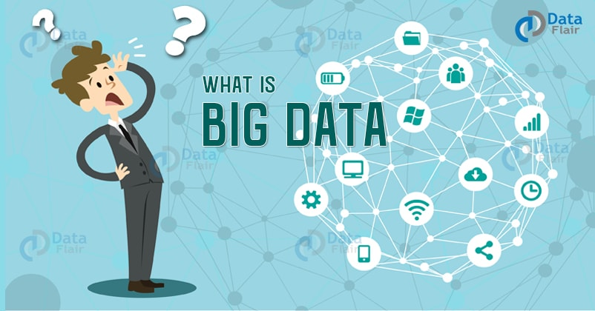
INTRODUCTION

Slide 5
Data which are very large in size is called Big Data. Normally we work on data of size MB or maximum GB(Movies, Codes) but data in Peta bytes i.e. 10^15 byte size is called Big Data. It is stated that almost 90% of today's data has been generated in the past 3 years.
Some of the sources of bigdata are social networking sites , ecommerce sites, weather stations , share market.
The main issue of the bigdata is Huge amount of unstructured data which needs to be stored, processed and analyzed.
The one of the main important solution is to analyze the data.

Slide 6
Why Data Visualization??
Data visualization is a general term that describes any effort to help people understand the significance of data by placing it in a visual context. Patterns, trends and correlations that might go undetected in text-based data can be exposed and recognized easier with data visualization software.
We can visualize our data either in Tables or Graphs.
Graphs and tables serve different purposes. Choose the appropriate data display to fit your purpose.
Common Display Types:
Bar plots, Box plots, Heatmaps, Tree plot, Pie charts.

Slide 7
Data Visualization Best Practices
There are four basic presentation types that you can use to present your data:
Comparison
Composition
Distribution
Relationship

Slide 8
HOW TO SELECT RIGHT CHART???
To determine which chart is best suited for each of those presentation types, first you must answer a few questions:
How many variables do you want to show in a single chart? One, two, three, many?
How many items (data points) will you display for each variable? Only a few or many?
Will you display values over a period of time, or among items or groups?

Slide 9
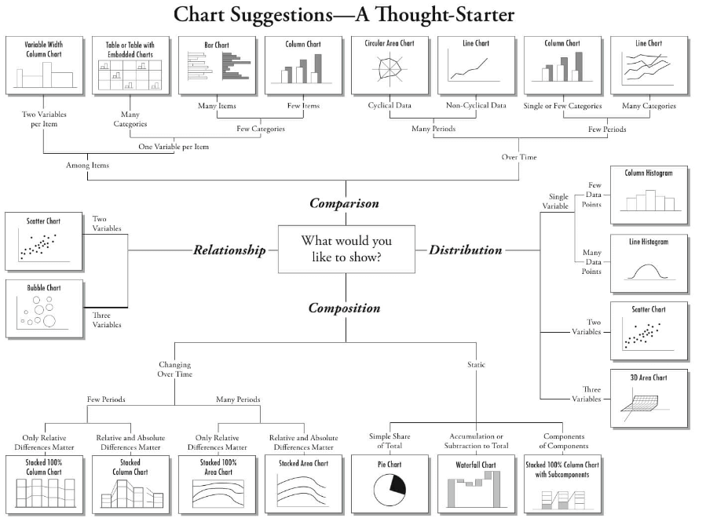

Slide 10
In your day-to-day activities, we will come across the below listed 8 charts most of the time.
Scatter Plot
Histogram
Bar & Stack Bar Chart
Box Plot
Area Chart
Heat Map
Correlogram
Pie charts and donut charts

Slide 11
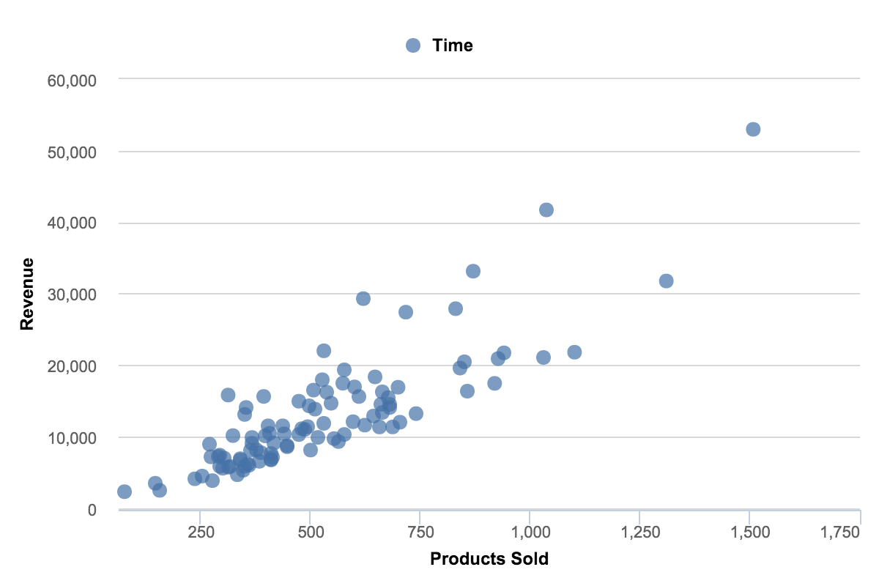
Scatter plot
Scatter charts are primarily used for
correlation and distribution analysis.
Good for showing the relationship
between two different variables
where one correlates to
another (or doesn’t).

Slide 12
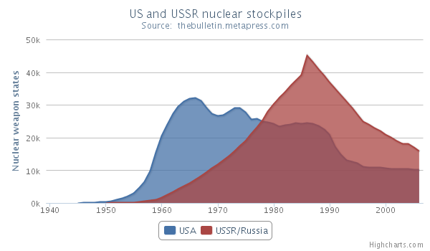
Area chart
Area chart is used to show continuity
across a variable or data set. It is
very much same as line chart and
is commonly used for time series
plots. Alternatively, it is also used
to plot continuous variables and
analyze the underlying trends.

Slide 13
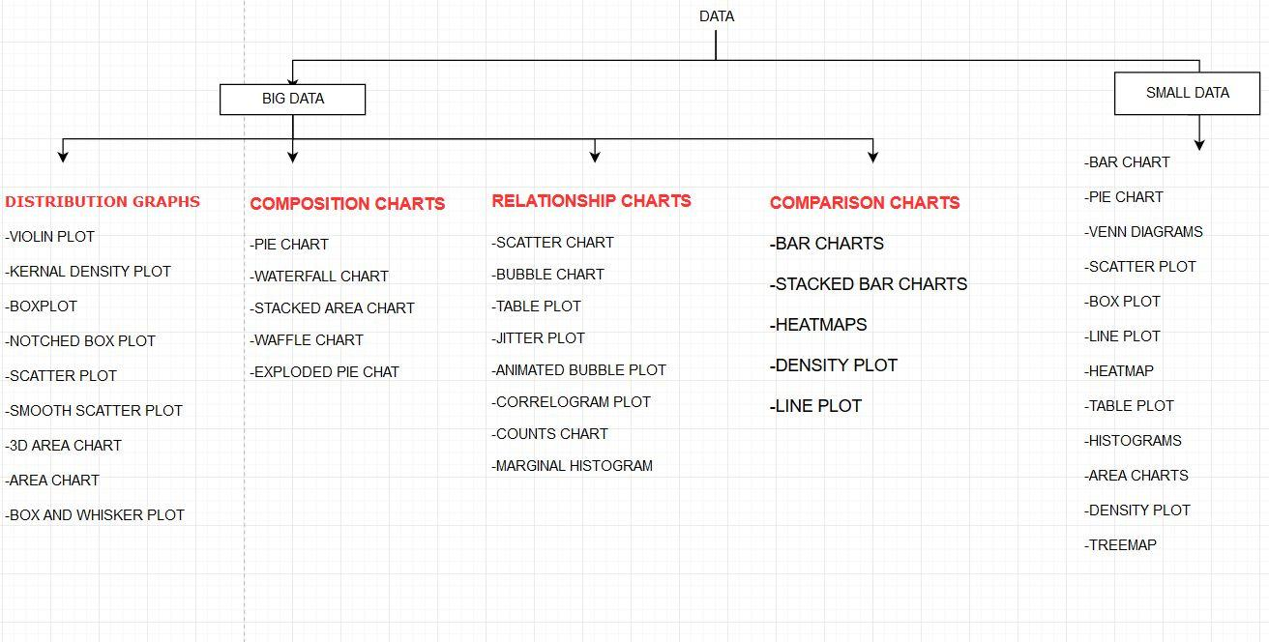

Slide 14
Software Requirements
R programming language for visualizaing graphs.
Packages I have been using are:ggplot2
patchwork
ggiraph
dygraphs
googlevis
RcolorBrewer
rcdimple
plotly
highcharter
Golang services to receive data and to show it in server.

Slide 15
Scope of the project
First the user will give a data in .csv or excel file so the software should first understand the data.
Then I will give distinction about every presentation type (composition or comparison or distribution or relationship ) so that user has to choose one among these.
Then the next step is for every presentation type there will be some charts like for composition pie or donut chart , stacked column chart ,stacked area chart , waterfall chart will come under this presentation type.
For comparison column chart , bar chart , line chart , two-axis chart will come.

Slide 16
Contd..
For distribution chart violin plot , box plot , area chart , 3D Area chart will come.
For relationship chart bubble chart , table plot , jitter plot , correlogram plot will come.
Now according to presentation type he or she have chosen the output will be presented in server by using golang services.

Slide 17
Advantages
Enhanced Assimilation of Business Information
Quick Access to Relevant Business Insights
Better Understanding of Operational & Business Activities
Rapid Identification of Latest Trends
Easy Comprehension of Data

Slide 18
References
"Big Data Visualization: Turning Big Data Into Big Insights", Intel IT Center, pp. 1-14, March 2013.
"Data Visualization: Making Big Data Approachable and Valuable White Paper" in SAS, pp. 1-4, January 2013.
SAS Data Visualization: What it is and why it matters, [online] Available: www.sas.com/en_sg/insights/big-data/data-visualization.html.
H Childs, B Geveci, W Schroeder, J Meredith, K Moreland, C Sewell, T Kuhlen, EW Bethel, "Research challenges for visualization software", Computer, vol. 1, no. 5, pp. 34-42, May 2013.
Lidong Wang, Guanghui Wang, Cheryl Ann Alexander, "Big Data and Visualization: Methods Challenges and Technology Progress", Digital Technologies, vol. 1, no. 1, pp. 33-38, 2015.

