Slide 1
1
CSE 427: VIRTUALIZATION & CLOUD COMPUTING
HANDS-ON-LAB (HOL) LAB
vMOTION & MONITORING PERFORMANCE
by
Mr. Ajay Kumar Badhan
Assistant Professor
M.TECH[CST], B.TECH [CSE]
Email: ajay.27337@lpu.co.in
Personal Blog: https://ajaykumarbadhan.wordpress.com/
Preferred Text Book
Cloud Computing Bible: Barrie Sosinky – 1st Edition, Wiley India Pvt. Ltd.
Cloud Computing: Fundamentals, Industry Approach & Trends by Rishabh Sharma, Wiley
Cloud Computing: Principles & Paradigms by Raj Kumar Buyya, James Broberg, Andrzej Goscinski, Wiley
@Mr. Ajay Kumar Badhan

Slide 2
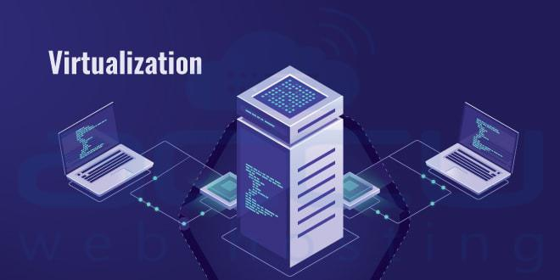
2
PART -I: VIRTUALIZATION
CONTENT
VIRTUALIZATION TECHNIQUES
Virtualization Technology
Overview of x86 Architecture
Types of Virtualization
Concepts of VLAN
Concepts of SLAN
Concepts of VSAN
Benefits of VLAN, SLAN, & VSAN
@Mr. Ajay Kumar Badhan

Slide 3
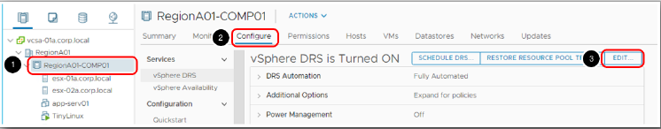
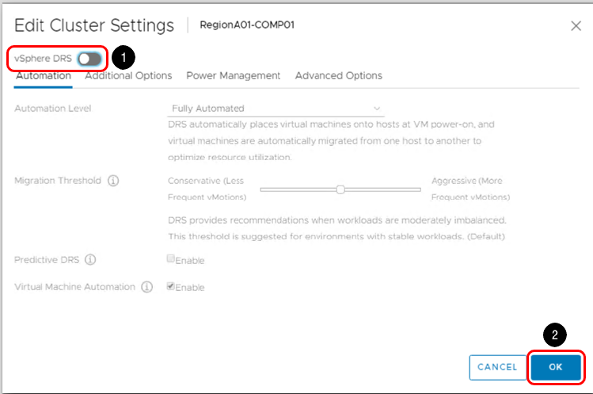
3
PART - I: VIRTUALIZATION
INTRODUCTION
Migrating Virtual Machine with VMware vMotion
@Mr. Ajay Kumar Badhan

Slide 4
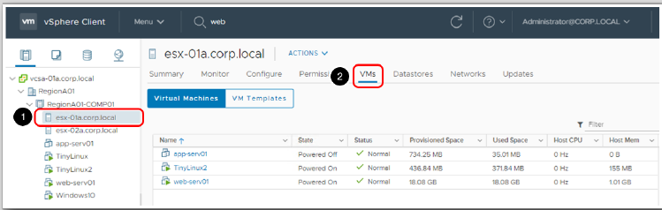
4
PART - I: VIRTUALIZATION
INTRODUCTION
Migrating Virtual Machine with VMware vMotion
@Mr. Ajay Kumar Badhan

Slide 5
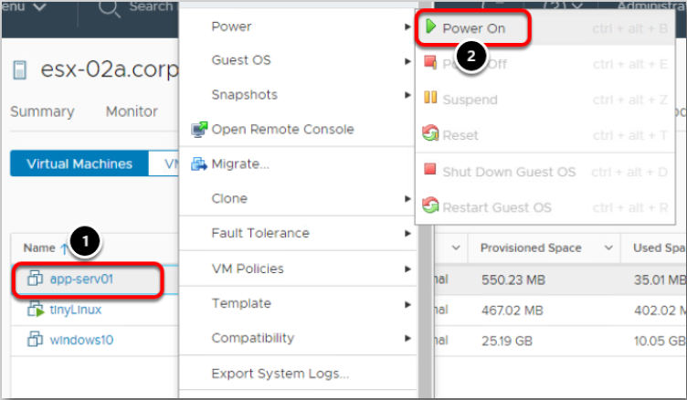
5
PART - I: VIRTUALIZATION
INTRODUCTION
Migrating Virtual Machine with VMware vMotion
@Mr. Ajay Kumar Badhan

Slide 6
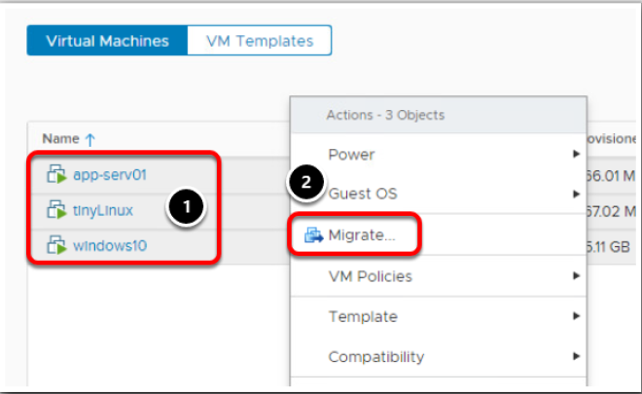
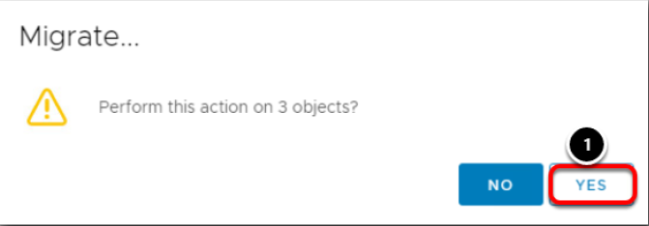
6
PART - I: VIRTUALIZATION
INTRODUCTION
Migrating Virtual Machine with VMware vMotion
@Mr. Ajay Kumar Badhan

Slide 7
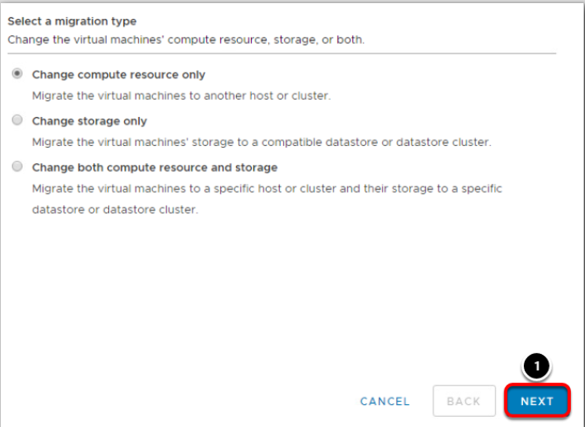
7
PART - I: VIRTUALIZATION
INTRODUCTION
Migrating Virtual Machine with VMware vMotion
@Mr. Ajay Kumar Badhan

Slide 8
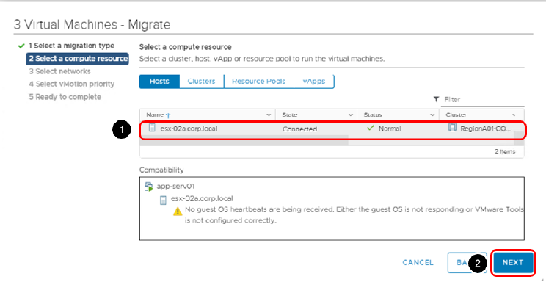
8
PART - I: VIRTUALIZATION
INTRODUCTION
Migrating Virtual Machine with VMware vMotion
@Mr. Ajay Kumar Badhan

Slide 9
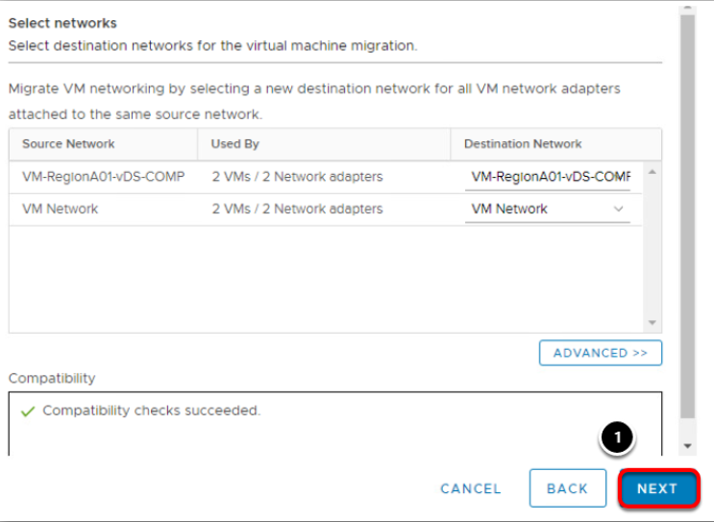
9
PART - I: VIRTUALIZATION
INTRODUCTION
Migrating Virtual Machine with VMware vMotion
@Mr. Ajay Kumar Badhan

Slide 10
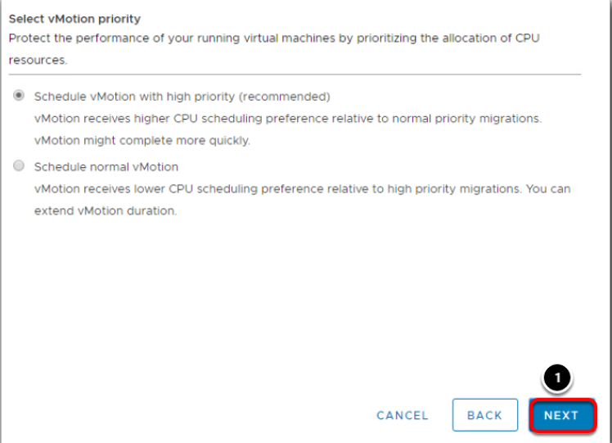
10
PART - I: VIRTUALIZATION
INTRODUCTION
Migrating Virtual Machine with VMware vMotion
@Mr. Ajay Kumar Badhan

Slide 11
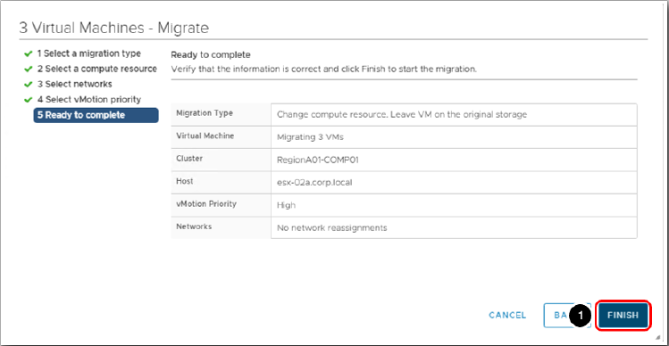
11
PART - I: VIRTUALIZATION
INTRODUCTION
Migrating Virtual Machine with VMware vMotion
@Mr. Ajay Kumar Badhan

Slide 12
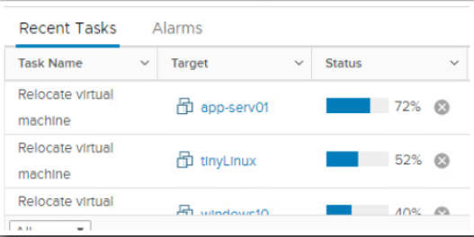
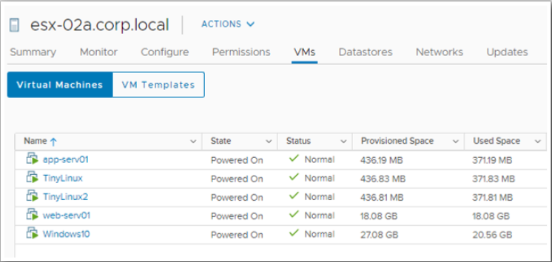
12
PART - I: VIRTUALIZATION
INTRODUCTION
Migrating Virtual Machine with VMware vMotion
@Mr. Ajay Kumar Badhan

Slide 13
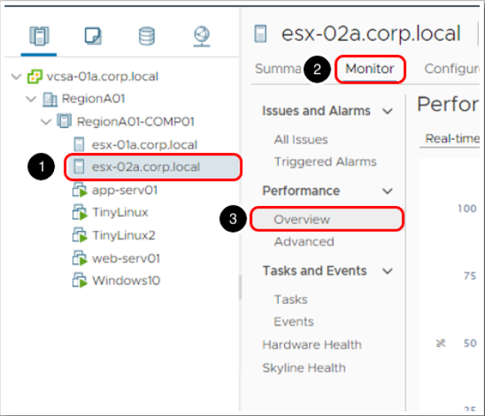
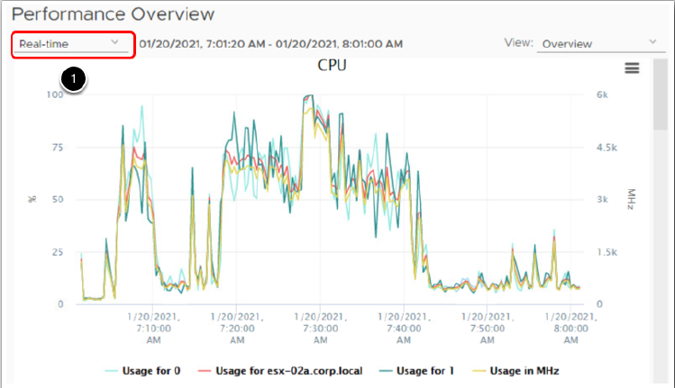
13
PART - I: VIRTUALIZATION
INTRODUCTION
vSphere Monitoring & Performance
@Mr. Ajay Kumar Badhan

Slide 14
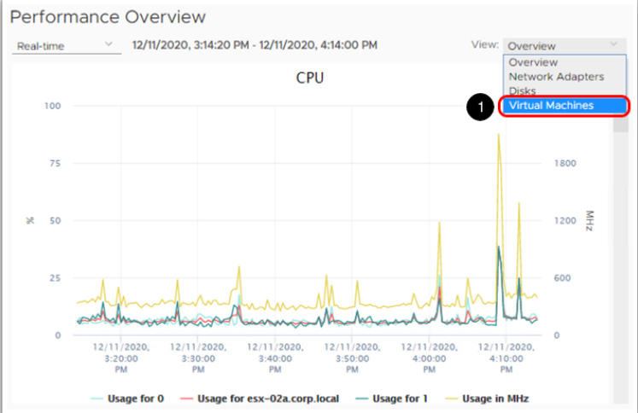
14
PART - I: VIRTUALIZATION
INTRODUCTION
vSphere Monitoring & Performance
@Mr. Ajay Kumar Badhan

Slide 15
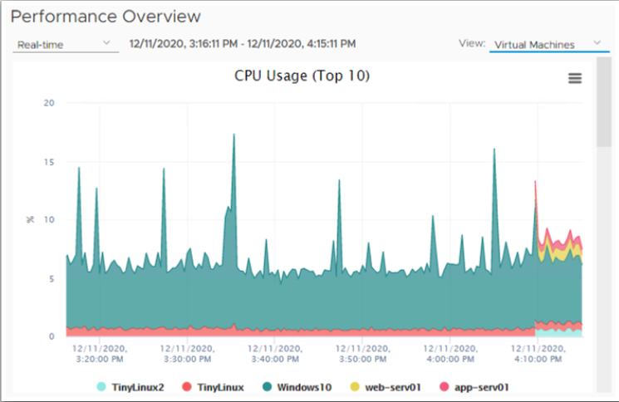
15
PART - I: VIRTUALIZATION
INTRODUCTION
vSphere Monitoring & Performance
@Mr. Ajay Kumar Badhan

Slide 16
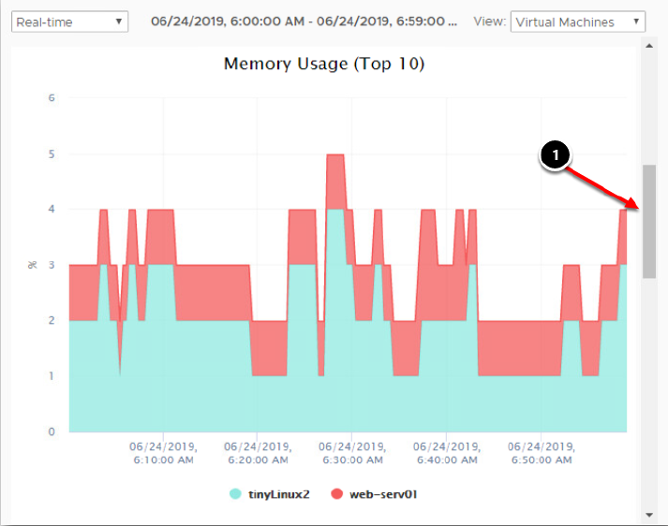
16
PART - I: VIRTUALIZATION
INTRODUCTION
vSphere Monitoring & Performance
@Mr. Ajay Kumar Badhan

Slide 17
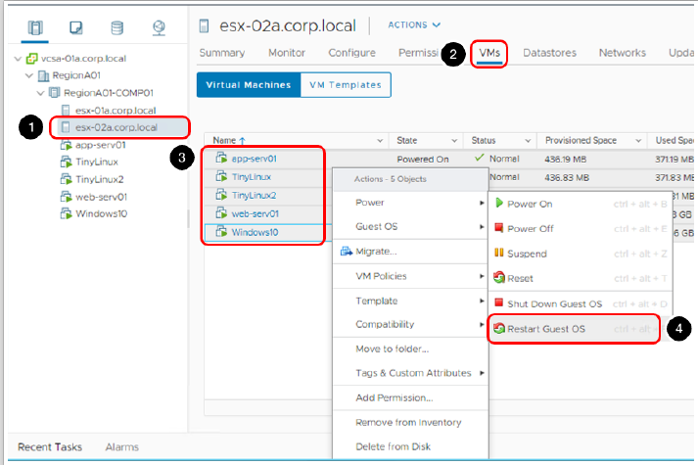
17
PART - I: VIRTUALIZATION
INTRODUCTION
Select the VM to be restarted
@Mr. Ajay Kumar Badhan

Slide 18
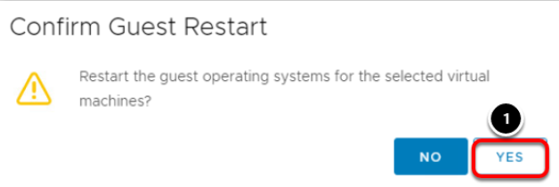
18
PART - I: VIRTUALIZATION
INTRODUCTION
Select the VM to be restarted
@Mr. Ajay Kumar Badhan

Slide 19
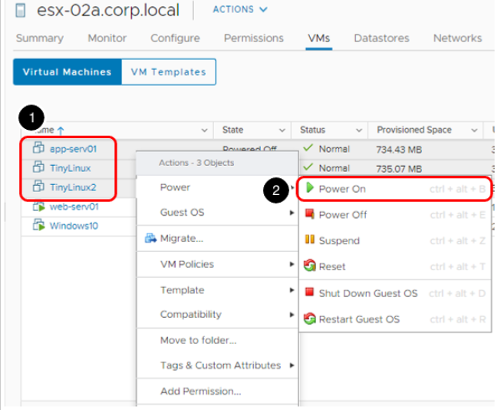
19
PART - I: VIRTUALIZATION
INTRODUCTION
Select the VM to be restarted
@Mr. Ajay Kumar Badhan

Slide 20
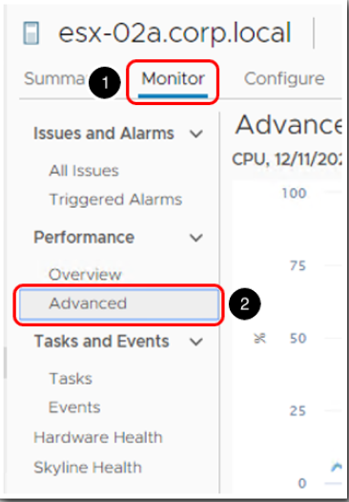
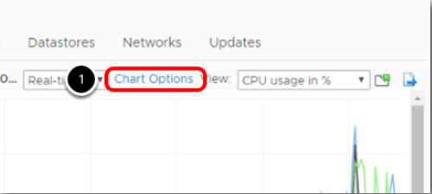
20
PART - I: VIRTUALIZATION
INTRODUCTION
Select the VM to be restarted
@Mr. Ajay Kumar Badhan

Slide 21
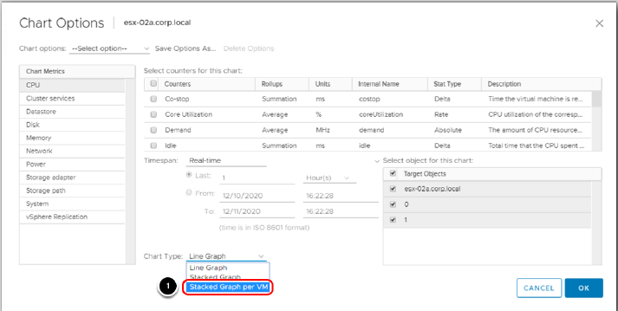
21
PART - I: VIRTUALIZATION
INTRODUCTION
Select the VM to be restarted
@Mr. Ajay Kumar Badhan

Slide 22
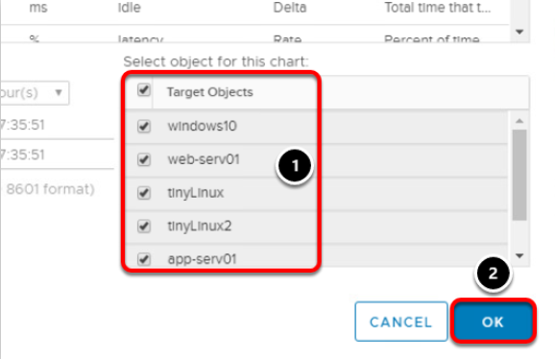
22
PART - I: VIRTUALIZATION
INTRODUCTION
Select the VM to be restarted
@Mr. Ajay Kumar Badhan

Slide 23
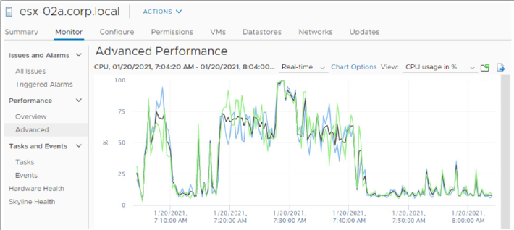
23
PART - I: VIRTUALIZATION
INTRODUCTION
Select the VM to be restarted
@Mr. Ajay Kumar Badhan

Slide 24
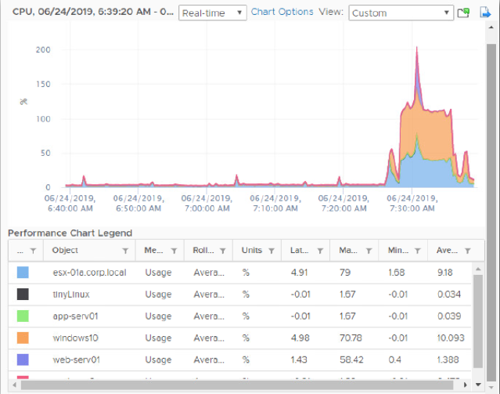
24
PART - I: VIRTUALIZATION
INTRODUCTION
Select the VM to be restarted
@Mr. Ajay Kumar Badhan

Slide 25
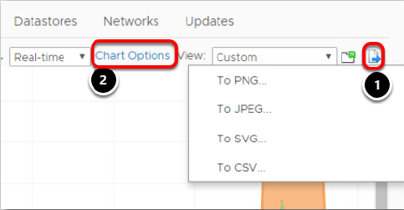
25
PART - I: VIRTUALIZATION
INTRODUCTION
Select the VM to be restarted
@Mr. Ajay Kumar Badhan

Slide 26
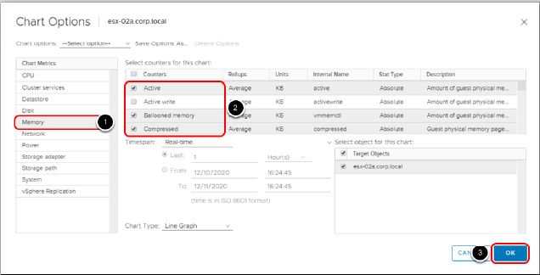
26
PART - I: VIRTUALIZATION
INTRODUCTION
Select the VM to be restarted
@Mr. Ajay Kumar Badhan

Slide 27
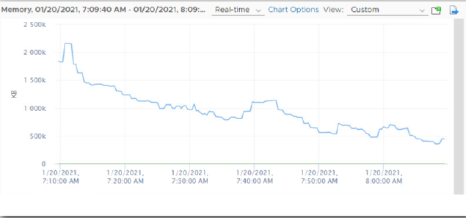
27
PART - I: VIRTUALIZATION
INTRODUCTION
Select the VM to be restarted
@Mr. Ajay Kumar Badhan

