Slide 1
1
CSE 427: VIRTUALIZATION & CLOUD COMPUTING
LAB
EVENTS & ALARMS
by
Mr. Ajay Kumar Badhan
Assistant Professor
M.TECH[CST], B.TECH [CSE]
Email: ajay.27337@lpu.co.in
Personal Blog: https://ajaykumarbadhan.wordpress.com/
Preferred Text Book
Cloud Computing Bible: Barrie Sosinky – 1st Edition, Wiley India Pvt. Ltd.
Cloud Computing: Fundamentals, Industry Approach & Trends by Rishabh Sharma, Wiley
Cloud Computing: Principles & Paradigms by Raj Kumar Buyya, James Broberg, Andrzej Goscinski, Wiley
@Mr. Ajay Kumar Badhan

Slide 2
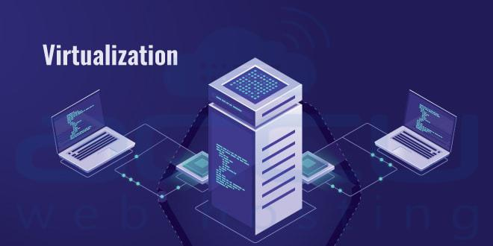
2
VIRTUALIZATION 101 -
CONTENT
HOL (Hands-on Lab) – Virtualization 101
Lab Code: HOL-2210-01-SDC
Enabling DRS of vSphere
@Mr. Ajay Kumar Badhan

Slide 3
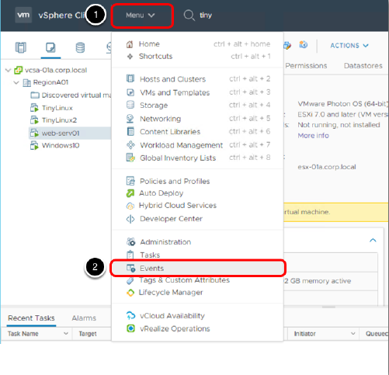
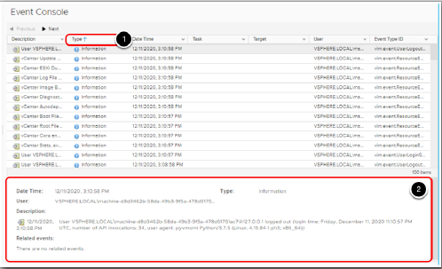
3
PART - I: VIRTUALIZATION
EVENTS & ALARMS
Review Default Alerts
@Mr. Ajay Kumar Badhan

Slide 4
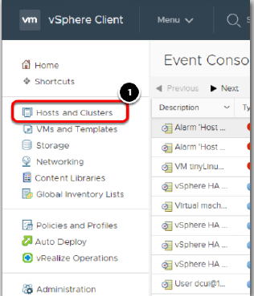
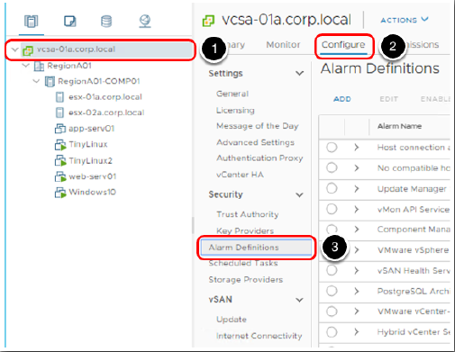
4
PART - I: VIRTUALIZATION
EVENTS & ALARMS
Review Default Alerts
@Mr. Ajay Kumar Badhan

Slide 5
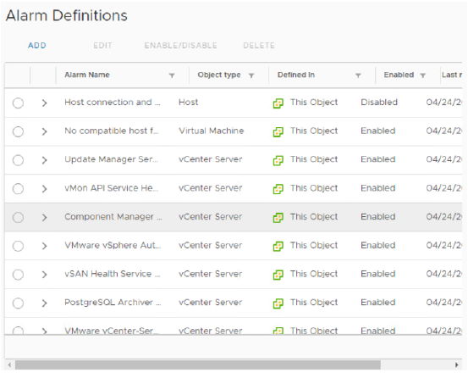
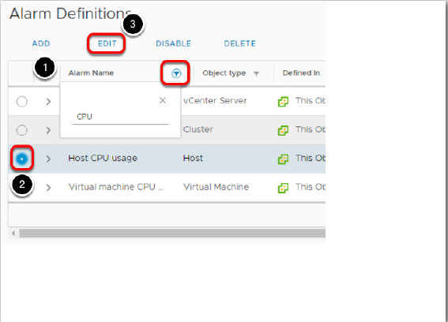
5
PART - I: VIRTUALIZATION
EVENTS & ALARMS
Review Default Alerts
@Mr. Ajay Kumar Badhan

Slide 6
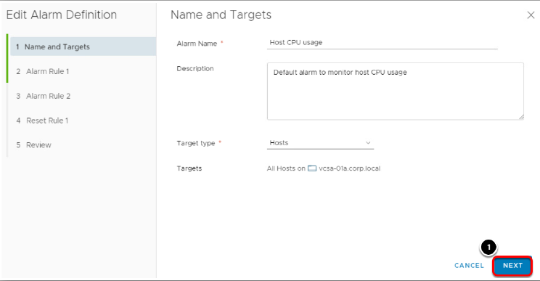
6
PART - I: VIRTUALIZATION
EVENTS & ALARMS
Review Default Alerts
@Mr. Ajay Kumar Badhan

Slide 7
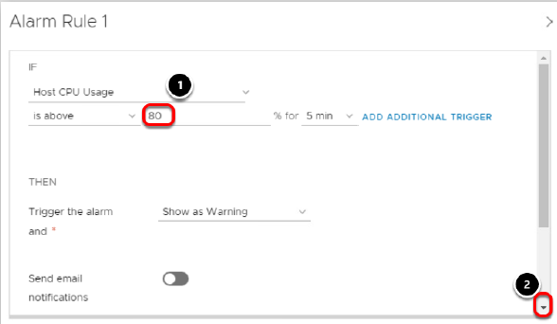
7
PART - I: VIRTUALIZATION
EVENTS & ALARMS
Review Default Alerts
@Mr. Ajay Kumar Badhan

Slide 8
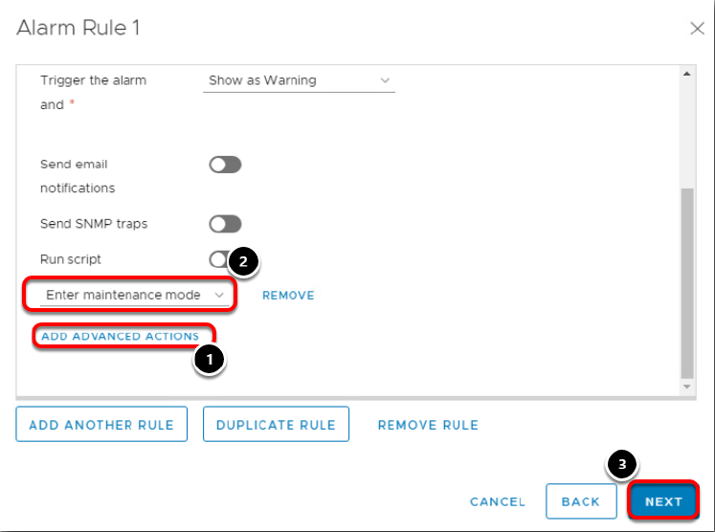
8
PART - I: VIRTUALIZATION
EVENTS & ALARMS
Review Default Alerts
@Mr. Ajay Kumar Badhan

Slide 9
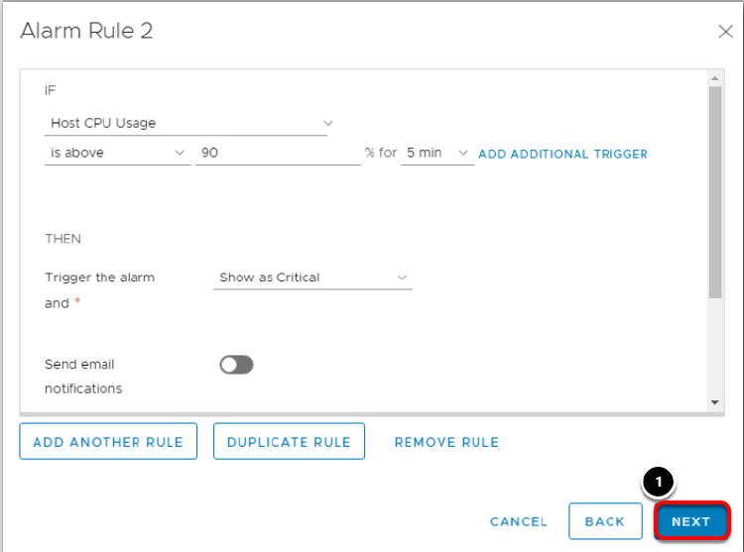
9
PART - I: VIRTUALIZATION
EVENTS & ALARMS
Review Default Alerts
@Mr. Ajay Kumar Badhan

Slide 10
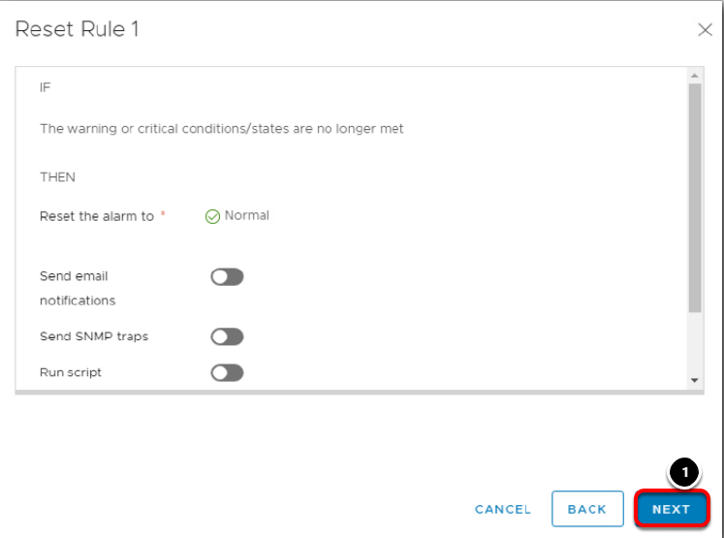
10
PART - I: VIRTUALIZATION
EVENTS & ALARMS
Review Default Alerts
@Mr. Ajay Kumar Badhan

Slide 11
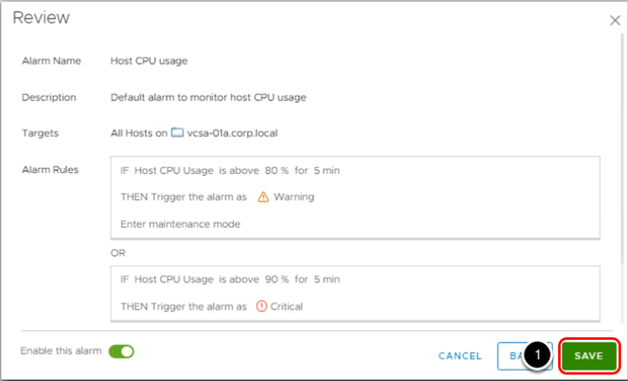
11
PART - I: VIRTUALIZATION
EVENTS & ALARMS
Review Default Alerts
@Mr. Ajay Kumar Badhan

Slide 12
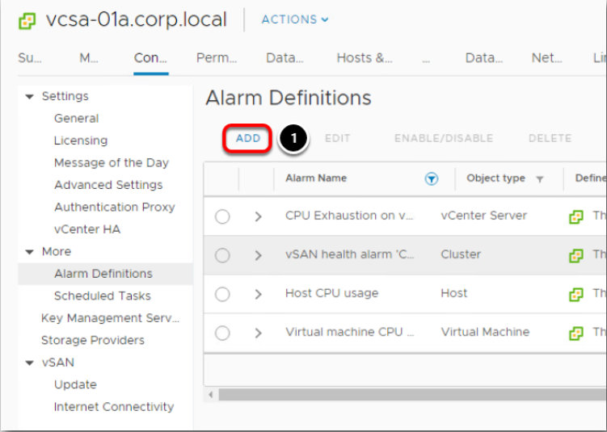
12
PART - I: VIRTUALIZATION
EVENTS & ALARMS
Create New Alarm
@Mr. Ajay Kumar Badhan

Slide 13
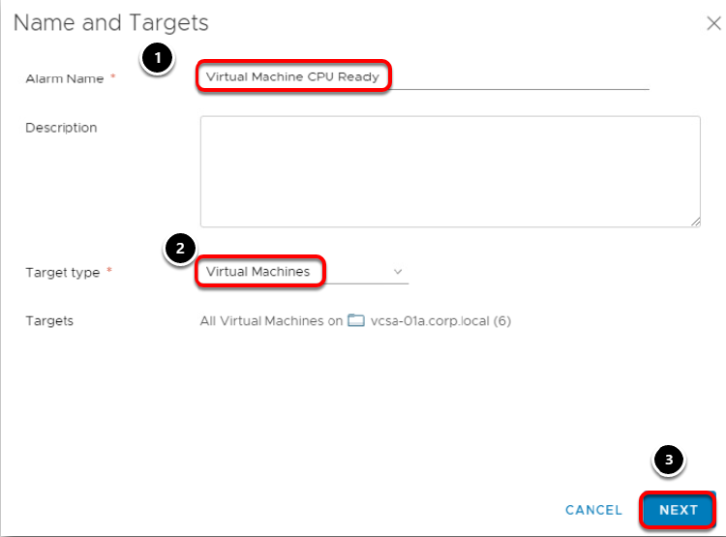
13
PART - I: VIRTUALIZATION
EVENTS & ALARMS
Create New Alarm
@Mr. Ajay Kumar Badhan

Slide 14
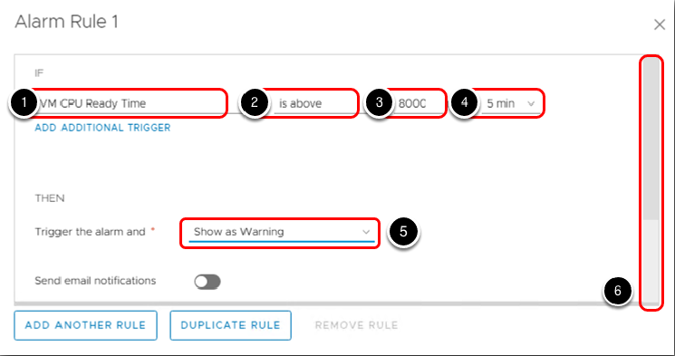
14
PART - I: VIRTUALIZATION
EVENTS & ALARMS
Create New Alarm
Define CPU Ready Time
@Mr. Ajay Kumar Badhan

Slide 15
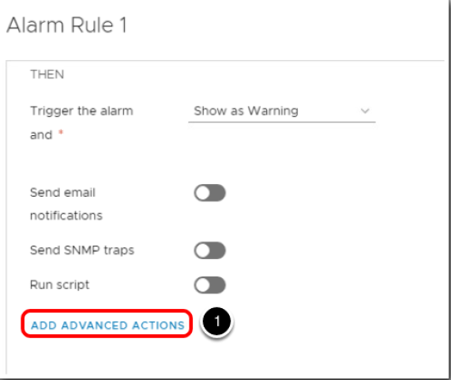
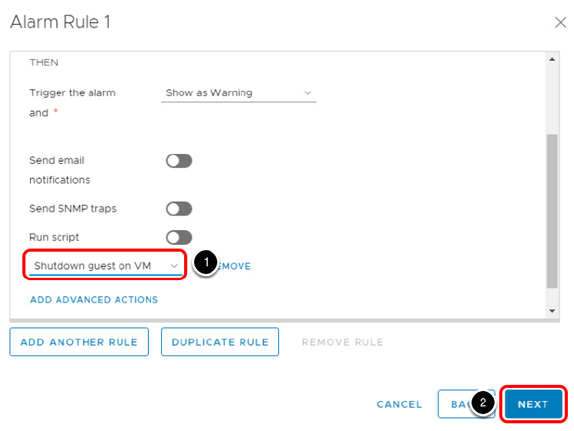
15
PART - I: VIRTUALIZATION
EVENTS & ALARMS
Create New Alarm
Alarm Rule 1
@Mr. Ajay Kumar Badhan

Slide 16
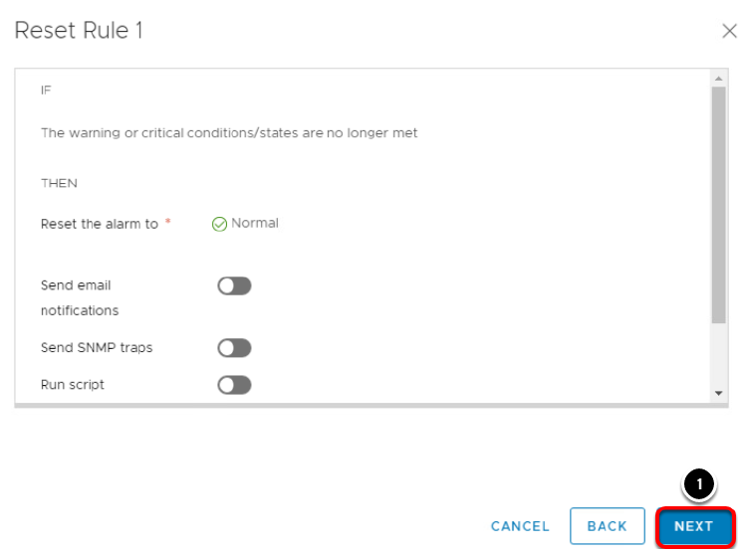
16
PART - I: VIRTUALIZATION
EVENTS & ALARMS
Create New Alarm
Alarm Rule 1
@Mr. Ajay Kumar Badhan

Slide 17
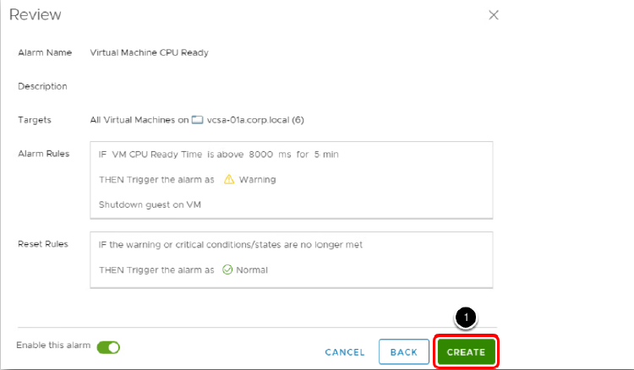
17
PART - I: VIRTUALIZATION
EVENTS & ALARMS
Create New Alarm
Review
@Mr. Ajay Kumar Badhan

Slide 18
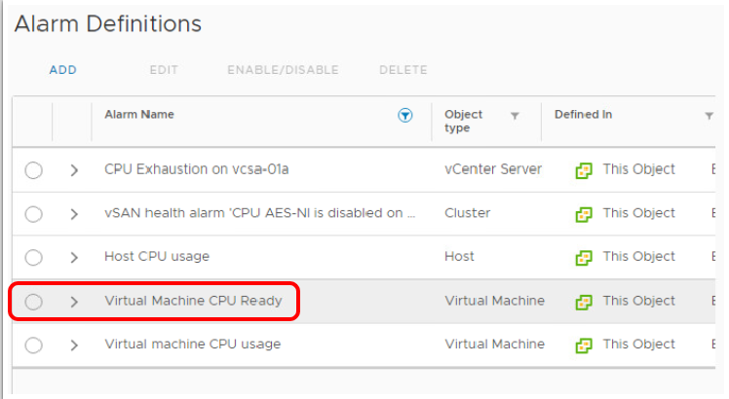
18
PART - I: VIRTUALIZATION
EVENTS & ALARMS
Create New Alarm
New Alarm Created
@Mr. Ajay Kumar Badhan

