Slide 1
1
CSE 427: VIRTUALIZATION & CLOUD COMPUTING
LAB
HIGH AVAILABILITY & DISTRIBUTED RESOURCE SCHEDULER (DRS)
by
Mr. Ajay Kumar Badhan
Assistant Professor
M.TECH[CST], B.TECH [CSE]
Email: ajay.27337@lpu.co.in
Personal Blog: https://ajaykumarbadhan.wordpress.com/
Preferred Text Book
Cloud Computing Bible: Barrie Sosinky – 1st Edition, Wiley India Pvt. Ltd.
Cloud Computing: Fundamentals, Industry Approach & Trends by Rishabh Sharma, Wiley
Cloud Computing: Principles & Paradigms by Raj Kumar Buyya, James Broberg, Andrzej Goscinski, Wiley
@Mr. Ajay Kumar Badhan

Slide 2

2
VIRTUALIZATION 101 -
CONTENT
HOL (Hands-on Lab) – Virtualization 101
Lab Code: HOL-2210-01-SDC
Enabling HA of vSphere
Enabling DRS of vSphere
@Mr. Ajay Kumar Badhan

Slide 3
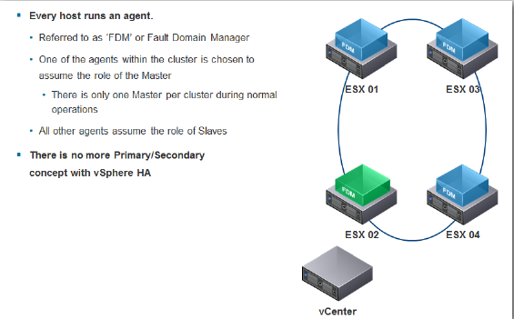
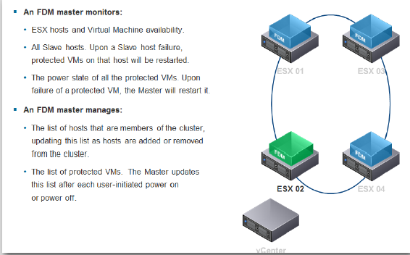
3
PART - I: VIRTUALIZATION
TYPE – II HYPERVISOR
vSPHERE AVAILABILITY
vSphere Availability provides high availability for virtual machines by pooling the virtual machines and the hosts they reside on into a cluster. Hosts in the cluster are monitored and in the event of a failure, the virtual machines on a failed host are restarted on alternate hosts.
@Mr. Ajay Kumar Badhan

Slide 4
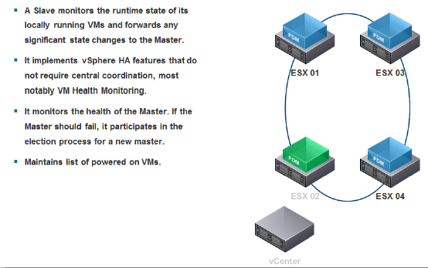
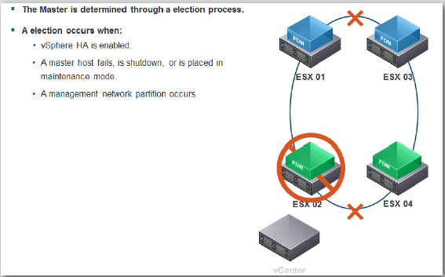
4
PART - I: VIRTUALIZATION
TYPE – II HYPERVISOR
vSPHERE AVAILABILITY
@Mr. Ajay Kumar Badhan

Slide 5
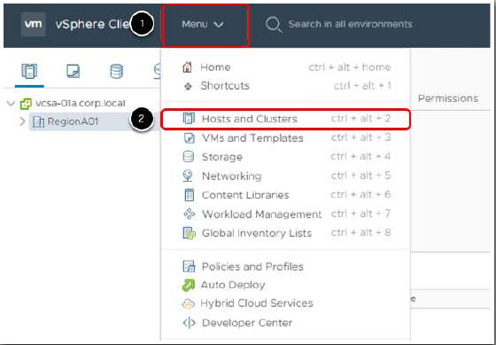
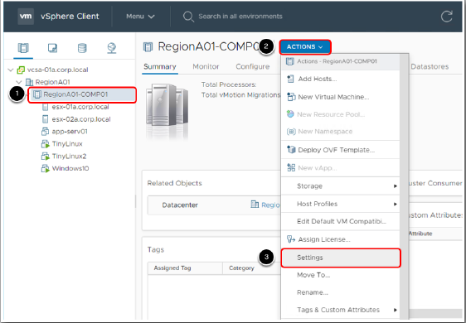
5
PART - I: VIRTUALIZATION
TYPE – II HYPERVISOR
Enable and Configure vSphere Availability
@Mr. Ajay Kumar Badhan

Slide 6
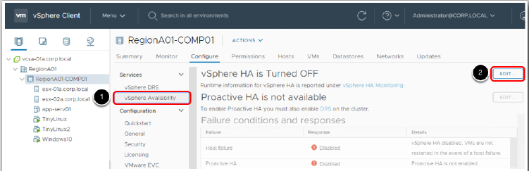
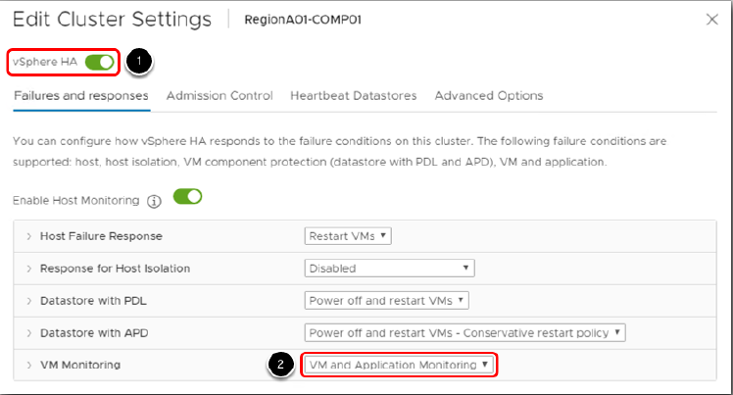
6
PART - I: VIRTUALIZATION
vSPHERE HIGH AVAILABILITY
Enable and Configure vSphere Availability
@Mr. Ajay Kumar Badhan

Slide 7
7
PART - I: VIRTUALIZATION
vSPHERE HIGH AVAILABILITY
Enable and Configure vSphere Availability
@Mr. Ajay Kumar Badhan

Slide 8
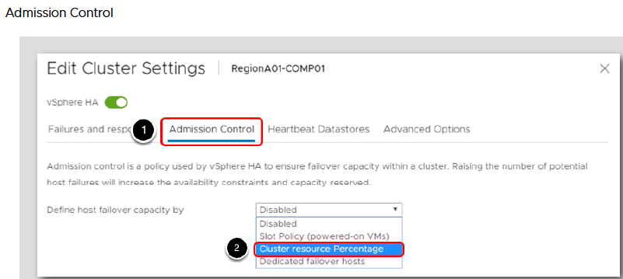
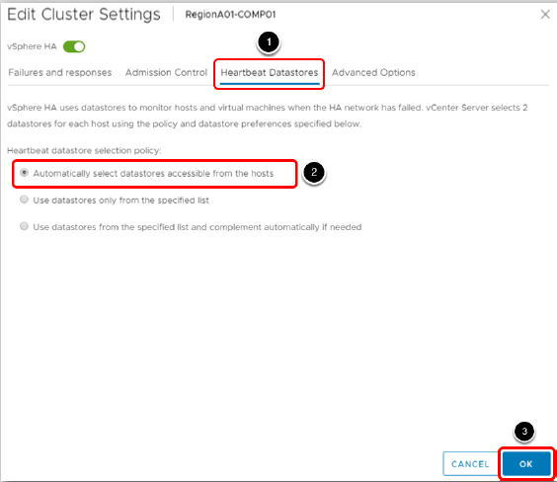
8
PART - I: VIRTUALIZATION
vSPHERE HIGH AVAILABILITY
Enable and Configure vSphere Availability
@Mr. Ajay Kumar Badhan

Slide 9
9
PART - I: VIRTUALIZATION
vSPHERE HIGH AVAILABILITY
Enable and Configure vSphere Availability
@Mr. Ajay Kumar Badhan

Slide 10
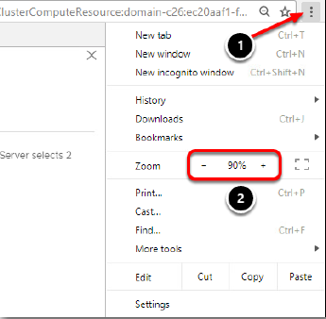
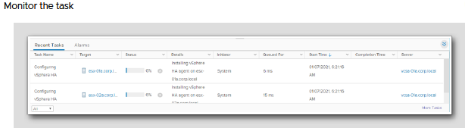
10
PART - I: VIRTUALIZATION
vSPHERE HIGH AVAILABILITY
Enable and Configure vSphere Availability
@Mr. Ajay Kumar Badhan

Slide 11
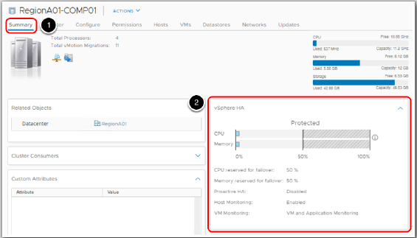
11
PART - I: VIRTUALIZATION
vSPHERE HIGH AVAILABILITY
Enable and Configure vSphere Availability
@Mr. Ajay Kumar Badhan

Slide 12
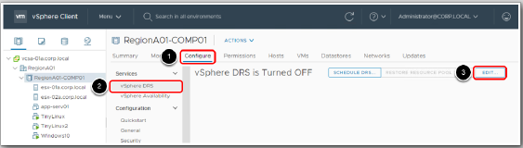
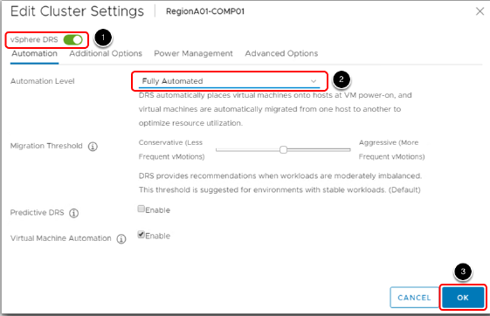
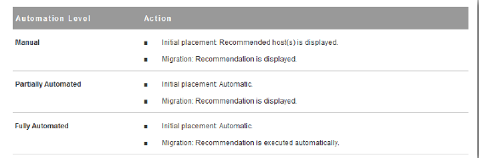
12
PART - I: VIRTUALIZATION
DISTRIBUTED RESOURCE SCHEDULER
Enable DRS
@Mr. Ajay Kumar Badhan

Slide 13
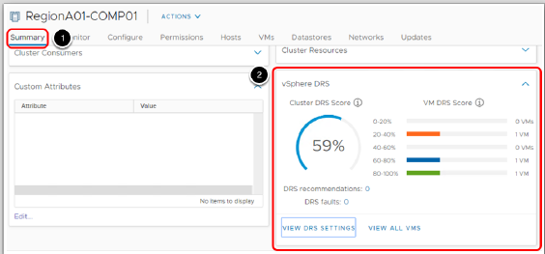
13
PART - I: VIRTUALIZATION
DISTRIBUTED RESOURCE SCHEDULER
Enable DRS
@Mr. Ajay Kumar Badhan

