Slide 1
1
CSE 427: VIRTUALIZATION & CLOUD COMPUTING
LAB
CREATING A VIRTUAL MACHINE & CLONING IT USING TEMPLATE
by
Mr. Ajay Kumar Badhan
Assistant Professor
M.TECH[CST], B.TECH [CSE]
Email: ajay.27337@lpu.co.in
Personal Blog: https://ajaykumarbadhan.wordpress.com/
Preferred Text Book
Cloud Computing Bible: Barrie Sosinky – 1st Edition, Wiley India Pvt. Ltd.
Cloud Computing: Fundamentals, Industry Approach & Trends by Rishabh Sharma, Wiley
Cloud Computing: Principles & Paradigms by Raj Kumar Buyya, James Broberg, Andrzej Goscinski, Wiley
@Mr. Ajay Kumar Badhan

Slide 2

2
VIRTUALIZATION 101 -
CONTENT
HOL (Hands-on Lab) – Virtualization 101
Lab Code: HOL-2210-01-SDC
Creating a Virtual Machine
Installing a OS in Virtual Machine
@Mr. Ajay Kumar Badhan

Slide 3

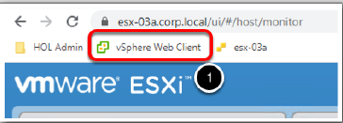
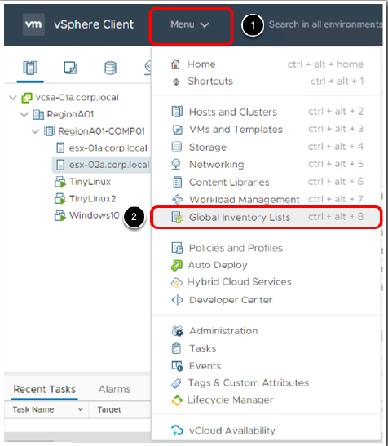
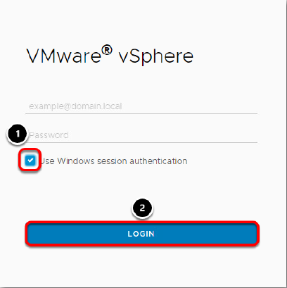
3
PART - I: VIRTUALIZATION
TYPE – I HYPERVISOR
Creating a Virtual Machine
@Mr. Ajay Kumar Badhan

Slide 4
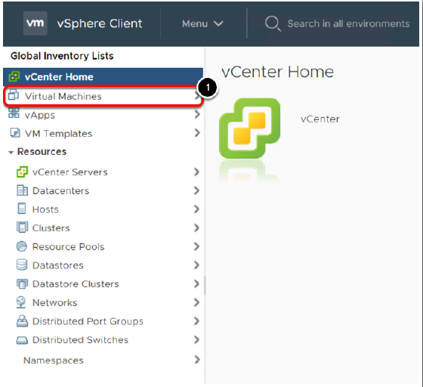
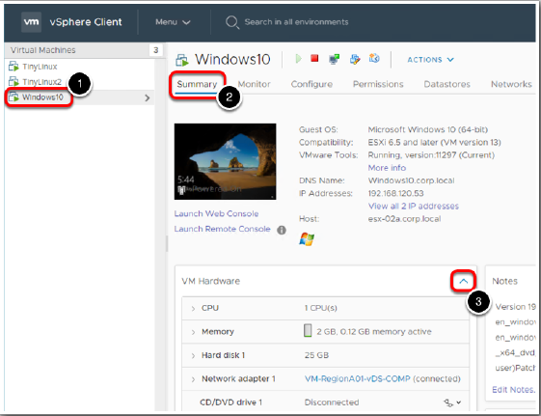
4
PART - I: VIRTUALIZATION
TYPE – I HYPERVISOR
Creating a Virtual Machine
@Mr. Ajay Kumar Badhan

Slide 5
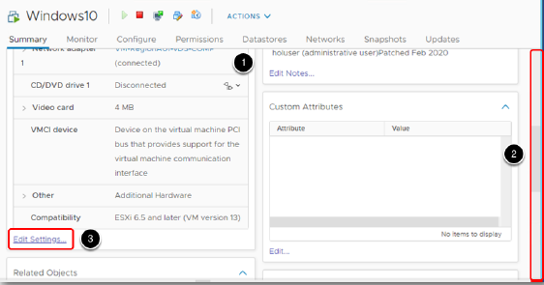
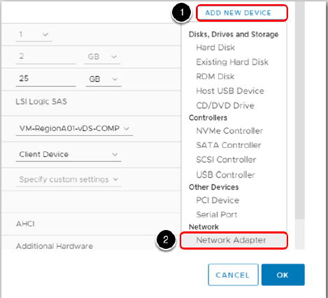
5
PART - I: VIRTUALIZATION
TYPE – I HYPERVISOR
Creating a Virtual Machine
@Mr. Ajay Kumar Badhan

Slide 6
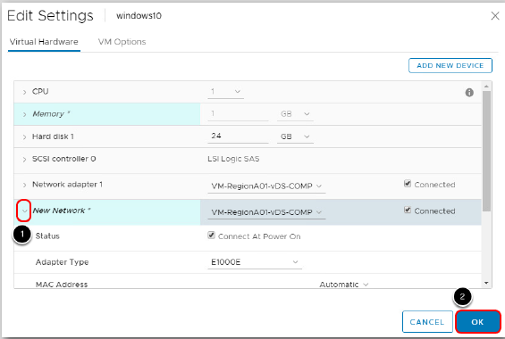


6
PART - I: VIRTUALIZATION
TYPE – I HYPERVISOR
Creating a Virtual Machine
@Mr. Ajay Kumar Badhan

Slide 7
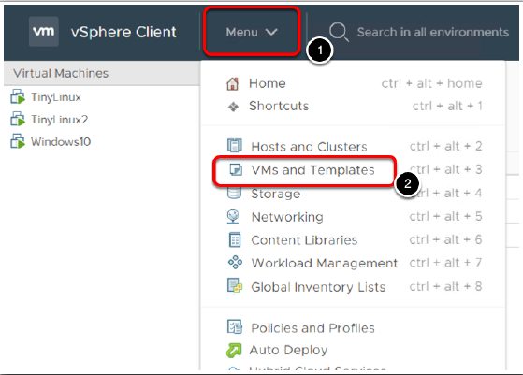
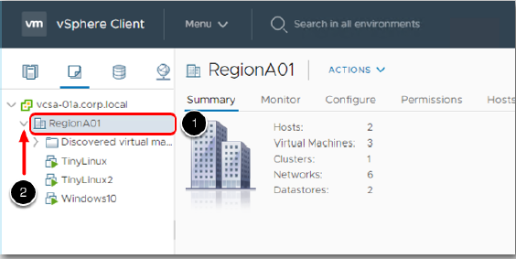
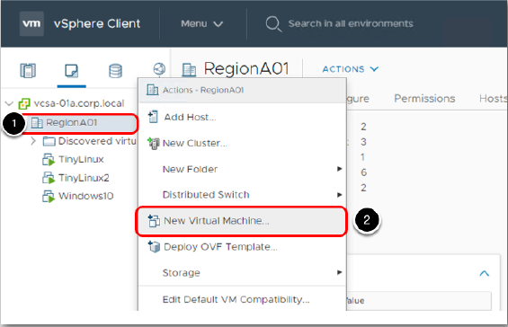
7
PART - I: VIRTUALIZATION
TYPE – I HYPERVISOR
Creating a Virtual Machine
@Mr. Ajay Kumar Badhan

Slide 8
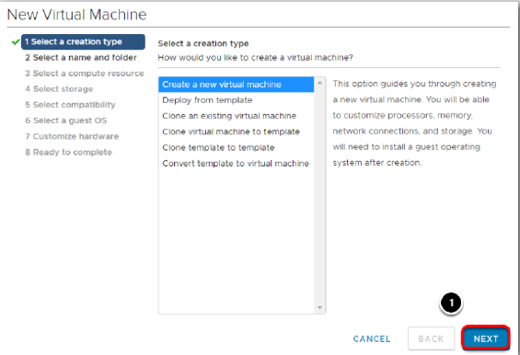
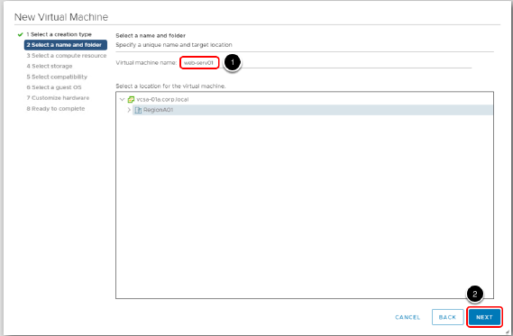
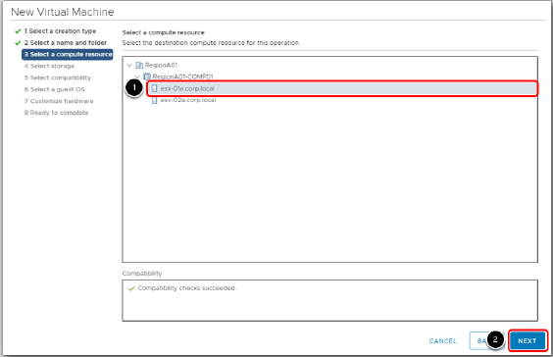
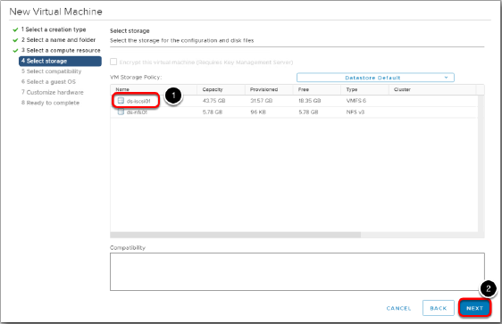
8
PART - I: VIRTUALIZATION
TYPE – I HYPERVISOR
Creating a Virtual Machine
@Mr. Ajay Kumar Badhan

Slide 9
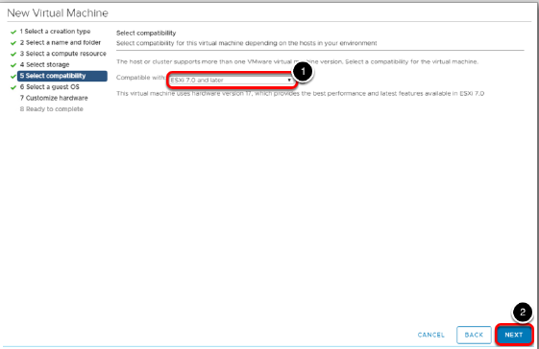
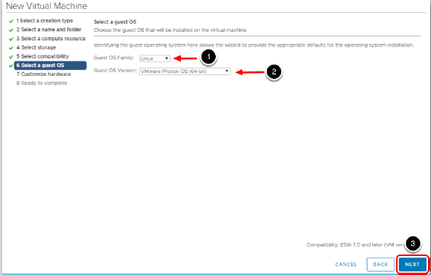
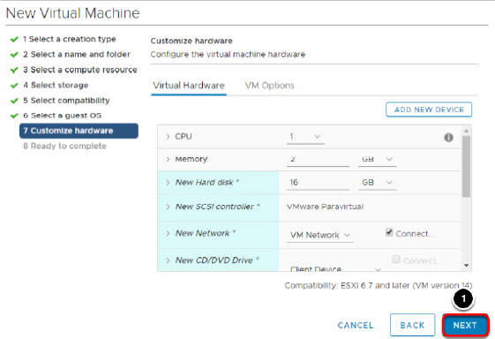
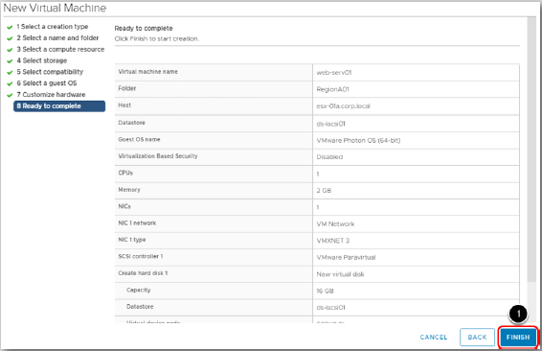
9
PART - I: VIRTUALIZATION
TYPE – I HYPERVISOR
Creating a Virtual Machine
@Mr. Ajay Kumar Badhan

Slide 10
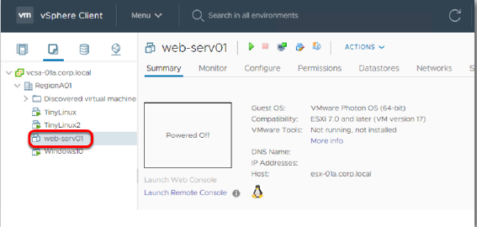
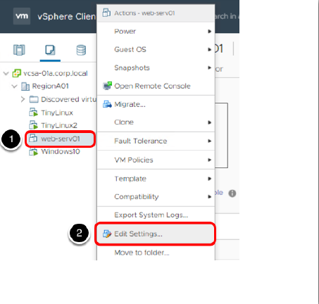
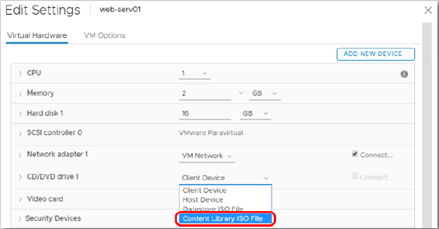
10
PART - I: VIRTUALIZATION
TYPE – I HYPERVISOR
Creating a Virtual Machine
@Mr. Ajay Kumar Badhan

Slide 11
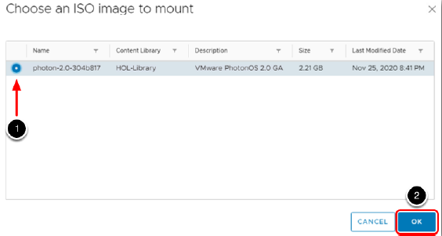
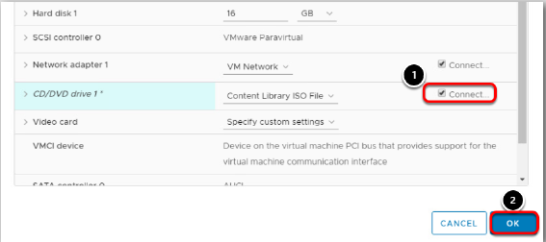
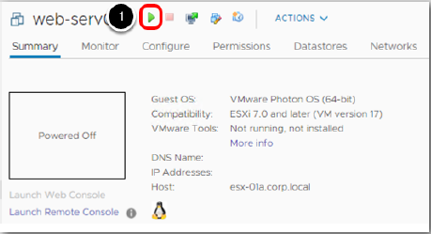
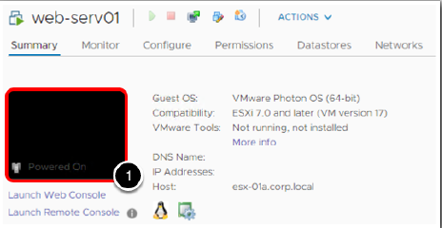
11
PART - I: VIRTUALIZATION
TYPE – I HYPERVISOR
Creating a Virtual Machine
@Mr. Ajay Kumar Badhan

Slide 12
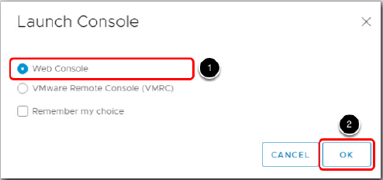

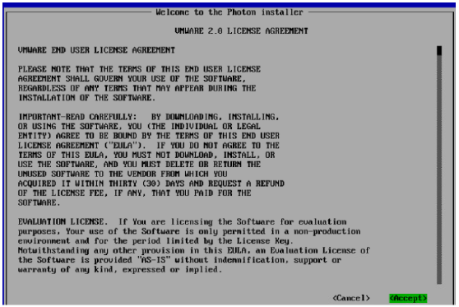
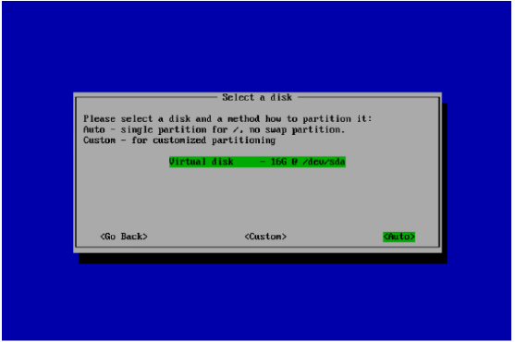
12
PART - I: VIRTUALIZATION
TYPE – I HYPERVISOR
Creating a Virtual Machine
@Mr. Ajay Kumar Badhan

Slide 13
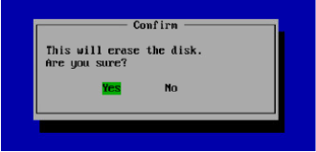
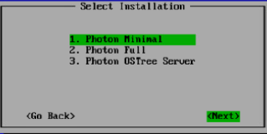
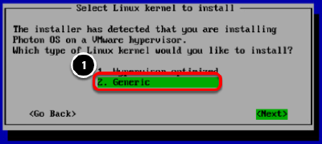
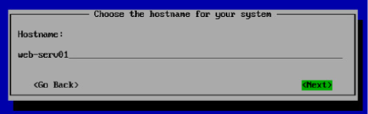
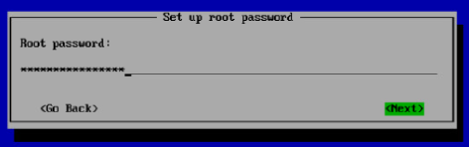
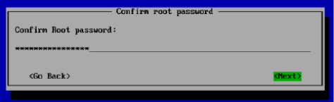
13
PART - I: VIRTUALIZATION
TYPE – I HYPERVISOR
Creating a Virtual Machine
@Mr. Ajay Kumar Badhan

Slide 14
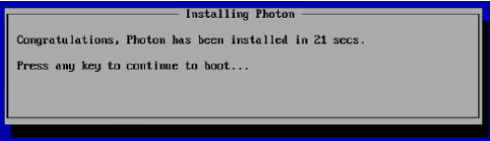
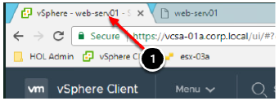
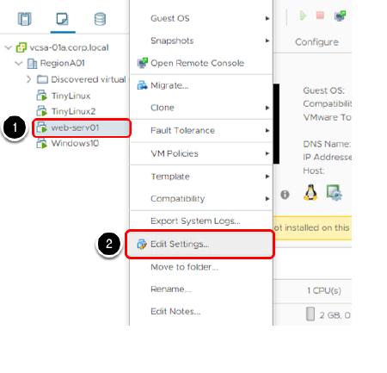
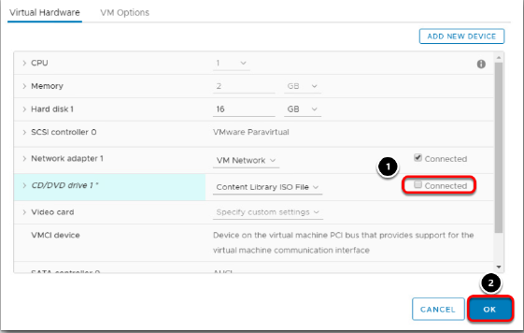
14
PART - I: VIRTUALIZATION
TYPE – I HYPERVISOR
Creating a Virtual Machine
@Mr. Ajay Kumar Badhan

