Slide 1
Machine Learning | 25SC2107E | Project Review 2
Personalized Federated
Deep Learning
for Wireless Link Quality Prediction
Under Non-IID Cell Data
Guide:
Dr. N. Lava Prasad Sir
Team Members:
2520040009 - Pranay Chowdary
2520040095 - Siddhu Bhagavan
2520040045 - Mohan
Dataset: UJIIndoorLoc Wi-Fi RSSI Fingerprint
Framework: TensorFlow 2.20 | Federated Personalization (FedPer)
Deployment: Gradio 6.26 + FastAPI Interactive Dashboard
1 / 10

Slide 2
Problem Statement
Motivation & Research Gap
The Challenge
Wireless link quality prediction is critical for optimizing handovers, resource allocation, and user experience in modern networks.
Key Issues:
Centralized models require sharing raw user data, raising serious privacy concerns
Standard Federated Learning (FedAvg) trains a single global model that cannot adapt to heterogeneous device environments
Non-IID data distribution across wireless devices causes significant accuracy degradation in federated settings
Existing approaches lack efficient decision-boundary handling for RSSI-based classification tasks
Research Gap
No existing work combines personalized federated layers (FedPer) with threshold-aware RSSI boundary classification under non-IID conditions for wireless link quality.
Our Objective
Design a privacy-preserving, personalized federated deep learning system that achieves high accuracy for wireless link quality prediction across heterogeneous devices with non-IID data.
4-Class Link Quality
Poor: max RSSI < -75 dBm
Fair: -75 <= max RSSI < -65 dBm
Good: -65 <= max RSSI < -55 dBm
Excellent: max RSSI >= -55 dBm
2 / 10

Slide 3
Proposed Methodology
Personalized Federated Learning with Hybrid RSSI Decision
FedPer: Personalized Federated Learning
Unlike FedAvg which averages all weights, FedPer splits each client model into:
Shared Base Layers (Federated)
Shared across all 16 clients via server aggregation
Extract universal wireless signal features
Private Head Layers (Local Only)
Remain on each device; never shared
Adapt to each device unique RSSI distribution
Threshold-Aware Boundary Branch
Specialized neurons for RSSI boundary regions
Improves accuracy near class transition thresholds
Thresholds: -75, -65, -55 dBm
Hybrid Decision Strategy
margin_hybrid | Margin = 0.25 dBm
IF min|max_RSSI - threshold| <= 0.25 dBm:
-> Use Neural Network (boundary region)
ELSE:
-> Use fast RSSI rule-based prediction
Key Innovation
93.5% of predictions use instant RSSI rules
Only 6.5% invoke the neural model
(only at class boundaries)
-> Ultra-low latency + high accuracy
3 / 10

Slide 4
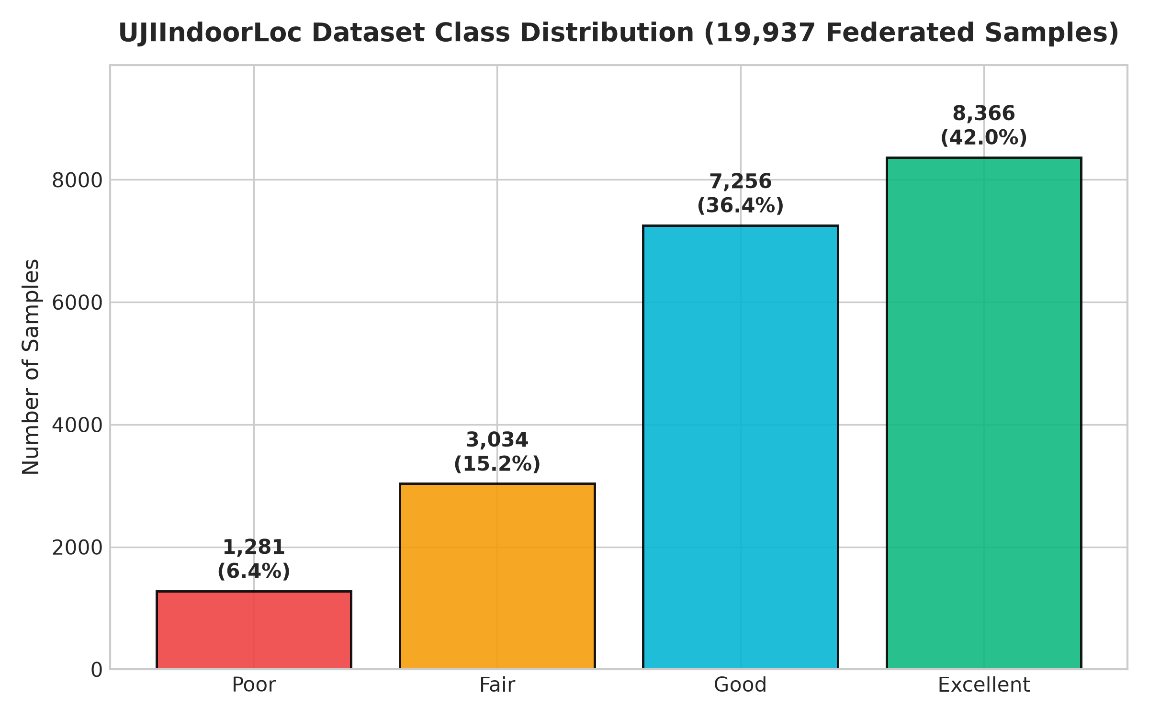
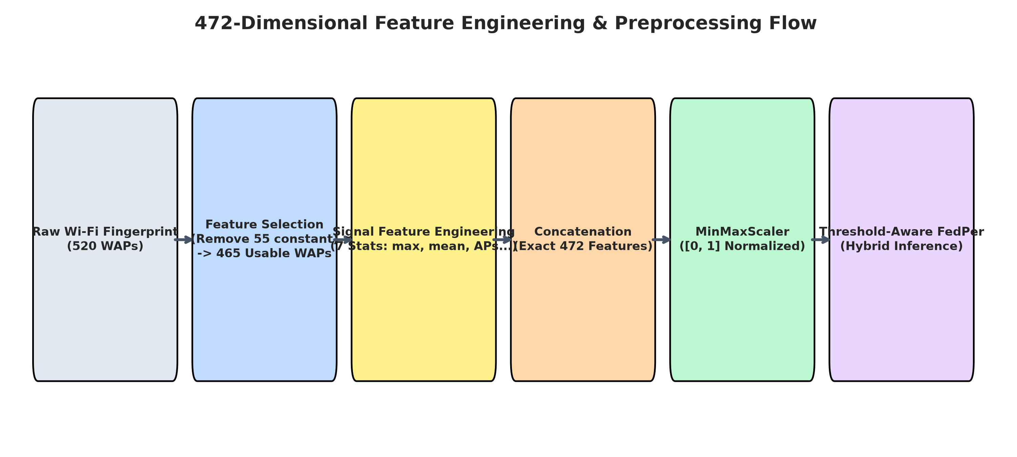
Dataset & Feature Engineering
UJIIndoorLoc Wi-Fi RSSI Fingerprint Dataset
Dataset Overview
Source: UJIIndoorLoc
Total Samples: 19,937
Original WAP Features: 520
Constant Features Removed: 55
Final Usable WAPs: 465
Value 100 -> converted to -100 dBm
7 Engineered Features
max_rssi
mean_rssi
median_rssi
std_rssi
detected_aps
top3_mean, top5_mean
Total Model Features: 472
Federated Data Split
Clients: 16 (by PHONEID)
Split: 70 / 15 / 15
Train: 13,949 samples
Val: 2,990 samples
Test: 2,998 samples
Non-IID across devices
4 / 10

Slide 5
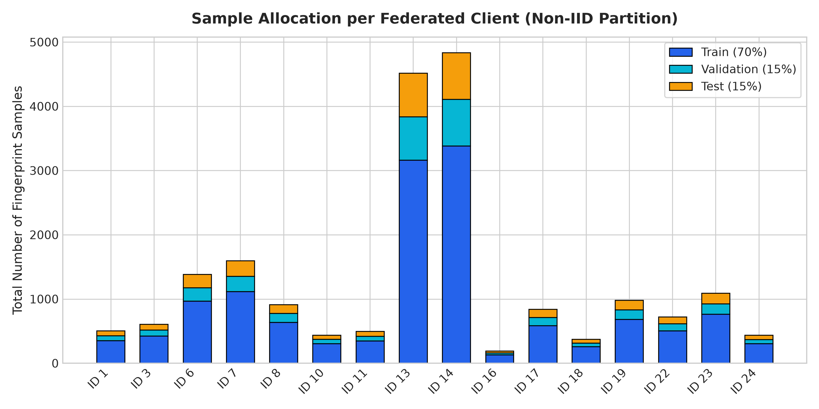
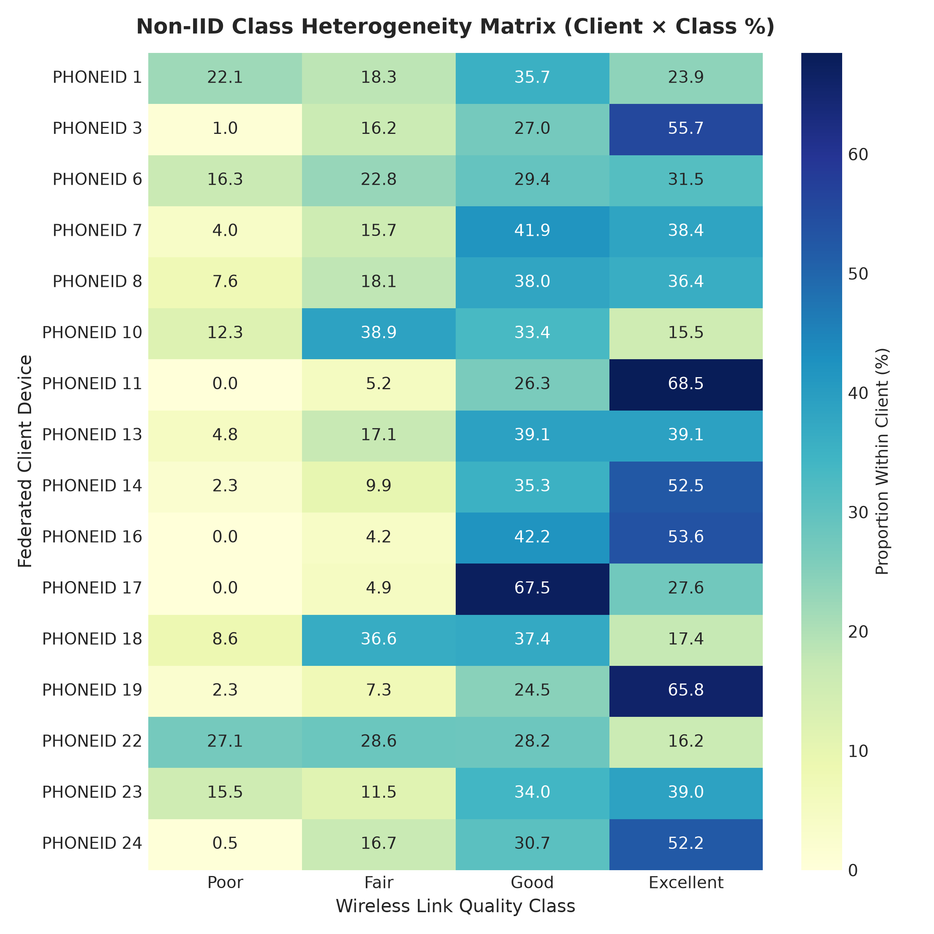
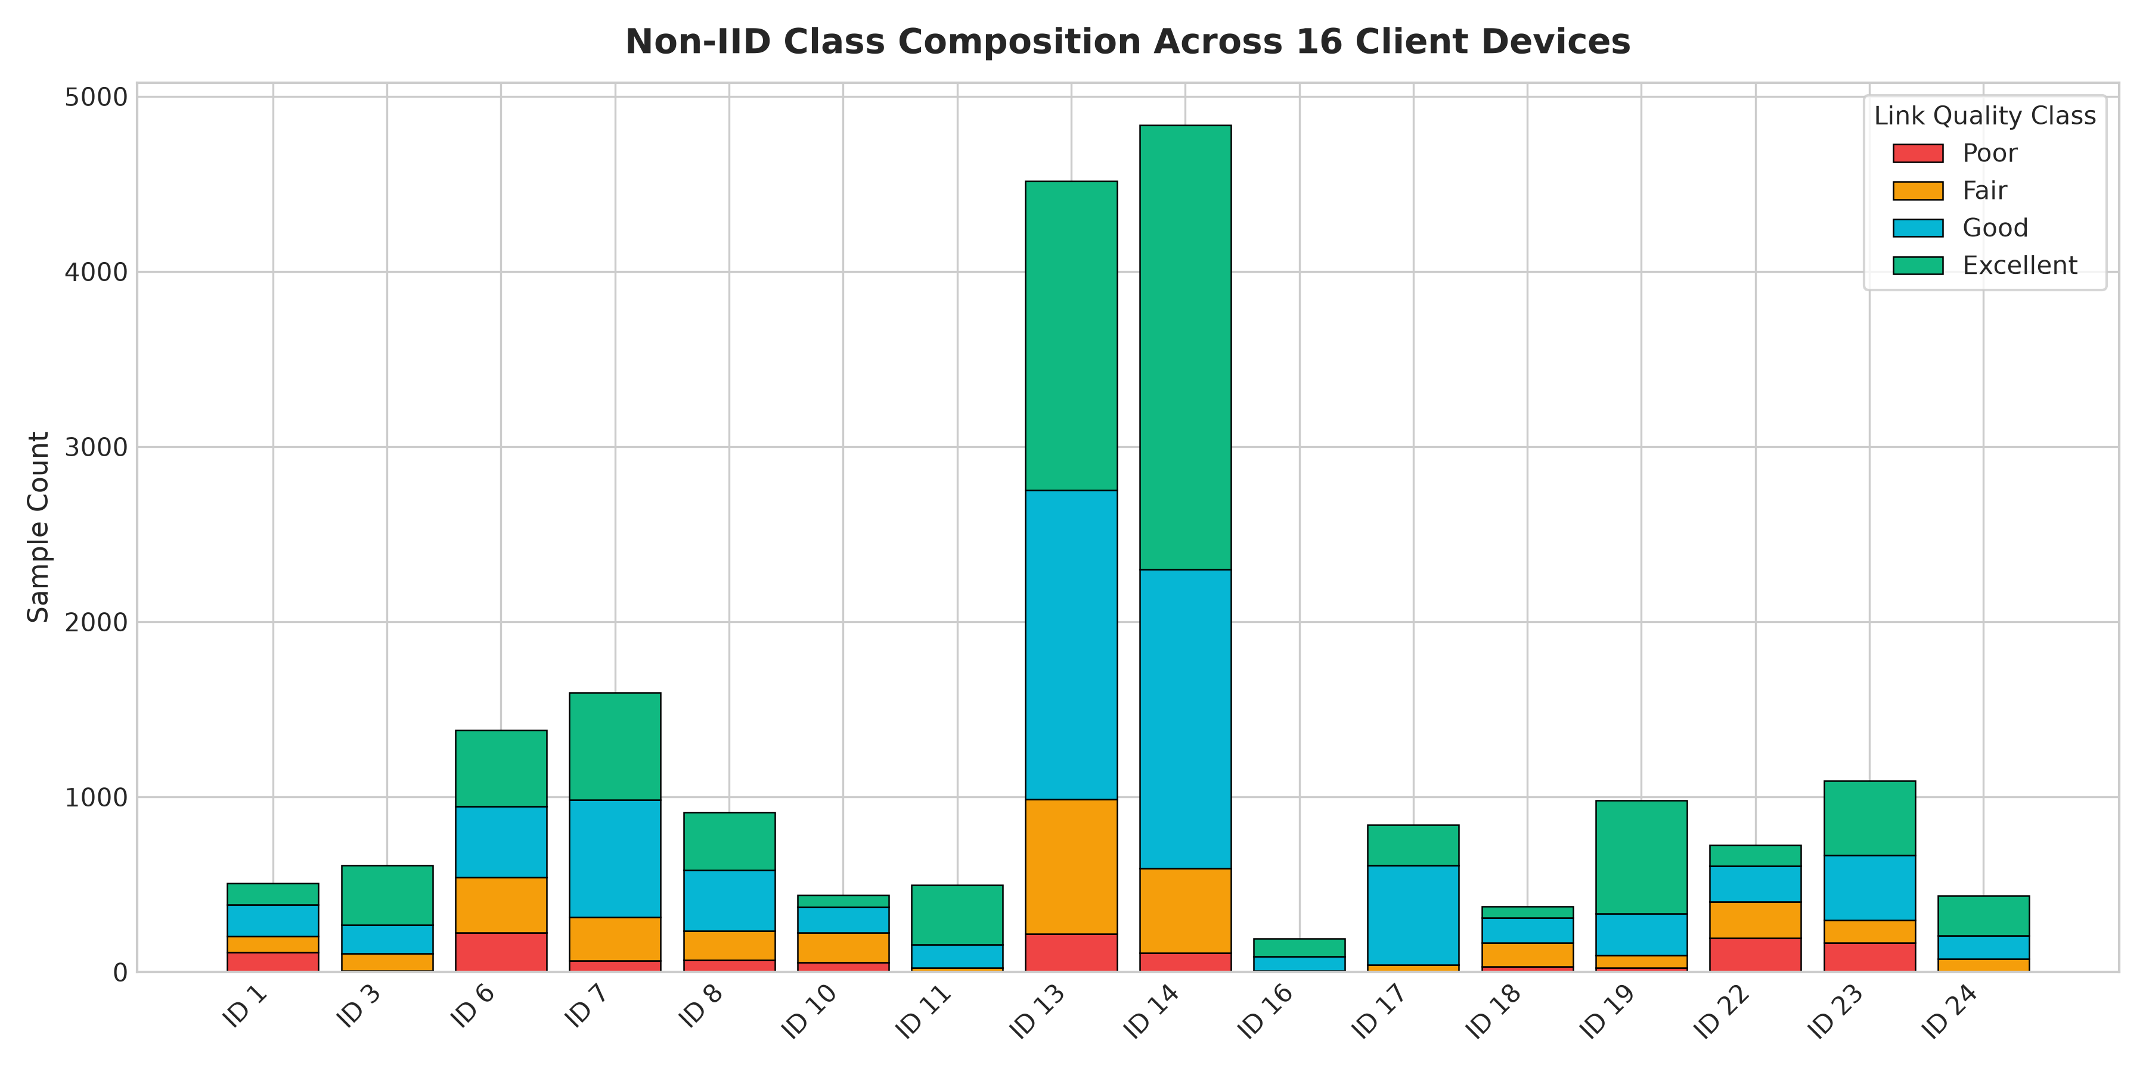
Non-IID Data Analysis
Client-Level Heterogeneity in Wireless Signal Distribution
Key Observations
Highly imbalanced sample counts across clients (Client 14: 726 vs Client 16: 29 samples)
Different class proportions per device - true non-IID setting
Some clients lack certain classes entirely
Justifies personalized (FedPer) over global (FedAvg) approach
5 / 10

Slide 6
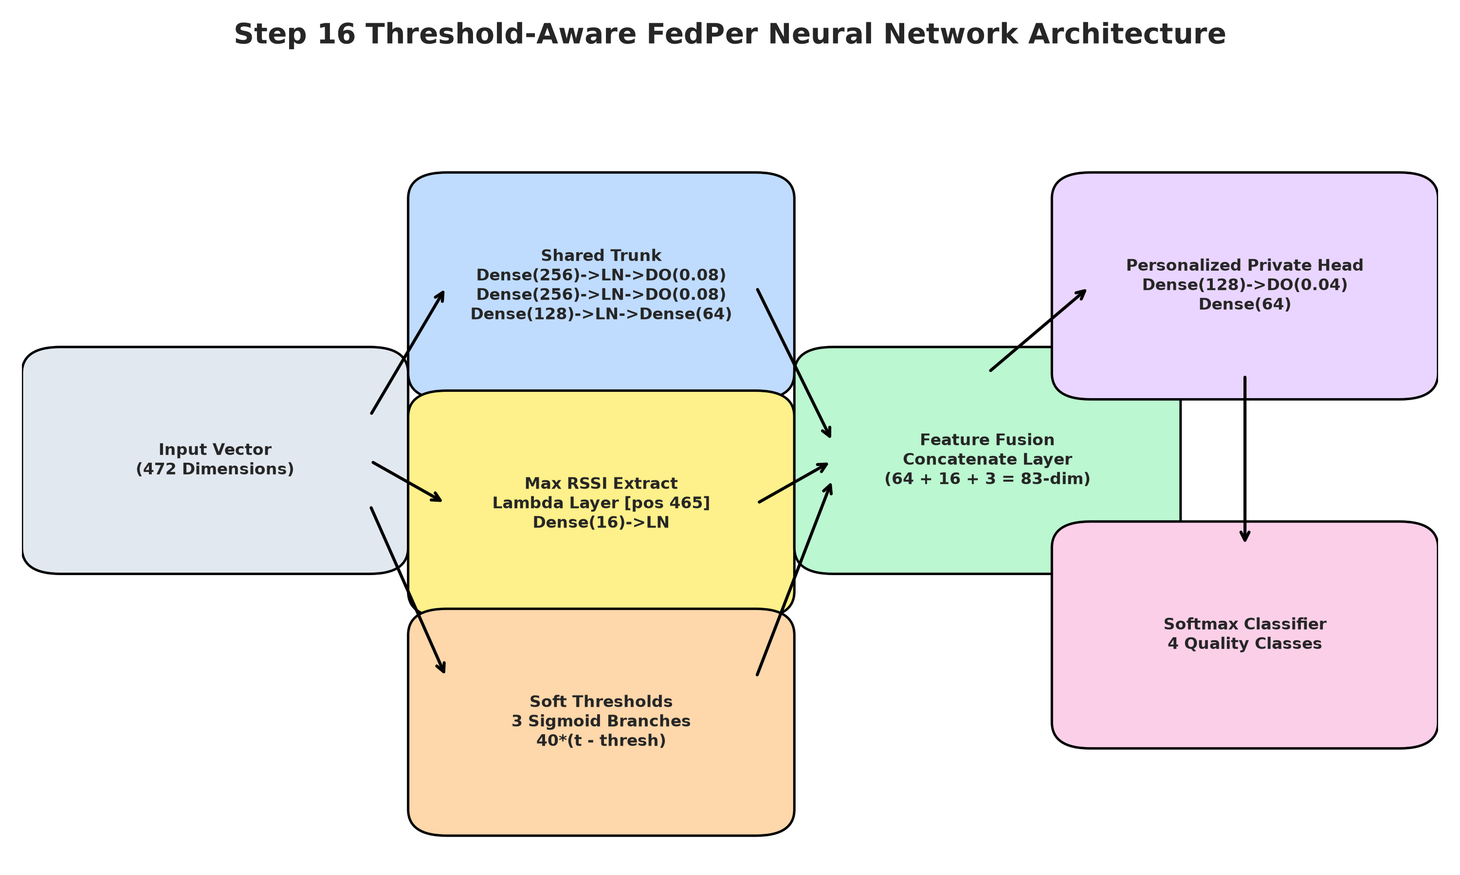
Model Architecture
Threshold-Aware Personalized FedPer Neural Network
Architecture Details
Input Layer
472 features (465 WAPs + 7 engineered)
Shared Base (Federated)
Dense layers shared across all clients via FedPer aggregation protocol
Private Head (Local Only)
Client-specific classification layers. Never leave the device
RSSI Boundary Branch
Specialized neurons activated for samples near thresholds: -75, -65, -55 dBm
Output Layer
Softmax over 4 classes: Poor / Fair / Good / Excellent
Normalization: MinMaxScaler [0,1]
6 / 10

Slide 7
Project Workflow
End-to-End Implementation Pipeline
01
02
03
04
05
06
Data Collection
& Preprocessing
Federated
Partitioning
Baseline
Training
FedPer
Personalization
Threshold-Aware
Integration
Hybrid
Deployment
UJIIndoorLoc dataset
520->465 WAPs + 7 features
MinMaxScaler normalization
->
16 clients by PHONEID
70/15/15 split
Non-IID distribution
->
Centralized MLP: 93.13%
FedAvg global: 82.89%
Performance baselines
->
Shared + private layers
Architecture search A/B/C/D
35 federated rounds
->
Boundary branch neurons
Margin grid search
Best: 0.25 dBm margin
->
Rule-based + Neural
97.60% final accuracy
Gradio + FastAPI UI
Tech Stack: Python 3 | TensorFlow/Keras 2.20 | Scikit-learn | NumPy | Pandas | Gradio 6.26 | FastAPI | Uvicorn
7 / 10

Slide 8
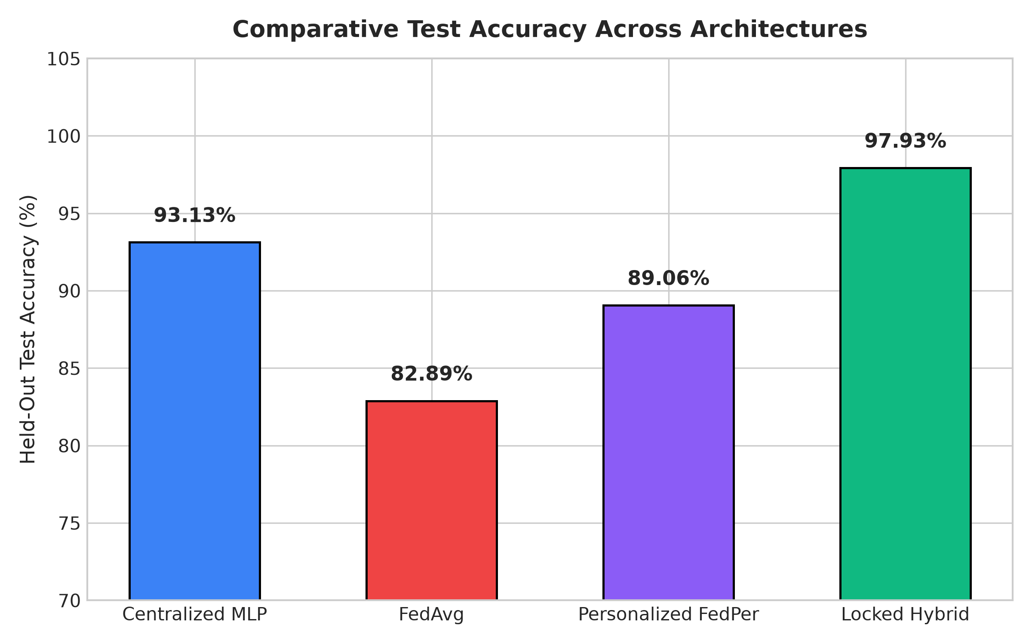
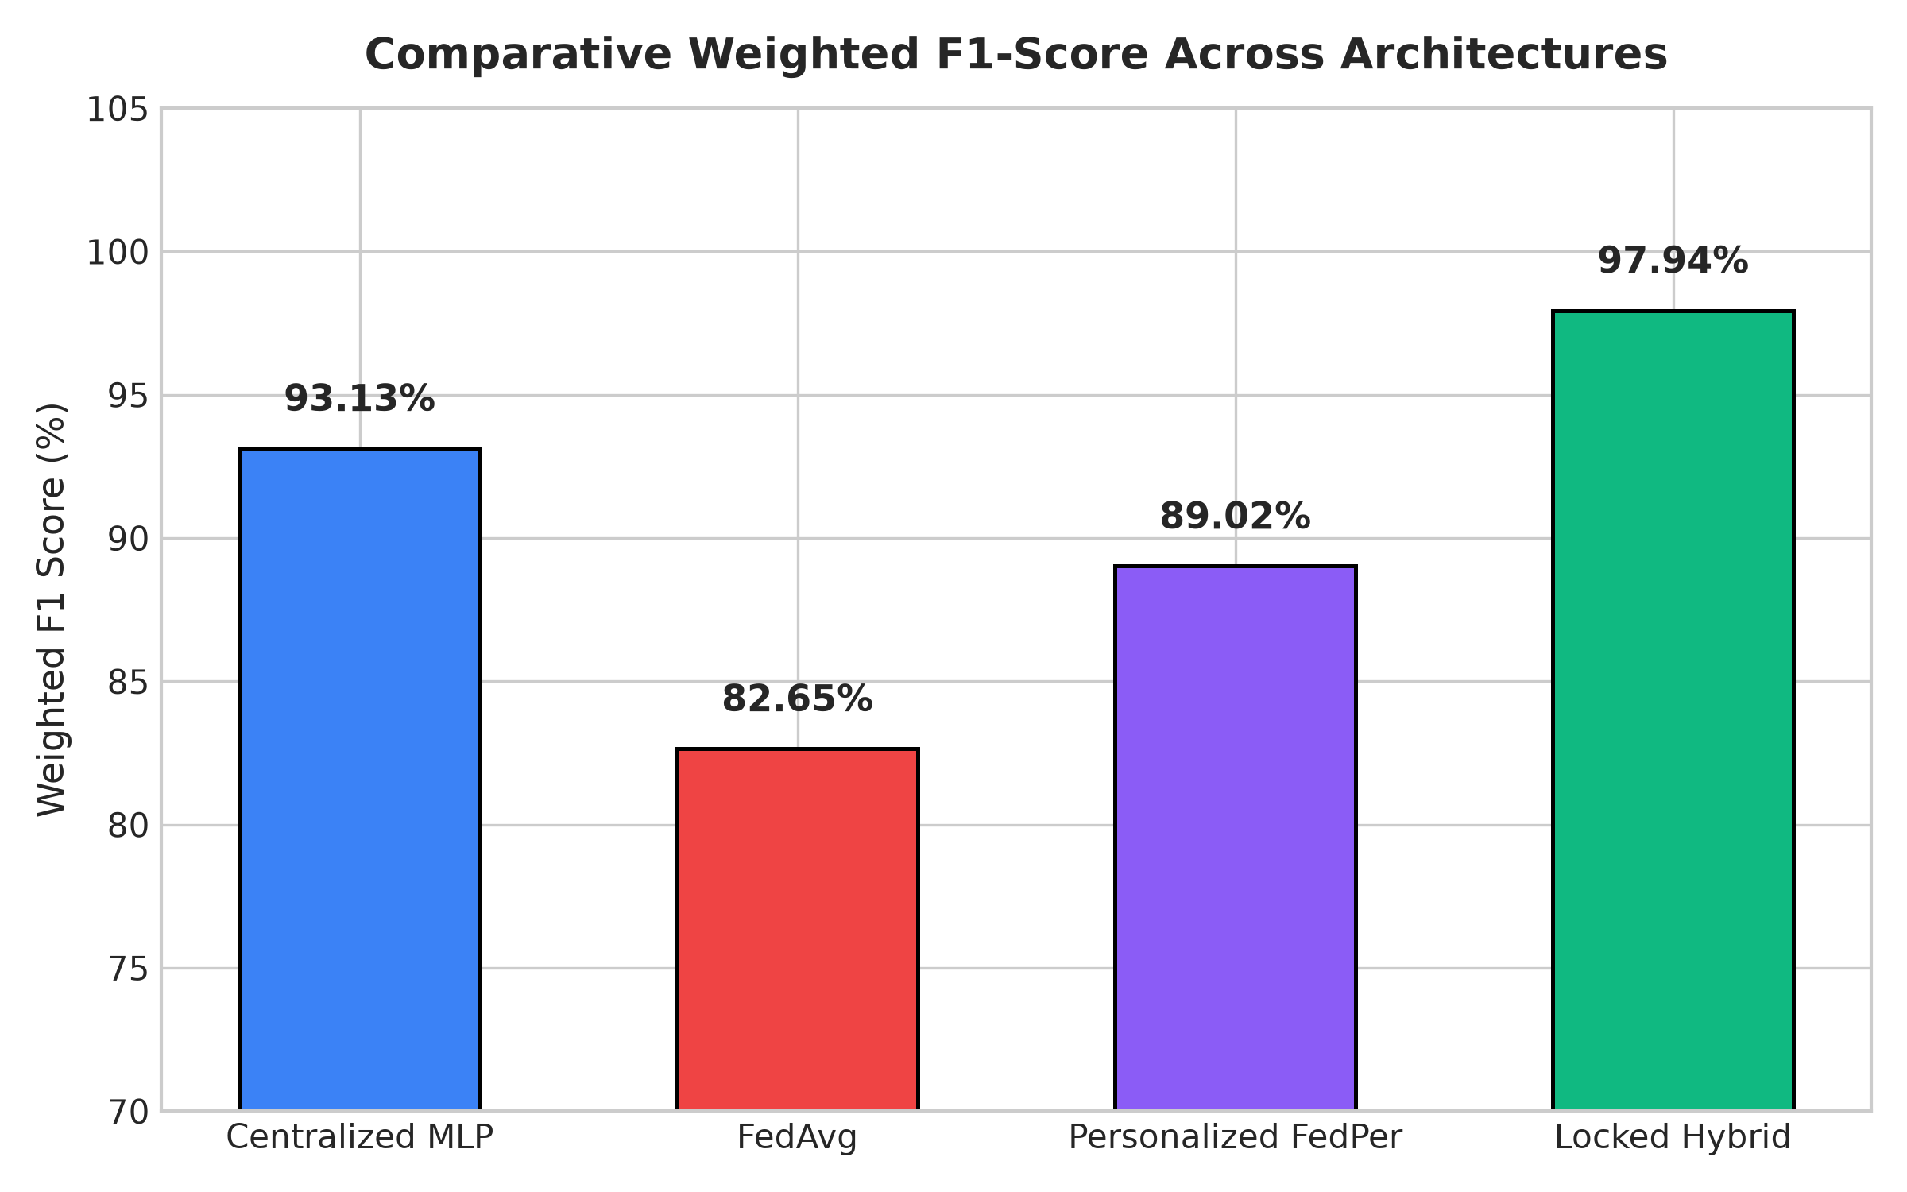
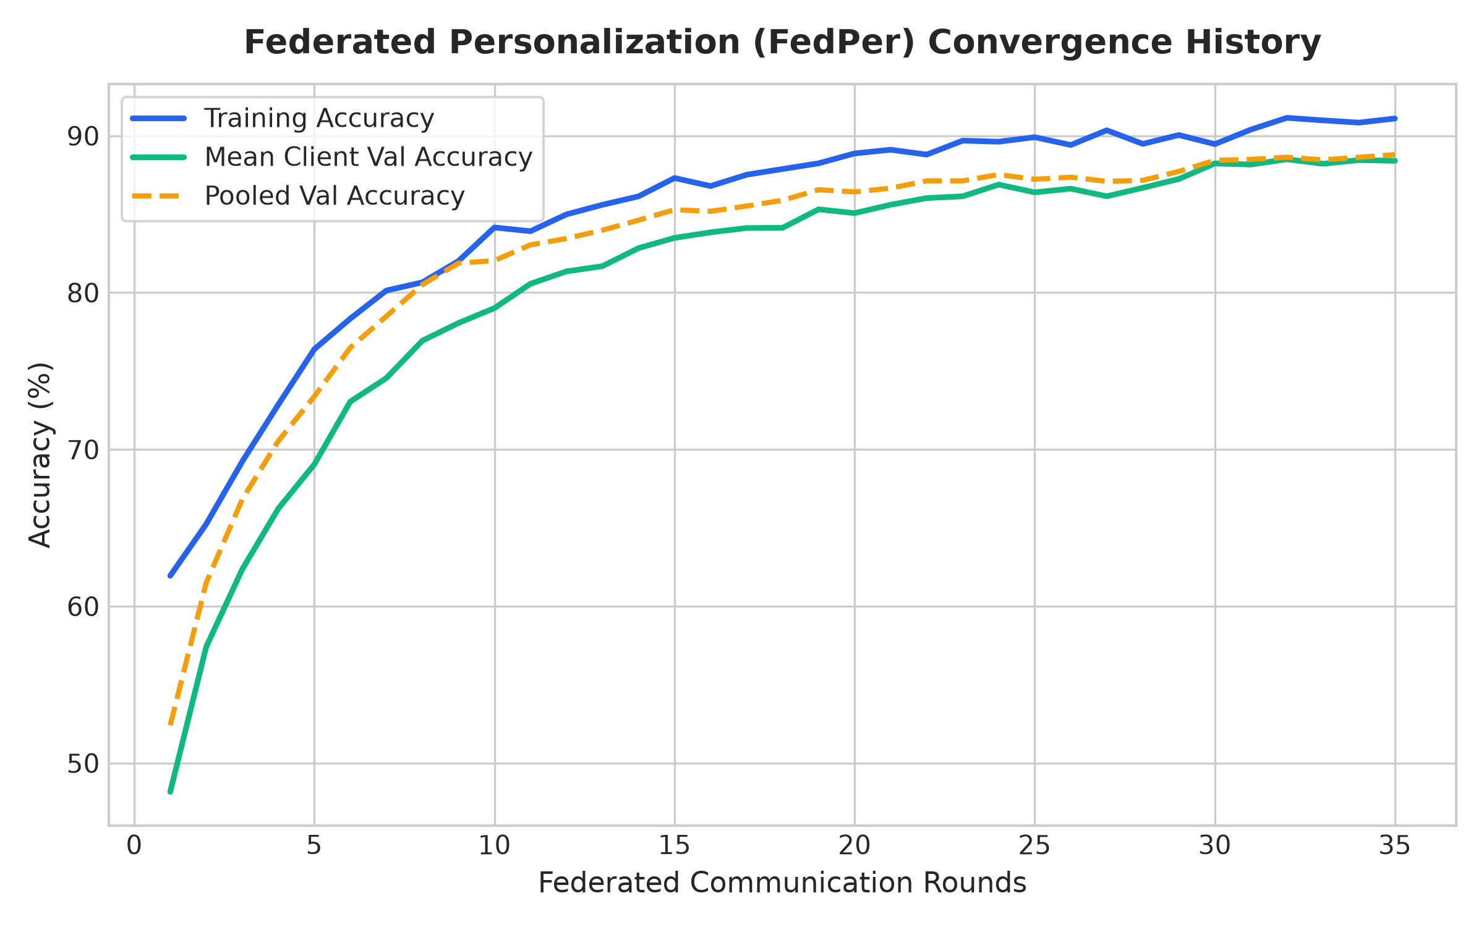
Experimental Results
Model Comparison & Performance Analysis
Centralized MLP
FedAvg (Global)
FedPer (Neural)
Hybrid FedPer
Balanced Accuracy
93.13%
82.89%
89.06%
97.60%
98.13%
Model Test Accuracy Balanced Acc Weighted F1 Improvement
Centralized MLP 93.13% 92.91% 93.13% Baseline (no privacy)
FedAvg (Global) 82.89% 82.73% 82.65% -10.24 pp
Personalized FedPer 89.06% 89.37% 89.02% +6.17 pp over FedAvg
Hybrid FedPer (Final) 97.60% 98.13% 97.61% +14.71 pp over FedAvg
8 / 10

Slide 9
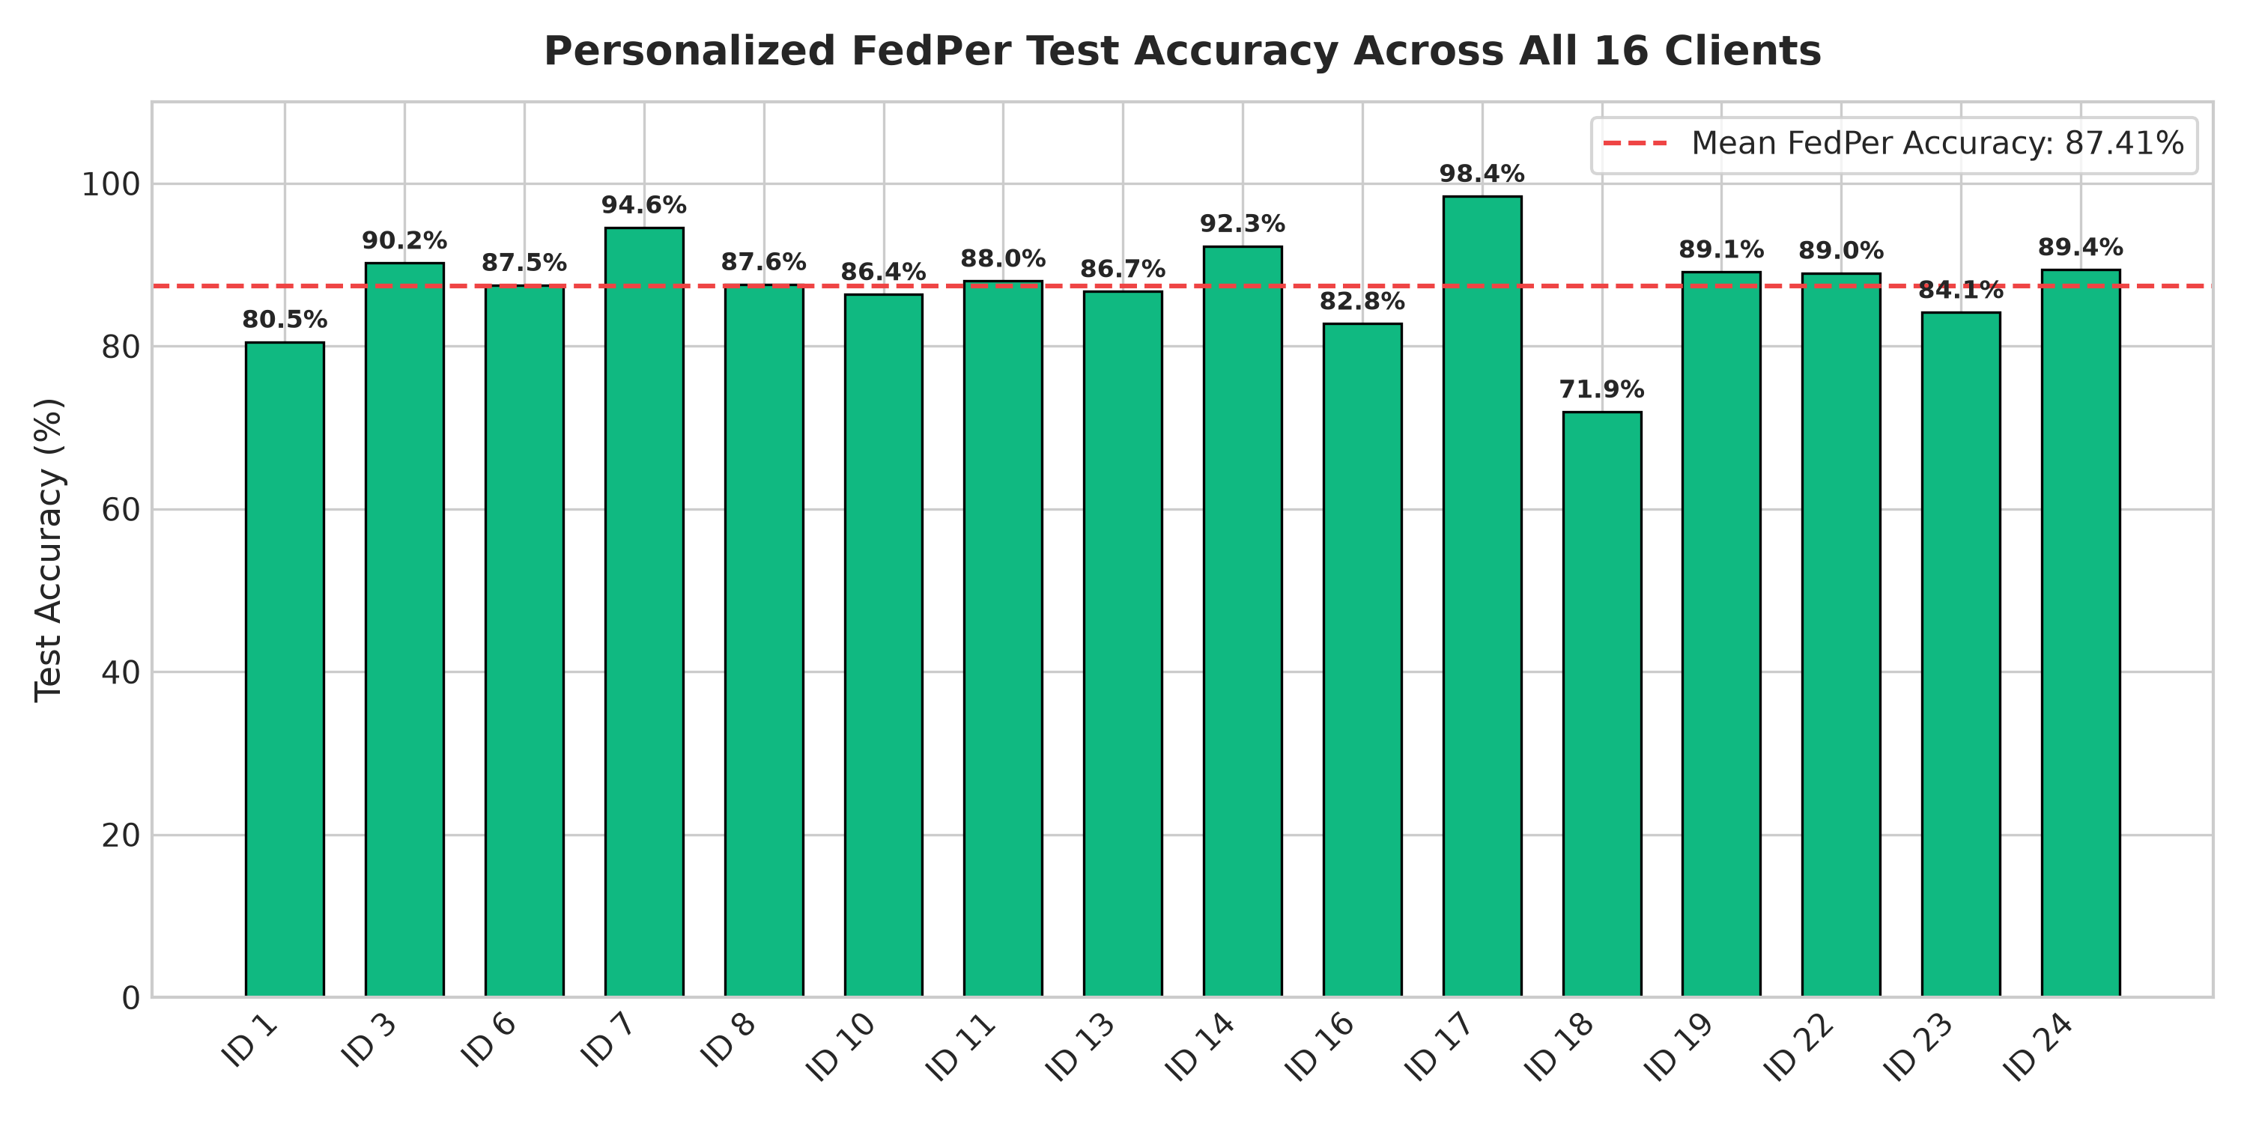
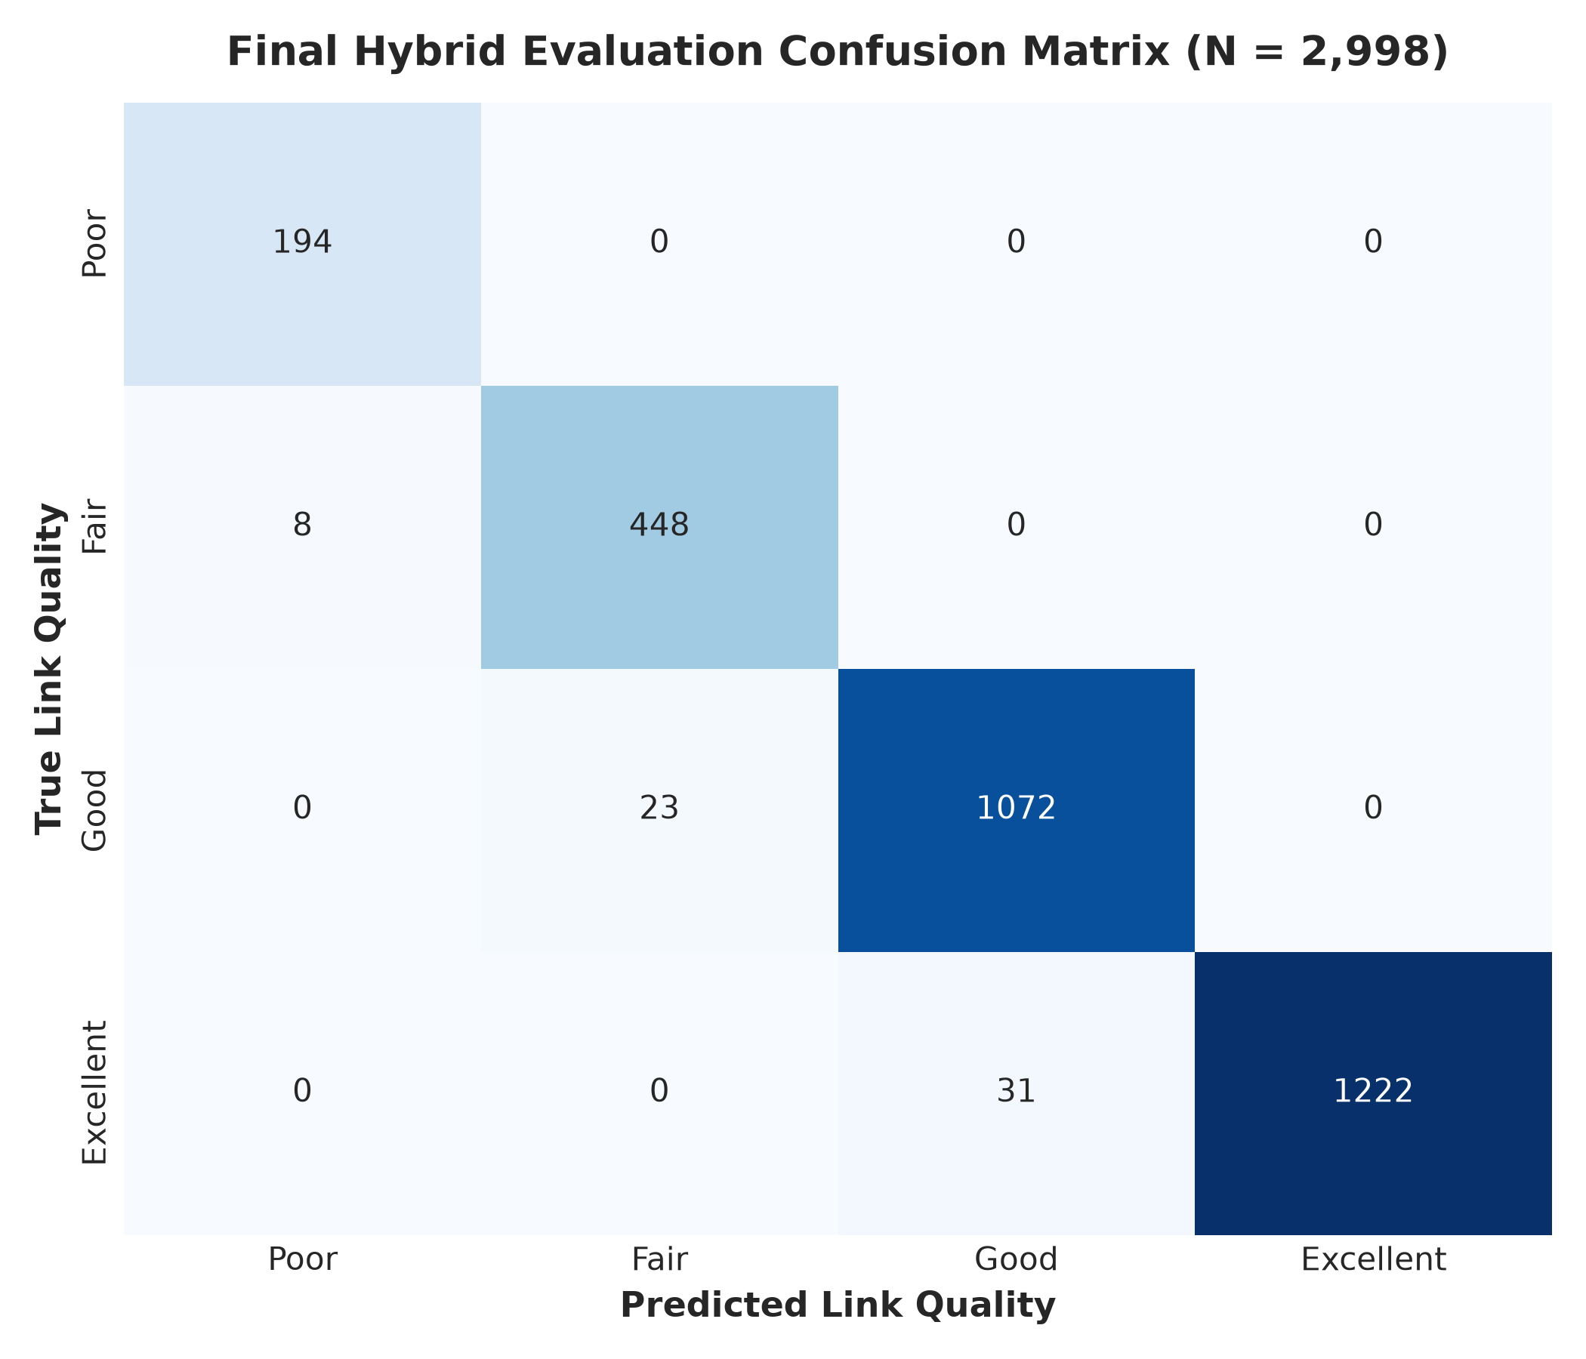
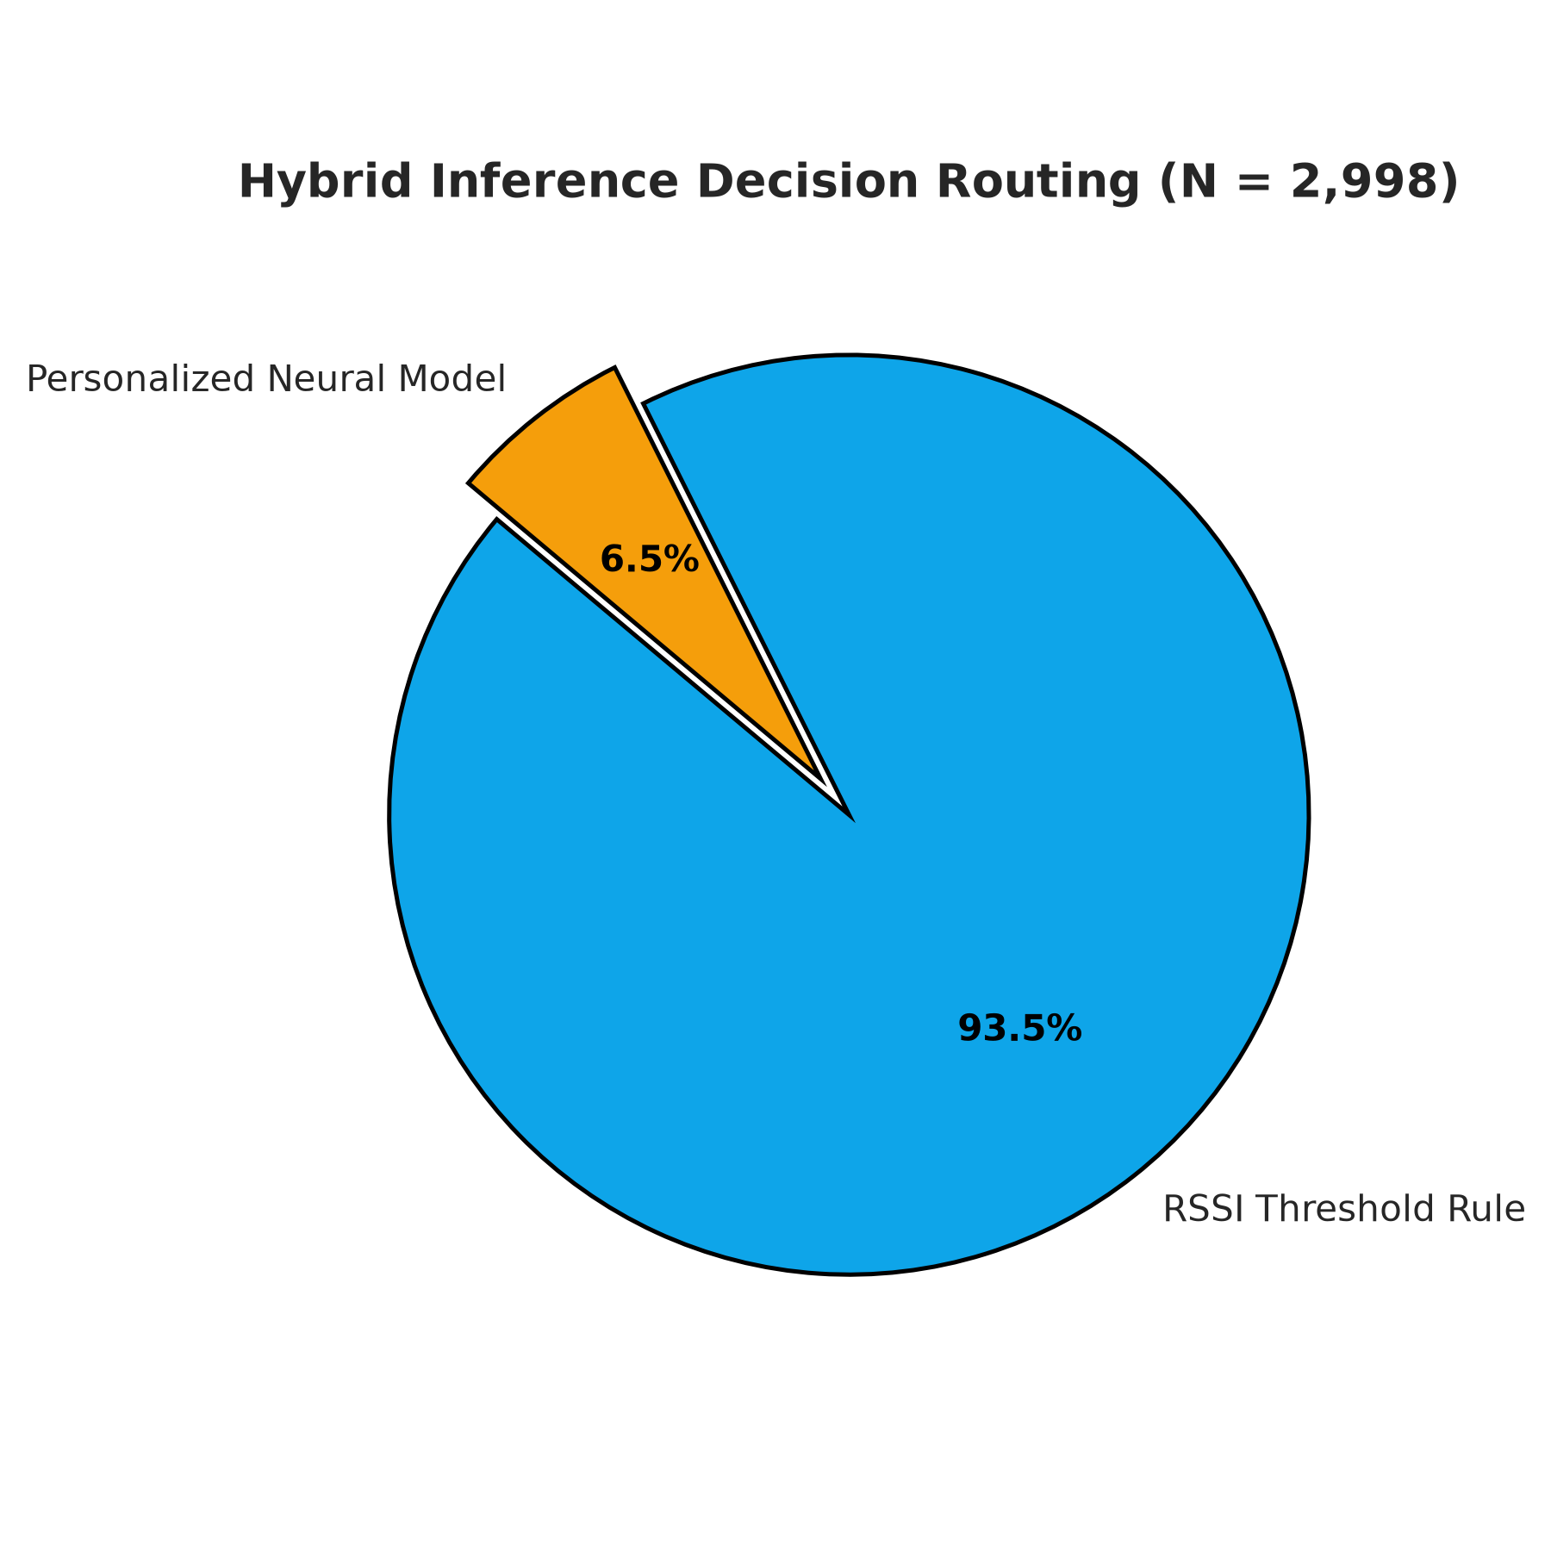
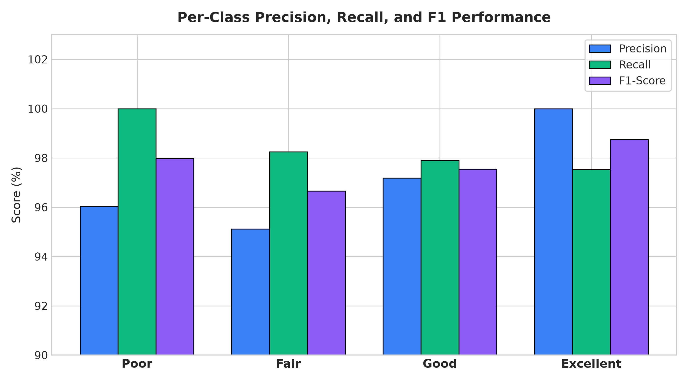
Detailed Analysis
Per-Client Accuracy, Confusion Matrix & Hybrid Decisions
9 / 10

Slide 10
Progress & Future Work
Current Status and Planned Enhancements
Completed Work
Dataset preprocessing & feature engineering (472 features)
Non-IID federated partitioning across 16 client devices
Centralized MLP baseline training (93.13%)
FedAvg global model training (82.89%)
Personalized FedPer with architecture search (89.06%)
Threshold-aware boundary integration
Hybrid margin strategy + grid search (97.60%)
Gradio + FastAPI interactive deployment dashboard
Full evaluation: per-client accuracy, confusion matrix, per-class metrics, convergence analysis
GitHub repository with code, data, docs & results
Complete Jupyter notebook for reproducibility
Future Enhancements
Extend to real 4G/5G cellular RSSI datasets
Dynamic client joining/leaving (asynchronous FL)
Differential privacy integration for added security
On-device model compression (pruning/quantization)
Real-time prediction latency benchmarking
Key Takeaway
Our hybrid personalized federated system achieves 97.60% accuracy while preserving user privacy, outperforming both centralized (+4.47 pp) and standard federated approaches (+14.71 pp).
Privacy + Personalization = Superior Performance
10 / 10

