Slide 1
Project Group 7
By: Madiha Najam, Fatima Zahra El Mansouri, Tanvir, Shehryar Siddiqui
https://github.com/siddi582/PfizerFinalProject-

Slide 2

ExPloring the dataset
Tools used:
Excel
Tableau
SQL
Machine-Learning
ETL
Linear Regression

Slide 3

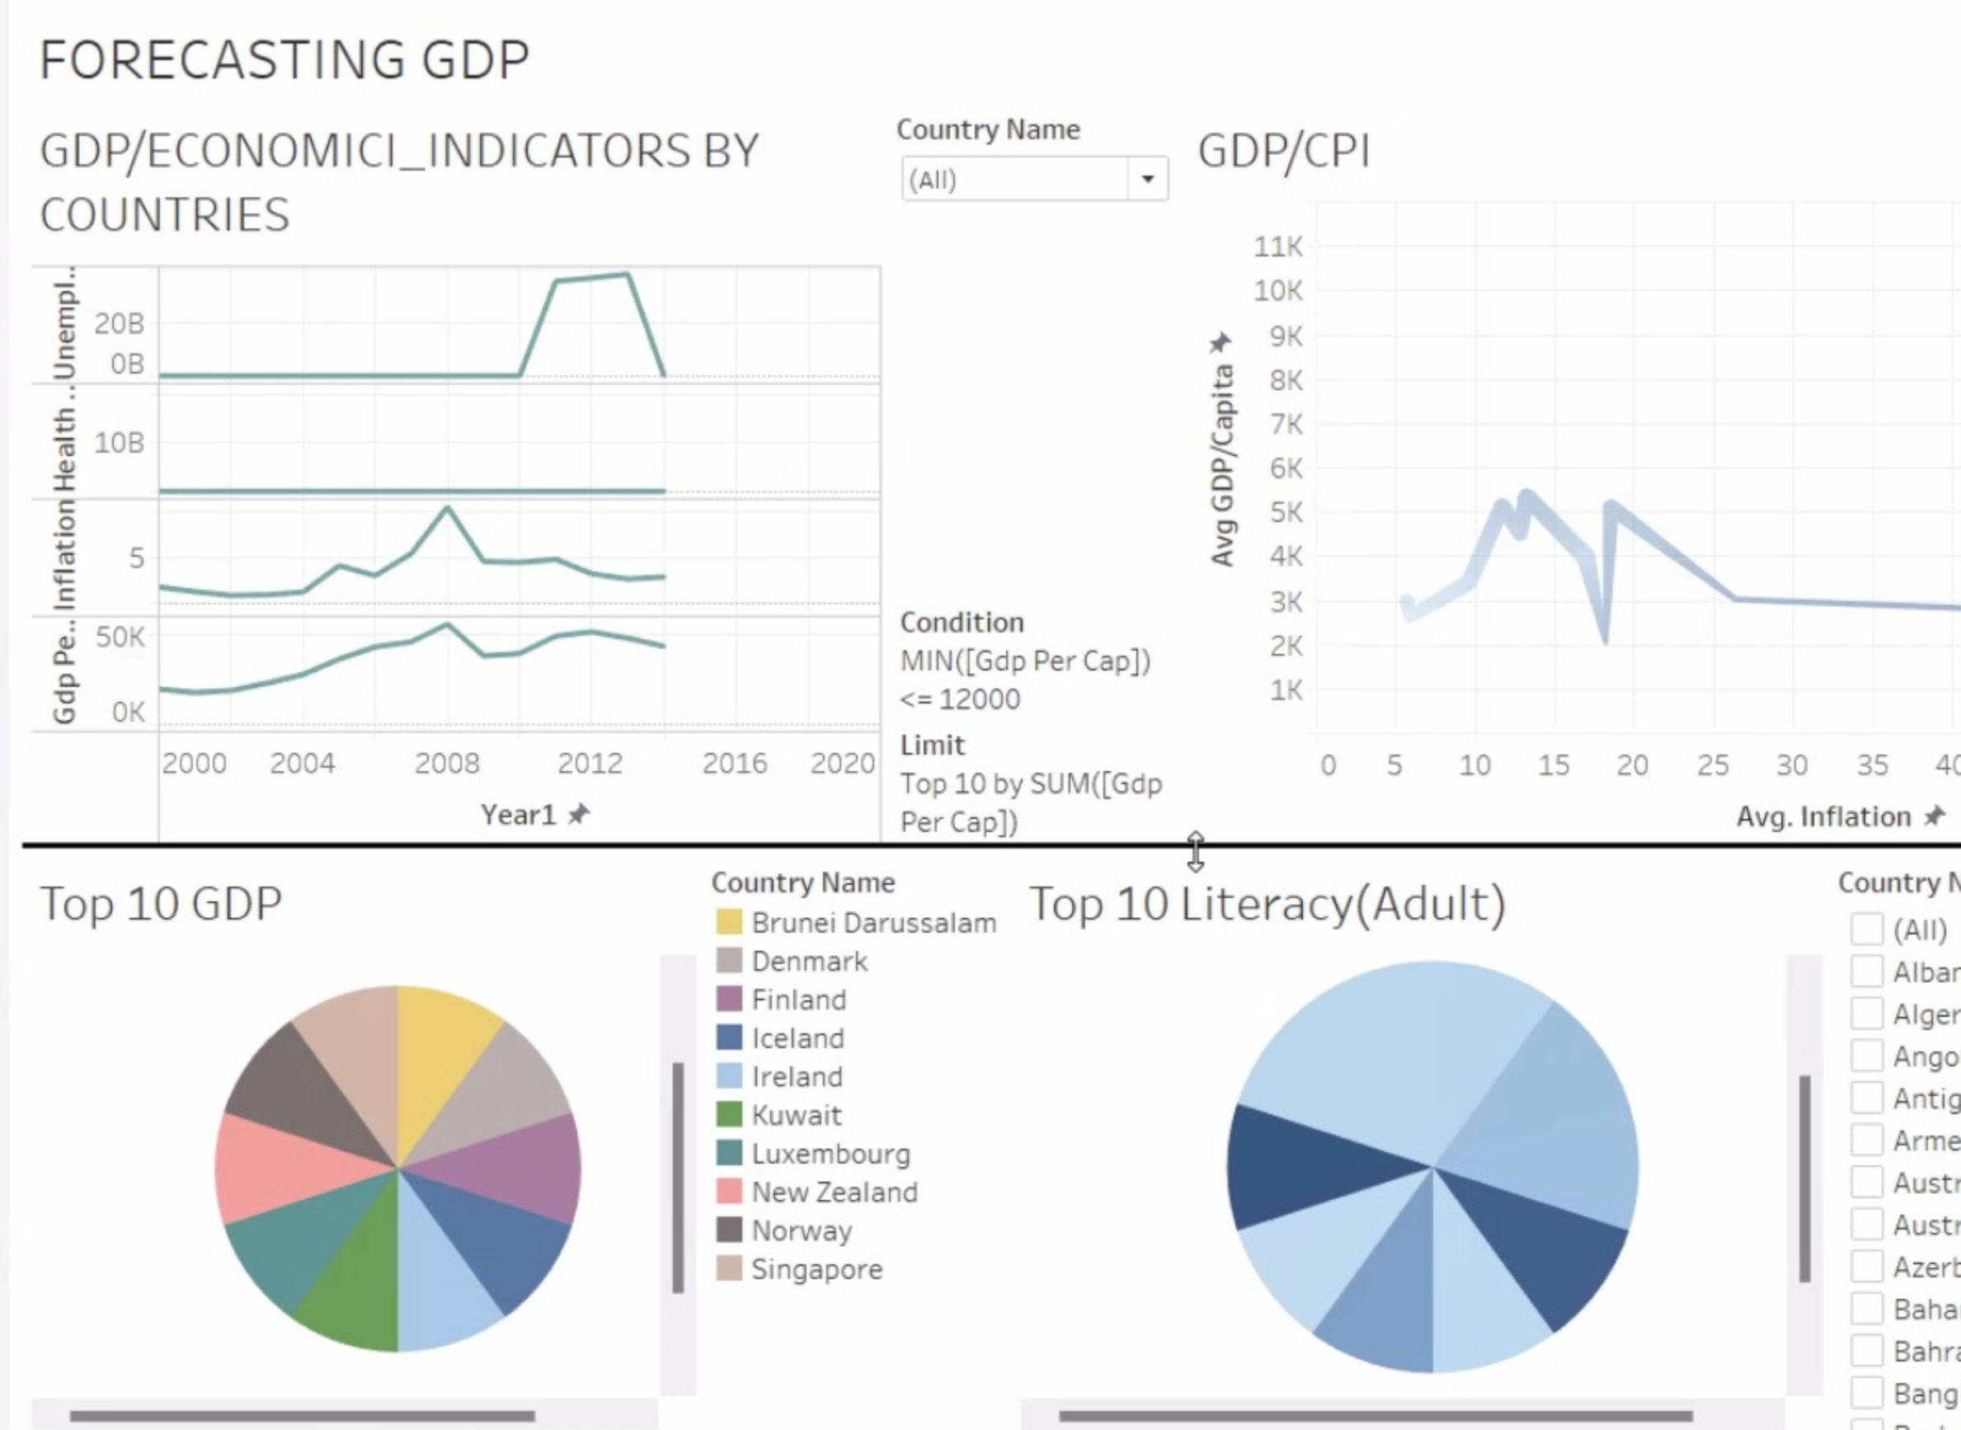
GDP FOReCast 2021-2022

Slide 4
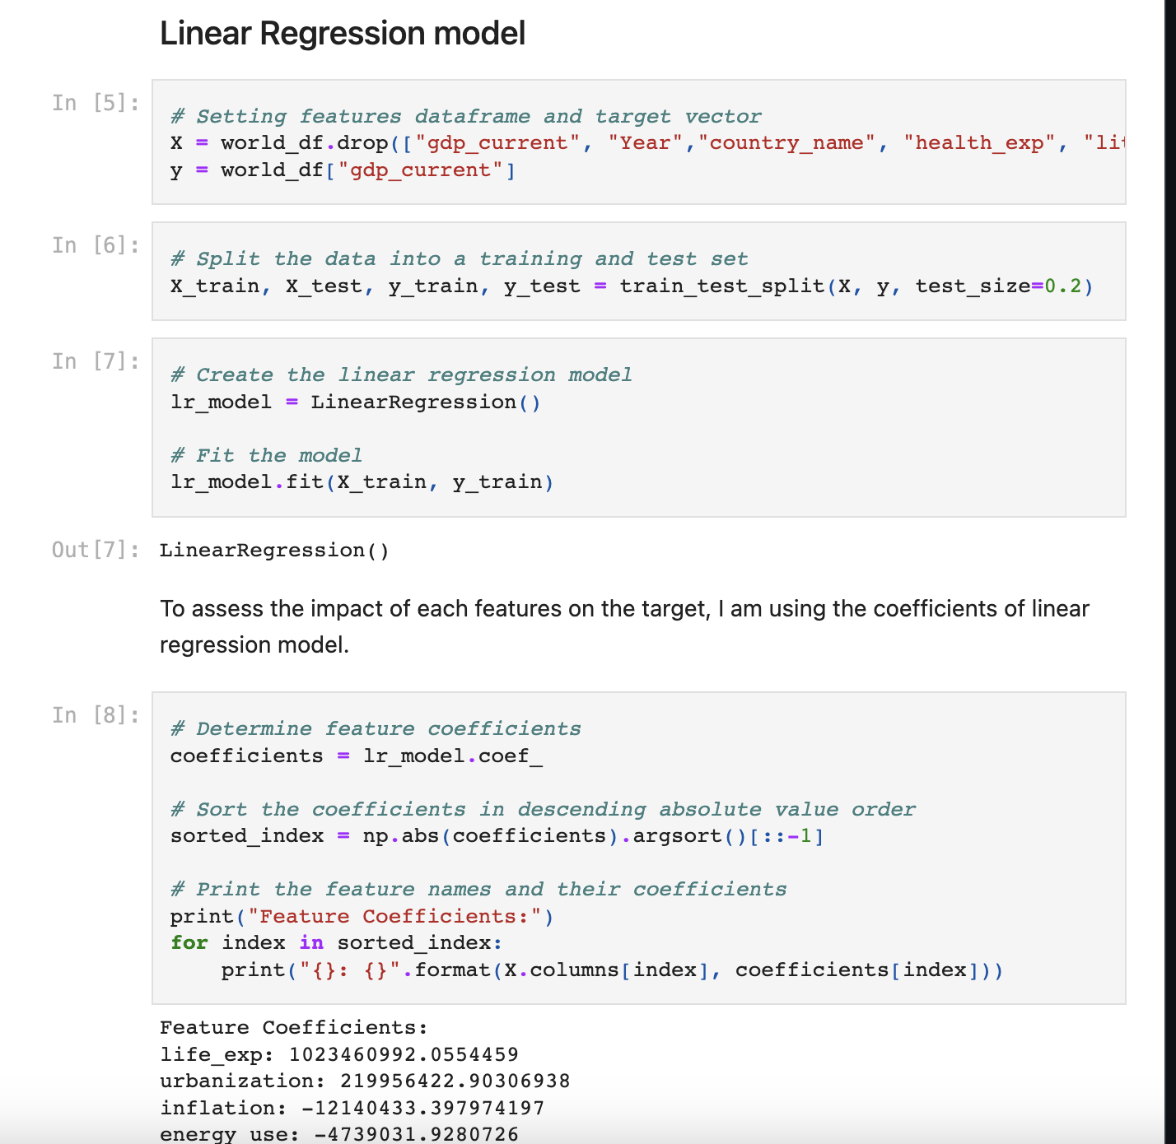
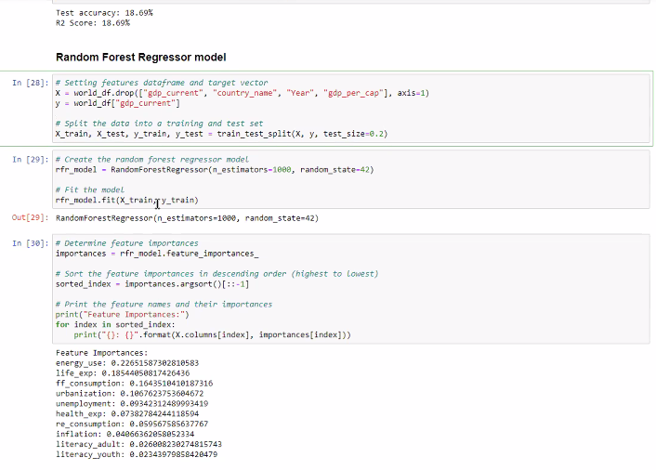
Best MODEL: Linear Regression

Slide 5
oTHER ACCURACY TRACKING METHODS and RELEVANCE

Slide 6
conclusion

Slide 7
Questions?

