Slide 1
Python
INTRODUCTION
Python is a popular programming language. It was created by Guido van Rossum, and released in 1991.

Slide 2
It is used for: Desktop Applications Web Applications Data Science Artificial Intelligence Machine Learning Scientific Computing Robotics Internet Of Things (Iot) Gaming Mobile Apps Data Analysis And Preprocessing
INTRODUCTION
Python works on different platforms (Windows, Mac, Linux, Raspberry Pi, etc).
Python has a simple syntax similar to the English language.
Python has syntax that allows developers to write programs with fewer lines than some other programming languages.
Python runs on an interpreter system, meaning that code can be executed as soon as it is written. This means that prototyping can be very quick.
Python can be treated in a procedural way, an object-oriented way or a functional way.

Slide 3
Foundation In The Late 1980s. The Implementation Of Python Was Started In December 1989 By Guido Van Rossum At CWI In Netherland. In February 1991, Guido Van Rossum Published The Code (Labeled Version 0.9.0) To Alt.Sources. In 1994, Python 1.0 Was Released With New Features Like Lambda, Map, Filter, And Reduce. Python 2.0 Added New Features Such As List Comprehensions, Garbage Collection Systems. On December 3, 2008, Python 3.0 (Also Called "Py3k") Was Released. It Was Designed To Rectify The Fundamental Flaw Of The Language. ABC Programming Language Is Said To Be The Predecessor Of Python Language, Which Was Capable Of Exception Handling And Interfacing With The Amoeba Operating System.
HISTORY

Slide 4
Why the Name Python? There is a fact behind choosing the name Python. Guido van Rossum was reading the script of a popular BBC comedy series "Monty Python's Flying Circus". It was late on-air 1970s. Van Rossum wanted to select a name which unique, sort, and little-bit mysterious. So he decided to select naming Python after the "Monty Python's Flying Circus" for their newly created programming language. The comedy series was creative and well random. It talks about everything. Thus it is slow and unpredictable, which made it very interesting.
HISTORY

Slide 5
Version
Python Version | Released Date
Python 1.0 | January 1994
Python 1.5 | December 31, 1997
Python 1.6 | September 5, 2000
Python 2.0 | October 16, 2000
Python 2.1 | April 17, 2001
Python 2.2 | December 21, 2001
Python 2.3 | July 29, 2003
Python 2.4 | November 30, 2004
Python 2.5 | September 19, 2006
Python 2.6 | October 1, 2008
Python 2.7 | July 3, 2010
Python 3.0 | December 3, 2008
Python 3.1 | June 27, 2009
Python 3.2 | February 20, 2011
Python 3.3 | September 29, 2012
Python 3.4 | March 16, 2014
Python 3.5 | September 13, 2015
Python 3.6 | December 23, 2016
Python 3.7 | June 27, 2018
Python 3.8 | October 14, 2019

Slide 6
1) Easy To Learn And Use 2) Expressive Language 3) Interpreted Language 4)Cross-platform Language 5) Free And Open Source 6) Object-oriented Language 7) Extensible 8) Large Standard Library 9) Integrated 10) Embeddable 11) Dynamic Memory Allocation
Feature of Python

Slide 7
Making The Program More Understandable. Readability Of The Code Restrict Code Execution Provide An Overview Of The Program Or Project Metadata To Add Resources To The Code Type Of Comments 1.SINGLE LINE: # This Code Is To Show An Example Of A Single-line Comment Print( 'This Statement Does Not Have A Hashtag Before It’ ) 2.MULTILINE: Python Does Not Provide The Facility For Multi-line Comments. However, There Are Indeed Many Ways To Create Multi-line Comments. With Multiple Hashtags (#) Using String Literals Because Python overlooks string expressions that aren't allocated to a variable, we can utilize them as comments. CODE: 'it is a comment extending to multiple lines'
Comment in Python

Slide 8
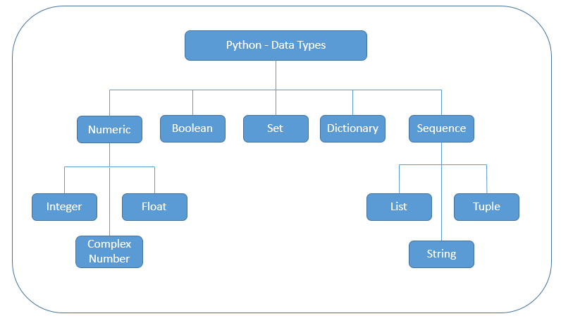
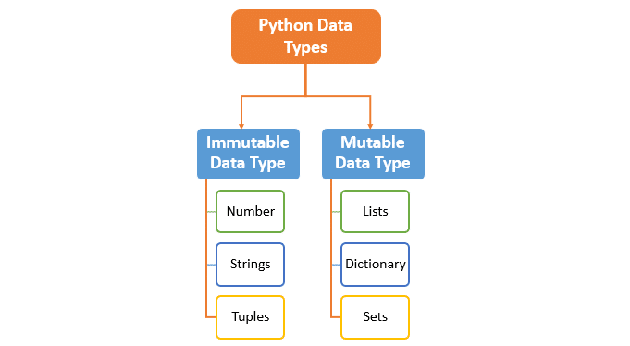
Data type in python

Slide 9
Variable: Variables Can Hold Values, And Every Value Has A Data-type. Python Is A Dynamically Typed Language; Hence We Do Not Need To Define The Type Of The Variable While Declaring It. The Interpreter Implicitly Binds The Value With Its Type.
<type 'int'> <type 'str'> <type 'float'>
a = 5
The variable a holds integer value five and we did not define its type. Python interpreter will automatically interpret variables a as an integer type.
Python enables us to check the type of the variable used in the program. Python provides us the type() function, which returns the type of the variable passed.
Ex. a=10
b="Hi Python"
c = 10.5
print(type(a))
print(type(b))
print(type(c))
<type 'int'>
<type 'str'>
<type 'float'>

