Slide 1
Intro:
Class- Be on time
Homework:
Office Hours: Take survey
Text- free pdf http://people.cs.vt.edu/~shaffer/Book/JAVA3elatest.pdf
Course repository
https://github.com/skalakm/232

Slide 2
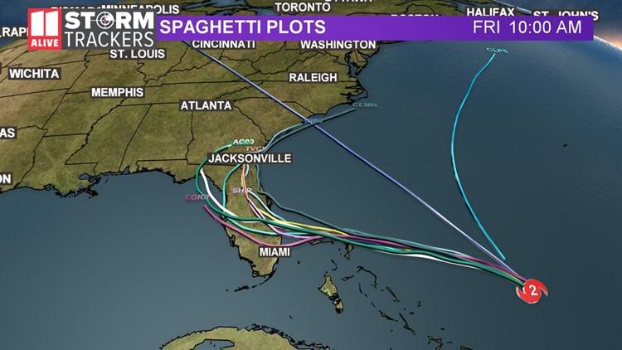

Slide 3
The Last Programming Class You Will Ever Take
Data structure- an organization of data in a computer’s memory
Eg
Why?
Make common operations efficient

Slide 4
Computer examples
Stack
Efficient add/remove at “top”
Inefficient for anything else
Hashmap
Efficient for finding value by key
Inefficient for accessing in some order (eg alphabetical)

Slide 5
Problem solving
Comp 131/132
Most of the approach was already designed
Comp 232
More often, given only a problem statement (input and output)

Slide 6
Course goals:
Toolkit development
Know what data structures are possible and what they are good at
Choice
Static or dynamic
Common operations
Access pattern
Search types
Performance analysis

Slide 7
Asymptotic performance analysis
Big-O, omega, theta
Tradeoffs
Time vs space
Readability/maintainability vs code size/efficiency

Slide 8
Problem solving skills

Slide 9
Terminology
Simple/primitive data type
Aggregate/composite data type
Abstract data type
Operations, but not implementation
Data structure
Implementation of an abstract data type

Slide 10
Demo github

Slide 11
Problem
What, not how
Sorting- put elements in order
Searching- find a specific element in a collection
Find a path through a maze
Instance or Case
A set of inputs of a particular form of any size
NOT A SPECIFIC INPUT

Slide 12
Algorithm
How
Many algorithms for same problem (sorting)
Properties
Correct
Concrete steps (doable in finite time)
Unambiguous order
Finite number of steps
Terminates
Program
Executable implementation of an algorithm in a programming language

Slide 13
Function- a mathematical function
Positive inputs, positive output, increasing

Slide 14
Physical examples
Dictionary
Library

Slide 15
Recursion
1 or more base cases
1 or more recursive calls

Slide 16
CountX
countX(s) = Base Case(s):0 if s is empty
Recursive Cases(s): 1 + countX(s - 1st char) if first char is ‘x’
countX(s - 1st char) if first char is not ‘x’
Theater time
Code time

Slide 17
Important recursive algorithms
Generate permutations
Generate subsets
Generate combinations

Slide 18
Permutations
Base Case(s): {””} if s is empty
Recursive Case(s): for each char c in s
Add c prepended to permute(s-c)

Slide 19
Identicons

Slide 20
Subsets
Base Case(s): if rest is empty-> {prefix}
Recursive Case(s): Move first char of rest into prefix.
Add all subsets of rest prefixed by prefix.
AND
Remove first char of rest.
Add a subsets of rest prefixed by prefix.

Slide 21
Combinations

Slide 22
Recursive backtracking
Maze solving

Slide 23
Homework
I will post first homework this afternoon
Demo
Wednesday is a lab day

Slide 24
Recursive Backtracking:
Make a choice
if (recursion can solve the remaining problem)
Done!
Undo the choice
Repeat with next choice…
Out of choices?
No solution.

Slide 25
Maze

Slide 26
N queens
Given an nxn chess board, place n queens on the board such that no two queens are attacking each other. No two queens can be on the same column, row, or diagonal.

Slide 27
Sudoku
https://en.wikipedia.org/wiki/Sudoku_solving_algorithms

Slide 28
Split array
Given an array of int values, can the values be split in into 2 groups that have equal sum?
E.g. {5, 1, 4} Yes -> {5} {1, 4} -> true
{3, 2, 6} No -> false

Slide 29
Split array
splitArray(nums, s1, s2, start)
Can we put nums from start on into s1 & s2 such that s1==s2

Slide 30
How can we find actual numbers?

Slide 31
https://www.washingtonpost.com/technology/2019/09/04/an-artificial-intelligence-first-voice-mimicking-software-reportedly-used-major-theft/
“An artificial-intelligence first: Voice-mimicking software reportedly used in a major theft”

Slide 32
Goals for today
Get the course repository on your machine and running in Eclipse.
Get your homework repository on your machine and running in Eclipse.
Make a text file for your written responses to homework 1 in your homework 1 folder.
Get a hackerrank user name.
Submit your hackerrank username to moodle.
Create a labs package in your homework repository in eclipse.
Do the “solve me first” problem in that folder, with test cases.
Submit a solution to “solve me first” on hackerrank.

Slide 33
How to measure the speed of an algorithm
Empirical: Run it and see how long it takes
Analytical: Carefully examine it determine its speed

Slide 34
Iterative Algorithms Process
Pick a basic operation
Count how many times that operation occurs

Slide 35
Double array entries

Slide 36
Spreadsheet demo

Slide 37
Common Functions for Growth Rate
Class: Function:
Constant T(n) = c Slower Growth
Logarithmic T(n) = a * lg n + …
Linear T(n) = a*n + …
Log-Linear T(n) = a*n*lg n + …
Polynomial T(n) = a*n² + …
T(n) = a*n³ + …
Etc.
Exponential T(n) = a*2^{n} + …
T(n) = a*3^{n} + …
Etc.
Factorial T(n) = a*n! + ... Faster Growth
NOTES: lg n = log2n
… = any function that grows more slowly
e.g. T(n) = a₁*n² + a₂*n*lg n + a₃*n + a₄*lg n + c
Efficient
Inefficient

Slide 38
Things we use big-O (or Ω or Θ) for
Functions
Cases (or instances)
Algorithms (or programs)
Problems

Slide 39
Formal Asymptotic Bound Definitions
Algebraic
Upper Bound - O:
For T(n) a non-negative function, T(n) is in Ο(f(n)) if there exists constants c>0 and n₀>0 such that T(n) <= c f(n) for all n > n₀.
Lower Bound - Ω:
For T(n) a non-negative function, T(n) is in Ω(g(n)) if there exists constants c>0 and n₀>0 such that T(n) >= c g(n) for all n > n₀.
Theta Bound - Θ:
For T(n) a non-negative function, T(n) is in Θ(g(n)) if there exists constants c₁>0, c₂>0 and n₀>0 such that c₂ g(n) <= T(n) <= c₁ g(n) for all n > n₀.

Slide 40
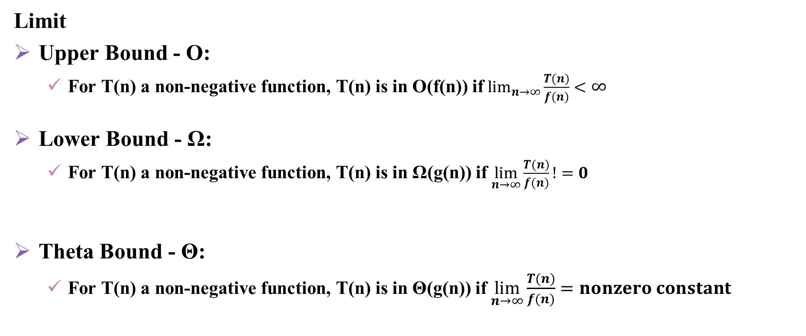
Limit
Upper Bound - O:
For T(n) a non-negative function, T(n) is in Ο(f(n)) if $\lim_{n→∞}{\frac{T(n)}{f(n)}}<$ $∞$
Lower Bound - Ω:
For T(n) a non-negative function, T(n) is in Ω(g(n)) if $\lim_{n→∞}{\frac{T(n)}{f(n)}}!=0$
Theta Bound - Θ:
For T(n) a non-negative function, T(n) is in Θ(g(n)) if $\lim_{n→∞}{\frac{T(n)}{f(n)}}=nonzero constant$

Slide 41
Asymptotic Bound Simplification
If f(n) is in Ο(g(n)) and g(n) is in O(h(n)), then f(n) is in Ο(h(n)).
If f(n) is in O(k*g(n)) for any constant k>0, then f(n) is in O(g(n)).
O(g₁(n)) and f₂(n) is in O(g₂(n)) then, f₁(n) + f₂(n) is in O(max(g₁(n),g₂(n)).
O(g₁(n)) + O(g₂(n)) is in O(max(g₁(n),g₂(n)).
If f₁(n) is in O(g₁(n)) and f₂(n) is in O(g₂(n)) then, f₁(n)*f₂(n) is in O(g₁(n)*g₂(n)).
O(g₁(n))*O(g₂(n)) is in O(g₁(n)*g₂(n))

Slide 42
Priestley lecture (Wednesday 7pm, ATS)
Tim Gowers (2014)- Fields Medalist
James Hansen (2013)- discoverer of global warming
Vinton Cerf (2007)- invented the internet
John Conway (2001)
Marvin Minsky (1995)- invented AI
Francis Crick (1988)- discoverer of DNA
Donald Knuth (1982)- cs demigod
Carl Sagan (1975)
Margaret Mead (1972)- invented anthropology

Slide 43
Just wing it method
Find largest term, ignoring constants and slower growing terms
Upper Bound - O:
For T(n) a non-negative function, T(n) is in Ο(f(n)) iff T(n) “<=“ f(n)
Lower Bound - Ω:
For T(n) a non-negative function, T(n) is in Ω(g(n)) iff T(n) “>=“ f(n)
Theta Bound - Θ:
For T(n) a non-negative function, T(n) is in Θ(g(n)) iff T(n) “=“ f(n)

Slide 44
More examples
replace first x
Input is an arraylist of Character
Change the first ‘x’ to a ‘y’ and stop
count 0s in 2d array
Input is an nxn 2d array of int
Output is the number of 0s in the 2d array

Slide 45
Actual Iterative Algorithms Process
Pick an input measurement
Pick a basic operation
Consider if there is a worst case or best case
Count how many times that operation occurs

Slide 46
Best case and worst case discussion
Best case vs worst case vs algorithm

Slide 47
Upper triangular sum
Given a 2d array, find the sum of elements in the upper right side

Slide 48

$\sum_{i=0}^{n}{i=1+2+3+…+n=}n(n+1)/2$
$\sum_{i=0}^{n}{i^{2}}=?$
$\sum_{i=0}^{n}{ln⁡(i)}=?$
$\sum_{i=0}^{n}{\frac{1}{i}}=?$

Slide 49

Summation
$\sum_{i=0}^{n}{f(i)∈θ(\int_{0}^{n}{f(i)}}di)$

Slide 50
Homework
+ = correct
v = mostly correct
- = incorrect
x = incorrect in an upsetting way

Slide 51
Average case
replaceFirstX

Slide 52
Average
You must make an assumption about distribution.
Take the average running time over that distribution.

Slide 53
Function vs Algorithm vs Case vs Problem

Slide 54
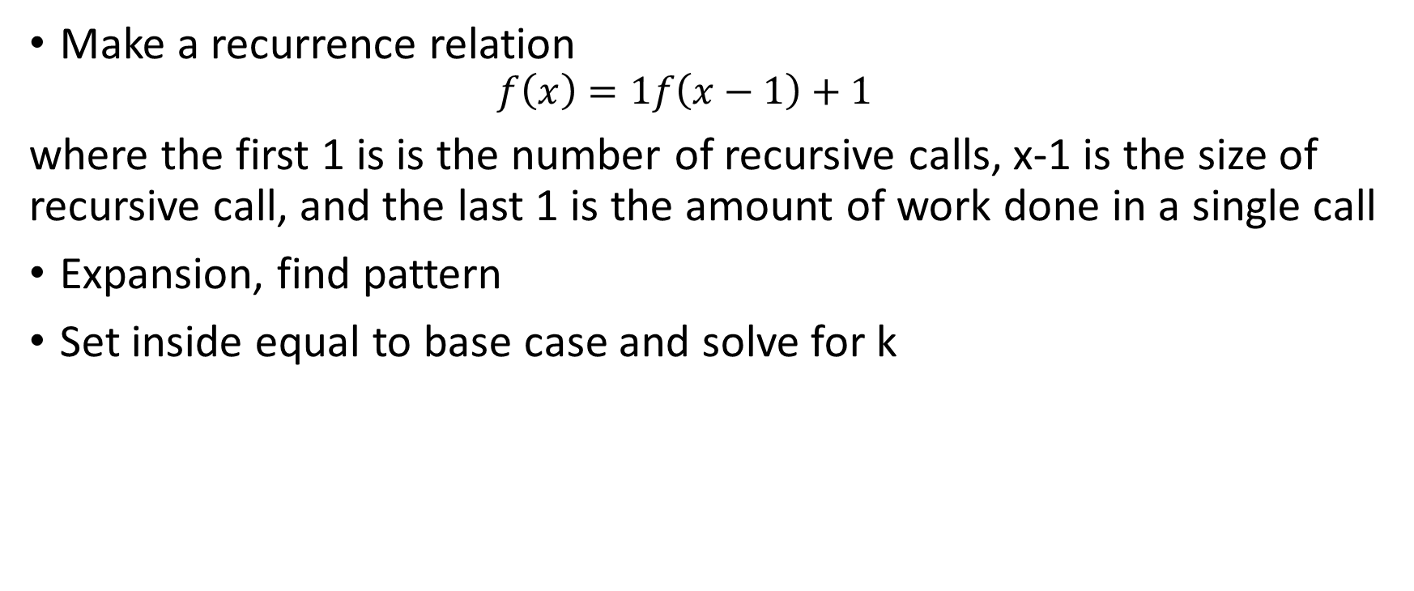
Analyzing recursive methods
Make a recurrence relation
$$f\left(x\right)=1f\left(x−1\right)+1$$
where the first 1 is is the number of recursive calls, x-1 is the size of recursive call, and the last 1 is the amount of work done in a single call
Expansion, find pattern
Set inside equal to base case and solve for k

Slide 55
Inheritance, Interface, Generic
Class that extends another class
Interface
Class that implements an interface
Class that implements two interfaces

Slide 56
Talk tomorrow
Where do I go from here?
Homework due 1 week from today

Slide 57
T(n) = 2 T(n/2) + n

Slide 58
List232
get, set are easy
add is trickier

Slide 59
Add options
Make starting size so big that we never need to increase it

Slide 60
Add options
When we hit the capacity, increase it by 1

Slide 61
Add options
When we hit capacity, double the size

Slide 62
Quantum Supremacy
https://www.theverge.com/2019/9/23/20879485/google-quantum-supremacy-qubits-nasa

Slide 63
Lab grading
Hackerrank testing
Readability
Comments
Structure
Student tests

Slide 64
Linked list
Doubly linked
Head and tail nodes

Slide 65
Doubly Linked List Operations
constructor()
head:
tail:
next:
next:


:prev
:prev
elem:

elem:

add(element)
head:
tail:
next:
next:


:prev
:prev
elem:

elem:

next:
:prev
elem:
node:
A

Slide 66
Doubly Linked List Operations
constructor()
head:
tail:
next:
next:


:prev
:prev
elem:

elem:

add(element)
:pred
head:
tail:
next:
next:


:prev
:prev
elem:

elem:

next:
:prev
elem:
node:
A

Slide 67
Doubly Linked List Operations
insert(index, element)
E.g. insert(0,B)
head:
tail:
next:
next:
next:


:prev
:prev
:prev
elem:

elem:
elem:

A
next:
:prev
elem:
node:
B

Slide 68
Doubly Linked List Operations
insert(index, element)
E.g. insert(0,B)
succ:
head:
tail:
next:
next:
next:


:prev
:prev
:prev
elem:

elem:
elem:

A
next:
:prev
elem:
node:
B

Slide 69
Linked list
Doubly linked
Head and tail nodes

Slide 70
Linear search
Linear search- find if a given item is in a list

Slide 71
Iterators
Allow sequential access to a data structure
next, hasNext, prev, hasPrev, insert, remove
Conceptually, it is pointing at a spot between two elements
Iterator, Iterable (getIterator),

Slide 72
Self driving trash can

Slide 73
ONE ROW IS NOT A BEST CASE
Average case
Base case of even or odd for palindrome.
palindrome string that is long enough to reach the recursive call.

Slide 74
a. T / F If A ∈ O(n) then A ∈ O(n²).
b. T / F If A ∈ O(n lg n) then A ∈ Ο(lg n).
c. T / F If A ∈ Ω(n lg n) then A ∈ Ω(lg n).
d. T / F If A ∈ Ω(n²) then A ∈ Ο(n).
e. T / F If A ∈ O(n) then A ∈ Ω(lg n).
f. T / F A ∈ Ω(1).

Slide 75
g. T / F If A ∈ Θ(nlg n) then A ∈ Ω(n) ∩ Ο(n²).
h. T / F If A ∈ O(n) it will always be slower than B ∈ O(lg n) when run on the same input.
i. T / F If A ∈ Θ(n) and B ∈ Ω(n²) then there is guaranteed to be an instance of the problem for which A is faster than B.
j. T / F If A ∈ Θ(n) and B ∈ Ω(lg n) then there is guaranteed to be an instance of the problem for which B is faster than A.
k. T / F If A ∈ Ω(nlg n) and B ∈ O(n) then there is guaranteed to be an instance of the problem for which B is faster than A.
l. T / F If A ∈ Θ(n2) and B ∈ Θ(n) then B will always be faster than A.

Slide 76
Implementing stack with list

Slide 77
Concurrent modification

Slide 78
Maze lab
Recursive backtracking

Slide 79
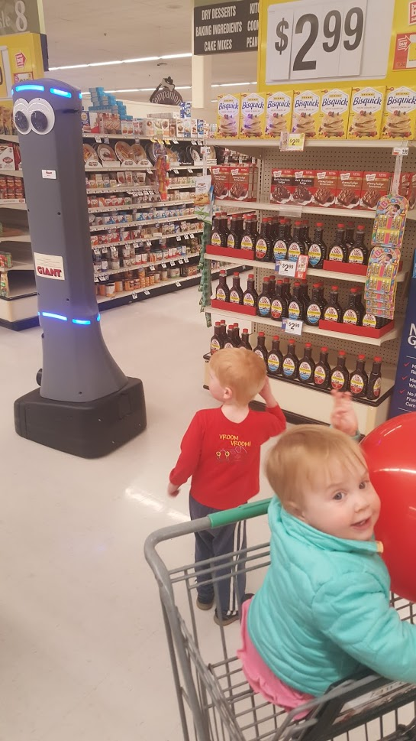
Test case 18 is k=0, 50000 4s
Concurrent modification on lists

Slide 80
Input maze
-x--
S--X
-X-E
Red is X, black is -, aces are start and end
Up, down, left, right

Slide 81
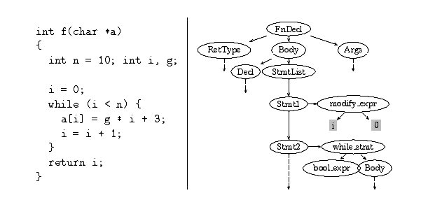
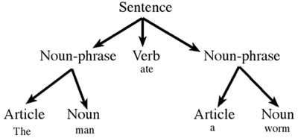
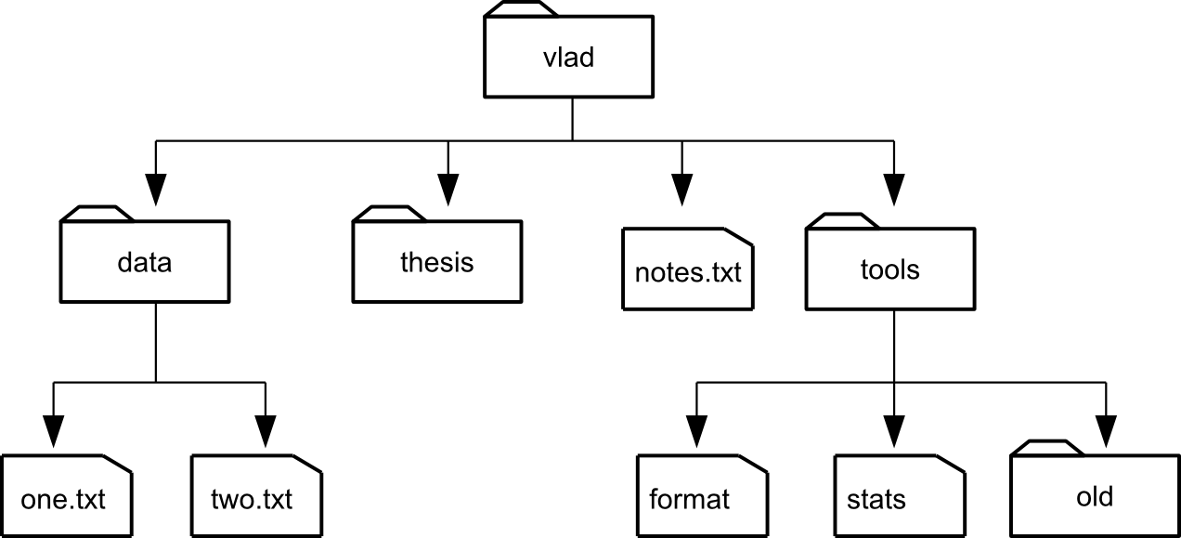
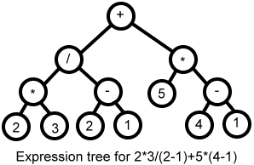
Some Tree Structures

Slide 82
Binary Trees
A binary tree is a tree with:
Nodes that have 0, 1 or 2 children
Children are distinguishable: left / right
Some binary trees:
Notes:
One on the right may not look like a binary tree, but technically it is - it is just highly unbalanced.
Draw another on the board where it zig-zags (right child / left child / right child etc…)

Slide 83
Tree Terminology
Nodes
Root / leaf / internal nodes
Node Degree
Tree Arity
Edges
Ancestors / Descendants
Parents / children / siblings
Paths
Path / path length
Node depth / Node level
Tree height / Tree width
Full / Complete Tree
a
b
c
g
f
e
d
h
i
j
Notes:
Quickly… all in the text… pretty straight forward.
Path: abfj
Book Defines Path Length by # of edges.
Some others use number of nodes.
Node depth – length of path from root to node.
Root is at depth 0.
Depth of h is 3
Level: All nodes at depth 2 are in level 2.
Tree height – number of levels in a tree.
Tree width – max number of nodes in a level
Full/Complete – refer to previous slide.

Slide 84
Recursive View of Binary Trees
Binary trees have a recursive structure.
For any node in the tree, its left and right children (if any) are the root of a smaller binary tree.
a
b
c
right sub-tree
of a
left sub-tree
of a
g
f
e
d
h
i
j
Notes:
Left sub-tree of b is the tree rooted at g.
Right sub-tree of f is the tree rooted at f.
Left sub-tree of c is the single node tree e.
What this structure means is that if we want to do something to every node in the tree we can do it recursively.
Imagine I have a function X that can be performed on a node in the binary tree.
Then to apply it to the whole tree I can: {Write on board…}
Do X to whole tree:
Do X to the root
Do X to the left sub-tree
Do X to the right sub-tree
When we do X to the left sub-tree it will recursively…
Do X to the root of that sub-tree (e.g. b)
Do X to the left sub-tree of that sub-tree (e.g. tree rooted at g)
Do X to the right sub-tree of that sub-tree (e.g. tree rooted at f)
The other three traversals are based upon this notion.

Slide 85
Binary Tree Traversals
Four ways to traverse a binary tree:
Level-order traversal
Breadth-first
Pre-order traversal
Depth-first
In-order traversal
Post-order traversal
a
b
c
g
f
e
d
h
i
j

Slide 86
Binary Tree Traversals
Four ways to traverse a binary tree:
Level-order traversal
Breadth-first
a b c g f e d h i j
Pre-order traversal
Depth-first
a b g h i f j c e d
In-order traversal
h g i b j f a e c d
Post-order traversal
h i g j f b e d c a
a
b
c
g
f
e
d
h
i
j

Slide 87
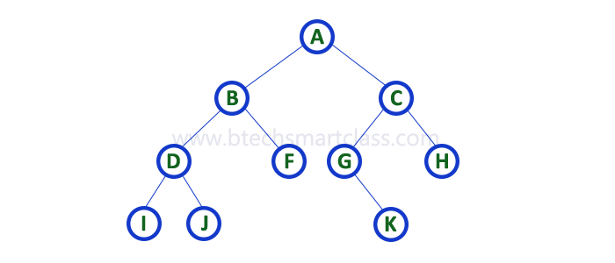
Binary Tree Traversals
Notes:
Level:
Pre:
In:
Post:

Slide 88
Removal
Find node
If easy to remove, remove it
Otherwise, find easy to remove node
Swap original to that node and remove it

Slide 89
stuff
Test on Friday
No office hours today
Solutions posted for 3
Solutions posted for 4

Slide 90
Priority Queue Abstract Data Type
Operations
Add, remove min, size

Slide 91
Implementing priority queue
Sorted array list
Unsorted array list

Slide 92
Binary tree
10
20
30
13
108
50
105
37
36
70

Slide 93
Binary tree priority queue
Binary tree
Complete
Heap property

Slide 94
add
10
20
30
13
108
50
105
37
36
70

Slide 95
Remove min
10
20
30
13
108
50
105
37
36
70

Slide 96
Intensive DNA search yields 10 genes tied directly to schizophrenia
https://www.sciencemag.org/news/2019/10/intensive-dna-search-yields-10-genes-tied-directly-schizophrenia

Slide 97
Binary Search tree abstract data type
Add
Remove
Get
Size
Next key

Slide 98
Comparison
Implementation:
Operation: Unsorted Linked-List Sorted Array List
get(K key) Ω(1),Ο(n),Θ(n)_{ave} Ω(1),Ο(lg n),Θ(lg n)_{ave}
add(K key, V value) Θ(1) Ω(lg n),Ο(n),Θ(n)_{ave}
remove(K key) Ω(1),Ο(n),Θ(n) _{ave} Ω(lg n),Ο(n),Θ(n)_{ave}
nextKey(K key) Ω(1),Ο(n),Θ(n) _{ave} Ω(lg n),Ο(n),Θ(n)_{ave}

Slide 99
Binary search tree
Binary tree
Binary search tree property – all nodes in left subtree are less than root of that subtree, all nodes in right subtree are greater than root of that subtree

Slide 100
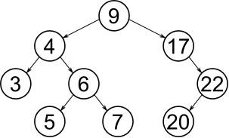

Slide 101
Streams (not in book)
The stream object is a way of operating on a list of data
Key functions
map – applies a function to every element, result is a stream
forEach – applies a function on every element, result is nothing
filter – removes elements that return false on a given Boolean function
reduce – combines the elements in some way
collect – returns the objects in some structure

Slide 102
Stream examples

Slide 103
Function notation
Refer to a function as “objectType”::”functionName”. For example, “System.out::println”.
Lambda expressions
“(input) -> { function }”
Can shorten sometimes

Slide 104
Examples of lambda
Find all primes
IntStream.range(2,1000).filter( s -> {
for(int i = 2; i < s; ++i) {
if(s%i==0)
return false;
}
return true;
}).forEach(System.out::println);

Slide 105
Examples
ArrayList<Integer> list = new ArrayList<Integer>();
(add a bunch of integers)
list.stream().forEach( System.in::println )
list.stream().map( s -> s + 2 )
list.stream().filter( s -> s < 5)
list.stream().collect( Collectors.toList() )
list.stream().reduce( (s, t) -> { if( s > t) { return s; } else { return t;} } )
list.stream().reduce( (total, cur) -> {total+=cur; return total;} )
Be careful about copying these (-, not –)

Slide 106
Good resource
https://winterbe.com/posts/2014/07/31/java8-stream-tutorial-examples/

Slide 107
Selection Sort
Basic idea: find smallest, put it at front, repeat

Slide 108
Merge sort
Sort one half, sort other half, merge together

Slide 109
Best Worst Algorithm
Selection Sort: Θ(n²) Θ (n²) -> Θ(n²)
Merge Sort: Θ(n lg n) Θ (n lg n) -> Θ(n lg n)

Slide 110
Practice

Slide 111
Insertion sort
5 4 3 2 1
4 5 3 2 1
4 3 5 2 1
3 4 5 2 1
3 4 2 5 1
3 2 4 5 1
2 3 4 5 1
2 3 4 1 5
2 3 1 4 5
2 1 3 4 5
1 2 3 4 5

Slide 112
Optimizations for merge sort
Insertion as base case
Sorted lists

Slide 113
Presorting
Find max/min
Find nearest elements
Find furthest elements
Set intersection
K largest elements
Element uniqueness

Slide 114
Dropping
Deepfake
Rush hour

Slide 115
Hashing
Search (get) Bounds
Linear Search Ω(1), O(n)
Binary Tree Ω(1), O(n)
Binary Search Ω(1), O(lg n)
Balanced BST Ω(1), O(lg n)

Slide 116
Hashing is terrible at:
Iteration, going through all of the elements in a well defined order
Get max/min finding the element with the minimum/maximum key
Get next - finding the element with the next largest/smallest key
Range queries - finding all values with keys in a given range
However
Hash Table is Θ(1) average get, Θ(1) amortized add

Slide 117
Hashing: Time and space efficient method for mapping a key to the index of its associated value in an unordered collection.
HashMap Operations:
put(K key, V value) Θ(1) average
add or update
key cannot be null
get(K key) Θ(1) average
remove(K key) Θ(1) average
return value or null
size() ≡ n
capacity()≡ m

Slide 118
Open Hashing / closed addressing demo

Slide 119
Open hashing / closed addressing
Each element is a linked list
Element always maps to one particular spot

Slide 120
256- Overenrolled. The plan is to offer a new section in Fall 2020. Only one section will be offered this spring (many students will be cut). If you get cut and there is a section in the fall then you will get into that section.
Test
Average was 51/60, standard deviation was 8.4
Test was too small, so I added a 15 point question that everyone got right.
Worst questions were about the mystery function and selection sort

Slide 121
Huffman
Frequency count
char can be an index
Printing \n and \t
Make Tree
Need a tree class
It should implement comparable<Itself>
It should have a constructor that take two trees and combines them
It should have a level order traversal

Slide 122
Make code
Treat code as string
Code of this node is code of parent + 0 or 1 (left or right child)
Add all codes to HashMap<Character, String>
Print message
easy

Slide 123
Closed hashing, open addressing
Probing- checking more than one place to put an element
Probe sequence- the sequence of places checked
Home index- the initial place to put an element
Clustering- creation of long runs of filled slots

Slide 124

Analysis of failed search
If it’s in the home index
$$=1+\frac{n}{m}$$
If it’s not…
$$=1+\frac{n}{m}+\frac{n}{m}\frac{n−1}{m−1}+…$$

Slide 125

$$=1+\frac{n}{m}+\frac{n}{m}\frac{n−1}{m−1}+\frac{n}{m}\frac{n−1}{m−1}\frac{n−2}{m−2}…$$
$≤1+\frac{n}{m}+\frac{n}{m}\frac{n}{m}+\frac{n}{m}\frac{n}{m}\frac{n}{m}…$

Slide 126

$$=1+\frac{n}{m}+{\left(\frac{n}{m}\right)}^{2}+{\left(\frac{n}{m}\right)}^{3}+…+{\left(\frac{n}{m}\right)}^{m−1}$$
$=1+\sum_{i=0}^{m−1}{({n/m)}^{i}}$
$≤1+\sum_{i=0}^{∞}{({n/m)}^{i}}$
Note: we resize so n/m <= 0.5
$\sum_{i=0}^{∞}{a^{i}= \frac{1}{1−a} for 0<a<1}$
$=1+\frac{1}{1−\frac{n}{m}}$
$≤1+\frac{1}{1−0.5}$

Slide 127

Analysis of successful search
Not going to do the analysis, but it’s
$$T_{SS}\left(n\right)≤\frac{1}{n/m}ln\frac{1}{1−n/m}$$
Intuition: It has to be faster than failing.

Slide 128
Probing options
Primary clustering- different home indexes have same probe sequence
Secondary clustering- same home index has same probe sequence

Slide 129
Definitions
Home index – initial index in the hash table checked to for an element
Probe sequence- sequence of indexes checked in a hash table. Home index is probeSequence[0]
Probe function- function to generate probe sequenc

Slide 130
Probe function
Probe sequence- sequence of indexes to try to place an element
h(i,k) = (i+k)%m <- linear probing
h(i,k) = (i*i+k)%m <- quadratic probing

Slide 131
Probe function
Desired goals for a hash function-
1. Repeatable- gives same result every time
2. Approximates simple uniform hashing

Slide 132
Desired goals for a probe function
1. Avoid having two probe sequences with different home index being similar, i.e. avoid primary clustering.
2. Every index should be in the probe sequenc.

Slide 133
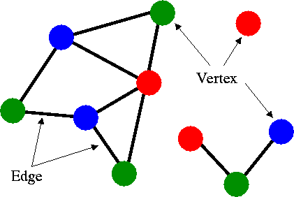
Graphs
Graph: A finite non-empty set of vertices and a finite, possibly empty, set of edges.

Slide 134
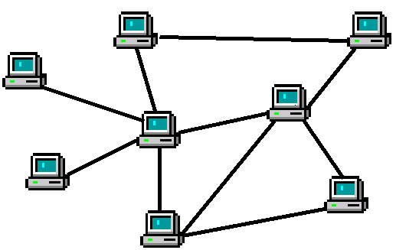
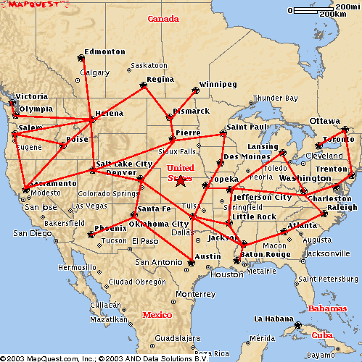
Graph Applications
Computer networks
Transportation routes
Task planning
A
B
F
C
E
D
Notes:
Lots of applications:
Vertices are things, edges are relationships between them...
Computer Networks: vertex == computer, edge == network connection.
Minimum amount of cable to connect all
Shortest path between 2 computers
Transportation: vertex == location, edge == transportation means (road, air route, train)
Shortest route from A to B - google maps
Task Planning: Vertices are tasks - edges are conflicts or dependencies
Can the events be scheduled w/o conflict?
How many time slots would be required?

Slide 135
Graph Notation
Graph: A finite non-empty set of vertices and a finite, possibly empty, set of edges.
G=<V,E>
V = set of vertices
|V| = number of vertices
E = set of edges
|E| = number of edges

Slide 136
Types of Graphs
Undirected Graph
Directed Graph
Weighted Graph
Notes:
Different applications will call for different types of graphs.
Undirected - edges do not have direction.
Directed - edges have direction
Undirected - computer network where information can flow equally well in both directions between two computers.
Directed -
google maps - where there are one way streets -
airlines that fly from NY-LA but not LA-NY (go to LV on way back instead)
Directed graphs can have edges both ways between vertices.
Any undirected graph can be represented as a directed graph by...
Weighted graphs can be directed as well as undirected.
Edge weights can be:
Cost of network cable installation
Driving distance / time

Slide 137
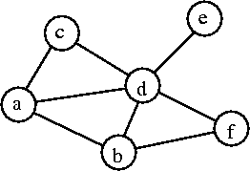
Undirected Graphs
Edges in undirected graphs do not have a direction.
i.e. (a,c) = (c,a)
G=<V,E>
V = {a,b,c,d,e,f}
E = {(a,b),(a,c),(a,d),(b,d), (b,f),(c,d),(d,e),(d,f)}
Notes:
What is the minimum and maximum number of edges in an undirected graph?
0 <= |E| <= (|V|*(|V|-1))/2
Every vertex is connected to all |V|-1 others, but that counts every edge twice (i.e. (a,b) and (b,a)) so divide by 2.

Slide 138
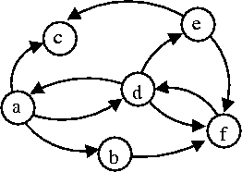
Directed Graph (digraph)
Edges in directed graphs have a direction:
i.e. (a,c) ≠ (c,a)
G=<V,E>
V={a,b,c,d,e,f}
E={(a,b),(a,c),(a,d),(b,f),(d,a), (d,e),(d,f),(e,c),(e,f),(f,d)}
Notes:
Maximum number of edges in a directed graph?
0 <= |E| <= |V|*(|V|-1)
No division by 2 on the number of edges because (a,b) and (b,a) are distinct in a digraph.

Slide 139
Graph Terminology
Neighbors
Vertex Degree:
In degree
Out degree
Paths
E.g. [a, b, f, d, e]
Path length
Simple path
Cycles
Acyclic graph
DAG
Notes:
Degree = number of incident edges.
in degree = incoming edges
out degree = outgoing edges
For Vertex d?
Path - sequence of adjacent vertices
Path length = # of edges in the path (note different from what text did with trees)
Cycle = path that starts and ends at the same vertex
Path here? {a, b, f, d, a}
Length? 4
Any longer? Shorter?

Slide 140
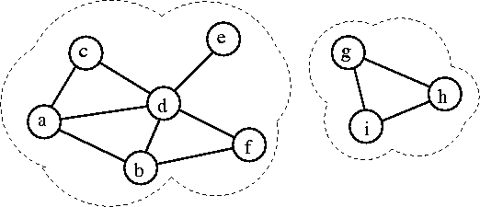
Graph Structures
Connected Graph: A graph in which all vertices are connected:
Connected Component: A maximal sub-graph of a given graph.

Slide 141
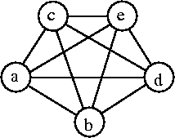
Graph Density
Density: |E| / |V|
Sparse Graph: A graph with a small number of edges relative to its number of vertices.
Dense Graph: A graph with almost all possible edges.
Complete Graph: Graph containing all possible edges.
K_{|V|}: Complete graph with |V| vertices.

