Slide 1
Intro:
Class- Be on time
Homework:
Office Hours: Take survey
Text- free pdf http://people.cs.vt.edu/~shaffer/Book/JAVA3elatest.pdf
Course repository
https://github.com/skalakm/232

Slide 2
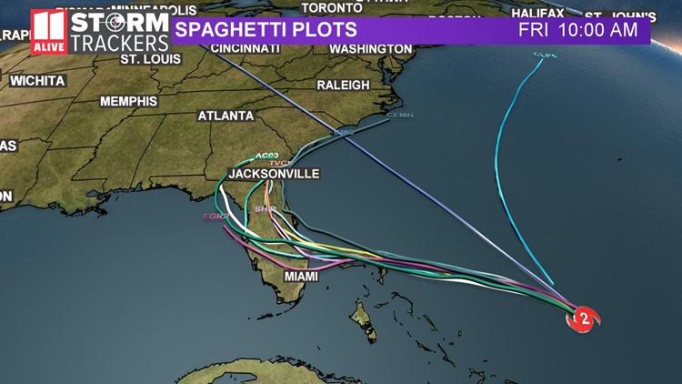

Slide 3
The Last Programming Class You Will Ever Take
Data structure- an organization of data in a computer’s memory
Eg
Why?
Make common operations efficient

Slide 4
Physical examples
Dictionary
Library

Slide 5
Computer examples
Stack
Efficient add/remove at “top”
Inefficient for anything else
Hashmap
Efficient for finding value by key
Inefficient for accessing in some order (eg alphabetical)

Slide 6
Problem solving
Comp 131/132
Most of the approach was already designed
Comp 232
More often, given only a problem statement (input and output)

Slide 7
Course goals:
Toolkit development
Know what data structures are possible and what they are good at
Choice
Static or dynamic
Common operations
Access pattern
Search types
Performance analysis

Slide 8
Asymptotic performance analysis
Big-O, omega, theta
Tradeoffs
Time vs space
Readability/maintainability vs code size/efficiency

Slide 9
Problem solving skills

Slide 10
Terminology
Simple/primitive data type
Aggregate/composite data type
Abstract data type
Operations, but not implementation
Data structure
Implementation of an abstract data type

Slide 11
Problem
What, not how
Sorting- put elements in order
Searching- find a specific element in a collection
Find a path through a maze

Slide 12
Algorithm
How
Many algorithms for same problem (sorting)
Properties
Correct
Concrete steps (doable in finite time)
Unambiguous order
Finite number of steps
Terminates
Program
Executable implementation of an algorithm in a programming language

