Slide 1

Machine Learning Model Deployment using Fast API
This tutorial provides a complete workflow for creating a classification model using the Iris dataset, deploying it using FastAPI
Step 1: Create Folder Structure (data, model, main.py, train.py and requirements.txt)
Step 2: Read csv file (folder: data)
Step 3: Train model (train.py: script to train the model)
Step 4:

Slide 2
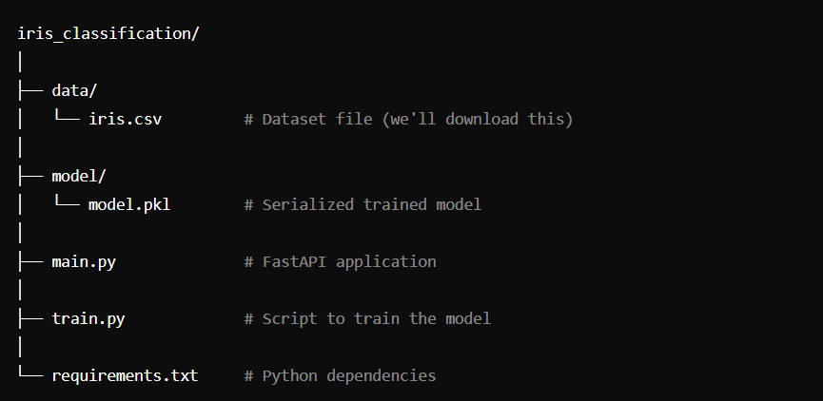
Machine Learning Model Deployment using Fast API
Folder structure

