Slide 1

AstroSage Analysis
By hamza siddiqui
20/07/2025

Slide 2
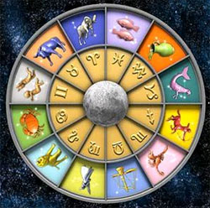
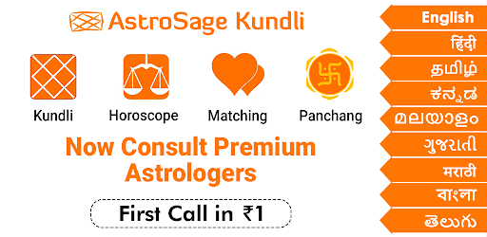
What do is astrosage?
Astrosage is recognized as one of the most reliable astrology platforms, catering not only to individuals seeking astrological guidance but also to advanced research and development in the field of astrology. it serves as a comprehensive source, addressing everything from everyday life queries to highly specialized astrological concerns. our mission is to assist individuals in overcoming challenges and contribute to the betterment of humanity through the divine science of astrology.

Slide 3
Problem statement
To optimize call center operations for AstroSage with a 1 crore investment.
The goal is to determine how to allocate this investment to maximize operational efficiency, customer satisfaction, and profitability.
This project will involve analyzing historical call data, performance metrics, and market trends to make informed decisions.

Slide 4

Data overview
Top 10 Guru on Call , Earning and Rating
Guru Name | Sum of Call time Duration ( Minute ) | Sum of Astrologers Earnings
Astro Divya | 2358.846 | 3696.9853
Astro Ruchi | 2252.6342 | 10274.658
Astro Seema | 1531.569 | 2690.8173
Astro Shalini | 2948.3075 | 6807.6067
Astro Sonam S | 1978.9112 | 2907.4947
Dr Balkrisna | 1323.6726 | 15910.208
Tarot Ari | 1085.7309 | 2222.5587
Tarot Bee Riya | 359.5957 | 2178.7125
Tarot Rupika | 936.616 | 2198.75
Usha Siingh | 186.8486 | 2870.2667
Average of rating
3.479166667
4.442728443
3.398347107
3.417108251
3.719414894
2.593886463
3.854166667
2.36204576
2.846560847
2.15
Total Consultation | 28027
Net Amount | 213987.3153
Total Calls | 8511
Net Amount (Call) | 168442.035
Total chats | 19514
Net amount(chat) | 45494.68

Slide 5
Methodology
Cleaned the dataset by removing irrelevant columns and finalizing required fields.
Created pivot tables for analyzing agent performance, call patterns, and revenue trends.
Designed a multi-page dashboard in Excel using slicers and navigation buttons.
Implemented interactivity by linking charts with filters (month, website, consultation type).
Visualized key metrics using bar, line, donut, and stacked column charts.

Slide 6
Traffic website
The chart shows the distribution of website usage:
Gurucool accounts for the majority with 72% (20,225 users).
App usage contributes 28% (7,800 users).
Dashboard usage is negligible at 0% (2 users).
This indicates that most traffic comes from the Gurucool platform, while the dashboard is rarely used.

Slide 7
User chat status
According to given data Only 20% chat are completed which is very low. Need to improve chat completing percentage by providing automate AI Chat support for initial engage and improve AI Chat Bot increase chat completing.
completed
incompleted
Not available
failed

Slide 8
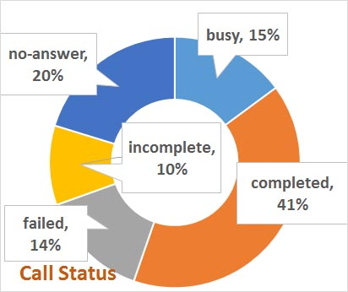
User call status
Most calls are successfully completed, but a significant portion (around 59%) are either unanswered, busy, failed, or incomplete — indicating scope for improving connectivity and call handling.
Need to improve call completing percentage by providing automate IVR call for initial engage and hire more agent to increase call completing

Slide 9
Identifying performance gaps
Astrosage has been facing challenges in maintaining optimal call center performance as per given data :
Declining customer satisfaction scores
Inconsistent call volumes.
Variability in agent performance.
Overall agent performance is poor.
Average performance of guru is not fair .
Average customer satisfaction is very low.
Average rating is 2.93 , which is very low .
Daily call volume is inconsistent.
Total change in call volume is in negative , and average change is in negative.

Slide 10
Revenue generated by consultation type
Based on the data in the chart:
Calls generated ₹168,520.62, accounting for 79% of the total revenue.
Chats generated ₹45,494.68, making up 21%, while Complementary (₹50.60) and Public Live Calls (₹0) had negligible revenue impact.

Slide 11
Rating wise guru distribution
The majority of gurus, around 7,256, have a rating of 0, which suggests they are either new or haven't been rated yet. a large number also fall within the low rating range (1 to 3), indicating there may be quality issues or a need for performance improvement. very few gurus have high ratings (6 to 8), showing that top-rated gurus are limited, and this could be an opportunity for focused training or mentoring.

Slide 12
Total call distribution by hour
Call peak hour must be focus on Peak hour to engage more user and generate Maximum revenue.

Slide 13
User engagement based on ratings
ACCORDING TO DATA
Majority of users (7256) gave a rating of 0, showing strong dissatisfaction or non-engagement.
Ratings between 2 and 3 are moderately high, while ratings 4 to 8 remain consistently lower and evenly distributed.
IT Need to improve customer satisfaction by providing Free chat through AI Chat Bot .

Slide 14
Top 10 guru
Represents the top 10 guru on earning based on various criteria like "sum of astrologers earnings", and "sum of call time duration".

Slide 15
Daily net amount
ACCORDING TO DATA,
Sum of Daily net Amount
( including call , chat )
Daily net amount shows major fluctuations, with significant peaks around mid-December.
Several sharp rises and drops highlight irregular cash flow patterns during the period.

Slide 16
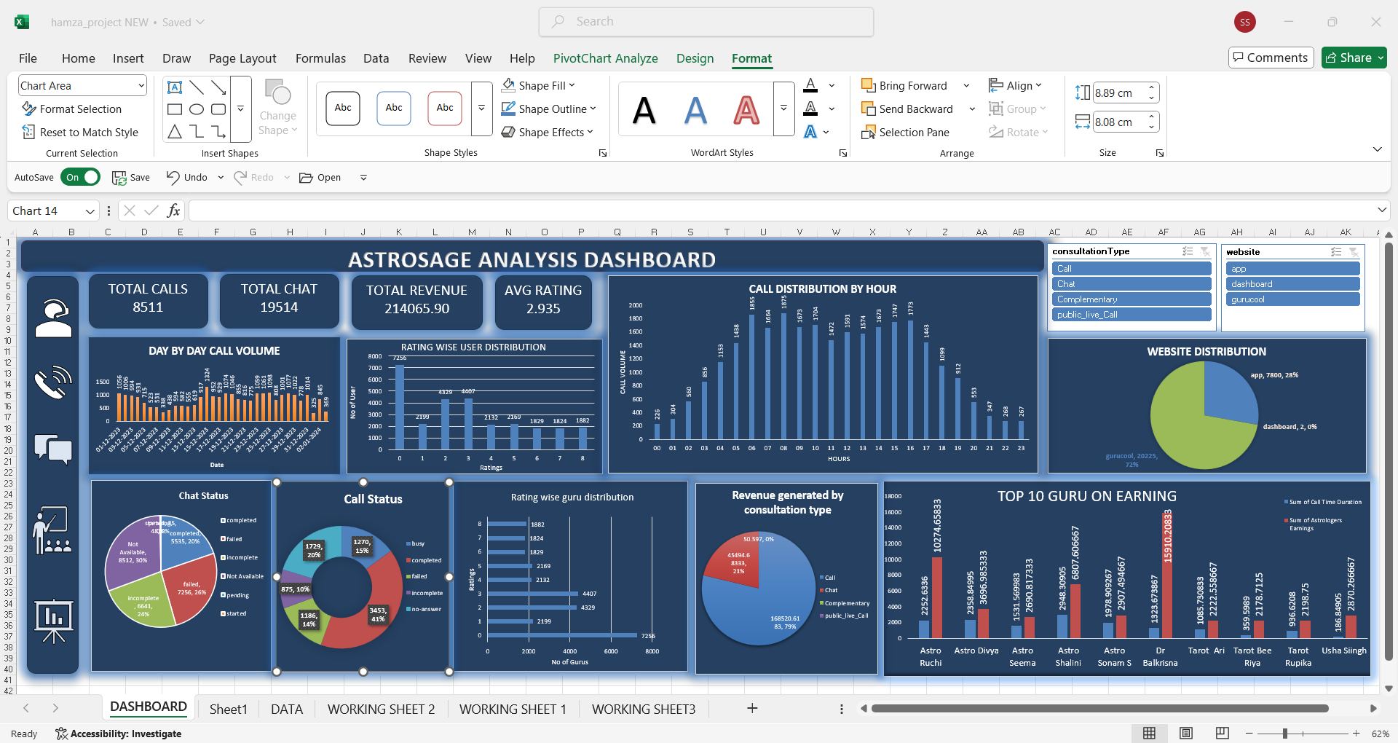
Dashboard

Slide 17
Key insight summary
AstroSage is experiencing lower average call volumes compared to AstroGuru, while customer satisfaction levels are steadily declining, indicating possible service concerns. Additionally, agent performance shows considerable variation, with certain agents performing exceptionally well and others lagging behind.
Possible Key Factors
From the analysis of call center operations, the following attributes appear to influence customer satisfaction:
Call Duration: Efficient or appropriately timed calls often reflect quicker resolution of issues.
Agent Performance: Factors such as the number of calls managed, agent ratings, and specific expertise (e.g., Guru name) can affect satisfaction levels.
Call Channel and Type: Differences between free and paid services, chat versus voice interactions, or the type of consultation provided can play a role.
Call Status: Whether the issue was resolved or left unresolved, including cases requiring refunds or escalations, impacts customer perception.
Time of Call: Performance during peak and off-peak hours may influence customer experience.

Slide 18
Suggestion
Suggestions for Improvement Based on Findings
Enhanced Agent Training: Prioritize training on key factors that drive higher satisfaction, such as improving consultation quality and minimizing resolution times.
Optimize Call Duration: Determine the ideal duration range linked to better customer experience and streamline processes to maintain efficiency within that window.
Integrate Customer Feedback: Leverage insights from customer feedback to pinpoint recurring issues and strengths, enabling continuous service improvements.
Strategic Resource Deployment: Assign top-performing agents to peak hours or complex cases to ensure consistent and high-quality customer interactions.

Slide 19
Conclusion
The AstroSage call center data revealed clear trends in user behavior, platform usage, and agent performance
Peak hours and repeat callers were major drivers of consultation volume and revenue
The mobile app emerged as the dominant platform, with chat-based services leading in revenue generation
By implementing the recommendations, AstroSage can enhance efficiency, customer satisfaction, and long-term profitability

Slide 20


