Slide 1
Biometric Security in Banking
ArcFace-Based Face Recognition for ATM Authentication
Group Members
Member 1
Member 2
Md. Nadeem - 2511022250019
Prasannashree B — 2511022250032
Member 3
Member 4
Ayush Kumar — 2511022250025
Anuvid Mishra — 2511022250036
Master of Computer Applications · Semester III · Alliance University
Submitted To: Ms. Sanjivni Ma'am · Academic Year: 2025–26

Slide 2



Problem Statement and Project Objective
Traditional Authentication
Proposed Biometric Authentication
Vulnerable to card theft, PIN compromise, shoulder surfing, and credential attacks.
Facial biometrics eliminate physical tokens and reduce attack surface.
ATM Card
PIN Entry
Access Granted
Face Capture
Face Recognition
Identity Verification
Project Objective
Develop an ArcFace-based ATM authentication prototype using facial biometrics and deep learning.
Team Contribution
Member 1
Member 2
Member 3
System Architecture & Project Design
Face Detection & Image Preprocessing
ArcFace Embedding & Face Matching
Member 4
Flask Interface, Testing & Documentation

Slide 3

Proposed Biometric ATM Authentication Architecture
Live Capture
Face Detection
Preprocessing
ArcFace Embed
The pipeline flows from live capture through detection, preprocessing, and ArcFace embedding to an authentication decision.
Authentication Outcomes
✓ Match Verified
✗ Not Authenticated
Similarity ≥ 0.60
Similarity below threshold
⚠ No Face Detected
⚠ Multiple Faces
Authentication halted
Authentication rejected

Slide 4


CNN-Based Face Detection and ArcFace Recognition
Face Detection
MTCNN (Multi-task Cascaded CNN) serves as the primary detector, locating faces with high accuracy. OpenCV acts as a fallback for robustness.
ArcFace Recognition
ArcFace converts the detected face into a facial embedding — a compact numerical representation of identity.
Deep Metric Learning
Embeddings of the same person cluster closely; embeddings of different persons are pushed apart in the feature space.
FaceNet and VGGFace2 are important research concepts but are not directly implemented in this prototype.

Slide 5
Face Data, Preprocessing and Embedding Generation
Reference Enrollment Pipeline
01
02
03
Reference Face Image
Face Detection
Image Preprocessing
Account holder's registered photo
MTCNN primary, OpenCV fallback
Quality enhancement pipeline
04
05
ArcFace Model
Reference Embedding
Deep feature extraction
Stored securely for verification

Slide 6
Image Preprocessing Techniques
A comprehensive overview of the preprocessing techniques applied to enhance face image quality before ArcFace embedding generation.
RGB Conversion
Low-Light Detection
CLAHE Enhancement
Gamma Correction
Standardizes colour space
Identifies poor illumination
Improves local contrast
Brightness normalisation
Face Size & Alignment Validation
Ensures proper framing
These techniques ensure optimal image quality for accurate facial feature extraction and embedding generation.

Slide 7
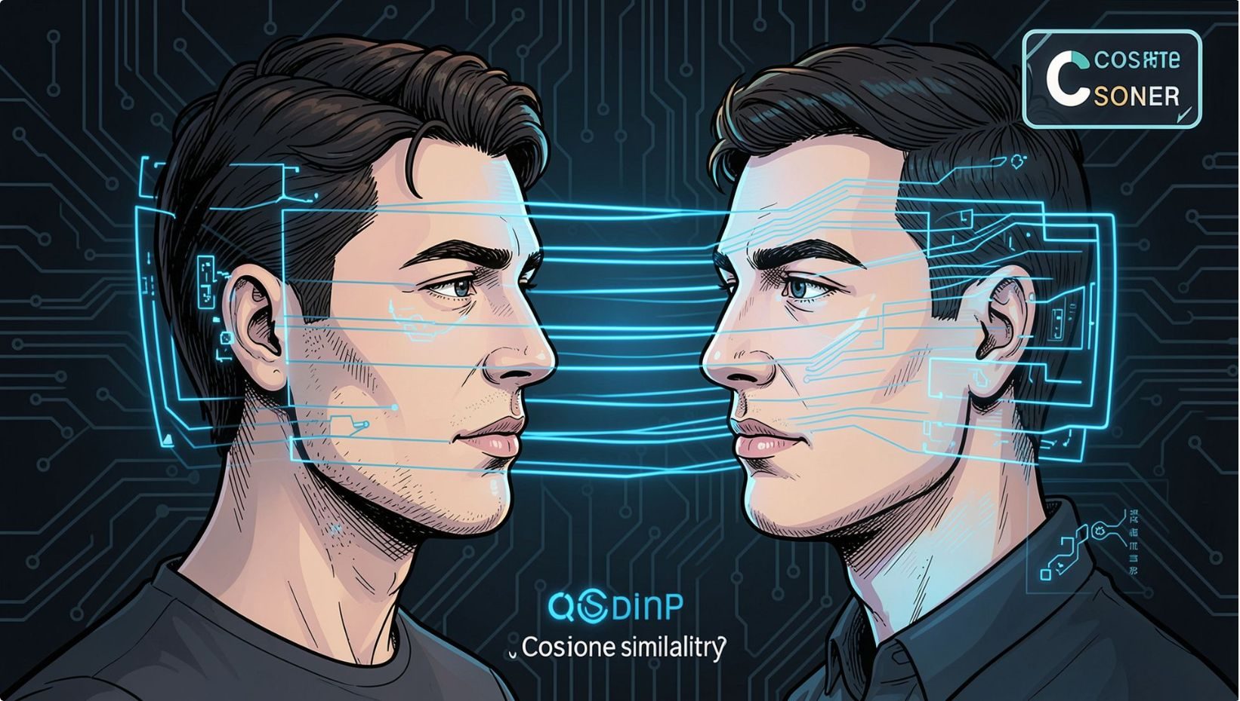
Real-Time Face Verification and Matching Strategy
Verification Pipeline
1
Live frame captured via ATM camera
2
Face detected and preprocessed
3
ArcFace generates live embedding
4
Cosine similarity computed against reference
5
Authentication decision rendered
Decision Logic
Similarity ≥ 0.60
Similarity < 0.60
✓ MATCH VERIFIED — Access granted
✗ NOT AUTHENTICATED — Access denied
A higher cosine similarity score indicates a stronger match between the live face and the registered reference.

Slide 8
ATM Security and Validation Features
No Face Detection
Multiple Face Detection
Authentication does not proceed when no valid face is detected in the frame.
Authentication is rejected when more than one face is detected simultaneously.
Face Alignment Validation
Low-Light Detection
The face must be properly positioned and aligned within the camera frame.
Poor illumination is detected and corrected via CLAHE and gamma correction.
Unknown User Detection
Other Registered User Detection
Users whose similarity score falls below 0.60 are rejected automatically.
System identifies when a live face matches a different registered reference image.

Slide 9
Experimental Results and ATM Prototype Demonstration
Test Case Outcomes
Test Case
System Response
Correct Registered User
✓ MATCH VERIFIED
Unknown User
✗ USER NOT AUTHENTICATED
No Face Detected
⚠ NO FACE DETECTED
Multiple Faces Present
⚠ MULTIPLE FACES DETECTED
Low-Light Environment
Image Enhancement Applied

Slide 10
Current Limitations and Future Security Enhancements
Current Limitations
Future Enhancements
Liveness detection and anti-spoofing not implemented
Blink detection and challenge-response not implemented
Liveness verification and blink detection
Head movement and challenge-response authentication
FAR and FRR not yet experimentally calculated
Threshold of 0.60 requires further optimisation
Deep learning-based anti-spoofing module
FAR and FRR performance evaluation
Large-scale datasets (LFW, VGGFace2) not used
Academic prototype — not for production deployment
Encrypted storage of biometric embeddings
Multi-factor authentication and ATM integration
The roadmap traces the path from the current prototype through enhanced biometric security to a production-ready ATM system.

Slide 11
Conclusion
This project demonstrates an ArcFace-based facial biometric authentication prototype for enhancing ATM security — integrating real-time face detection, image preprocessing, low-light enhancement, deep metric learning, and cosine similarity matching into a functional Flask-based system.
Real-Time Detection
Image Enhancement
MTCNN primary detector with OpenCV fallback
CLAHE, gamma correction, and low-light handling
ArcFace Embeddings
Cosine Similarity
Deep metric learning for robust identity representation
Threshold-based matching at 0.60 for authentication
"Facial biometrics can provide an intelligent, contactless, and secure additional authentication layer for future banking and ATM systems."
Thank You
Questions and Discussion

