Slide 1
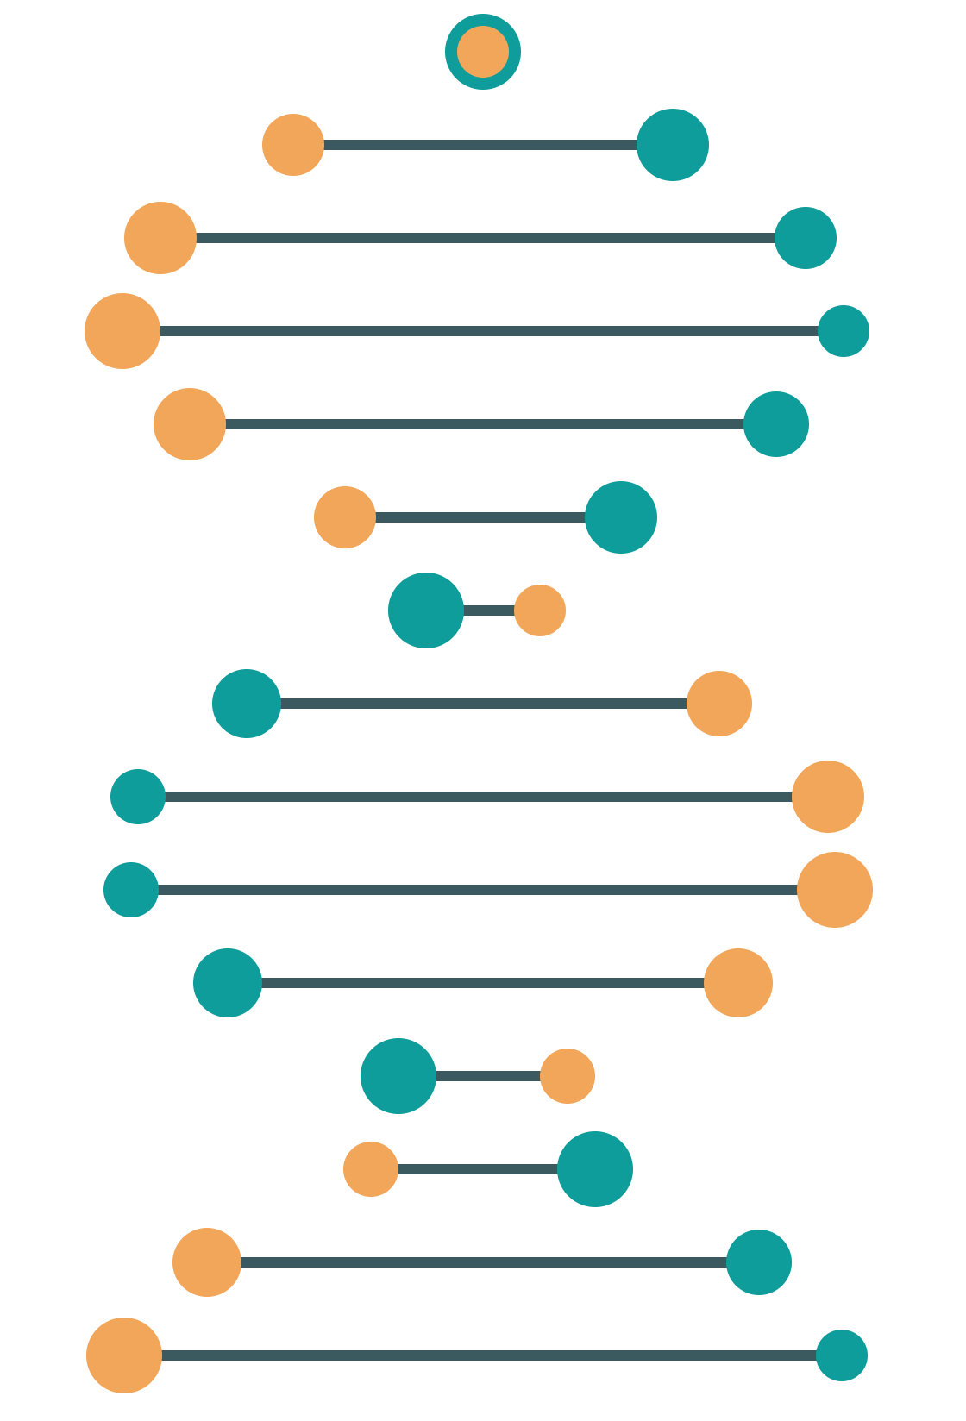
Global DNA and Protein Sequence Alignment Using the Needleman–Wunsch Algorithm
Data Structures and Algorithms-3 (25CS2103E)
S. Hasini Reddy · 2520030287
Anushka Kulkarni · 2520030501
Akshaya Minnekanti · 2520030516
Under the guidance of Dr. Yamini Devi

Slide 2
Abstract
01 · ABSTRACT
A bioinformatics application for global sequence alignment with the Needleman–Wunsch algorithm. It compares DNA and protein sequences using dynamic programming, scoring rules and gap penalties, then reports the alignment score, matched and mismatched regions, and the aligned sequences.
1
DNA and protein input
2
Dynamic programming
3
Optimal alignment and score
DSA-3 · Needleman–Wunsch Sequence Alignment
2 / 9

Slide 3
Introduction and Literature Survey
02 · BACKGROUND
Introduction
Literature survey
Sequence alignment compares DNA and protein sequences to find similarities. Needleman–Wunsch scores matches, mismatches and gaps to find the optimal alignment.
Alignment reveals similarities and evolutionary relationships
Needleman–Wunsch is the classical global alignment algorithm
A scoring matrix is built, then traced back
Global alignment covers the full length of both sequences
DSA-3 · Needleman–Wunsch Sequence Alignment
3 / 9

Slide 4
Problem Statement and Objectives
03 · PROBLEM
Problem statement
Objectives
Comparing long sequences manually is difficult
Sequences contain matches, mismatches and gaps
A systematic method is needed to find the optimal alignment
Calculate an alignment score from predefined scoring rules
Handle matches, mismatches and gap penalties correctly
Display the final aligned sequences clearly
DSA-3 · Needleman–Wunsch Sequence Alignment
4 / 9

Slide 5
Algorithm Flow
04 · METHOD
1
2
3
4
Enter both sequences
Set match, mismatch and gap scores
Initialize the DP matrix
Fill the matrix
5
6
7
8
Traceback from bottom-right cell
Generate the optimal alignment
Calculate the alignment score
Display aligned sequences and score
DSA-3 · Needleman–Wunsch Sequence Alignment
5 / 9

Slide 6
Results
05 · RESULTS
✓
Optimal aligned sequences
Time complexity
O(m × n)
✓
Corresponding alignment score
✓
Matches, mismatches and gaps handled correctly
Space complexity
O(m × n)
Example
G
A
T
T
A
C
A
Match
GATTACA vs GCATGCT
score -1
Mismatch
G
C
A
T
G
C
T
Gap
DSA-3 · Needleman–Wunsch Sequence Alignment
6 / 9

Slide 7
Hardware and Software Requirements
06 · REQUIREMENTS
Hardware
Software
Processor: Intel Core i3 or equivalent and above
RAM: minimum 4 GB
Storage: minimum 500 MB free
Keyboard, mouse and standard display
OS: Windows, Linux or macOS
Language: Java, JDK 8 or above
IDE: IntelliJ IDEA, Eclipse, VS Code or NetBeans
Standard Java libraries
DSA-3 · Needleman–Wunsch Sequence Alignment
7 / 9

Slide 8
Conclusion
07 · CONCLUSION
Needleman–Wunsch finds the optimal alignment of two biological sequences by breaking the problem into smaller overlapping subproblems.
Dynamic programming
Optimal substructure
Recurrence relations
Matrix computation
Backtracking
DSA-3 · Needleman–Wunsch Sequence Alignment
8 / 9

Slide 9
Future Scope
08 · NEXT STEPS
01
02
03
04
Local alignment
Affine gap penalties
Multiple alignment
Protein scoring
Smith–Waterman algorithm
More realistic alignments
More than two sequences
BLOSUM and PAM matrices
05
06
07
08
Visualization
Optimization
Database integration
Interactive interface
DP matrix and alignment path
Memory-efficient DP for large sequences
Compare against biological databases
Web or desktop sequence input
DSA-3 · Needleman–Wunsch Sequence Alignment
9 / 9

