Slide 1
Event detection
three-episode scenario

Slide 2
Three-episode problem
0
0.35
0.61
1
Event 1
Event 1+ Event 2
Event 2
Episode 1
Episode 2
Episode 3
If we calculate the distributions of the three episodes, we have p1,p2,p3.
Suppose the event signatures are E1,E2,E3
The following two scenarios are possible:
After solving the first two equations for E1/E2, depending on whether p3 is closer to E1 or E2, we can decide the sequence of events.
Event 2 stopped after episode 2 | Event 1 stopped after episode 2
E1 = p1 0.5*E1 + 0.5*E2 = p2 E1 = p3 | E1 = p1 0.5*E1 + 0.5*E2 = p2 E2 = p3

Slide 3
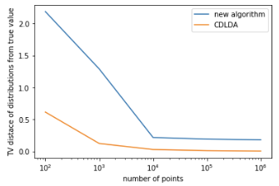
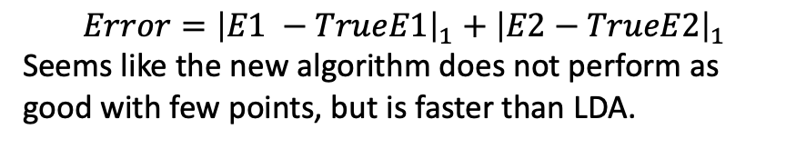
Performance comparison with CD-LDA
$$Error={\left|E1 −TrueE1\right|}_{1}+{\left|E2−TrueE2\right|}_{1}$$
Seems like the new algorithm does not perform as good with few points, but is faster than LDA.

