Slide 1
Active Learning
One query-at-a-time

Slide 2

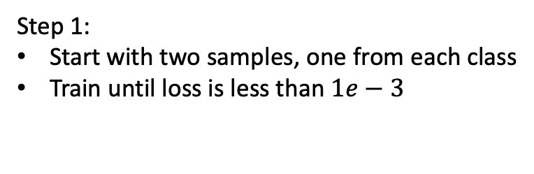
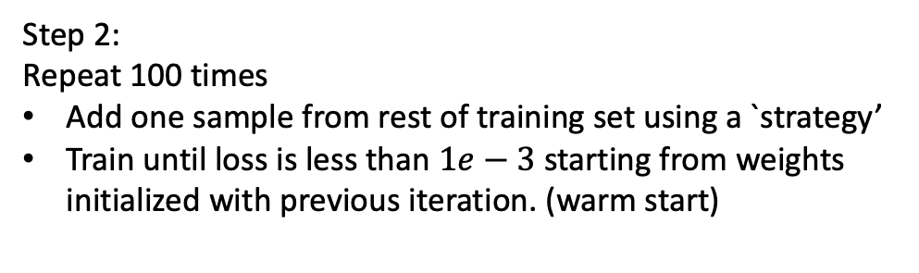
Initial iteration
Test set has 1991 images (28 x 28)
Training set has about 11000 data points
Roughly equal proportion of digits
Classifier – Two-layer network
First layer 784 (input image) x 100
Second layer 100 x 1
Step 1:
Start with two samples, one from each class
Train until loss is less than $1e−3$
Step 2:
Repeat 100 times
Add one sample from rest of training set using a `strategy’
Train until loss is less than $1e−3$ starting from weights initialized with previous iteration. (warm start)
Jordan T. Ash , Ryan P. Adams On Warm-Starting Neural Network Training

Slide 3
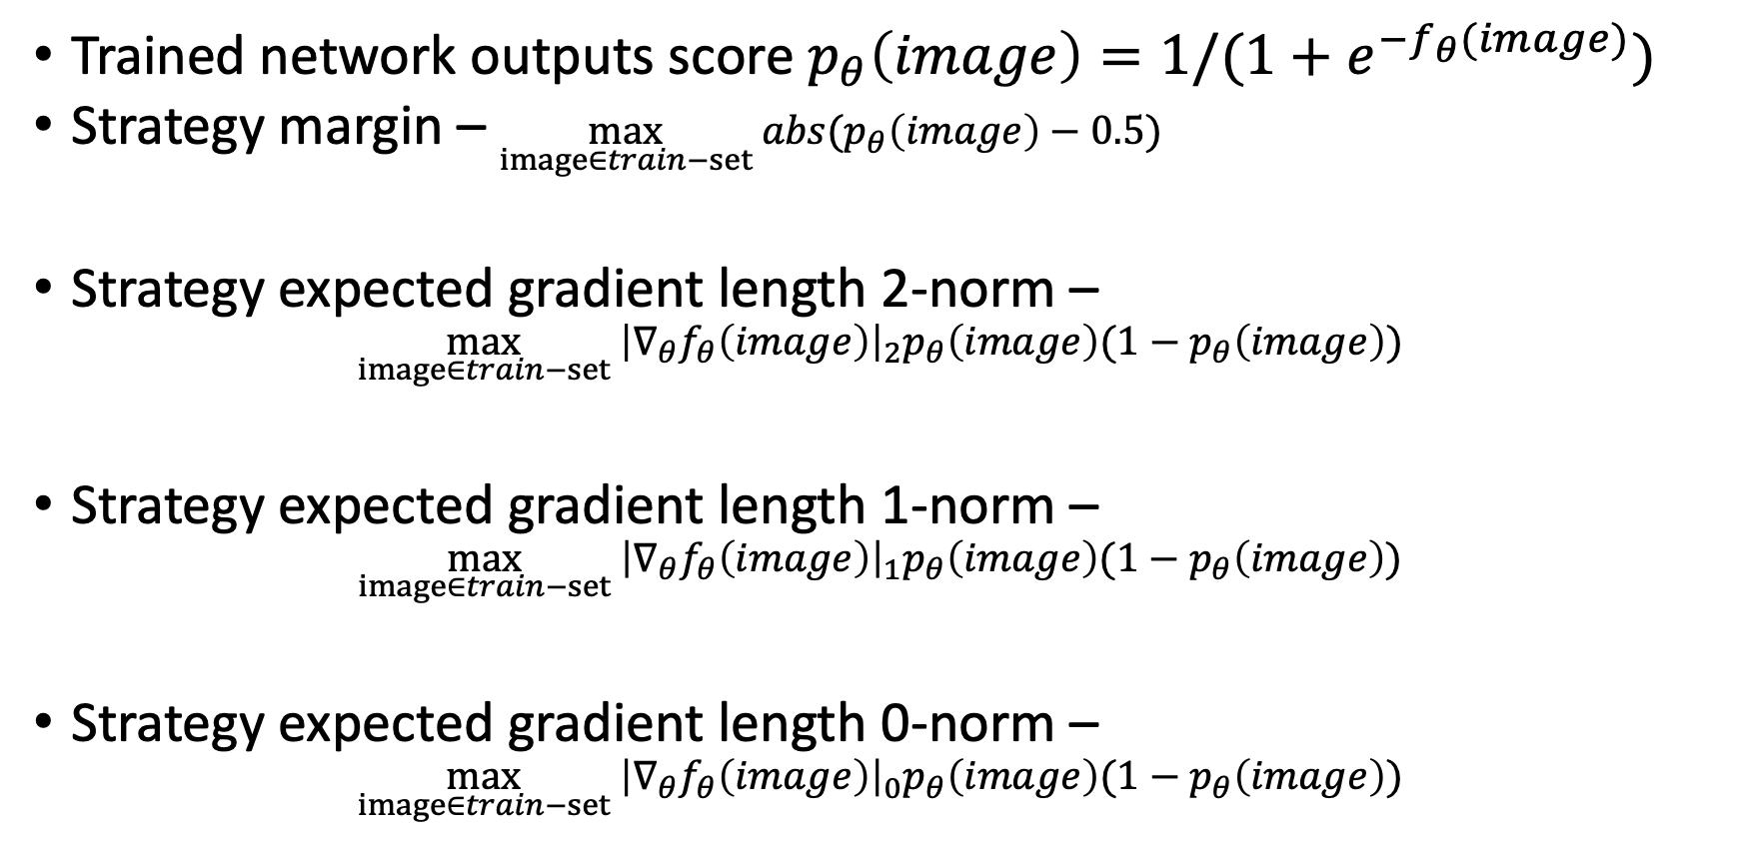
Strategies
Trained network outputs score $p_{θ}\left(image\right)=1/(1+e^{−f_{θ}(image)})$
Strategy margin – $\max_{image∈train−set} abs(p_{θ}\left(image\right)−0.5)$
Strategy expected gradient length 2-norm –
$$\max_{image∈train−set} {\left|∇_{θ}f_{θ}\left(image\right)\right|}_{2}p_{θ}\left(image\right)(1−p_{θ}\left(image\right))$$
Strategy expected gradient length 1-norm –
$$\max_{image∈train−set} {\left|∇_{θ}f_{θ}\left(image\right)\right|}_{1}p_{θ}\left(image\right)(1−p_{θ}\left(image\right))$$
Strategy expected gradient length 0-norm –
$$\max_{image∈train−set} {\left|∇_{θ}f_{θ}\left(image\right)\right|}_{0}p_{θ}\left(image\right)(1−p_{θ}\left(image\right))$$

Slide 4
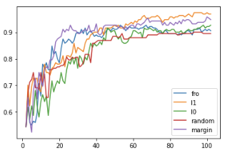
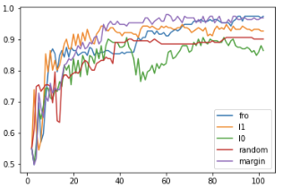
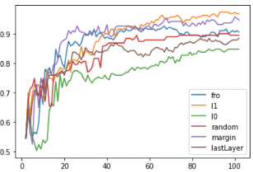
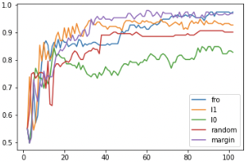
Initial number of samples is 2
SGD, lr = 0.01, m=0.9, tol = 1e-3
ADAM, lr = 0.001, tol = 1e-3
We see that the random one does not seem to improve after 40 samples, so we start with initial 40 samples to better see the difference between different methods
Notes:
While training of last layer lr is 1e-1 less than lr while training as a whole.

Slide 5
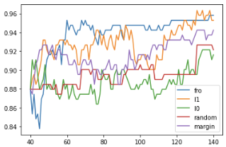
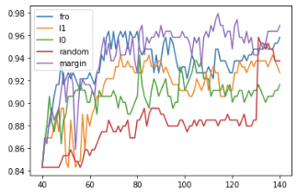
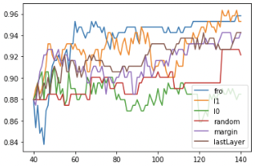
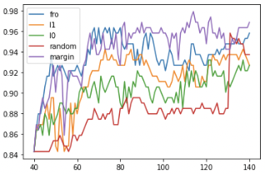
Initial number of samples is 40
SGD,lr = 0.01,m=0.9,tol = 1e-3
ADAM,lr = 0.001,tol = 1e-3
Notes:
While training of last layer lr is 1e-1 less than lr while training as a whole.

Slide 6
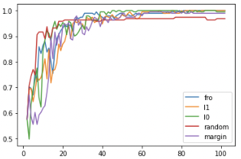
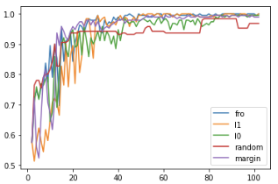
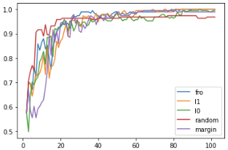
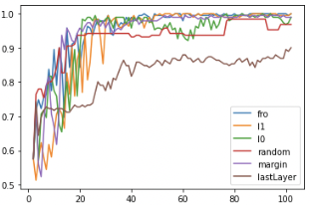
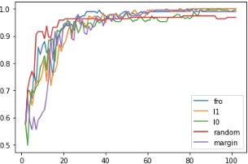
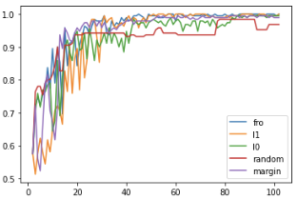
CNN - Initial number of samples is 2
Network CNN – 2 conv, 2 MLP
SGD, lr = 0.01,m=0.9, tol = 1e-4
ADAM, lr = 0.001, tol = 1e-4
Notes:
While training of last layer lr is 1e-1 less than lr while training as a whole.

Slide 7
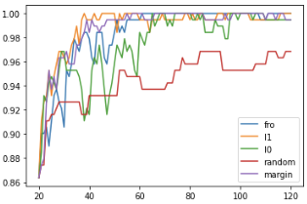
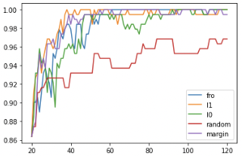
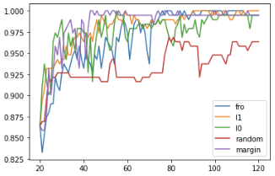
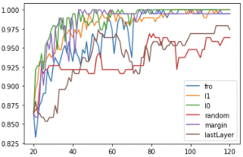
CNN - Initial number of samples is 20
Network CNN – 2 conv, 2 MLP
SGD, lr = 0.01, m = 0.9, tol = 1e-4
ADAM, lr = 0.001, tol = 1e-4
Notes:
While training of last layer lr is 1e-1 less than lr while training as a whole.

Slide 8
Conclusions
Initially `random’ strategy works well, but it stops improving after some iterations, whereas active learning strategy keeps improving regardless.
Adam and SGD behave differently under different norms and different architectures, but we need more experiments like averaging over multiple seeds to get a better understanding.

Slide 9
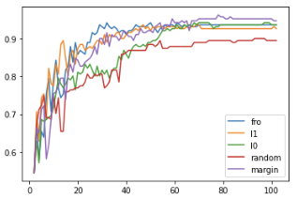
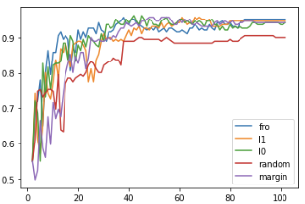
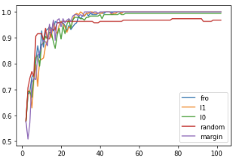
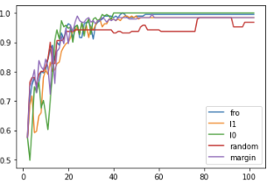
Query smaller unlabeled pool of 500 images
Starting with 2 images.
MLP with SGD
MLP with Adam
CNN with SGD
CNN with Adam

