Slide 1


CAPSTONE PROJECT MoVie Recommendation system
Presented By
Student Name: Uzair meezan siddiqui
College Name: suman Ramesh tulsiani technical campus, khamshet
Department: computer engineering
Email ID: siddquy2004@gmail.com
AICTE Student ID: STU67696aa8149091734961832

Slide 2
OUTLINE
Problem Statement (Should not include solution)
Proposed System/Solution
System Development Approach (Technology Used)
Algorithm & Deployment
Result (Output Image)
Conclusion
Future Scope
References

Slide 3
Problem Statement
Nowadays, there are thousands of movies available online. because of this, it becomes confusing and time-consuming to choose a good movie to watch. many people want suggestions based on their past choices or similar movies they liked earlier. so, we need a system that can recommend movies based on a given movie title.

Slide 4
Proposed Solution
In this project, we have made a movie recommendation system that gives similar movie suggestions. we are using the “plot keywords” (short descriptions) of movies to compare them. based on this comparison, the system finds movies that are similar to the one you entered. it shows the top 5 movies that match the most.

Slide 5
System Approach
Programming language: python
Tools used:
jupyter notebook
pandas, scikit-learn
Dataset: downloaded from kaggle and uploaded to my github movie_metadata.csv
Columns used:
movie_title
plot_keywords (used for comparing movies)

Slide 6
Algorithm & Deployment
How it works:
first, we use a tool called tf-idf vectorizer. it changes the keywords into numbers so the computer can understand and compare them.
then we use cosine similarity to find out how close two movies are based on those keywords.
when the user types a movie name, the system finds the 5 movies that are most similar to it.
Testing method:
the code runs in jupyter notebook.
the user inputs a movie name and sees 5 recommendations as output.

Slide 7
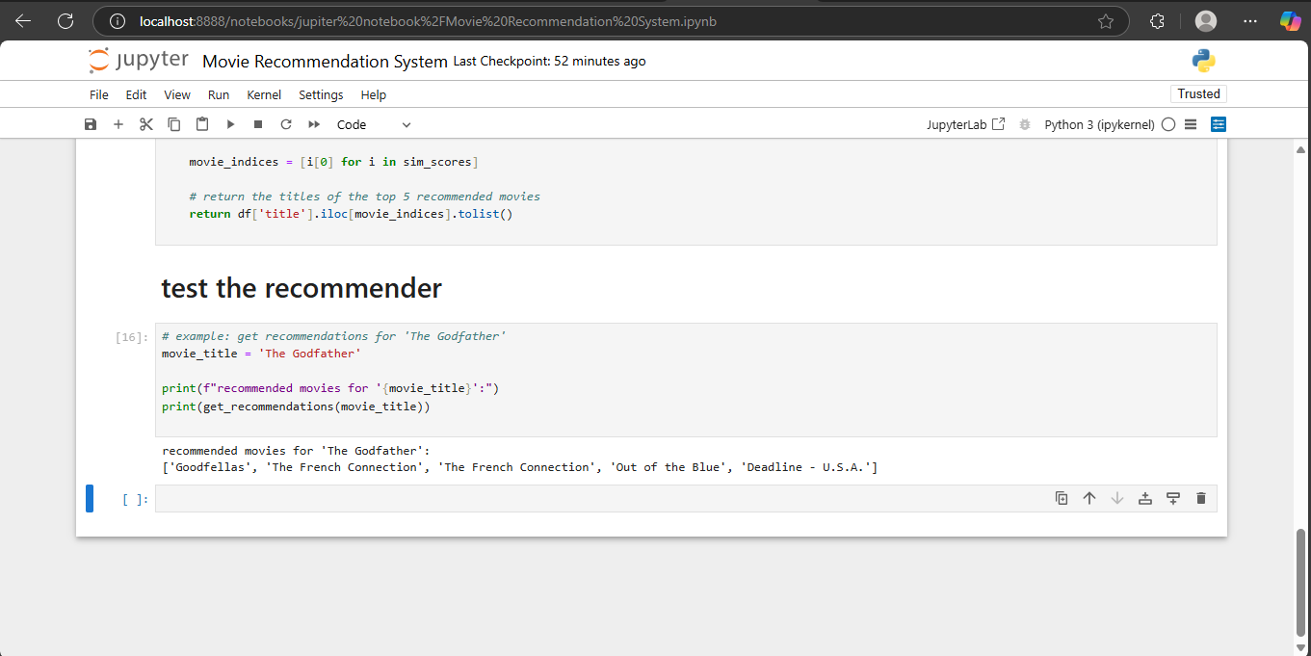
Result

Slide 8
Conclusion
This movie recommendation system gives good suggestions based on keywords. it is helpful for users who want to discover similar movies. it works well and can be improved further by adding more features in future.

Slide 9
Future scope
we can include ratings and user reviews to make the system smarter
can create a web version using flask or streamlit
search box can be made better using fuzzy search or auto-suggestions
more data can be added like genres, actors, and directors

Slide 10
References
kaggle dataset: https://www.kaggle.com/datasets/karrrimba/movie-metadatacsv
scikit-learn documentation: https://scikit-learn.org
pandas documentation: https://pandas.pydata.org
github project repo: https://github.com/siddquy2004/Movie_Recommendation_System_AICTE

Slide 11
Thank you

