Slide 1
Better Learning
A Mobile Application for early detection and intervention for
Speech and Learning related Learning Disabilities using
Natural Language Understanding (NLU) and Deep Learning Systems

Slide 2
Introduction
Project Goals
Create a low cost and accessible tool to assess and detect speech and language related disabilities among young kids
Evaluate and use the latest advances in Artificial Intelligence technologies for Natural Language Understanding and Deep Learning to create a solution for detection of speech and language related disabilities

Slide 3
Background and Research
Speech and Language related learning disabilities are very common among young kids. Impact educational learning among kids.
Early detection and intervention of disabilities can make a positive difference in a kid’s life.
Clinical assessments and evaluations for speech and language related disabilities are expensive and inaccessible to most kids and parents.

Slide 4
Background: Learning Disabilities
As per Individuals with Disabilities Act (IDEA)
“Speech and language impairments tend to emerge at a young age, and the earlier a child is diagnosed and receives services accordingly, the more likely a child can outgrow the disability.”
“Educational Challenges for kids:
Communicating effectively with classmates and teachers
Understanding and/or giving oral presentations
Participating in classroom discussion”

Slide 5
Hypothesis
Mobile application is a good medium for assessment and evaluation of such disabilities, specific for kids who are natural users of smartphones and tablets.
Artificial Intelligence, Natural Language Understanding (NLU) and Deep Learning systems have become viable technology choices for solutions to these problems.
Focus on the target of 5-8 years old kids as early detection and intervention of disabilities is important.
Assessment tests should be based on existing research and standardized tests used in medical community.

Slide 6
Experiment Design
Create a mobile application for iPhone and iPad devices
Create speech recognition models focused only on English
Use Amazon Web Services (AWS) Cloud platform for the backend of my application, Natural Language Understanding (NLU) and Deep Learning
Identify the tests based on existing standardized tests; I chose CELF 5 (Clinical Evaluation of Language Fundamentals)
Train the NLU speech models with speech phrases and utterances working with 5-8 years old kids
Conduct assessment test runs to tune data
Note: For medical and ethical concerns, I didn’t conduct any tests that indicate absence or presence of learning disabilities among human subjects

Slide 7
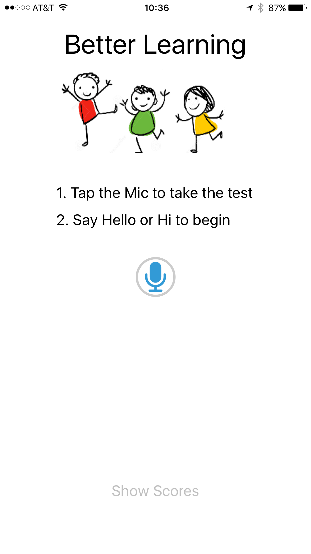



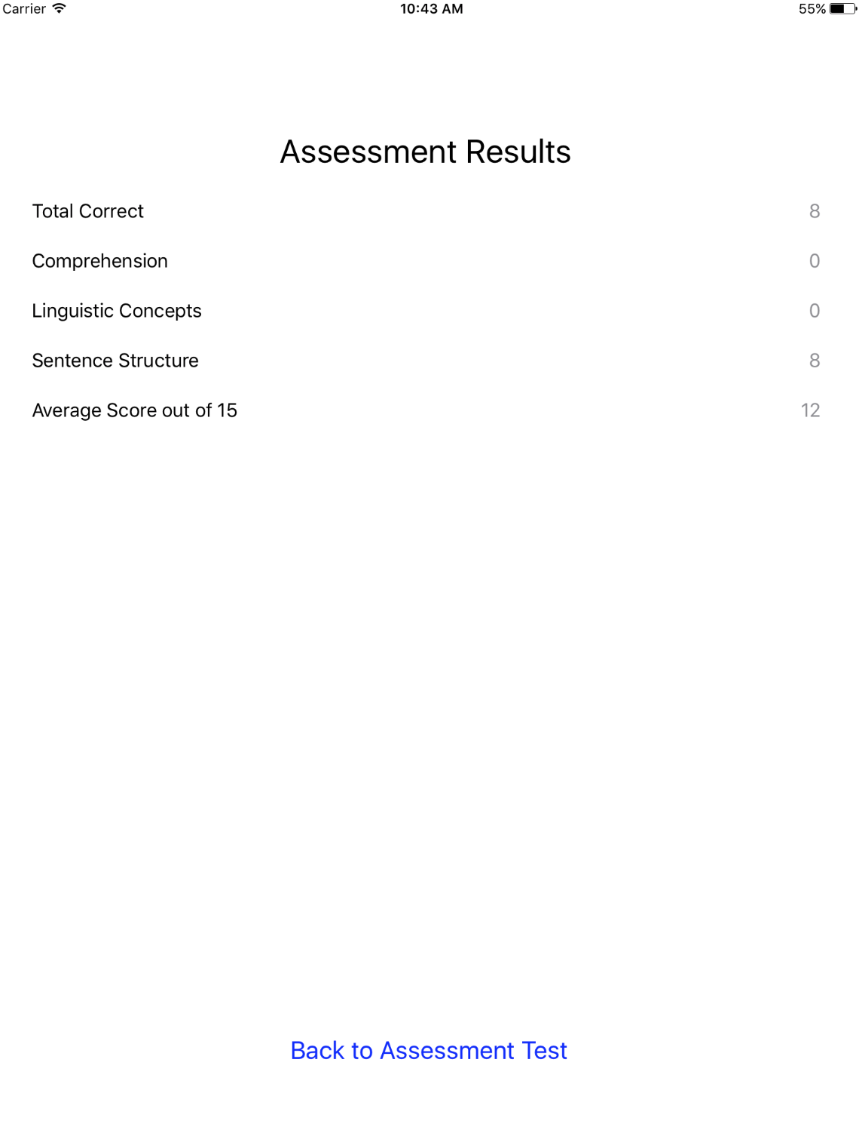
Design of Application
3
Update speech models, training models
or store assessment results
Use for Natural Language
Understanding
2
Better Learning
Assessment Tests and Speech Models
BetterLearning
Application
Amazon Lex
NLU and Deep Learning
Assessment Results
Take assessment or
train models
4
Return Assessment results
to mobile app
1
Assessment Results

Slide 8
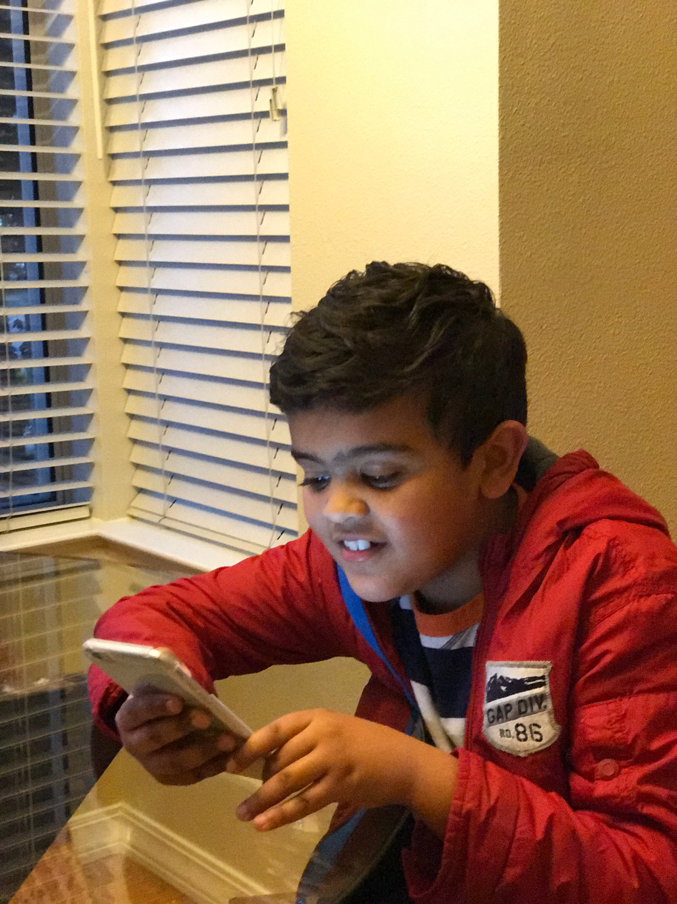
Experiment Setup and Procedure
Tap on Mic button to take the assessment test
Qualification of kids eligibility to take the assessment
Series of interactive questions using natural language; three set of tests
Utterances and responses processed using Automated Speech Recognition (ASR) model and deep learning
Results computed for assessment
Show Assessment results grouped by each category of assessment tests
Average scores across all assessment tests

Slide 9
Clinical Evaluation of Language Fundamentals
Test Categories chosen:
Sentence Comprehension
Linguistic Concepts
Word Structure
Word Classes
Following Directions
Formulated Sentences
Recalling Sentence
Spoken Paragraphs
Pragmatics Profiles
Test Type | Sample Question
Sentence Comprehension | The girl has a big, spotted, black dog. What color is the dog?
Sentence Comprehension | The quick brown fox jumps over the lazy dog. What color is the fox?
Linguistic Concepts | Here is one cup. Here is one more cup. How many cups are there?
Linguistic Concepts | Which of these is not an animal, Cat, Dog, Book, Tiger, Elephant
Sentence Structure | Tim said, these toys are mine. Who do these toys belong to?
Sentence Structure | A lion is big, but an elephant is even bigger. Who is bigger, lion or elephant?

Slide 10
Experiment Data

Slide 11
Experiment Data

Slide 12
Experiment Results
5-8 year old kids found the tests easy to take; 23 sessions conducted with 73% to 78% success completion rate based on the type of the tests. Reasons for failed tests:
Automated speech recognition failed to understand speech response
Kid couldn’t understand spoken instruction
Average correct answer rate ranged from 2.69 to 3.34 (out of 5) across the three test categories:
Sentence comprehension with the highest average score while Sentence Structure has the lowest

Slide 13
Learnings and Challenges
Training of Speech models for Automated Speech Recognition and NLU is a complex process: required > 30 sample responses and utterances for each test question
Accuracy of NLU depends on the training data; Also only English language is supported for speech recognition
NLU tools are still evolving in maturity: Number of failed-to-complete assessments because of Automated Speech Recognition was close to 25% for each test category

Slide 14
Conclusion and Discussion
Better Learning Mobile application can be a potential low cost and easy to use substitute for expensive and less accessible clinical evaluation tools (such as CELF) for early detection of learning disabilities.
Artificial Intelligence tools for Natural Language Understanding and Deep Learning technologies are still evolving. As the accuracy increases, these technologies will help in medical advances.

Slide 15
Thanks
My dad and mom for providing encouragement and guidance
Mr. Kevin Adams for being my school mentor on this science project
My dad also guided me on iPhone/iPad app and getting started on Amazon Web Services
Amazon Web Services (AWS) Lex team, specifically Harshal Pimpalkhute and Kartik Nagarajan, for working with me on Natural Language Understanding and tuning/training the speech models
My younger 8 year old brother Dhruv for being the input and trainer for the NLU models
Karen Mathen for being my mentor on this project
Dr. Pronoti Nigam for her advice as a medical expert

Slide 16
References
IDEA definition of Speech and Language Impairments: http://www.specialeducationguide.com/disability-profiles/speech-and-language-impairments/
Automated screening for child communication disorders: http://news.mit.edu/2016/automated-screening-childhood-communication-disorders-0922
Tests that professional use for detection of learning disabilities http://dyslexiahelp.umich.edu/dyslexics/learn-about-dyslexia/dyslexia-testing/tests
American Speech-Language Hearing Association (ASHA) Language-based Learning Disabilities http://www.asha.org/public/speech/disorders/LBLD.htm
Understood.org https://www.understood.org/en/learning-attention-issues/child-learning-disabilities/listening-comprehension-issues/understanding-your-childs-trouble-with-listening-comprehension
Deep Learning systems https://www.technologyreview.com/s/513696/deep-learning/
Natural Language Processing http://research.google.com/pubs/NaturalLanguageProcessing.html

Slide 17
Next Steps and Further Research
Extend the application and tests to other assessment categories
Add more languages (just English is supported now) and more age categories
Analyze more standardized tests for medical and clinical evaluations, and apply to my application
Collect more training data for speech models and learning models
Perform detailed scientific and mathematical analysis of test data
Area under the curve for ROC analysis
False positives
With low false positive, indicate learning disabilities for human subjects under test

