Slide 1

POWER MENU CONTROLS
PPS Mini Project | Roll Nos – 55 to 60

Slide 2
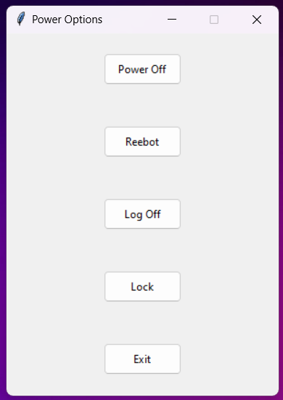
WHAT DOES IT LOOK LIKE ?
tkinter window
root
Buttons

Slide 3
Power Menu Controls This Program allows you to control various power aspects of your PC
Shutting Down your PC
Restarting your PC
Signing Out
Locking your PC

Slide 4

Prerequisites
Python
Basic Knowledge about Python
Importing and Using Modules
TKINTER and OS
Basic User Interface Designing Knowledge
Using the Internet

Slide 5
Program Code
import os
import tkinter as tk
from tkinter import ttk
# FUNCTION DEFINITIONS
def shutdown():
os.system("shutdown /s /t 1")
def reboot():
os.system("shutdown /r /t 1")
def logoff():
os.system("shutdown /l")
def lockpc():
os.system(r'"C:\Windows\System32\rundll32.exe user32.dll,LockWorkStation"')
# TKINTER WINDOW
root = tk.Tk()
root.geometry('300x400')
root.resizable(False, False)
root.title('Power Options')

Slide 6
# SHUTDOWN BUTTONS
shutd_button = ttk.Button(
root,
text = "Power Off",
command = shutdown
)
shutd_button.pack(
ipadx=5,
ipady=5,
expand=True
)
# REEBOT BUTTON
reboot_button = ttk.Button(
root,
text = "Reebot",
command = reboot
)
reboot_button.pack(
ipadx=5,
ipady=5,
expand=True
)
# LOG OFF BUTTON
logoff_button = ttk.Button(
root,
text = "Log Off",
command = logoff
)
logoff_button.pack(
ipadx=5,
ipady=5,
expand=True
)
# LOCK BUTTON
lock_button = ttk.Button(
root,
text = "Lock",
command = lockpc
)
lock_button.pack(
ipadx=5,
ipady=5,
expand=True
)

Slide 7
# EXIT BUTTON
exit_button = ttk.Button(
root,
text = 'Exit',
command = lambda: root.quit()
)
exit_button.pack(
ipadx = 5,
ipady = 5,
expand = True
)
root.mainloop()

Slide 8
WHERE COULD IT HELP?
Controlling other PCs via SSH remotely It could help in controlling other PCs via SSH (Secure Shell Protocol) after adding some additional features E.g.: Selecting a particular PC (out of many) to shut down or reboot over the SSH
PC 1
We want
to turn of PC 2
Shutdown
Signal
YOUR
PC
SSH
SERVER
* Gross
Oversimplification
We send the power off signal to PC 2 via SSH
PC 2
Shutdown
Signal

Slide 9
IMPROVEMENTS ?
Improving the User Interface and User Experience
By Adding Icons and Images
By Adding a confirmation Dialogue
Make it OS Independent
Currently this works only on Windows. Rewrite the code so that it can work on Linux and MacOS as well

Slide 10
CONCLUSION
Through this project we have explored how to create a versatile GUI using TKINTER
As a future scope, the GUI may include features such as voice recog, sending emails and all in one interface, etc
Our project showcases the power of Python in creating interactive applications
We welcome you to feel free to customize and expand this GUIs to suit your needs
The possibilities are endless when it comes to Python and GUI development!

Slide 11

THANK YOU
Source Code is Available on GitHub
https://github.com/rototrash/kollege

