Slide 1
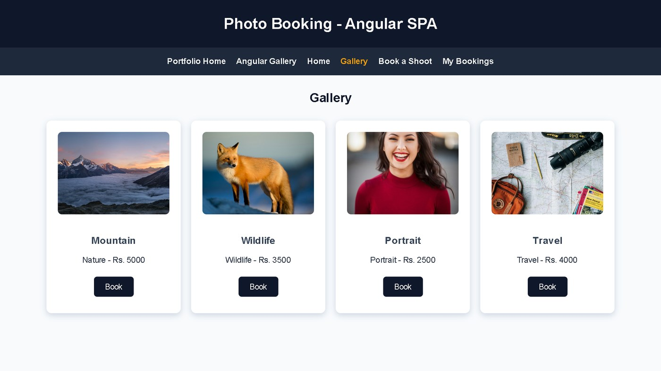
Department of Artificial Intelligence
& Machine Learning
ESSENTIALS OF WEB PROGRAMMING (EWP) · PROJECT PRESENTATION
LensFolio
Online Photography Portfolio & Shoot Booking App
Our live Angular gallery
Mapped to HTML · CSS · JavaScript · TypeScript · Angular
Roll No. | Team Members · AIML-C · III Year
24EG107C10 | Devarapalli Akshaya
24EG107C22 | Kasam Siddhartha
24EG107C54 | Syed Ibrahim Ahmed
24EG107C57 | Vellore Yashashwini
UNDER THE GUIDANCE OF
P. Chamundeshwari
Assistant Professor, Dept. of AI & ML
Notes:
Introduce the team and the project: LensFolio, a photography portfolio that grew from static HTML pages into an Angular single-page booking app.

Slide 2

Abstract & Problem Statement
INTRODUCTION
Abstract
LensFolio is an online photography portfolio built up across the EWP lab weeks. Visitors log in, browse a searchable photo catalogue, view photographer data loaded with AJAX from JSON and XML, and contact a photographer through a REST API. The journey ends in an Angular single-page app where clients browse the gallery, book a shoot with live form validation and see their bookings, all without a page reload.
Problem Statement
Independent photographers show their work on scattered social posts and take bookings over calls, so clients cannot browse categories, compare prices and request a shoot in one place.
12
lab modules
5
core web technologies
2
Angular apps
4
SPA routes
Notes:
Read the abstract briefly, then state the problem: no single place for a client to browse and book a photographer.

Slide 3


Objectives & Proposed System
INTRODUCTION
Objectives
Proposed System
01
Build a consistent multi-page portfolio with semantic HTML5 and one shared CSS3 stylesheet
One portfolio site where every module is linked from a shared navbar. The Angular SPA lets a client pick a photo category, book a shoot with instant validation and review bookings, with no page reloads.
02
Add interactivity with JavaScript: form validation, live search and AJAX data loading
Searchable photo catalogue & gallery
03
Rebuild the key flow in TypeScript and Angular as a single-page booking app
Photographer data via JSON / XML
Validated booking form + My Bookings
Notes:
Three objectives map to the three stages of the course: HTML/CSS, JavaScript, then TypeScript and Angular.

Slide 4






Technologies & Architecture
SYSTEM DESIGN
User
HTML + CSS
JavaScript
TypeScript
Angular SPA
Browser
Pages · style.css
DOM · fetch / AJAX
Interfaces · Classes
Components · Services · Router
STYLING
DATA & APIS
TOOLS
Custom CSS3: external style.css, Grid cards, hover effects
XML + DTD, JSON files, JSONPlaceholder REST API
Angular CLI 21, VS Code, Git & GitHub, Live Server
HOW A VISITOR MOVES THROUGH THE SITE
Login
›
Home
›
Catalogue
›
Photographer Data
›
Contact
›
Angular Gallery
›
Book a Shoot
›
My Bookings
Red steps run inside Angular
Notes:
Walk the flow left to right: the browser loads HTML pages styled by CSS, JavaScript adds behaviour and fetches data, TypeScript adds types, and Angular ties it into a single-page app.

Slide 5

Project Mapping to Course Concepts
HTML · CSS · JAVASCRIPT · TYPESCRIPT · ANGULAR
Concept | Where used in our project | Member
HTML5 Structure & Forms | login, home & register pages; nav, img, lists, form inputs (Wk 1–2) | Devarapalli Akshaya
CSS3 Styling | Inline, internal & external style.css; Grid cards, hover (Wk 3) | Devarapalli Akshaya
JavaScript & DOM | validation.js form checks; catalogue.js live search (Wk 4–5) | Kasam Siddhartha
XML, JSON & AJAX | photographers.xml + DTD; fetch() GET and REST POST (Wk 6–10) | Kasam Siddhartha
TypeScript | portfolio.ts: interface Photo, class Photographer, tsc (Wk 11) | Vellore Yashashwini
Angular Components & Binding | PhotoCard, @Input / @Output, *ngFor, ngClass, appHighlight (Wk 12) | Vellore Yashashwini
Angular CLI, Services & DI | ng new / serve / build; PhotoService, BookingService (Wk 13–14) | Syed Ibrahim Ahmed
Angular Forms & Routing | Template-driven booking form; 4 routes + routerLink (Wk 13–14) | Syed Ibrahim Ahmed
Notes:
Each concept from the syllabus and where it lives in the project, with the member who built it.

Slide 6

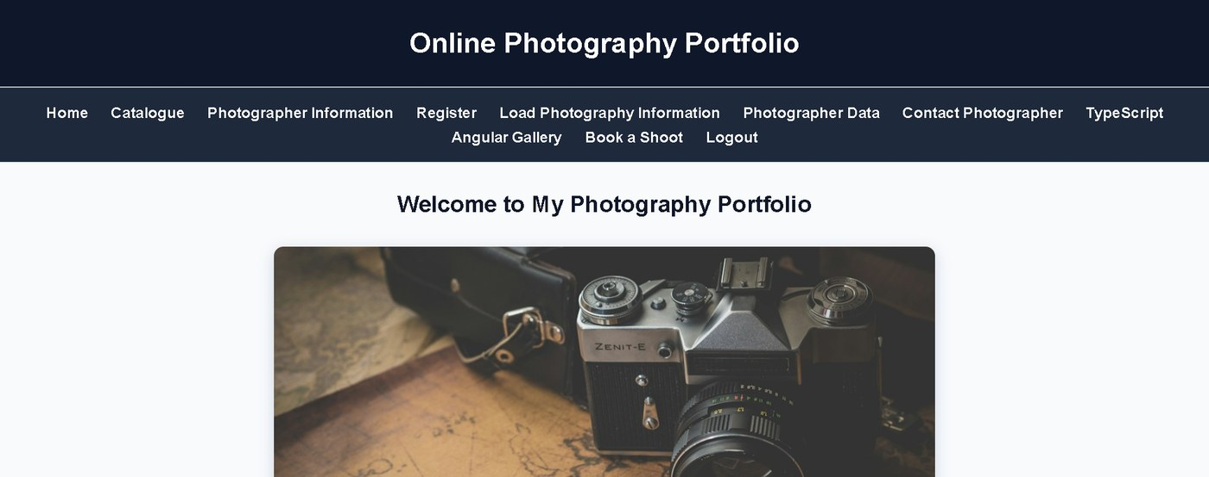
Pages & Styling
HTML5 & CSS3 · STRUCTURE AND STYLE
Front-end foundation
10+ linked pages share one navbar, from Login to Book a Shoot
Forms use text, email, tel, password, select and submit inputs
A single external style.css (~55 rules) themes every page
week_1/home.html styled by week_3/style.css
HTML5 Tags
CSS Methods
Layout & Effects
<nav> · <form> · <img> · <ul>
inline · internal · external
grid · :hover · box-shadow
Used in: Home, Login, Register
Used in: Week 3 comparison pages
Used in: catalogue & photo cards
Notes:
HTML gives every page its structure; one external stylesheet keeps the look consistent. Week 3 compared inline, internal and external CSS.

Slide 7

Interactivity & Typed Code
JAVASCRIPT · AJAX · TYPESCRIPT
JavaScript & AJAX
TypeScript
validation.js: email, 10-digit phone, password match
catalogue.js: live search filters photo cards
fetch(): GET TXT / JSON / XML, POST to REST API
interface Photo + class Photographer, typed members
Compiled by tsc (tsconfig.json) into portfolio.js
Output: portfolio total shown as Rs. 8500
fetch("photographers.json") // GET
.then(response => response.json())
.then(data => showCards(data));
fetch(API_URL, { // POST
method: "POST",
headers: { "Content-Type": "application/json" },
body: JSON.stringify(payload)
});
interface Photo {
title: string;
price: number;
}
class Photographer {
constructor(public name: string,
public photos: Photo[]) { }
total(): number {
return this.photos.reduce(
(sum, p) => sum + p.price, 0);
}
}
Notes:
JavaScript validates forms, filters the catalogue and talks to servers with fetch. TypeScript adds an interface and a class so mistakes are caught at compile time.

Slide 8
Components & Data Binding
ANGULAR · CLI, COMPONENTS, TEMPLATES & DIRECTIVES
Components in our project
@Component({
selector: 'app-photo-card',
imports: [NgIf, NgClass, HighlightDirective],
templateUrl: './photo-card.component.html'
})
export class PhotoCardComponent {
@Input() photo!: Photo;
@Output() liked = new EventEmitter<string>();
}
Created with ng new and ng generate; run with ng serve
Week 12: AppComponent + child PhotoCard
Week 13–14: Home, Gallery, Booking, Bookings pages
Standalone components + app.config.ts
Data Binding
Directives
Parent ↔ Child
{{ }} · [photo] · (click)
[(ngModel)]
*ngIf · *ngFor
ngClass · ngStyle
@Input() · @Output()
EventEmitter
Used in: search box & Like button
Custom: appHighlight on hover
Used in: likes counter
Notes:
The parent passes each photo down with property binding; the card sends a 'liked' event back up. ngClass colours the price, and our own appHighlight directive tints a card on hover.

Slide 9

Services, Forms & Routing
ANGULAR · SERVICES, DI, FORMS & ROUTING
Services & Template-Driven Form
Routing & Navigation
PhotoService & BookingService (providedIn: 'root') injected into Gallery, Booking & Bookings
Rules: required, minlength 3, email; Book Now stays disabled until valid
Routes: /, /gallery, /book, /bookings; unknown paths go home
routerLink + routerLinkActive in navbar · <router-outlet> in AppComponent; Book passes ?category=
@Injectable({ providedIn: 'root' })
export class BookingService { ... }
<input name="email" [(ngModel)]="booking.email"
#email="ngModel" required email>
<button [disabled]="bookingForm.invalid">
export const routes: Routes = [
{ path: '', component: HomeComponent },
{ path: 'gallery', component: GalleryComponent },
{ path: 'book', component: BookingComponent },
{ path: 'bookings', component: BookingsComponent },
{ path: '**', redirectTo: '' }
];
Notes:
Services hold the photo list and the bookings so every page shares the same data. The booking form is template-driven with ngModel; routing swaps pages without reloading.

Slide 10

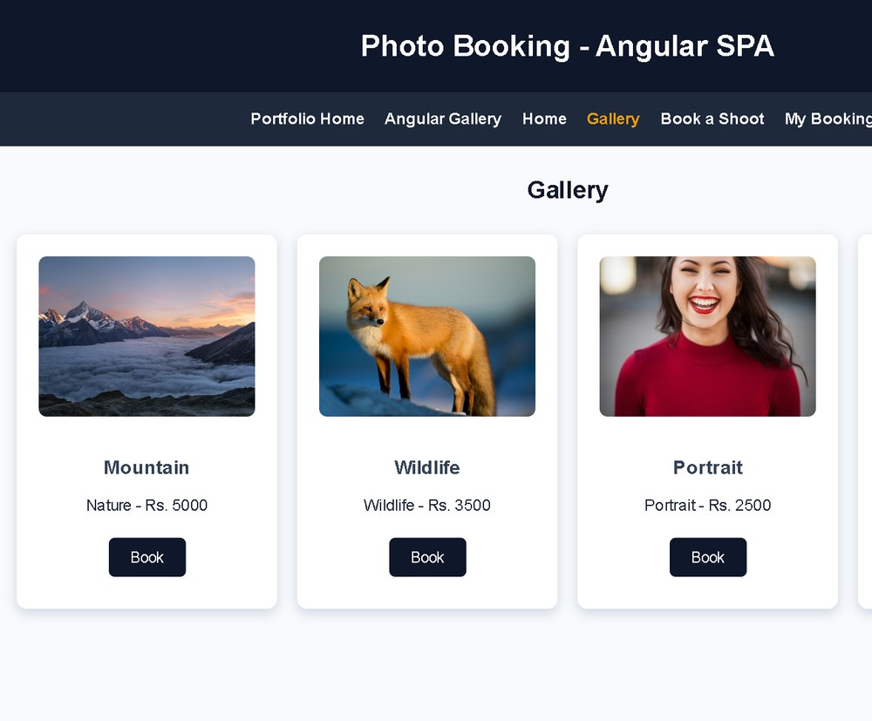
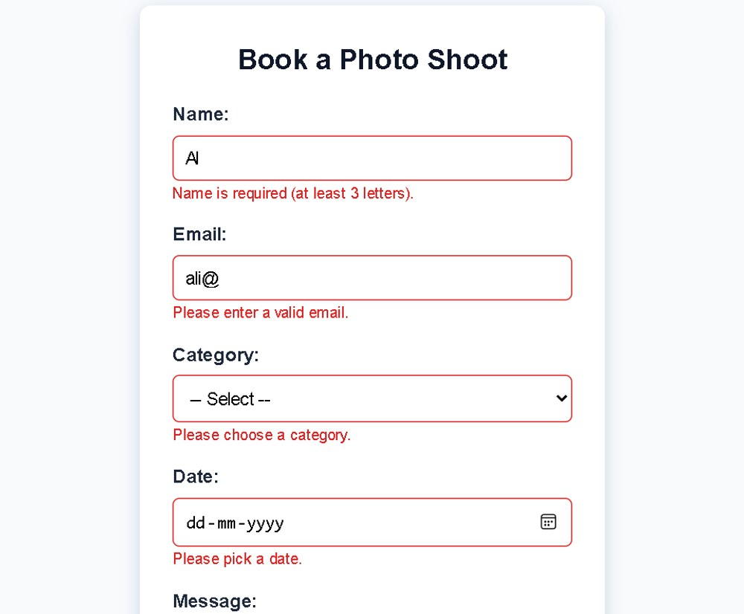
Output & Results
OUTPUT
Results
10+ pages, one shared theme
Live search & JS validation
JSON / XML via AJAX + POST
SPA: gallery → book → bookings
Runs on Live Server & ng serve
Angular gallery (/gallery)
Booking form with validation
Every module is reachable from the portfolio navbar, and both Angular apps are built into /output folders that open straight from the site.
Notes:
Show the live gallery, then the booking form: errors appear as you type and the button stays disabled until the form is valid.

Slide 11

Conclusion & Future Scope
WRAP-UP
Conclusion
Future Scope
LensFolio grew from static HTML and CSS into a working Angular SPA. Along the way we applied DOM scripting, AJAX with JSON and XML, TypeScript types, and Angular components, services, forms and routing.
Login with route guards for photographers
Node.js / Firebase backend via HttpClient to save bookings
Reactive forms, currency & date pipes, photo uploads
REFERENCES
1. Angular Documentation – angular.dev
2. TypeScript Documentation – typescriptlang.org
3. MDN Web Docs – developer.mozilla.org
4. JSONPlaceholder – jsonplaceholder.typicode.com
5. Unsplash – unsplash.com (portfolio photos)
Notes:
Summarise what was built and the concepts applied, then the next steps.

Slide 12

Thank You
Questions?
AIML-C · LensFolio – Online Photography Portfolio

