Slide 1
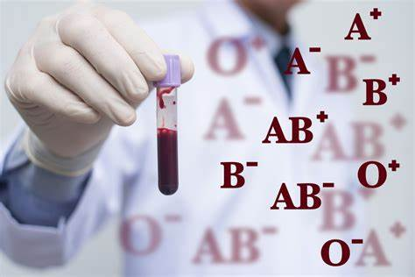
BLOOD GROUP PREDICTION BY FINGER PRINT IMAGES USING DEEP LEARNING TECHNIQUES

Slide 2
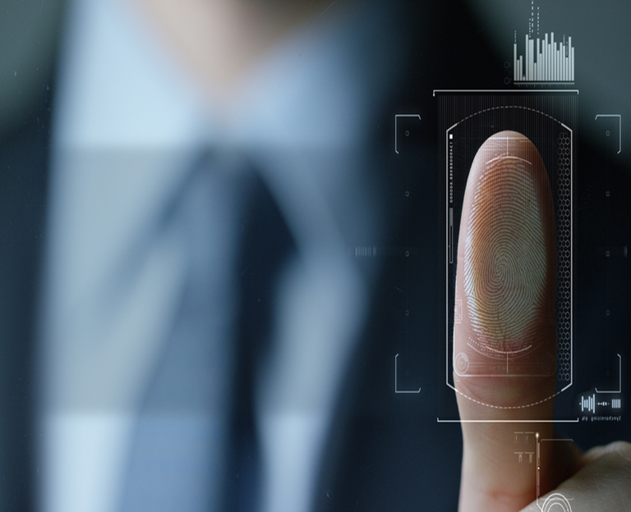
Introduction:
Blood group prediction is a crucial process in medical diagnostics and emergency care, traditionally carried out through serological tests that require blood samples and specialized laboratory equipment. These conventional methods, sometimes inaccurate, are invasive, time-consuming, and may be impractical in situations where resources are limited or unavailable in urgent situations. This research explores a novel approach of using fingerprint images for blood group detection, applying deep learning, specifically Convolutional Neural Networks (CNN) with good architectures. By analyzing the unique patterns in fingerprints, these models may offer a non-invasive, faster, and more efficient alternative to traditional methods. This study examines the feasibility of this approach, providing insights into how deep learning could potentially be utilized for blood group prediction.

Slide 3
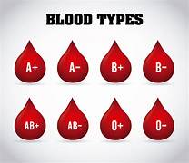
Types of Blood Group in Real Time
In real-life, blood groups are classified based on the presence of specific antigens on the surface of red blood cells. The two most important blood group systems are the ABO system and the Rh (Rhesus) factor. Here’s a breakdown

Slide 4
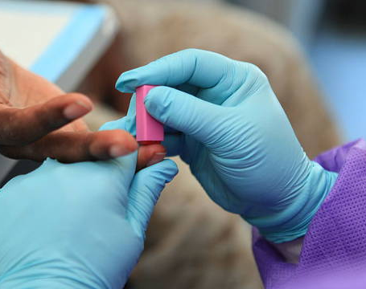
Existing methods to identify Blood Group
. Serological Testing (Traditional)
1) ABO & Rh Typing: Uses antigen-antibody reactions to detect blood type based on clumping.
2) Cross-Matching: Ensures compatibility before transfusions.
Automated Blood Typing Systems
Automated Analyzers: Rapid and accurate results using optical sensors in labs and hospitals.
Molecular (DNA-Based) Testing
Analyzes genes responsible for blood group antigens; useful in complex cases.
Rapid Blood Typing Kits
Portable and quick, used in emergencies and field settings.

Slide 5

Drawbacks on Present Methods
Serological Testing
. Requires blood samples; invasive and uncomfortable.
. Relies on lab facilities, which may be unavailable in remote or emergency situations.
2) Automated Blood Typing Systems
. High cost; equipment is expensive and requires maintenance.
. Primarily suitable for large hospitals and labs, not accessible everywhere.
3) Molecular (DNA-Based) Testing
. Complex, time-consuming, and costly.
. Not practical for routine use due to specialized equipment needs.
4) Rapid Blood Typing Kits
. Limited accuracy compared to lab tests.
. Kits may use only single time which cause in wastage of kits.

Slide 6

Literature Survey:
Research paper Name | Author Name | Journal Name | Published Date
A Novel Technique for Non-Invasive Measurement of Human Blood Component Levels From Fingertip Video Using DNN Based Models | Md. Rezwanul Haque, S. M. Taslim Uddin Raju, Md. Asaf-Uddowla Golap, And M. M. A. Hashem | IEEE | February 2021
A Novel Approach to Predict Blood Group using Fingerprint Map Reading | Vijaykumar Patil N,D.R Ingle | IEEE | April 2021
Relationship between Pattern of Fingerprints and Blood Groups | Yasmin Aamir, Riffat Masood, Nasim Irshad, Romana Malik, Noreen Farid, Muhammad Asif Shahab | Research Gate | September 2022
Blood group detection through finger print images using image processing (KNN) | G. Mounika, M. Anusha, D. Gopika, B. Siva kumari | IRJET | March 2023

Slide 7
Literature Survey:
Research paper Name | Author Name | Journal Name | Published Date
Relationship between pattern of fingerprints and blood groups | Harem Othman Smail, Dlnya Ahmed Wahab and Zhino Yahia Abdullah | Academia | July 2019
Fingerprint Based Blood Group Prediction Using Deep Learning | Swathi P , Sushmita K, Prof. Kavita V Horadi | IJARSCT | February 2024
Fingerprint patterns in relation to gender and blood groups - A study in Navi Mumbai | Amit Patil, Amrit Malik , Treza Shirole | Academia | September 2017
Relation between fingerprints and different blood groups | Noor Eldin Fayrouz MD, Asst. Professor a , Noor Farida MD, HOD b , A.H. Irshad PhD, Asst. Professor c | ElSEVIER | October 2011

Slide 8
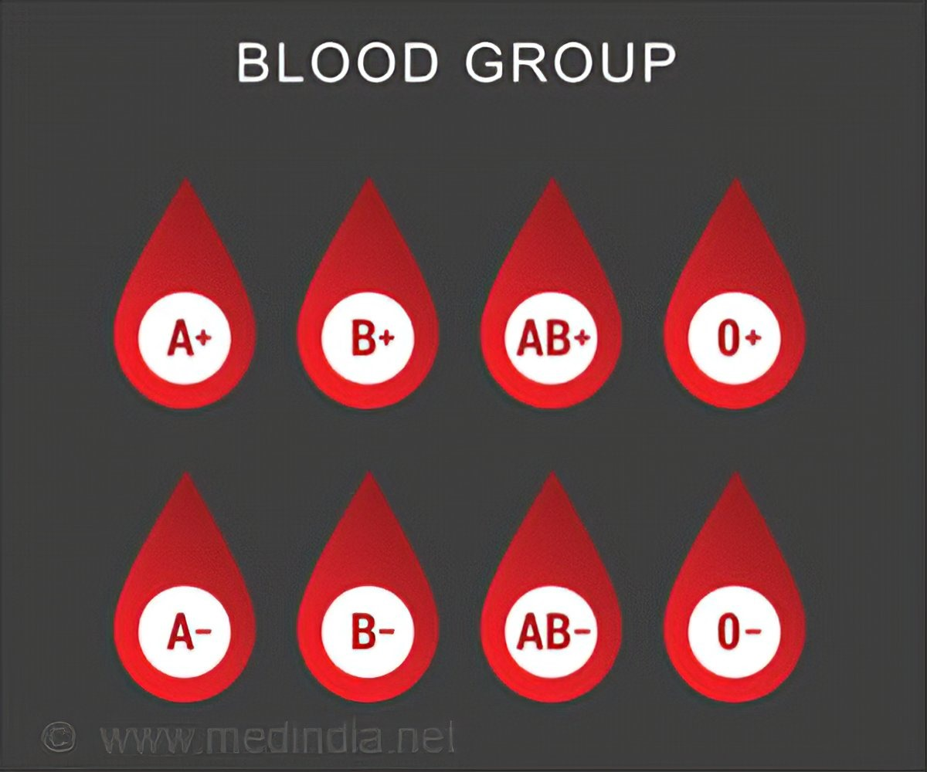
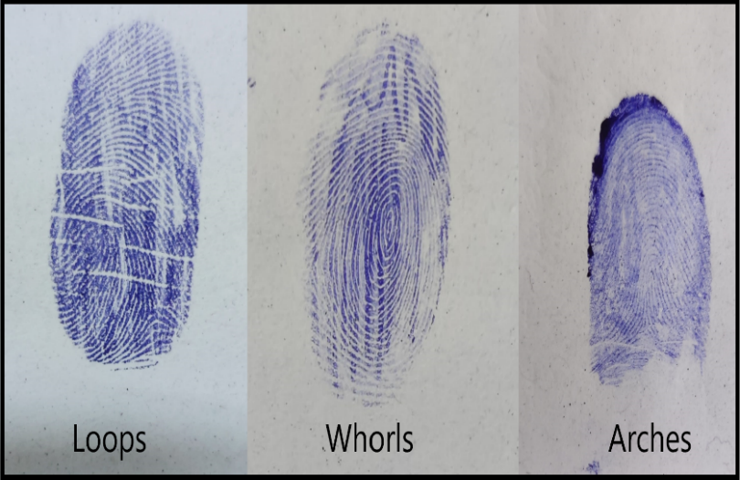
Objective:
Fingerprints, a fundamental feature, uniquely identify individuals due to the intricate patterns of ridges and valleys formed during the fetal stage, which remain unchanged throughout life. The primary patterns—loops, whorls , and arches along with minutiae points like bifurcations and ridge endings, make fingerprints invaluable for identification and security. Beyond traditional use, recent research suggests these patterns may carry biological information, including blood group indicators. Blood groups (A, B, AB, O) are vital for medical purposes like transfusions and transplants, typically identified through invasive serological methods .Our project explores the potential of non-invasive blood group detection using deep learning.

Slide 9
Objective:
Objectives of the Project:
1.To Investigate Feasibility:
2.To Develop a
Deep Learning Model:
3.To Build and Curate
a Dataset:
4.To Train and Optimize
the Model:
5.To Evaluate
Model Accuracy:
6.To Explore Practical Applications:
Assess the feasibility of using fingerprint images for blood group detection
by analyzing potential correlations between fingerprint patterns and blood groups.
Design and implement a deep learning model, specifically a convolutional neural network (CNN), capable of accurately classifying blood groups based on fingerprint images.
Collect and preprocess a diverse dataset of fingerprint images labeled with corresponding blood groups, ensuring data quality and representativeness.
Train the deep learning model on the curated dataset and optimize its performance through techniques such as hyperparameter tuning, data augmentation, and model validation.
Conduct rigorous testing of the model to evaluate its accuracy, precision, and generalization capabilities in predicting blood groups from fingerprint images.
Investigate the potential applications of this technology in healthcare, particularly as a non-invasive, rapid, and cost-effective alternative to traditional blood group testing methods.

Slide 10
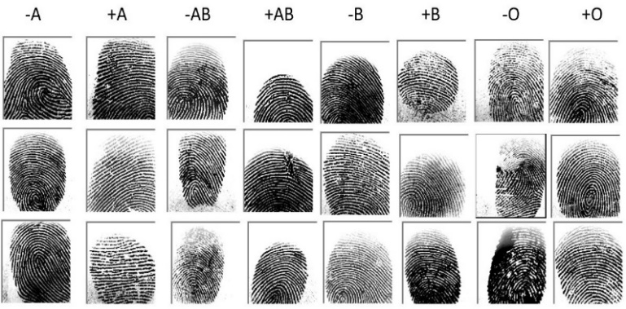
Dataset Collection
A dataset of 6,000 fingerprint images was collected from friends, students, peers in the college, and other sources like kaggle with each image labeled by blood group. The dataset was evenly distributed across the four primary blood groups A, B, AB, and O categorized into positive and negative types, as illustrated in Figure. To ensure diversity in fingerprint patterns, the images were sourced from a varied population, with each fingerprint accurately labeled with its corresponding blood group.

Slide 11
Proposed Methodology:
The proposed methodology for blood group detection using fingerprint images leverages advanced deep learning techniques. We begin by curating a large, diverse dataset of fingerprint images, carefully categorized by blood group. The dataset is preprocessed to enhance image quality and consistency through normalization and augmentation. Several Convolutional Neural Networks (CNNs) are then trained on this dataset to identify patterns within the fingerprints that correlate with specific blood groups. Rigorous validation methods are applied during training to optimize model performance and prevent overfitting. The model with the highest accuracy, precision, and recall is selected for deployment. After training the model, the system can predict a person's blood group from an uploaded fingerprint image, offering a quick, non-invasive alternative to traditional blood typing methods. This approach has the potential to significantly impact diagnostic practices, particularly in resource-limited settings.

Slide 12
Proposed Methodology
(Flow chart):
Data Collection
Data Preprocessing
Model Development
Model Evalution
Model Deployment
Future Directions

Slide 13
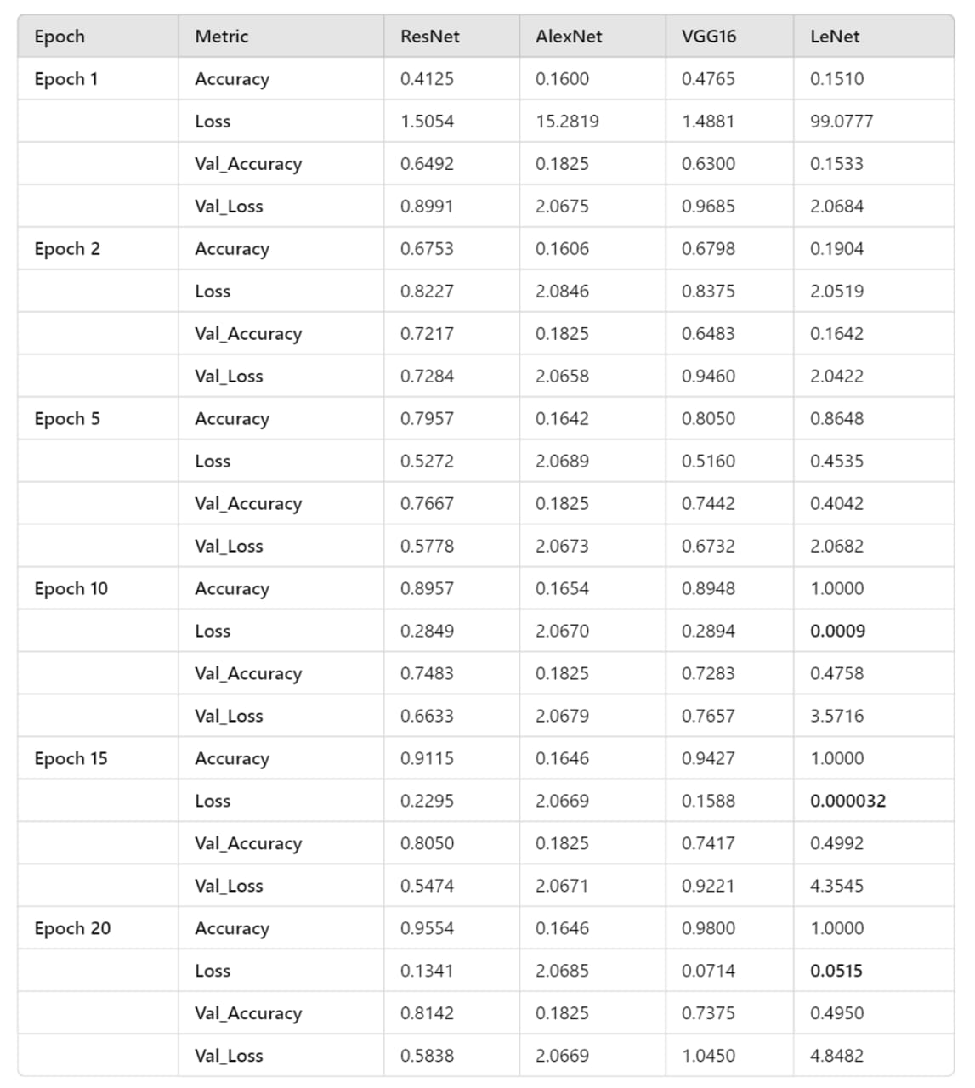
Comparision of Various Models

Slide 14
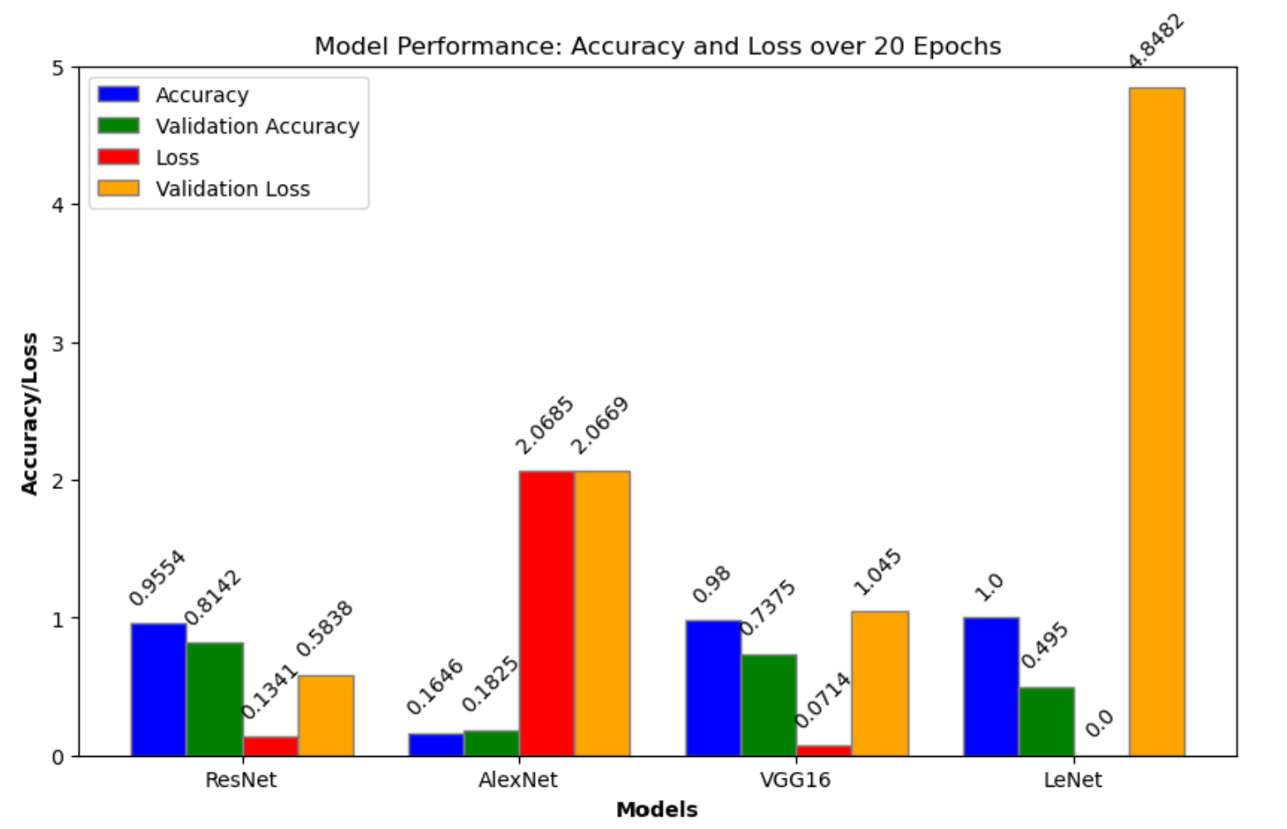
Performance Graph of Models
By comparing all the models ResNet34 emerged as the best-performing model, balancing high accuracy with low loss and strong validation performance, indicating good generalization. VGG16 also performed well but showed some signs of overfitting in later epochs. LeNet5, while achieving perfect accuracy, struggled with overfitting, as indicated by its high validation loss. Alex Net consistently underperformed across all epochs, with low accuracy and high loss, both on training and validation data.

Slide 15
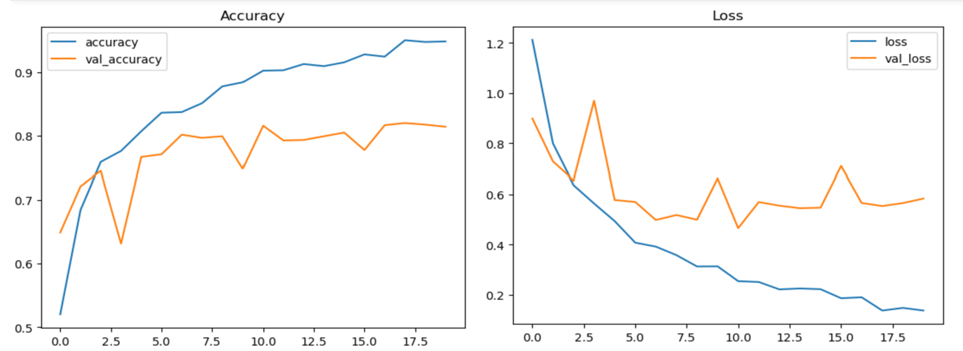
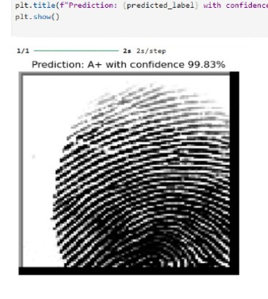
Result and Output:
Prediction of blood group using fingerprint image using resnet
Accuracy/loss results. Performance testing during model training of ResNet

Slide 16
Conclusion & Future Work:
In this evaluates four CNN architectures LeNet, Alex Net, VGG Net, and ResNet for predicting blood groups from fingerprint images. ResNet34 emerged as the most effective model, achieving an accuracy of 95.54% and a validation accuracy of 81.42%. Its depth, residual connections, and robust feature extraction capabilities enabled it to detect subtle fingerprint patterns associated with different blood groups. To advance this approach, future research could integrate additional biometric or genetic data, explore more sophisticated deep learning models, refine feature extraction techniques, and validate the model with larger and more diverse datasets, making fingerprint-based blood group detection more practical and reliable and it can be integrated with the real time data to get the output in our future research.

Slide 17
References
Nihar, T. & Yeswanth, K. & Prabhakar, K.. (2024). Blood group determination using fingerprint. MATEC Web of Conferences. 392. 10.1051/matecconf/202439201069.
P. N. Vijaykumar and D. R. Ingle, "A Novel Approach to Predict Blood Group using Fingerprint Map Reading," 2021 6th International Conference for Convergence in Technology (I2CT), Maharashtra, India, 2021, pp. 1-7, doi: 10.1109/I2CT51068.2021.9418114.
P, Swathi & K, Sushmita & Horadi, Prof. (2024). Fingerprint Based Blood Group using Deep Learning. International Journal of Advanced Research in Science, Communication and Technology. 699-708. 10.48175/IJARSCT-15393.
Patil, Amit, Amrit Malik, and Treza Shirole. "Fingerprint patterns in relation to gender and blood groups-A study in Navi Mumbai." Indian Journal of Forensic and Community Medicine 4, no. 3 (2017): 204-208.
Smail, Harem Othman, Dlnya Ahmed Wahab, and Zhino Yahia Abdullah. "Relationship between pattern of fingerprints and blood groups." J Adv Lab Res Biol 10, no. 3 (2019): 84-90.
Raja, D. Siva Sundhara, and J. Abinaya. "A cost-effective method for blood group detection using fingerprints." International Journal of Advance Study and Research Work 2 (2019).

Slide 18
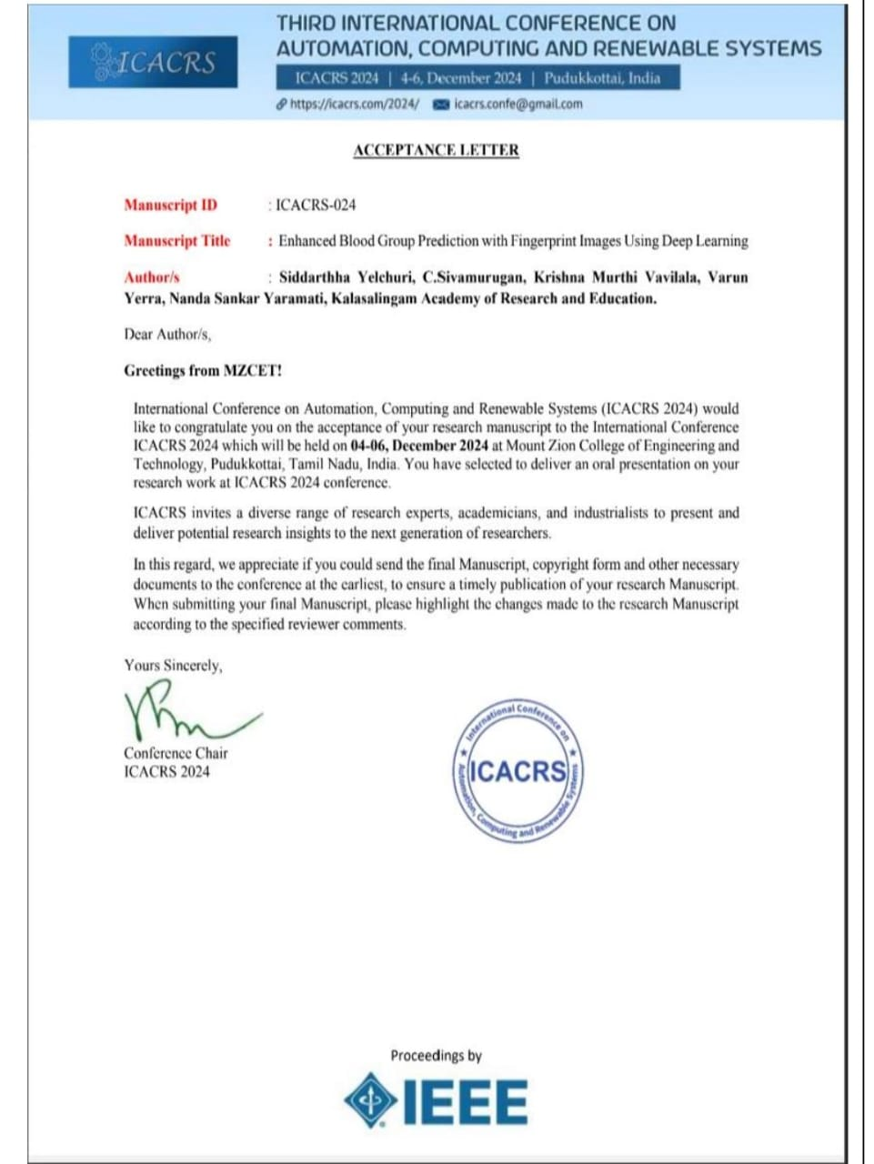
Publication

Slide 19



