Slide 1
BANK LOAN REPORT ANALYSIS
End-to-End Data Analytics Project
Excel
SQL Server
Power BI
Power Query
DAX
Siddu Varikuppala
linkedin.com/in/siddu-data | github.com/sidducv0528
Notes:
Introduce yourself and the project. Frame it as an end-to-end analytics project: SQL for data extraction and KPI logic, Power BI for interactive dashboards. State the goal in one sentence — this project shows how data analytics helps a bank monitor loan performance and improve lending decisions.

Slide 2
EXECUTIVE SUMMARY
Turning loan data into lending decisions
This project analyzes a 38,576-loan portfolio issued through 2021, using SQL to define and validate every KPI, and Power BI to turn that logic into an interactive report. The goal is simple: give lending teams a single, trusted view of how much has been funded, how much has been recovered, and where credit risk is concentrated — without waiting on manual, spreadsheet-driven reporting.
This dashboard delivers
✓
Better decision making
Trusted KPIs replace manual spreadsheet pulls
✓
Loan performance monitoring
Funded amount, collections, and MoM trend in one view
✓
Risk identification
Why loan analytics matters
Good vs bad loan split, surfaced by grade, term, purpose
Every additional day spent compiling reports manually is a day lending decisions run on stale numbers. Interactive dashboards answer “where is our risk today” in seconds, not weeks.
✓
Interactive reporting
Slicers for state, grade, and loan purpose — self-serve for any team
Bank Loan Report Analysis
2
Notes:
Deliver this in under a minute. Frame the business context: banks need faster, more reliable visibility into loan performance. Point to the four outcomes on the right as the concrete value this dashboard delivers to a lending or credit-risk team.

Slide 3
BUSINESS PROBLEM
Manual reporting can't keep pace with loan risk
!
The problem
✓
The analytics solution
●
Rising loan defaults erode portfolio value
●
SQL-validated KPIs give one trusted number for every metric
●
Manual, spreadsheet-based reporting is slow and error-prone
●
Power BI automates reporting — refresh replaces re-building
●
Decisions lag behind real-world loan performance
●
MTD / MoM tracking flags shifts as they happen
●
Limited real-time insight into risk concentration
●
Good vs Bad loan split quantifies risk in real time
●
High-risk borrower segments are hard to isolate
●
Grade, purpose, and term breakdowns isolate risk drivers
●
Portfolio performance is fragmented across teams
●
One interactive report, shared across every stakeholder
Bank Loan Report Analysis
3
Notes:
Frame the business pain first, then pivot to how analytics resolves each point one-for-one. Keep this conversational — the paired layout does the explaining, so narrate rather than read the slide.

Slide 4
PROJECT OBJECTIVES
What this project set out to do
1
2
3
4
Analyze applications
Track funded amounts
Monitor repayments
Measure loan quality
Track volume and composition of loan applications
Measure capital deployed across the portfolio
Compare amount received against amount funded
Classify loans as Good or Bad by outcome
5
6
7
8
Evaluate customer risk
Analyze regional trends
Build interactive dashboards
Support decision-making
Surface risk by grade, DTI, and interest rate
Compare performance across all 50 states
Self-serve reporting with slicers and drill-through
Turn findings into credit policy recommendations
Bank Loan Report Analysis
4
Notes:
Walk through the eight objectives as one continuous narrative: understand the book, measure its health, find the risk, and act on it. Emphasize that each objective maps directly to a page or visual in the final dashboard.

Slide 5
DATASET OVERVIEW
One record per loan, 24 attributes deep
38,576
Loan ID
Loan Amount / Funded Amount
Uniquely identifies each application
Capital requested and disbursed
Loan records
Loan Status
Purpose
Fully Paid, Current, or Charged Off
Stated reason for borrowing
24
Grade / Sub-Grade
Interest Rate
Bank's internal credit risk rating
Price of risk on the loan
Columns / attributes
Annual Income & DTI
Home Ownership
Borrower's repayment capacity
Rent, mortgage, or owned
50 states · 2021
Employment Length
Issue Date
Income stability proxy
Enables trend and cohort analysis
Geographic & time coverage
State
Enables regional risk comparison
Bank Loan Report Analysis
5
Notes:
Anchor the audience with real scale — 38,576 records, 24 fields, all 50 states, full year 2021. Then walk the field list quickly, pausing on Loan Status, Grade, and DTI since those drive the risk analysis later in the deck.

Slide 6
PROJECT WORKFLOW
From raw data to a business decision
Business
Problem
→
Raw Excel
Dataset
→
SQL Cleaning
& Analysis
↓
Power Query
& Data Model
→
DAX Measures
& Power BI
→
Insights &
Business Decisions
Each stage hands off a validated artifact to the next — SQL output feeds the Power BI model, and the model output is the dashboard leadership uses to act.
Bank Loan Report Analysis
6
Notes:
Walk left to right, top row then bottom row: the raw data is cleaned and analyzed in SQL first, then that validated logic is rebuilt in Power Query and DAX, ending in a dashboard that drives real lending decisions.

Slide 7
DATA PREPARATION
Clean data is the foundation of a trusted dashboard
Cleaning steps applied
Before
After
1
Removing duplicate loan records
✕ Inconsistent status labels
✓ Standardized 3-status field
2
Handling missing / null values
✕ Unformatted date fields
✓ Clean date-typed columns
3
Standardizing categorical fields (status, purpose, grade)
✕ Mixed data types
✓ Correct numeric / % types
4
Converting and formatting issue / payment dates
✕ Unverified totals
✓ Totals reconciled to source
5
Correcting data types (rates, currency, ratios)
6
Validating totals against source before reporting
Bank Loan Report Analysis
7
Notes:
Emphasize that reporting is only as trustworthy as the data behind it. Walk through the six cleaning steps briefly, then use the before/after panel to make the impact concrete.

Slide 8
SQL DATA ANALYSIS
Every KPI on the dashboard starts as a query
Example — Good Loan Percentage
What SQL answered
SELECT
(COUNT(CASE WHEN loan_status = 'Fully Paid'
OR loan_status = 'Current' THEN id END)
* 100.0) / COUNT(id) AS Good_Loan_Pct
FROM bank_loan_data;
▸
Total applications & funded amount
38,576 loans · $435.76M
▸
Amount received vs funded
$473.07M received
SQL techniques applied
▸
Average interest rate & DTI
12.05% · 13.33%
GROUP BY
CASE WHEN
Aggregate functions
▸
Good vs Bad loan split
Window functions
CTEs
JOINs
86.18% · 13.82%
▸
Trend by month, state, grade, purpose
Full breakdown tables
Bank Loan Report Analysis
8
Notes:
Show one real query as proof of technical depth, then pivot to the results panel to connect it to business numbers the audience already cares about. This is the slide most likely to get a technical follow-up question, so know the query cold.

Slide 9
POWER BI DEVELOPMENT
From validated query logic to an interactive report
→
→
1
2
3
Import data
Power Query
Data modeling
Excel source loaded into Power BI
Shape and transform before modeling
Define relationships and structure
→
→
4
5
6
DAX measures
Visuals & KPIs
Slicers & interactivity
Rebuild validated SQL KPI logic
Cards, trends, and breakdown charts
State, grade, purpose, term filters
Bank Loan Report Analysis
9
Notes:
Present this as one continuous pipeline, not six separate tasks. The key point: nothing here is guesswork — every DAX measure mirrors a SQL query already validated in the previous stage.

Slide 10
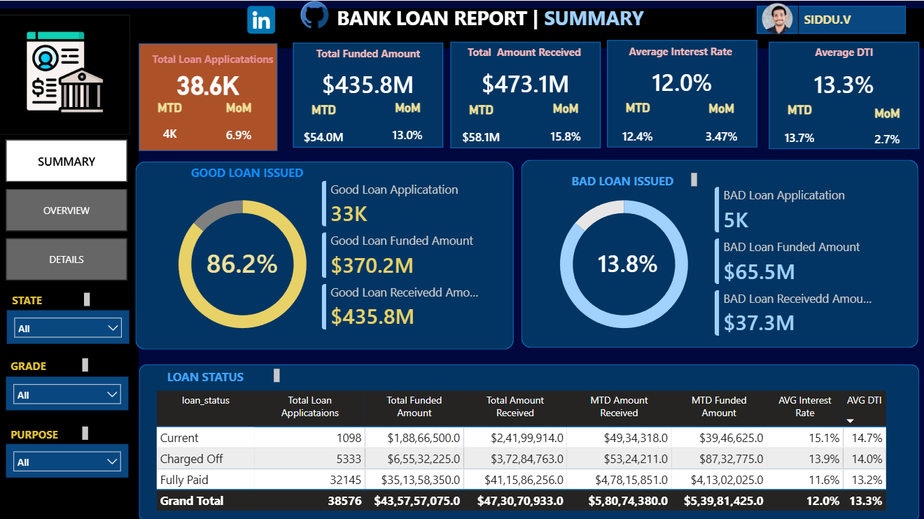
DASHBOARD OVERVIEW
The Summary page — one screen, full portfolio health
What this page shows
●
38,576 applications
MoM +6.9%
●
$435.8M funded
MoM +13.0%
●
$473.1M received
MoM +15.8%
●
86.2% Good Loans
vs 13.8% Charged Off
●
Loan status grid
Current · Charged Off · Fully Paid
Filters for State, Grade, and Purpose let any stakeholder self-serve their own slice of the portfolio.
Bank Loan Report Analysis
10
Notes:
Give a high-level walkthrough: KPI cards up top, Good vs Bad loan split as the headline risk view, and the loan status table underneath for the full breakdown. Tell the audience this is the landing page — the next section of the deck goes deeper into the Overview and Details pages.

Slide 11
SUMMARY DASHBOARD ANALYSIS
Portfolio health, one screen at a time
Good vs Bad Loan performance
Good Loans
33,243 apps · 86.18%
Funded $370.2M · Received $435.8M
Bad Loans (Charged Off)
5,333 apps · 13.82%
Funded $65.5M · Received only $37.3M
Loan status distribution
● Fully Paid — 32,145 loans
● Charged Off — 5,333 loans
● Current — 1,098 loans
Bank Loan Report Analysis
11
Notes:
Walk executives through the Summary page top to bottom: headline KPIs, then the Good vs Bad loan split as the primary risk signal, then the loan-status table for the full reconciliation. The key executive takeaway is that collections ($473M) exceed funding ($436M) portfolio-wide, even though charged-off loans recover only 57 cents on the dollar.

Slide 12
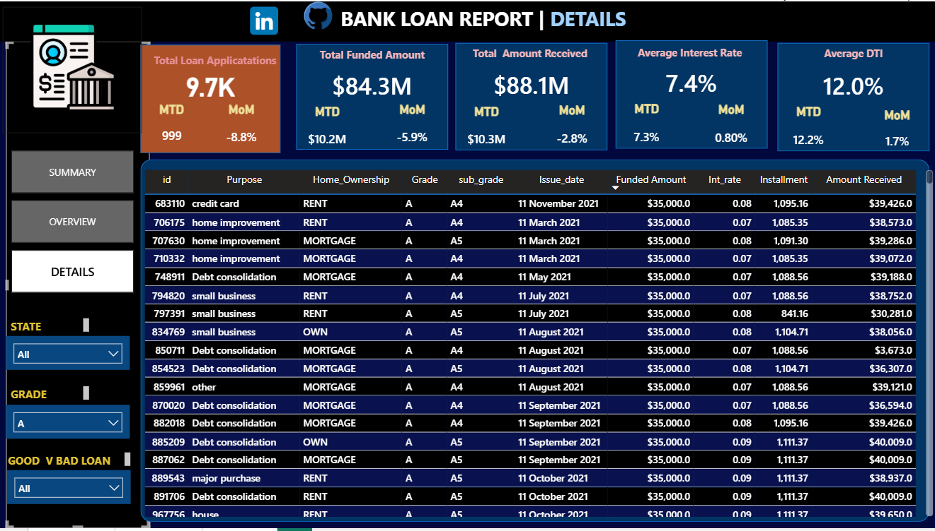
LOAN DETAILS DASHBOARD
Loan-level detail for operational drill-down
What you can drill into
✓
Loan ID & customer info
✓
Loan status per record
✓
Funded amount & amount received
✓
Interest rate
✓
Employment length
✓
Loan purpose
✓
Home ownership
✓
Borrower state
Filters: State · Grade · Good/Bad Loan
Lets analysts isolate any customer segment in seconds.
Bank Loan Report Analysis
12
Notes:
Show how the Details page complements the Summary and Overview pages — it's the audit layer. Demonstrate a filter, e.g. isolating Grade A loans in a specific state, to show operational teams can investigate individual records without needing a raw data export.

Slide 13
KEY PERFORMANCE INDICATORS
Nine numbers that define portfolio health
38,576
$435.76M
$473.07M
Total Applications
Total Funded Amount
Total Amount Received
Volume of lending activity
Capital deployed to borrowers
Cash collected to date
12.05%
13.33%
86.18%
Avg Interest Rate
Avg DTI
Good Loan %
Portfolio-wide pricing of risk
Borrower repayment capacity
Share Fully Paid or Current
13.82%
108.6%
56.9%
Bad Loan %
Loan Recovery Rate
Bad Loan Recovery
Share Charged Off
Received ÷ Funded, portfolio-wide
Received ÷ Funded, Charged Off only
Bank Loan Report Analysis
13
Notes:
Group these into three families as you present: volume and money (applications, funded, received), pricing and risk capacity (interest rate, DTI), and portfolio quality (good/bad %, recovery rates). The two recovery-rate cards are the most interview-worthy — they quantify exactly how much value charge-offs destroy.

Slide 14
KEY BUSINESS INSIGHTS
What the data says about portfolio risk
1
83.3% of loans are Fully Paid — the portfolio is fundamentally healthy
2
Charge-off rate rises from 5.7% (Grade A) to 31.3% (Grade G) — grading works
3
60-month loans default more than twice as often as 36-month loans (22.3% vs 10.7%)
4
Grade F/G on a 60-month term defaults over 5x more than Grade A on 36 months
5
Small business loans default most (25.6%) and are the only purpose with sub-100% recovery
6
Charged-off borrowers carry higher DTI (14.0% vs 13.2%) and pay ~2pts more interest
7
Debt consolidation is the top loan purpose — 18,214 loans, 47% of the portfolio
8
Nevada, Florida, and Missouri show the highest charge-off rates among high-volume states
9
California carries the largest loan volume but a near-average charge-off rate
10
Portfolio-wide collections ($473M) exceed funded capital ($436M) despite charge-offs
11
Charged-off loans recover only 57% of principal — Good loans recover 104%+
12
Wedding and major-purchase loans are the safest purposes by charge-off rate
Bank Loan Report Analysis
14
Notes:
These insights are computed directly from the dataset, not estimated — be ready to defend any number. The grade×term and small-business findings are the strongest talking points; lead with those if time is short.

Slide 15
BUSINESS RECOMMENDATIONS
Turning findings into credit policy actions
Tighten underwriting for Grade D–G, especially on 60-month terms
Add extra scrutiny for small-business loan applications
1
2
Flag and monitor applicants with DTI above 14% at approval
Re-price or cap exposure in above-average-risk states (NV, FL, MO)
3
4
Reward Grade A/B, 36-month, low-DTI segments with faster approval
Automate this reporting in Power BI Service for monthly refresh
5
6
Pilot a predictive default model using grade, term, DTI, and purpose
Build customer segments around the good-loan profile for targeted offers
7
8
Bank Loan Report Analysis
15
Notes:
Present these as a direct line from insight to action — each recommendation should map back to a specific finding from the previous slide. Recommendations 7 and 8 are the natural bridge into the Future Scope slide later in the deck.

Slide 16
TOOLS & TECHNOLOGIES USED
The right tool for each stage of the pipeline
E
S
P
P
Excel
SQL Server
Power Query
Power BI
Source data storage
Querying & KPI logic
Data transformation
Visualization & reporting
Held the raw 38,576-row loan extract
Validated every metric before visualization
Shaped and loaded data into the model
Built the interactive 3-page dashboard
D
D
D
DAX
Data Modeling
Data Visualization
Measure calculation
Relationships & structure
Design & storytelling
Rebuilt SQL logic as live report measures
Kept the report performant and accurate
Turned numbers into decision-ready visuals
Bank Loan Report Analysis
16
Notes:
Frame this as a deliberate pipeline, not a random tool list: Excel for storage, SQL for trusted logic, Power Query and DAX to operationalize that logic, Power BI to deliver it. If asked why SQL first instead of DAX-only, explain that SQL let you validate KPI logic independently before trusting it inside the report.

Slide 17
CHALLENGES FACED & SOLUTIONS
Problem-solving behind the polished dashboard
Challenge
Solution
Outcome
Missing & inconsistent data
Standardized categorical fields, handled nulls in SQL before load
Clean, trustworthy source table
Duplicate loan records
De-duplicated on loan ID during SQL preparation
One row per loan, accurate counts
Complex KPI logic (MTD/PMTD)
Validated each KPI as a standalone SQL query first
DAX measures matched SQL exactly
Dashboard performance
Simplified the data model and measure logic
Fast, responsive slicers and visuals
Choosing the right visuals
Matched chart type to the question (trend, share, comparison)
Clear, decision-ready dashboard
Bank Loan Report Analysis
17
Notes:
This slide demonstrates problem-solving, not just tool usage — walk through one or two rows in detail if asked a technical question, especially the MTD/PMTD validation challenge, since it shows a disciplined SQL-first approach.

Slide 18
BUSINESS IMPACT
What changes once this dashboard exists
✓
✓
✓
✓
Faster reporting
Improved decision-making
Better portfolio monitoring
Earlier risk identification
Hours of manual work replaced by a live refresh
Trusted KPIs, not competing spreadsheet versions
Funded, received, and status visible in one view
Grade×term risk visible before losses compound
✓
✓
✓
✓
Executive-level visibility
Automated KPI tracking
Reduced manual reporting
Higher operational efficiency
Leadership sees portfolio health without a request
MTD / MoM comparisons update without manual work
Analysts shift from data-pulling to analysis
One source of truth across lending teams
Bank Loan Report Analysis
18
Notes:
Tie each impact back to a named stakeholder — credit risk teams get earlier warning, executives get visibility without asking, analysts get their time back. This is the slide to slow down on for a business-executive audience specifically.

Slide 19
FUTURE SCOPE
From dashboard to enterprise analytics platform
1
2
3
4
5
ML-based loan default prediction
Customer credit scoring model
Python integration for advanced analytics
Power BI Service deployment
Scheduled automatic data refresh
6
7
8
9
10
Real-time / near-real-time dashboard
Azure cloud integration
Predictive analytics for risk trends
Fraud detection models
Executive mobile dashboard
Each enhancement builds toward one goal: moving from a reporting tool to a predictive, enterprise-grade risk platform.
Bank Loan Report Analysis
19
Notes:
Group these mentally into three horizons: predictive modeling (default prediction, credit scoring, fraud detection), infrastructure (Azure, scheduled refresh, Power BI Service), and access (real-time, mobile). Pick 2-3 to go deeper on if the interviewer shows interest in a specific direction.

