Slide 1
Walmart Sales Forecasting
DASHBOARD & MODELING PRESENTATION
Forecasting weekly sales for 45 stores, 12 weeks ahead, using a seasonal time-series model
Siddu • B.Sc. Mathematics, Statistics & Data Science
github.com/sidducv0528/Walmart-Sales-Forecasting

Slide 2
What This Covers
1
Objective & Dataset
What we're forecasting, and what data we have to work with
2
Exploratory Analysis
What actually drives weekly sales across 45 stores
3
Modeling Approach
SARIMA methodology, and an honest note on exogenous variables
4
Results & Dashboard
Model accuracy, and the interactive Streamlit app built around it
Walmart Sales Forecasting
2

Slide 3
The Dataset
Weekly sales records across all Walmart stores in scope
6,435
45
143
Feb 2010 –
Oct 2012
Weekly Records
Stores
Weeks per Store
Date Range
Columns: Store, Date, Weekly_Sales, Holiday_Flag, Temperature, Fuel_Price, CPI, Unemployment
Walmart Sales Forecasting
3

Slide 4
What Drives Weekly Sales?
Key findings from exploratory analysis
Seasonality dominates
Sales peak sharply in Nov–Dec (Thanksgiving/Christmas). Holiday weeks run ~7–8% higher than non-holiday weeks.
Unemployment & CPI: weak signal
Both under 0.1 correlation with sales at the aggregate level — though a handful of stores are more sensitive than others.
Temperature: minimal effect
Correlation ≈ −0.02 with weekly sales — essentially no relationship.
Store performance varies widely
Best store sold over 7× the volume of the worst store — argues for store-level, not chain-wide, planning.
Walmart Sales Forecasting
4

Slide 5
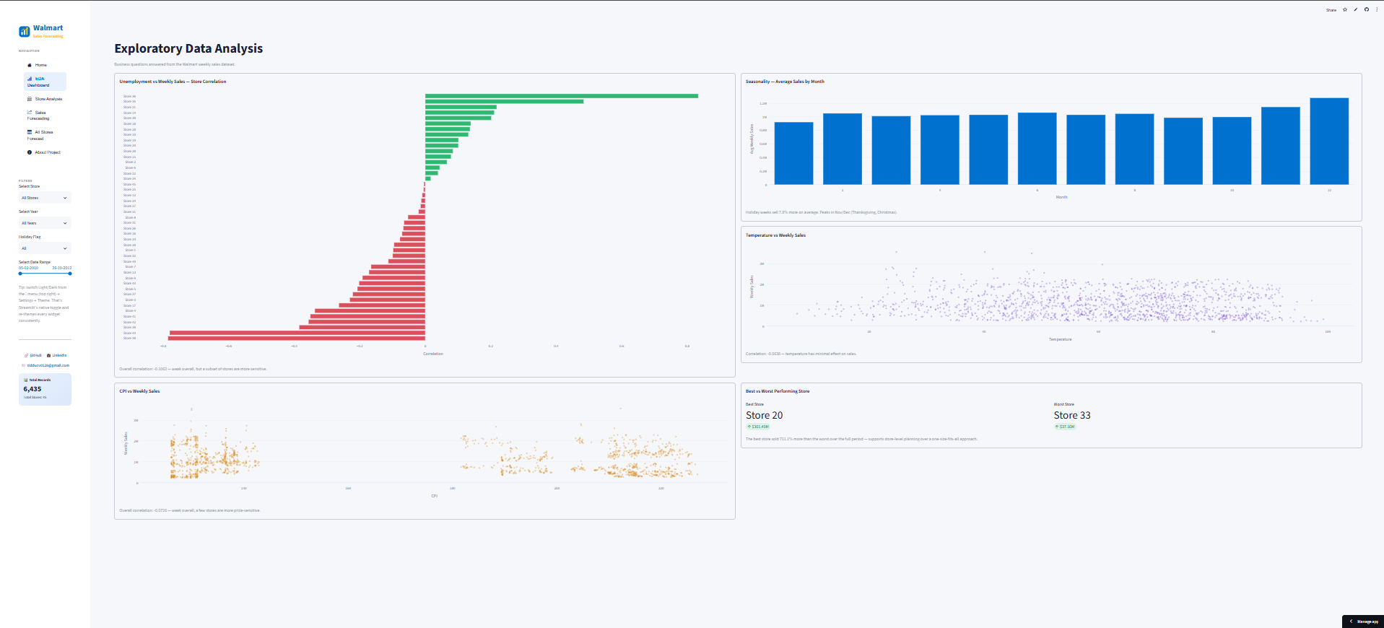
EDA Dashboard
Interactive exploration, built into the app
Walmart Sales Forecasting
5

Slide 6
Modeling Approach
SARIMA (1,1,1)(1,1,1,52) — fit independently for each of the 45 stores
The seasonal order of 52 captures the yearly weekly cycle directly — this is what drives the holiday-season spike observed in nearly every store, without needing a separate holiday input.
Evaluation Approach
The last 12 weeks of each store's history are held out as a test set. The model trains on all prior weeks, then forecasts are scored against the held-out actuals using MAE, RMSE, and MAPE — computed per store, not pooled.
MAPE | Rating
< 10% | Excellent
< 20% | Good
≥ 20% | Needs Improvement
Walmart Sales Forecasting
6

Slide 7
A Note on Model Naming
SARIMA vs. SARIMAX — why exogenous variables were excluded
The dataset includes Holiday_Flag, CPI, and Unemployment as candidate exogenous regressors. These were evaluated and deliberately NOT included as exogenous inputs, for two reasons backed by the EDA:
1. Holiday effects are already captured by the seasonal (…,52) term — adding Holiday_Flag separately would be largely redundant. 2. CPI and Unemployment move slowly month-to-month and showed weak correlation with weekly sales at the store level — unlikely to meaningfully improve a 12-week forecast.
This is implemented using statsmodels' SARIMAX class (which supports exogenous inputs), but none are passed — functionally this is a seasonal ARIMA (SARIMA) model, not true SARIMAX.
This distinction is tested, not assumed — see the correlation checks in the notebook.
Walmart Sales Forecasting
7

Slide 8
Results
Model accuracy across all 45 stores
3.66%
1.64%
14.15%
Average MAPE
Best Store (37)
Worst Store (35)
Across all 45 stores, the model averages 3.66% MAPE — rated Excellent. Store 35 is the only store outside the Excellent band, still rated Good.
Walmart Sales Forecasting
8

Slide 9
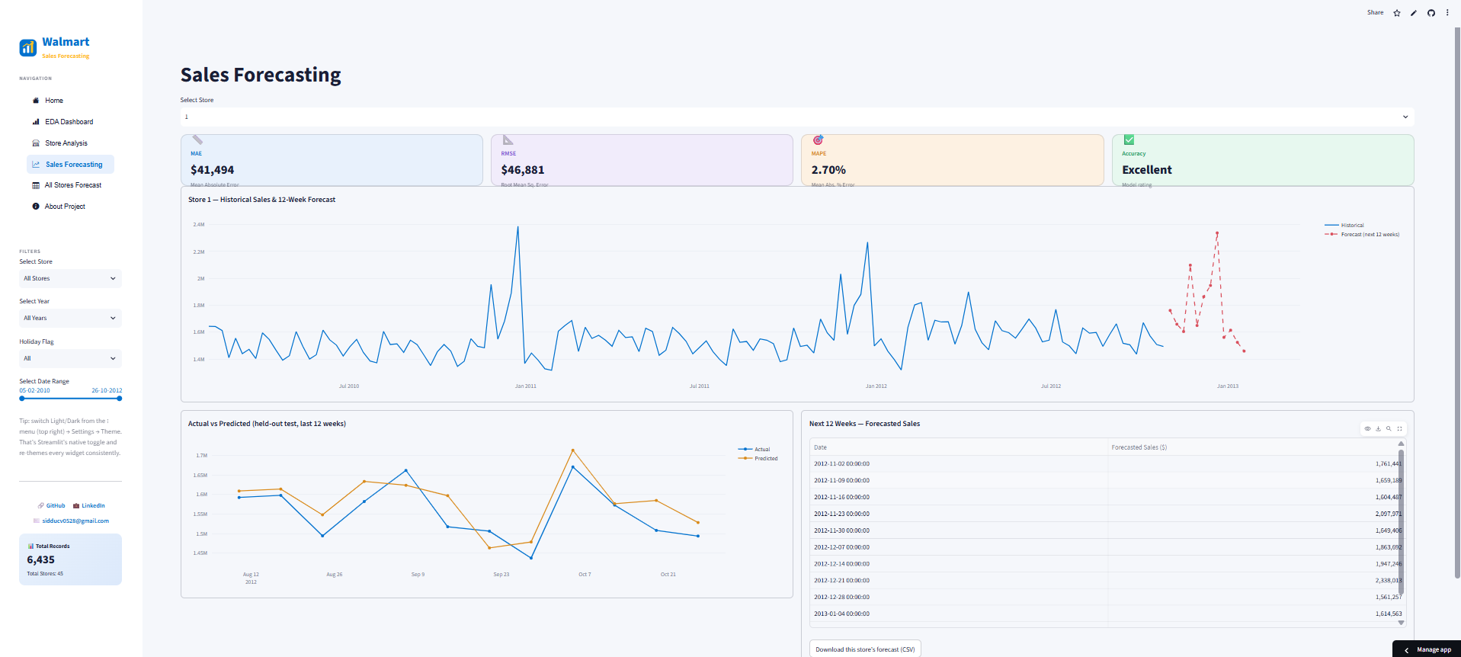
Per-Store Forecasting
12-week forecast, actual vs. predicted on held-out weeks
Walmart Sales Forecasting
9

Slide 10
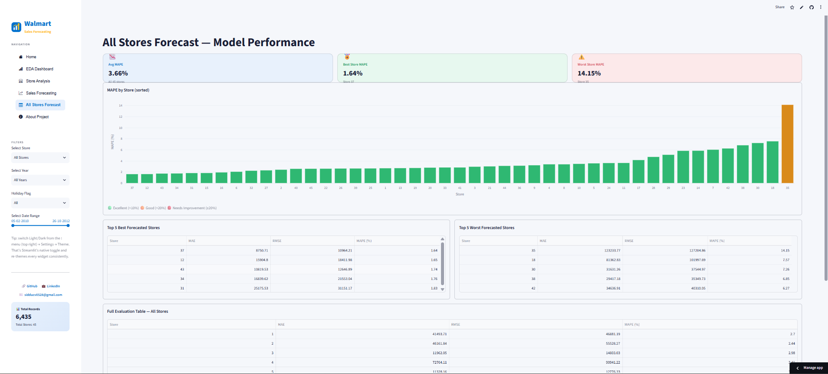
All Stores — Model Performance
MAPE by store, sorted, with best/worst breakdown
Walmart Sales Forecasting
10

Slide 11
Tech Stack & What's Next
Tech Stack
Future Improvements
Python — pandas, numpy
statsmodels — SARIMAX class (used as SARIMA)
Streamlit + Plotly — interactive dashboard
Streamlit Community Cloud — deployment
Test true SARIMAX with exogenous regressors vs. the SARIMA baseline
Per-store hyperparameter tuning (e.g. auto_arima) instead of one fixed order
Investigate Store 35 specifically — the one underperformer
Automate the refresh pipeline with a scheduled job
Walmart Sales Forecasting
11

Slide 12
Thank You
Walmart Sales Forecasting — Dashboard & Modeling Project
GitHub: github.com/sidducv0528
LinkedIn: linkedin.com/in/siddu-data
Email: sidducv0528@gmail.com
Walmart Sales Forecasting
12

