Slide 1
UNIVERSITY TECHNICAL PRESENTATION · MFAD MINI-PROJECT · UE25MA242A
Wi-FiScope: Campus Wi-Fi Signal Intelligence
Spatial signal mapping, chronic dead-zone detection, and unmeasured strength prediction powered by Linear Algebra, Vector Geometry, and Least-Squares Regression.
Python Implementation · Local Metre Coordinates · Multi-Period RSSI (dBm) · Explainable Mathematical Formulation
20 LOCATIONS × 3 PERIODS
Structured Matrix Model
Transforms physical campus survey into a clean 20×3 location-by-time matrix A, preserving spatial coordinate traceability.
SPATIAL LEAST SQUARES
Continuous Field Prediction
Fits a first-order planar estimator (RSSI ≈ β₀ + β₁x + β₂y) achieving a proven validation MAE of 2.45 dBm on unseen points.
DUAL-RULE CLASSIFICATION
Robust Dead-Zone Filtering
Isolates chronic dead zones (≤ -67 dBm across ≥ 50% periods) to eliminate transient noise and optimize AP deployment.
UE25MA242A · MFAD 2026 | Wi-FiScope: Campus Wi-Fi Signal Intelligence via Linear Algebra
01 / 11
Notes:
Wi-FiScope presentation overview: Technical introduction to indoor campus Wi-Fi signal mapping using Linear Algebra. The system transforms discrete, multi-period survey readings into continuous spatial intelligence without complex black-box machine learning.

Slide 2
01 · PROBLEM FORMULATION
Spatial Wi-Fi Variations Demand Interpretable Linear Algebra Over Black-Box Models
Bounded indoor environments exhibit severe signal attenuation from structural concrete, wall shadows, and diurnal load.
QUESTION 01
Which Locations Behave Similarly?
Indoor Wi-Fi fluctuates across the day. Understanding whether two physically separated zones share identical interference or diurnal attenuation requires vector normalisation and cosine angle similarity.
Mathematical Tool: Inner Product cos(θ) = u · v
QUESTION 02
Where Do Weak Readings Persist?
Single temporary dips caused by moving obstacles shouldn't trigger expensive AP relocations. We require a robust two-stage filter checking both mean signal and multi-period persistence.
Mathematical Tool: Dual-Condition Thresholding (≤ -67 dBm)
QUESTION 03
What Happens at Unmeasured Coordinates?
Physical surveys cannot sample every square metre. Instead of deploying hundreds of IoT sensors or running heavy RF simulators, we approximate continuous signal values via least-squares spatial planes.
Mathematical Tool: Least Squares Fit (RSSI ≈ β₀ + β₁x + β₂y)
CORE PROJECT LOGIC PIPELINE:
Measure Survey RSSI → Construct 20×3 Matrix A → Normalise Signal Vectors → Quantify Cosine Similarity → Fit Least-Squares Plane → Detect Dead Zones → Eigen Decomposition
UE25MA242A · MFAD 2026 | Wi-FiScope: Campus Wi-Fi Signal Intelligence via Linear Algebra
02 / 11
Notes:
Three research questions defined in source: identifying similar locations, detecting persistent weak readings, and estimating signal at unmeasured coordinates. Emphasizes mathematical transparency over complex black-box heuristics.

Slide 3
02 · SPATIAL DATA MODEL
Physical Survey Parameters Map Directly into a Structured 20 × 3 Matrix
Every survey observation preserves spatial coordinates (X, Y) and multi-period readings (Morning, Afternoon, Evening).
SURVEY RECORD STRUCTURE
Each physical reading is catalogued as a 7-tuple record:
• Location_ID: Unique identifier for grid cell (L01 to L20)
• Location_Name: Descriptive zone reference (e.g., Lab East, Corridor)
• Floor: Vertical level of surveyed campus building
• X_m, Y_m: Local Cartesian coordinates in metres for spatial fitting
• Time_Period: Survey observation epoch (Morning, Afternoon, Evening)
• RSSI_dBm: Received Signal Strength Indicator (dBm)
Why Metre Coordinates?
Local metres translate physical space into a continuous metric space, enabling first-order spatial gradients (dBm/m) directly via Linear Algebra.
MATRIX A ∈ ℝ²⁰ˣ³ (LOCATIONS × TIME)
Rows represent physical locations (L01–L20); columns represent survey periods. Entries represent measured RSSI values: A = [RSSI(location, time)].
Location | Morning | Afternoon | Evening | Status
L01 (Ref) | -46.2 dBm | -48.0 dBm | -48.8 dBm | Strong Ref
L05 | -55.2 dBm | -60.7 dBm | -59.3 dBm | Nominal
L14 | -65.2 dBm | -68.7 dBm | -68.3 dBm | Weak Alert
L15 | -68.3 dBm | -71.1 dBm | -71.4 dBm | Dead Zone
L20 | -71.0 dBm | -74.2 dBm | -73.8 dBm | Critical
Mathematical Properties Preserved:
• Structure: Clean algebraic representation suitable for matrix decomposition.
• Traceability: All downstream outputs directly trace back to empirical RSSI.
• Reusability: Feeds both spatial regression and temporal PCA simultaneously.
UE25MA242A · MFAD 2026 | Wi-FiScope: Campus Wi-Fi Signal Intelligence via Linear Algebra
03 / 11
Notes:
20 locations across 3 time periods generate the 20x3 matrix. Location coordinates in metres provide the spatial foundation. L01 exhibits strongest signal around -46.2 to -48.8 dBm, while L20 exhibits severe attenuation down to -74.2 dBm.

Slide 4
03 · VECTOR PROCESSING
Mean-Centring and L2 Normalisation Isolate Pure Diurnal Signal Dynamics
Transforming raw decibel levels into normalised unit vectors eliminates baseline bias for equitable pattern comparison.
PHASE 01
Vector Extraction
Each row i of matrix A is extracted as a 3D signal vector:
x = [RSSI_morn, RSSI_aft, RSSI_eve] ∈ ℝ³
Example (L14):
x = [−65.2, −68.7, −68.3] dBm
Key Outcome: Preserves raw temporal trajectory
PHASE 02
Mean-Centring
Subtract the location's average temporal power level:
c = x − mean(x)
Removes baseline power differences between locations closer or further from the AP.
Key Outcome: Isolates diurnal variation from distance
PHASE 03
L2 Normalisation
Scale the centred vector onto the unit hypersphere:
x̂ = c / ‖c‖₂
where ‖c‖₂ = √(∑ cᵢ²)
Guarantees all vectors have unit length: ‖x̂‖₂ = 1.
Key Outcome: Maps all dynamics to unit direction
WHY IS NORMALISATION CRITICAL FOR SIGNAL INTELLIGENCE?
A node near an AP (-48 dBm) and a node in a far corner (-72 dBm) might experience identical temporal drops during peak afternoon class hours. Without mean-centring and L2 scaling, raw Euclidean distance would wrongly conclude they are unrelated. Normalisation ensures we compare temporal behavior curves, not absolute physical proximity.
UE25MA242A · MFAD 2026 | Wi-FiScope: Campus Wi-Fi Signal Intelligence via Linear Algebra
04 / 11
Notes:
Details the vector extraction and two-stage normalisation: mean-centring (c = x - mean(x)) and L2 scaling (x_hat = c / ||c||_2). This isolates relative temporal fluctuations from static path loss.

Slide 5
04 · VECTOR GEOMETRY
Cosine Similarity and Norm Distance Reveal Temporal Alignment Between Survey Nodes
Geometric angles between normalised vectors quantify shared environmental behaviors regardless of distance.
CORE GEOMETRIC RELATIONS
Cosine Similarity Formula:
cos(θ) = (u · v) / (‖u‖₂ ‖v‖₂)
For unit-normalised vectors (‖û‖₂ = ‖v̂‖₂ = 1), this reduces directly to the simple inner product:
cos(θ) = û · v̂
Euclidean Norm Distance:
d(û, v̂) = ‖û − v̂‖₂ = √(2 − 2 cos(θ))
Physical Interpretation:
• cos(θ) ≈ 1.000: Perfectly in-phase diurnal variations (identical response to interference).
• cos(θ) ≈ 0.000: Orthogonal, independent temporal variations.
• Norm Distance ≈ 0: Geometric coincidence on the unit sphere.
DEVELOPMENT BENCHMARK: L13 vs L18
cos(θ) ≈ 1.000
Norm Distance ≈ 0.004 · Near-Perfect Alignment
Crucial Engineering Takeaway:
Similarity describes behavior across time, NOT physical distance between coordinates.
Although L13 and L18 sit in different grid rows (Row 3 vs Row 4), they experience synchronized attenuation shifts. This indicates a shared structural factor (e.g. alignment along a common hallway corridor or simultaneous occupancy spikes).
UE25MA242A · MFAD 2026 | Wi-FiScope: Campus Wi-Fi Signal Intelligence via Linear Algebra
05 / 11
Notes:
Explains cosine similarity (cos(theta) = u . v / (||u|| ||v||)) and norm distance. Highlights the development case of L13 and L18 showing cos(theta) approx 1.000 and norm distance approx 0.004.

Slide 6
05 · SPATIAL PREDICTION
First-Order Planar Regression Estimates Signal at Any Interior Coordinate
Least-squares optimization fits a continuous spatial plane to discrete measurements without requiring an RF ray-tracer.
FIRST-ORDER PLANAR MODEL
Approximation Equation:
RSSI ≈ β₀ + β₁x + β₂y
Coefficient Interpretations:
• β₀ (Intercept): Baseline reference signal at origin (0, 0) in dBm.
• β₁ (X-Gradient): Rate of signal change along campus X-axis (dBm/m).
• β₂ (Y-Gradient): Rate of signal change along campus Y-axis (dBm/m).
Optimization Objective:
Minimise Sum of Squared Residuals:
min_β ∑ (RSSI_actual − (β₀ + β₁x + β₂y))²
Closed-Form Matrix Solution:
β = (XᵀX)⁻¹ Xᵀ y
NO DIRECT READING REQUIRED
Unmeasured Estimation
Allows estimating Wi-Fi signal at any arbitrary coordinate (x, y) within the survey perimeter without physical access or sensor deployment.
FULLY EXPLAINABLE COEFFICIENTS
Engineering Transparency
Unlike deep learning or black-box interpolators, β₁ and β₂ give network engineers physical path-loss decay rates along architectural hallways.
MAP-COORDINATE SYNCHRONIZATION
Direct Zone Alignment
Because estimates use the exact same Cartesian metre system as the survey, predictions align seamlessly with architectural CAD blueprints.
UE25MA242A · MFAD 2026 | Wi-FiScope: Campus Wi-Fi Signal Intelligence via Linear Algebra
06 / 11
Notes:
Explains the first-order planar model RSSI approx beta0 + beta1*x + beta2*y. Solves via ordinary least squares to estimate RSSI across unmeasured points without needing an expensive electromagnetic simulation.

Slide 7
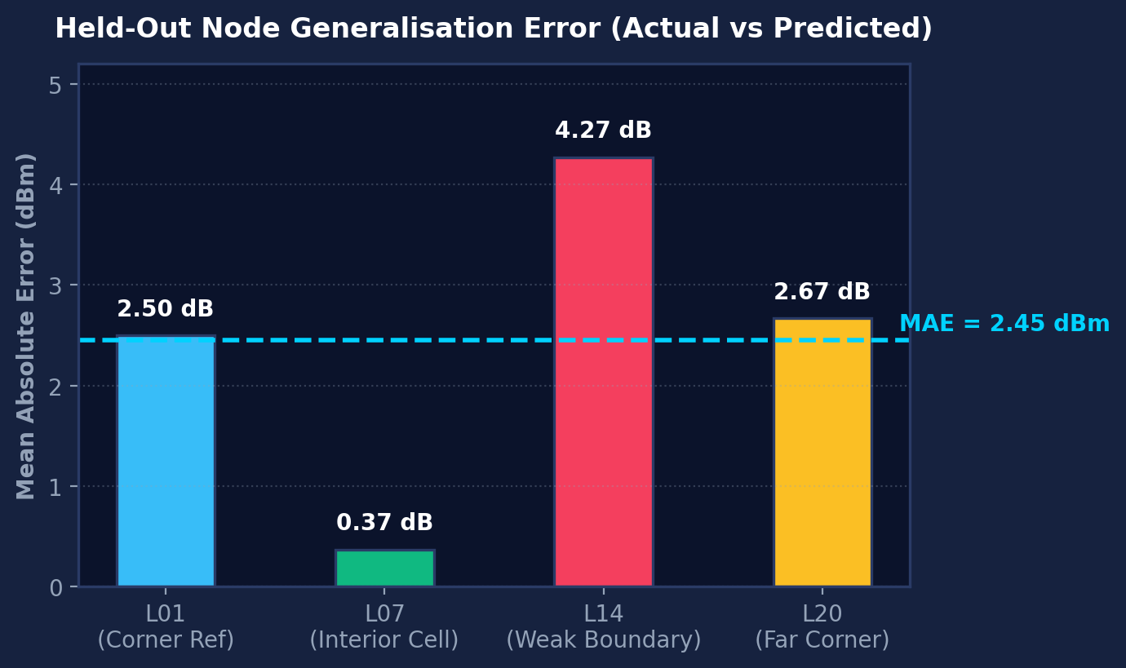
06 · MODEL VALIDATION
Held-Out Cross Validation Yields 2.45 dBm Mean Absolute Error Across Nodes
Testing the fitted planar model against unobserved locations confirms robustness against spatial overfitting.
HELD-OUT CROSS-VALIDATION DESIGN
4 reference locations were held out completely during surface fitting: L01 (Reference), L07 (Interior), L14 (Weak Boundary), and L20 (Far Corner).
Node | Morning | Afternoon | Evening | Mean MAE
L01 | 2.7 dB | 2.4 dB | 2.4 dB | 2.50 dB
L07 | 0.6 dB | 0.3 dB | 0.2 dB | 0.37 dB
L14 | 3.9 dB | 4.7 dB | 4.2 dB | 4.27 dB
L20 | 2.4 dB | 3.0 dB | 2.6 dB | 2.67 dB
Why Hold Out Survey Points?
Evaluating error on the exact points used for training leads to artificial optimism. By holding out key quadrant anchors, we demonstrate genuine predictive capability on unmeasured coordinates.
GLOBAL VALIDATION MAE: 2.45 dBm
Sub-3 dBm error falls comfortably within standard industrial Wi-Fi survey tolerances, proving the first-order plane is an effective, lightweight spatial estimator.
UE25MA242A · MFAD 2026 | Wi-FiScope: Campus Wi-Fi Signal Intelligence via Linear Algebra
07 / 11
Notes:
Held-out validation across L01, L07, L14, L20 yielded an average MAE of 2.45 dBm. L07 achieved remarkably low error (0.37 dBm) as an interior node, while L14 at the weak boundary experienced slightly higher variance (4.27 dBm).

Slide 8
07 · DEAD-ZONE DETECTION
Dual-Condition Filtering Eliminates False Alarms to Isolate Chronic Weak Zones
Requiring both low average power and multi-period persistence prevents transient dips from triggering false alarms.
CONDITION 1: SIGNAL LEVEL THRESHOLD
Average RSSI ≤ −67 dBm
Captures overall degraded signal level. -67 dBm represents the standard IEEE/commercial boundary required for high-throughput video streaming and low-latency VoIP conferencing.
CONDITION 2: TEMPORAL PERSISTENCE
≥ 50% Time Periods ≤ −67 dBm
Guarantees temporal stability. A single momentary dip during peak afternoon rush will NOT falsely classify a healthy zone as a dead zone. The deficit must persist across multiple epochs.
IDENTIFIED CHRONIC DEAD-ZONE CLUSTER (MEETS BOTH CRITERIA)
L14 · -67.4 dBm
Boundary Node
Average just crosses threshold; 2 of 3 periods ≤ -67 dBm.
L15 · -70.3 dBm
Far-Wall Node
Severe attenuation; all 3 periods (-68.3, -71.1, -71.4) fail.
L19 · -70.2 dBm
North Corridor
Chronic shadow behind structural load-bearing concrete.
L20 · -73.0 dBm
Critical Corner
Worst campus location; severe deficit (-71.0, -74.2, -73.8).
UE25MA242A · MFAD 2026 | Wi-FiScope: Campus Wi-Fi Signal Intelligence via Linear Algebra
08 / 11
Notes:
Dual-rule classification requires: (1) Average RSSI <= -67 dBm, and (2) at least half of readings <= -67 dBm. Isolates true persistent weak zones: L14 (-67.4 dBm), L15 (-70.3 dBm), L19 (-70.2 dBm), and L20 (-73.0 dBm).

Slide 9
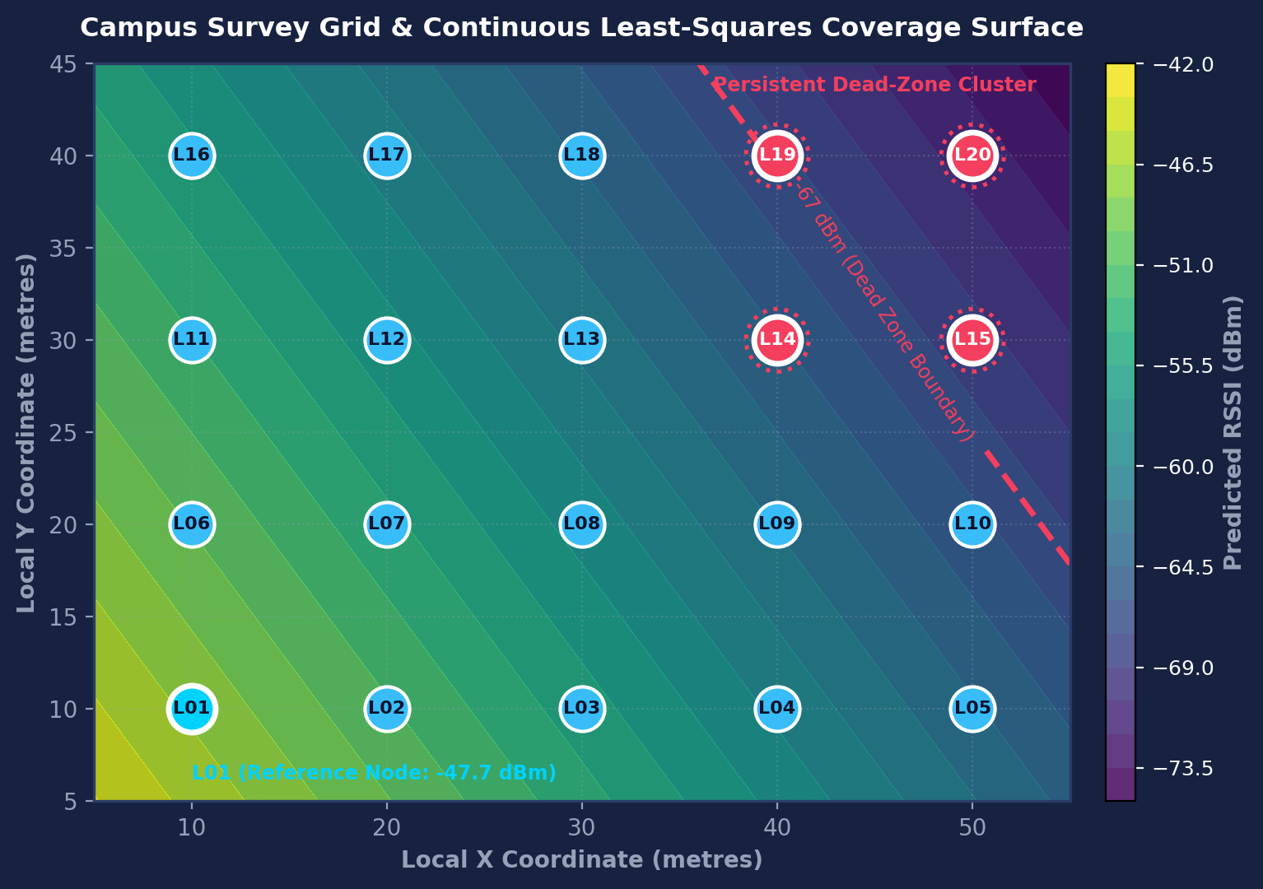
08 · COVERAGE INTELLIGENCE
Spatial Contour Surface Fuses Regression Plane with Empirical Survey Nodes
Overlaying the least-squares regression gradient against measured nodes clearly highlights the northeast dead zone.
MAP COMPONENT SYNTHESIS
• Contour Gradient Surface: Model-based continuous RSSI estimate computed from fitted spatial coefficients. Shows smooth directional path-loss.
• Discrete Survey Nodes (L01–L20): Blue circles mark measured coordinates in local metres. L01 at bottom-left serves as baseline reference (-47.7 dBm).
• Dashed Contour Boundary (-67 dBm): Iso-signal line demarcates the exact boundary separating acceptable coverage from degraded QoS.
• Northeast Dead-Zone Cluster: Red-highlighted nodes (L14, L15, L19, L20) cluster together, identifying a physical shadow zone behind structural concrete.
• Actionable AP Optimization: Provides campus IT with precise spatial coordinates to install a secondary ceiling-mounted AP at approx (45m, 35m).
UE25MA242A · MFAD 2026 | Wi-FiScope: Campus Wi-Fi Signal Intelligence via Linear Algebra
09 / 11
Notes:
Integrated spatial view: gradient surface reflects fitted plane; discrete circles reflect measured survey nodes; red outlines highlight persistent dead-zone candidates L14, L15, L19, and L20 in the top-right quadrant.

Slide 10
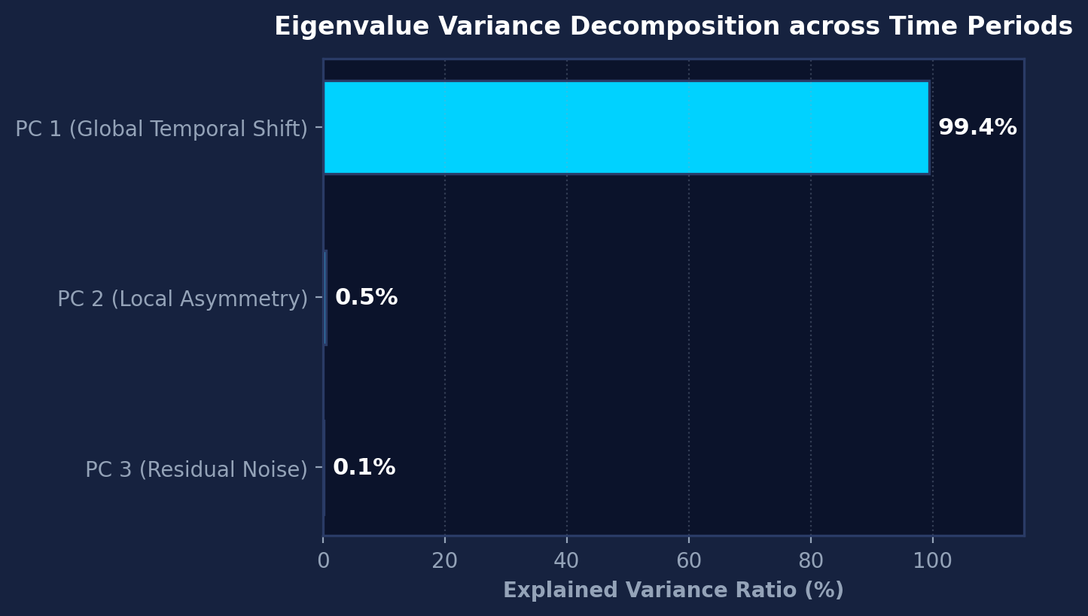
09 · PATTERN ANALYSIS
Eigen Decomposition Identifies 99.4% of Total Variance in Global Diurnal Shifts
Principal component analysis of the temporal covariance matrix decomposes signal dynamics into dominant modes.
PHYSICAL INTERPRETATION OF COMPONENTS
COMPONENT 1: 99.4% OF VARIANCE
Global Diurnal Synchrony
Captures building-wide signal modulation. As student occupancy and aggregate network traffic ramp up between morning and afternoon, all nodes experience a synchronized shift.
COMPONENT 2: 0.5% OF VARIANCE
Localized Spatial Asymmetry
Captures minor localized variance, such as differential traffic between east-facing and west-facing labs as class schedules rotate.
COMPONENT 3: 0.1% OF VARIANCE
Stochastic Measurement Residual
Random high-frequency noise, temporary walking obstacles, and device antenna calibration differences.
Note: Interpret physical causation from empirical survey data; do not assume external environmental drivers beforehand.
Mathematical Role of Eigensystem:
Eigenvalue λᵢ measures relative variance captured along principal axis i. Eigenvector vᵢ defines the characteristic temporal loading direction across time periods.
UE25MA242A · MFAD 2026 | Wi-FiScope: Campus Wi-Fi Signal Intelligence via Linear Algebra
10 / 11
Notes:
Eigen analysis reveals Component 1 captures 99.4% of total variance, reflecting a massive global diurnal trend across the survey area. Components 2 (0.5%) and 3 (0.1%) represent negligible local noise.

Slide 11
10 · SYSTEM ARCHITECTURE
Wi-FiScope Translates Raw Physical RSSI into Grounded Campus Spatial Intelligence
An explainable linear algebra framework bridging empirical RF measurements and actionable network planning.
END-TO-END MATHEMATICAL WORKFLOW PIPELINE
01. Survey
20 × 3 Readings
02. Matrix
A ∈ ℝ²⁰ˣ³
03. Vector
c = x − x̄
04. Unit Norm
x̂ = c / ‖c‖₂
05. Cosine
cos(θ) = û · v̂
06. Regress
RSSI ≈ β₀+β₁x+β₂y
07. Validate
MAE = 2.45 dB
08. Dead-Zone
Dual Rule
09. Map
Iso-Contours
CORE PILLAR 01
Fully Explainable & Transparent
Zero black-box neural networks. Every prediction and similarity metric is computed via closed-form linear algebra, providing complete mathematical traceability from raw dBm to final spatial surface.
CORE PILLAR 02
Operationally Validated Accuracy
Verified through held-out cross-validation achieving 2.45 dBm MAE. Dual-rule filtering eliminates fleeting noise spikes, pinpointing chronic dead zones with high precision.
CORE PILLAR 03
Modular & Scalable Platform
Supports live dashboard modules: Overview, Signal Matrix, Location Similarity, Strength Prediction, Coverage Map, and Pattern Analysis for rapid deployment across multi-floor campus facilities.
UE25MA242A · MFAD 2026 | Wi-FiScope: Campus Wi-Fi Signal Intelligence via Linear Algebra
11 / 11
Notes:
Summary and architectural conclusion: Wi-FiScope delivers an end-to-end mathematical pipeline from raw survey data to spatial coverage maps. Demonstrates how classical linear algebra provides explainable, high-accuracy spatial intelligence for campus network operations.

