Slide 1
1M1B AI FOR SUSTAINABILITY · FINAL PROJECT
SustainAI Router
Right capability.
Lower resource intensity.
THE DECISION PRINCIPLE
Use the least resource-intensive model that is reasonably capable of completing the task.
Explainable, environmentally aware AI task and model-tier recommendation
LIGHTWEIGHT
simple tasks
STANDARD
mixed tasks
ADVANCED
complex tasks
Research-backed · scope-controlled · no-code prototype
IBM SkillsBuild · AICTE · 21 September 2026
01

Slide 2
01 · PROBLEM
The problem: one default model does not fit every task
Today’s default pattern
The design question
Many AI applications
use one model for everything.
Which capability is enough
for this task?
Simple requests may be over-provisioned
Not the smallest model.
Not the strongest model by default.
Complex requests may be under-provisioned
Environmental/resource trade-offs stay invisible
LOW
MEDIUM
HIGH
translation / extraction
summarization / Q&A
reasoning / comparison
02
Positioning: decision-support layer, not a new routing algorithm.
02

Slide 3
02 · EVIDENCE
Why it matters: the evidence is real, but the numbers are contextual
GLOBAL SYSTEM OUTLOOK
BOUNDED PRODUCTION MEASUREMENT
~415 TWh
0.24 Wh
Data-centre electricity in 2024
Median Gemini Apps text prompt
Google’s 2025 full-stack study also reported 0.03 gCO₂e and 0.26 mL water for that measured service.
~945 TWh
IEA base case for 2030
All data centres · not AI inference alone
Specific provider · workload · boundary
Not a universal “AI query” number.
03
Sources: IEA Energy and AI (2025); IEA Key Questions on Energy and AI (2026); Google AI serving methodology (2025).
03

Slide 4
03 · EXISTING FIELD
Routing already exists — the project must not claim otherwise
Existing systems optimize different parts of the same trade-off space.
EXAMPLE
STATUS
PRIMARY OBJECTIVE
SELECTION SIGNAL
RouteLLM
Research / open-source
quality + cost
learned strong/weak routing
OpenRouter / Not Diamond
Commercial
task fit + cost
task classifier / learned selection
AWS / Microsoft
Managed cloud
quality + cost + latency
quality modes + model subsets
Vercel AI Gateway
Gateway
availability + cost + latency
provider/fallback routing
ML.ENERGY / GSF / Google
Research + infrastructure
energy / carbon
measurement, forecasting, scheduling
Conclusion: routing is established. Our value is making resource-awareness and governance understandable at the application layer.
04
Sources: RouteLLM, OpenRouter, AWS Bedrock, Microsoft Foundry, Vercel AI Gateway and ML.ENERGY documentation.
04

Slide 5
04 · GAP
The defensible gap: transparent resource-aware decision support
EXISTING CAPABILITY
LIMITATION
OUR CONTRIBUTION
Quality, cost, latency, availability
and emerging energy/carbon research.
Telemetry and environmental
metadata are fragmented; quality
risks can be hidden.
A no-code, explainable layer with
relative tiers, quality floor,
uncertainty and human override.
→
→
→
→
→
Not a new router. Not a footprint calculator. A visible policy layer for better decisions.
05
Gap claim is deliberately narrow: product integration, transparency and governance—not algorithmic novelty.
05

Slide 6
05 · USERS & STAKEHOLDERS
Who is affected — and who benefits?
1
AI product / developer teams
2
Sustainability / ESG teams
Need a configurable model pool and auditable policy.
Need boundaries, evidence and no greenwashing.
Recommendation + registry
Evidence status + assumptions
3
Enterprise copilots
4
End users
Serve mixed, high-volume traffic.
Need quality across languages and domains.
Task-to-tier workflow
Override + escalation
Communities near data centres are also affected by local energy, water and infrastructure decisions — which is why location and measurement matter.
06
Stakeholder mapping is part of the problem definition, not a claim that the demo serves communities directly.
06

Slide 7
06 · PROPOSED SOLUTION
How SustainAI Router works
01
TASK
02
UNDERSTAND
03
QUALITY FLOOR
User enters task
Task family + signals
Risk + priority
04
RESOURCE VIEW
05
EXPLAIN
06
ESCALATE
Relative tier profile
Reason + trade-off
Override / human review
The AI element is task understanding and explanation. The policy table remains inspectable and configurable.
07
Design principle: least resource-intensive tier that is reasonably capable—not “smallest model always.”
07

Slide 8
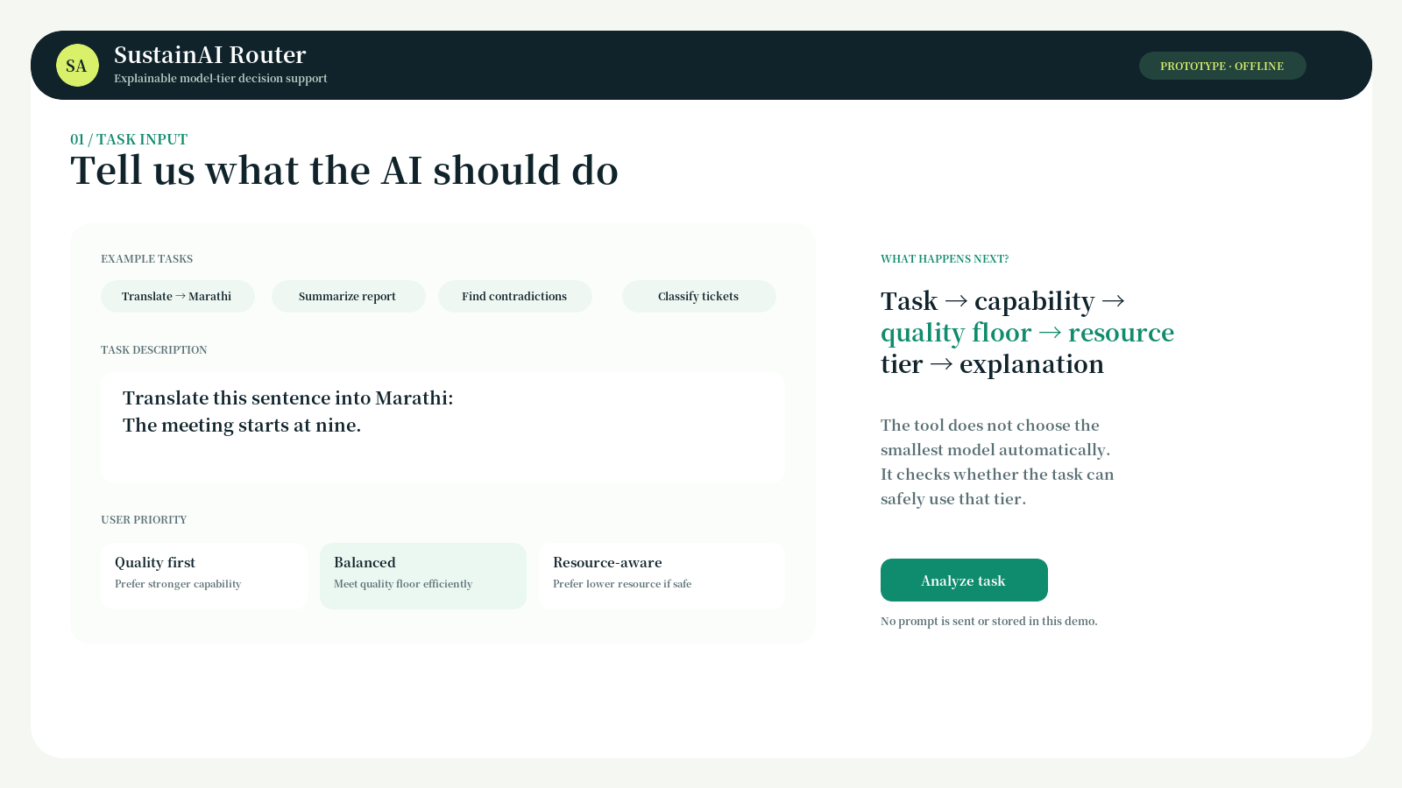
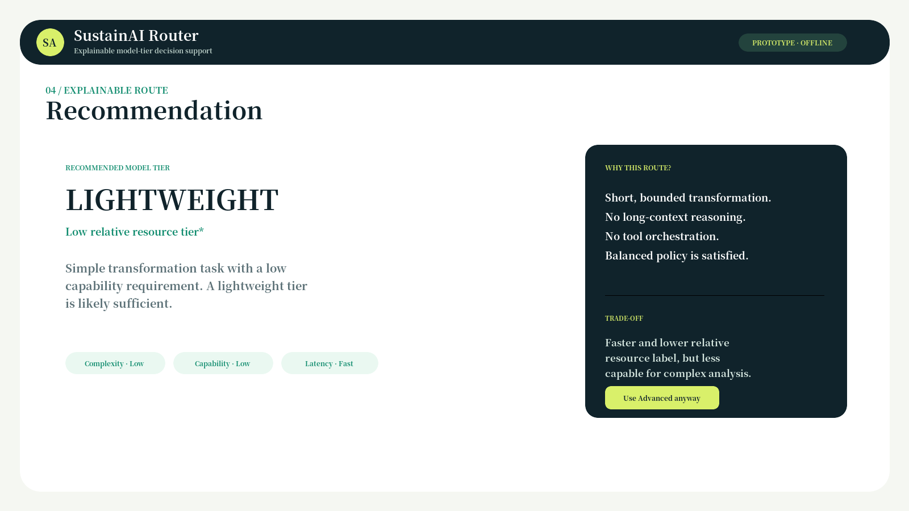
07 · PROTOTYPE / DEMO
Prototype: a product-like experience, not a school-project calculator
Task 1
Lightweight
Task 2
Standard
Task 3
Advanced
Translate → Marathi
Summarize → Standard
Contradictions → Advanced
Relative resource labels are conceptual assumptions. No exact energy, carbon, water or savings number is shown.
08
Screenshots from SustainAI_Prototype.html. Offline demo uses transparent mock rules; no prompt is sent or stored.
08

Slide 9
08 · USE CASES
Where the idea could fit in industry
CUSTOMER SUPPORT
INTERNAL COPILOT
Simple triage → Lightweight
FAQ answer → Standard
Escalation → Advanced
Formatting / search → Lightweight
Summary → Standard
Policy synthesis → Advanced
DOCUMENT WORKFLOW
AI SaaS PLATFORM
Field extraction → Lightweight
Report summary → Standard
Contradictions → Advanced
Approved model pool
Quality / cost / latency policy
Resource metadata + audit log
Potential value = quality + cost + latency + resource awareness, validated against the organization’s own workload.
09
Use cases are illustrative; the prototype is not enterprise-ready.
09

Slide 10
09 · IMPACT & EVALUATION
Impact and evaluation: what we will claim — and what we will not
EXPECTED IMPACT
PROPOSED EVALUATION
Environmental: makes resource efficiency visible; no savings % claimed
15–20 anonymized tasks
Operational: helps avoid over-provisioning when validated
Simple · Moderate · Complex
Economic: potential cost/latency efficiency at scale
Classification
Tier choice
Quality
Social: awareness with language/domain fairness safeguards
correctness
appropriate?
preserved?
Explanation
Fairness
clear?
language / domain
No fake performance percentages.
10
Status: proposed evaluation / prototype test plan. Results are not fabricated.
10

Slide 11
10 · RESPONSIBLE AI
Responsible AI is part of the route
FAIRNESS
TRANSPARENCY
Test English, Marathi and domain variation. Do not treat language as “easy.”
Show category, reason, confidence, evidence status and trade-off.
ETHICS + RELIABILITY
PRIVACY
Quality floor, conservative escalation, human review for high-impact work.
Minimize prompt retention; redact PII; use private/local analysis where possible.
Human/developer control remains final: override the recommendation, use a quality-first route or require review.
11
Reference frameworks: NIST AI RMF 1.0 and UNESCO Recommendation on the Ethics of AI.
11

Slide 12
11 · CONCLUSION
A modest, defensible project is stronger than an exaggerated one
SustainAI Router makes
resource-aware routing legible.
NEXT SCOPE
Measured model cards
Existing systems already route. Our contribution is a transparent policy layer that explains the decision, discloses assumptions and protects quality.
Telemetry + SCI
Multilingual evaluation
Real workload tests
Use the least resource-intensive model that is reasonably capable — not the smallest model at any cost.
Thank you · SustainAI Router · September 2026
12
Final project lock: SDG 12 · no exact environmental savings claim · 12 slides
12

