Slide 1
Intelli-Fridge

Slide 2

Philipp Fehre
Twitter: @ischi
Github: @sideshowcoder
Developer Advocate, Couchbase
Notes:
Ok so who am I
And why
Facinated by Jruby for some time now

Slide 3
Building the Intelligent Fridge
Never shop twice
Notes:
- Tell story about steffi and me buying stuff twice!

Slide 4

The Idea
Scan barcode of Items
Toggle if the item is in the fridge on each scan
Sync with the iPhone

Slide 5
Demo Time!

Slide 6
How DID I get Here?

Slide 7

It’s just ruby!
Notes:
Using jruby on a mac you have everything already
Install via ruby-build or ruby-install or rvm

Slide 8
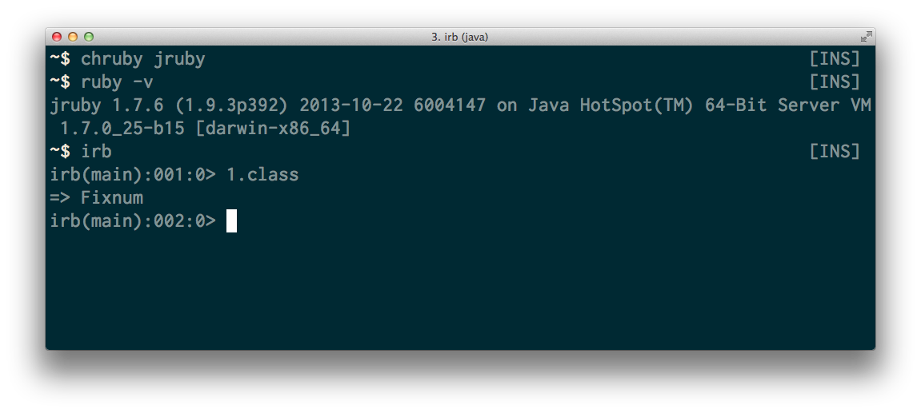
Notes:
All ruby code should just work (Rails, Sinatra etc…)
No support for C extensions
1.9 compatible

Slide 9
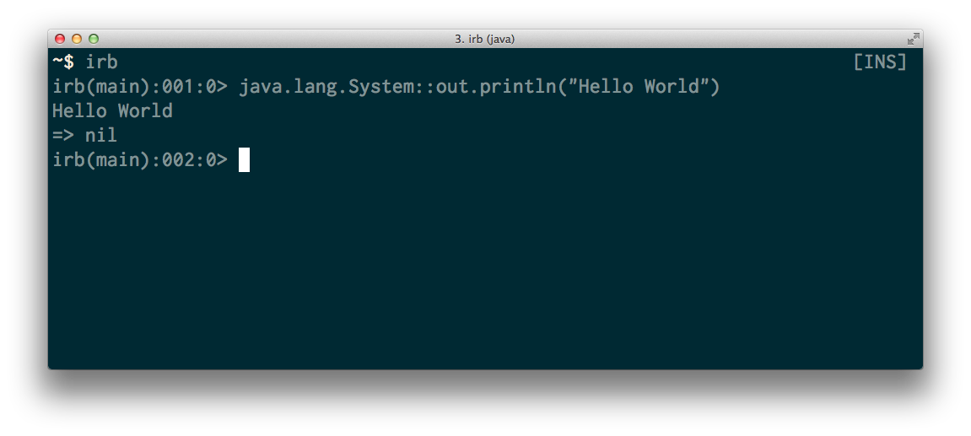
Notes:
You can call native java methods and any java code really
Defaults are under Java namespace or javax .

Slide 10
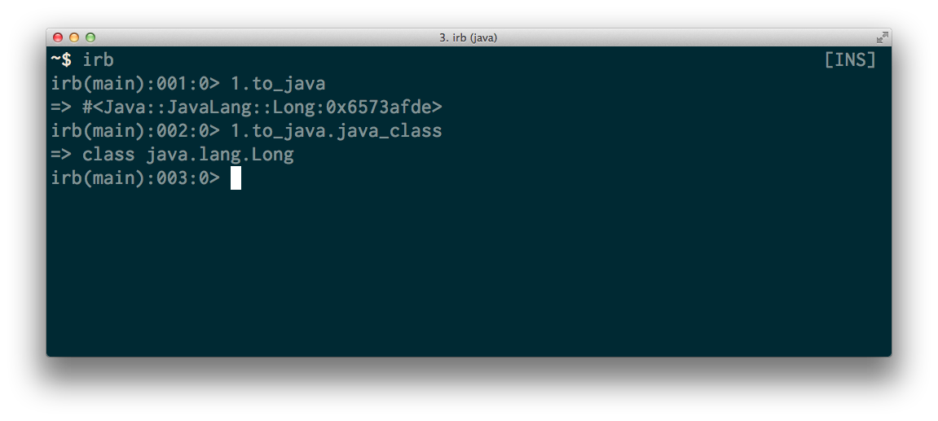
Notes:
Access to lower level Java objects
Sometimes needed to make method calls work

Slide 11
And more
GC, Java Debugging tools, Java Servers…
Notes:
Visual VM for debugging GC
Bytecode analyzers
Battle tested Java Webservers

Slide 12
Couchbase
NoSQL Document DB
Key / Value
Supports 2nd indexes
Is fast!
Is Consistent (in a cluster)

Slide 13
Couchbase Lite
Mobile NoSQL Database
Stores JSON
Supports 2nd indexes
Native on [INSERT YOUR PLATFORM HERE]
Notes:
Has a native component ( C )
Is using standart Java Idioms
Was originally written for Android (Has a lot of weirdness)

Slide 14
Couchbase Mobil
Couchbase Lite + Sync Gateway
Notes:
Let me tell you a little bit about Couchbase Lite so you know what is being build here
Syncing database for mobile devices
Lets you replicate data between databases
QUICK Demo on Mac and Pi

Slide 15
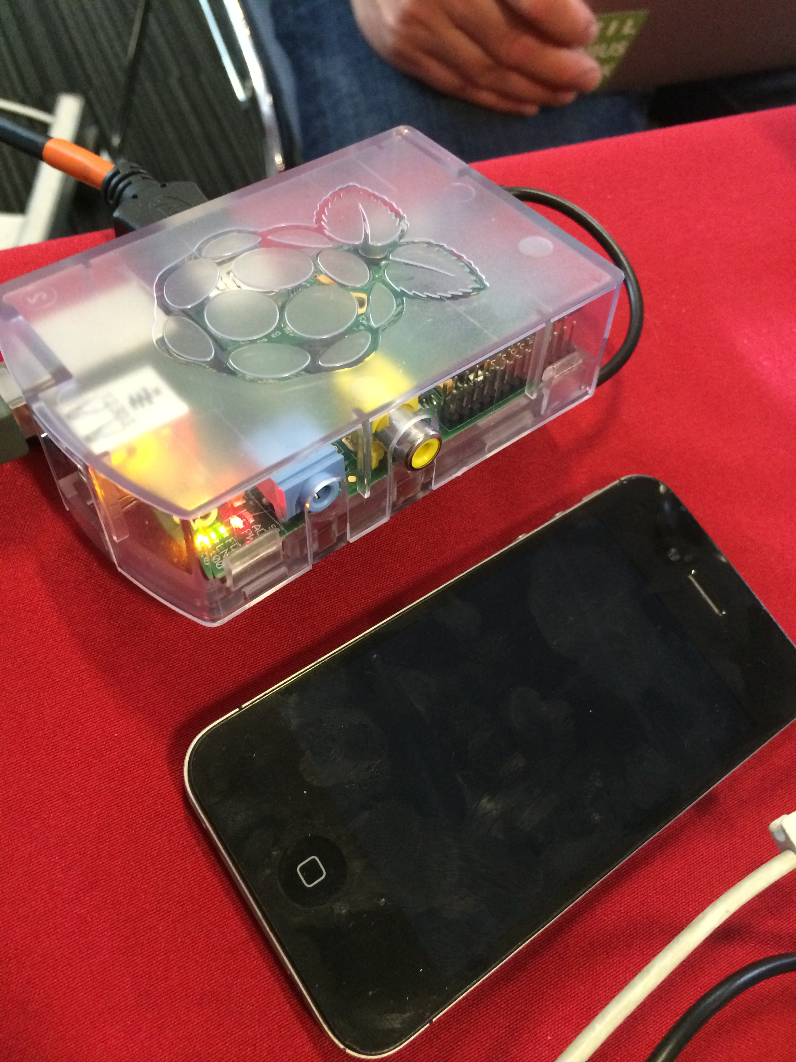
Couchbase Mobil
Couchbase Lite + Sync Gateway
Notes:
Couchbase Mobile is combination of Lite + Sync Gateway
Sync between all kind of devices
Handle authentication
And conflicts

Slide 16
Channels
Tags…

Slide 17
Authentication
Facebook, Mozilla Persona, User + Password, OAuth

Slide 18
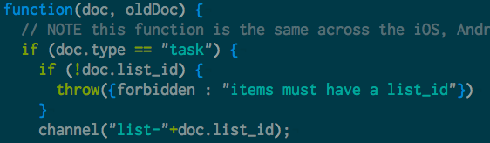
Sync Function

Slide 19
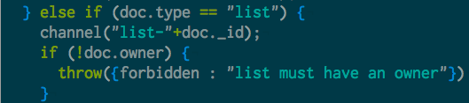
Channels
Notes:
We can have a lot of those (100.000 per instance)

Slide 20
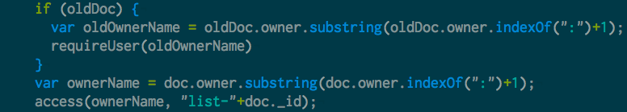
Authentication

Slide 21
Using Couchbase Lite
Notes:
So let’s talk about using JRuby and Couchbase
And how this works together

Slide 22
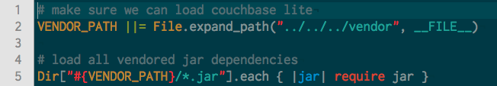
Loading JARs
Notes:
Most of the time you can just require them
Unless they have weird dependencies
If you need to load class files use java_import

Slide 23
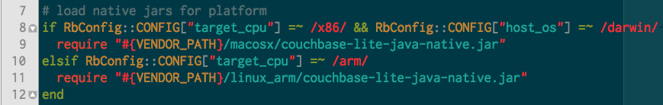
Loading native JARs
Notes:
Works almost the same
Use Ruby runtime to determine the system
This is really nice! Loading stuff at runtime makes this possible

Slide 24
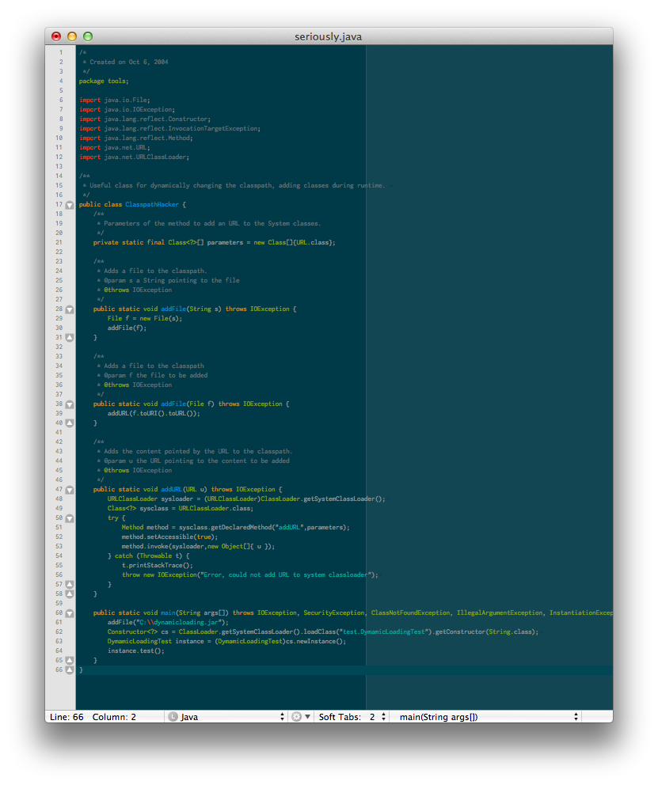
Just for reference… ;)
Notes:
Works in java as well
In just 60 lines of code…

Slide 25
Calling Java Methods
Notes:
If everything is loaded simply call the method
include_package namespaces include in module or class
Import makes it available everywhere, probably better to namespace

Slide 26
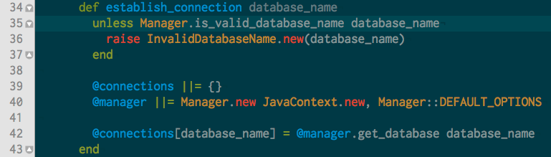
Calling Java Methods
Notes:
Using Java from JRuby feels good
You can just intermix it
And it just works, wrapping the native calls in one location is probably a good idea so
This is the database.rb file, it also has a method to return the connetion

Slide 27
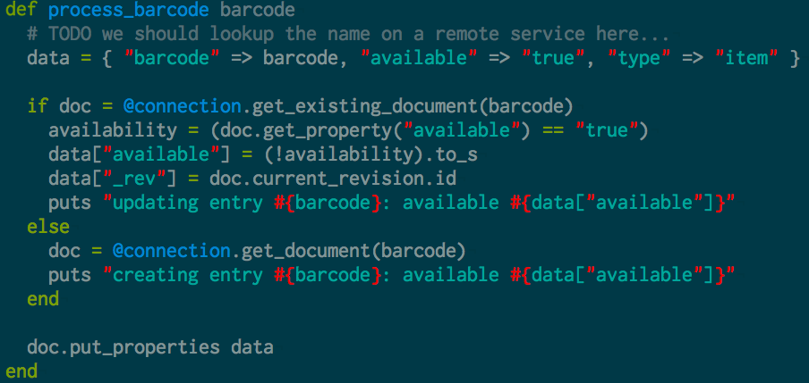
Creating Items in the database
Notes:
Like I said it’s a document database
Just store JSON
Quick note on channels for those interested those are tags for your documents
Ok this covers the basics

Slide 28
Setting up sync

Slide 29
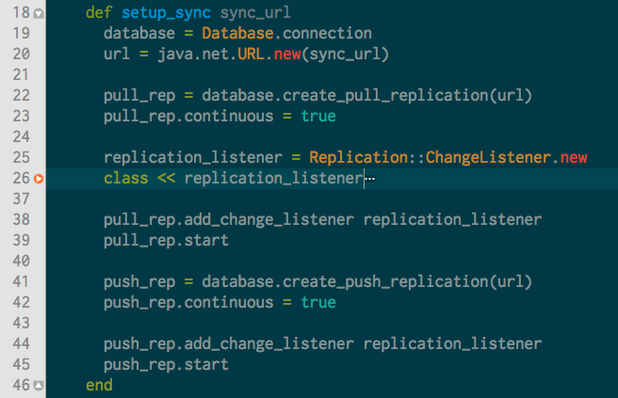
Notes:
Easy setup
We have already seen the monitoring
That will continuously replicate all the changes (this is configurabel)

Slide 30
Querying Couchbase Lite
Notes:
- Create the query

Slide 31
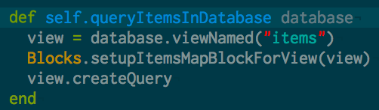
Querying Couchbase Lite
Notes:
- Index by date so they are displayed right!

Slide 32
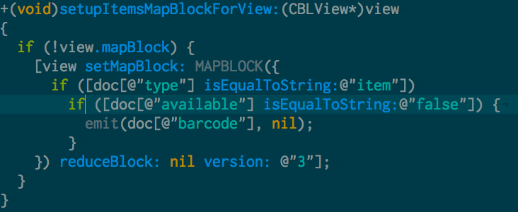
Querying Couchbase Lite
Notes:
Live query it, all changes will be listened to so we can display everything

Slide 33
Querying Couchbase Lite
Notes:
Handle the display
Standart swing table
Make sure to convert the types!
DEMO Again!

Slide 34
Putting it All together

Slide 35
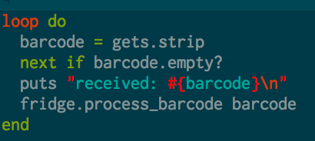
The Pi

Slide 36
Process the Item

Slide 37
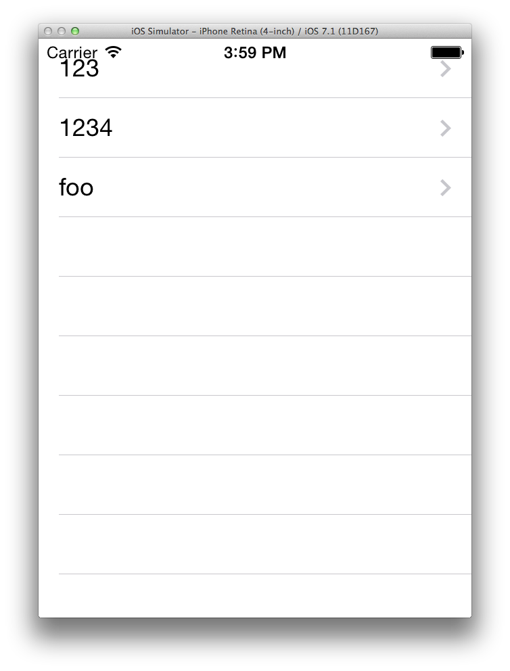
iPhone

Slide 38
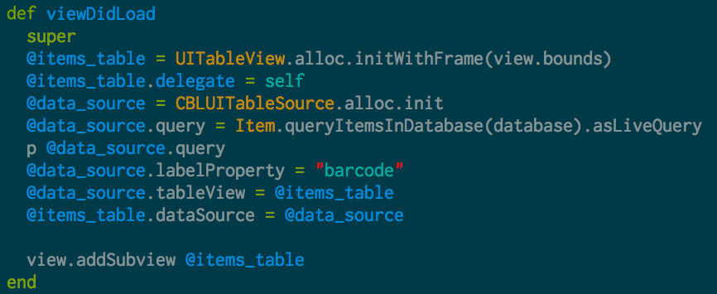
Items view

Slide 39
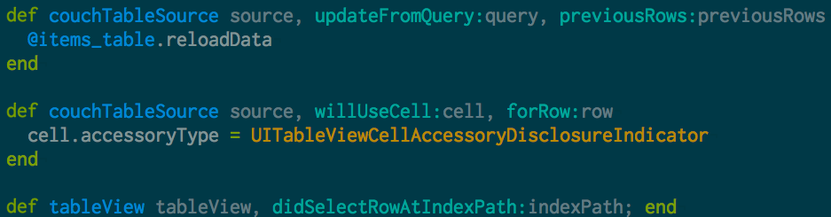
Using the DataSource
Notes:
- It’s a protocol

Slide 40
Come to SPANCONF!
http://london-2014.spanconf.io/
Tweet @matthewrevell and @spanconf right now! And you will get a discount code… later!

Slide 41


Couchbase Server 3.0 Beta Bug Bash Download, Find, Report, Win
DOWNLOAD Couchbase Server 3.0 Beta
Run some workload, play with it, FIND a bug
If you find a bug, REPORT it!
All bugs count – anything from correctness, to performance, to usability, to docs
WIN Prizes!!
http://www.couchbase.com/bugbash
Contest ends Aug 31st 2014

Slide 42
Questions?

Slide 43
Links
https://github.com/sideshowcoder/intelli_fridge
http://developer.couchbase.com/mobile/
http://github.com/couchbaselabs/pi-on-couch
http://www.couchbase.com/communities
http://jruby.org

