Slide 1

Personal Finance Management
Group’s member:
LinhLLL
GamNT
KhanhLTM
LocND
TuanNA

Slide 2

Content
Idea
Existing system review
Function list
Plan

Slide 3
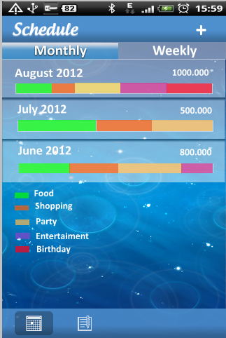
Idea
English: Personal finance management
Vietnamese: Quản lý tài chính cá nhân
Application name: Money Tracker

Slide 4
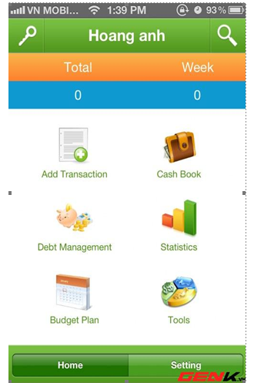
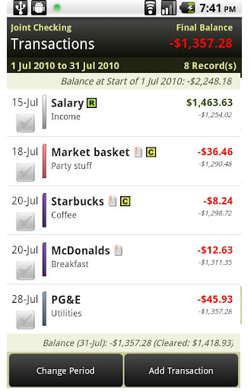
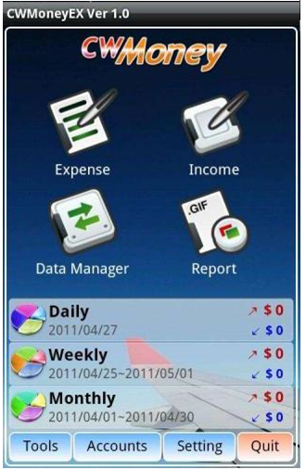
Existing system review
We reviewed with 3 system:
They don’t have enough functions which users want
Some functions are unnecessary
Example: Find place, ATM, café…
Besides, their interface is not user- friendly and it can make user misunderstand
Money Lover
Easy Money
CW Money

Slide 5
Existing system review
We have a table of comparison as follows:
Application Name | Money Lover | CWMoney | Easy Money | *Money Tracker
Expense/Income | Yes | Yes | Yes | Yes
Schedule | Yes | No | Yes | Yes
Borrowing/Lending | Yes | No | No | Yes
Synchronize Data | No | Yes | Yes | Yes
Export/Import | Yes | Yes | Yes | Yes
Transfer | No | Yes | Yes | No
Report/Chart | Yes | Yes | Yes | Yes
Input by NFC | No | No | No | Yes
User Friendly | Yes | No | Yes | Yes
Score | 7/9 | 5/9 | 7/9 | 8/9

Slide 6
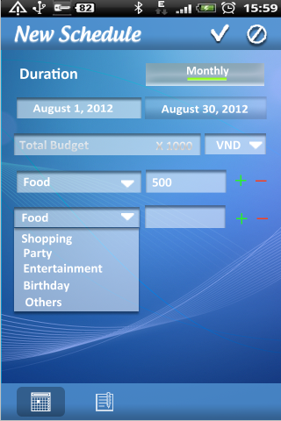
Function list
Our application have 6 main functions:
Schedule
Income and Expense management
Borrowing and Lending management
Report
Warning
Synchronization
Optional functions:
NFC payment
Q code input

Slide 7
Plan

