Slide 1
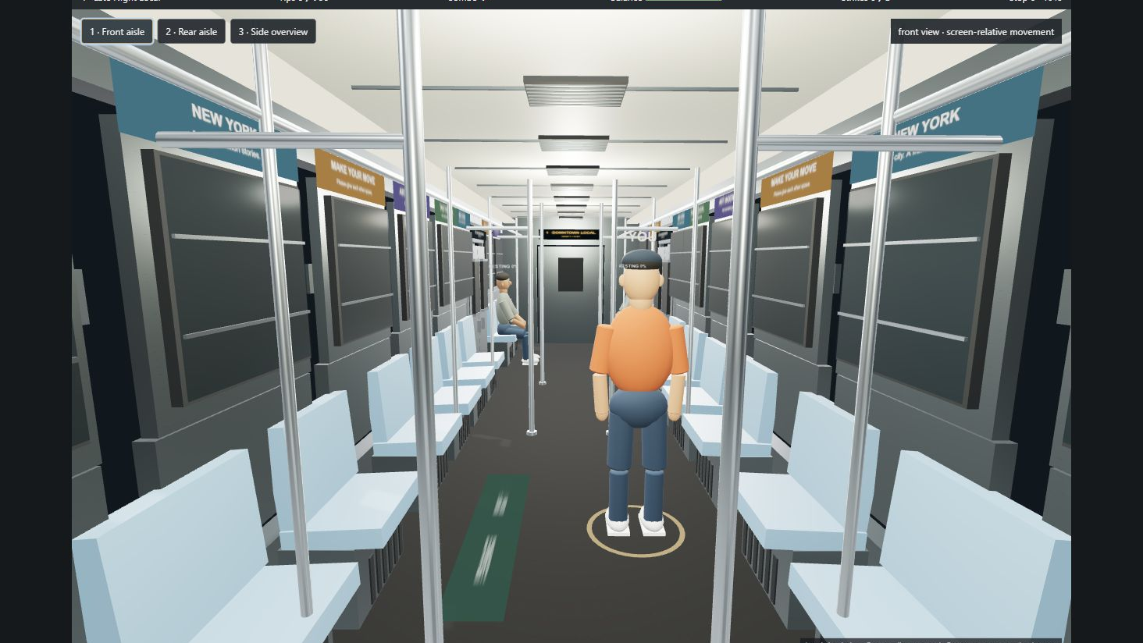
SHOWTIME
SUBWAY PERFORMER
A playable NYC subway performance game
Process documentation / Version 2
A local 3D game with an optional real-time visual enhancement layer
OCTOBER 2026

Slide 2
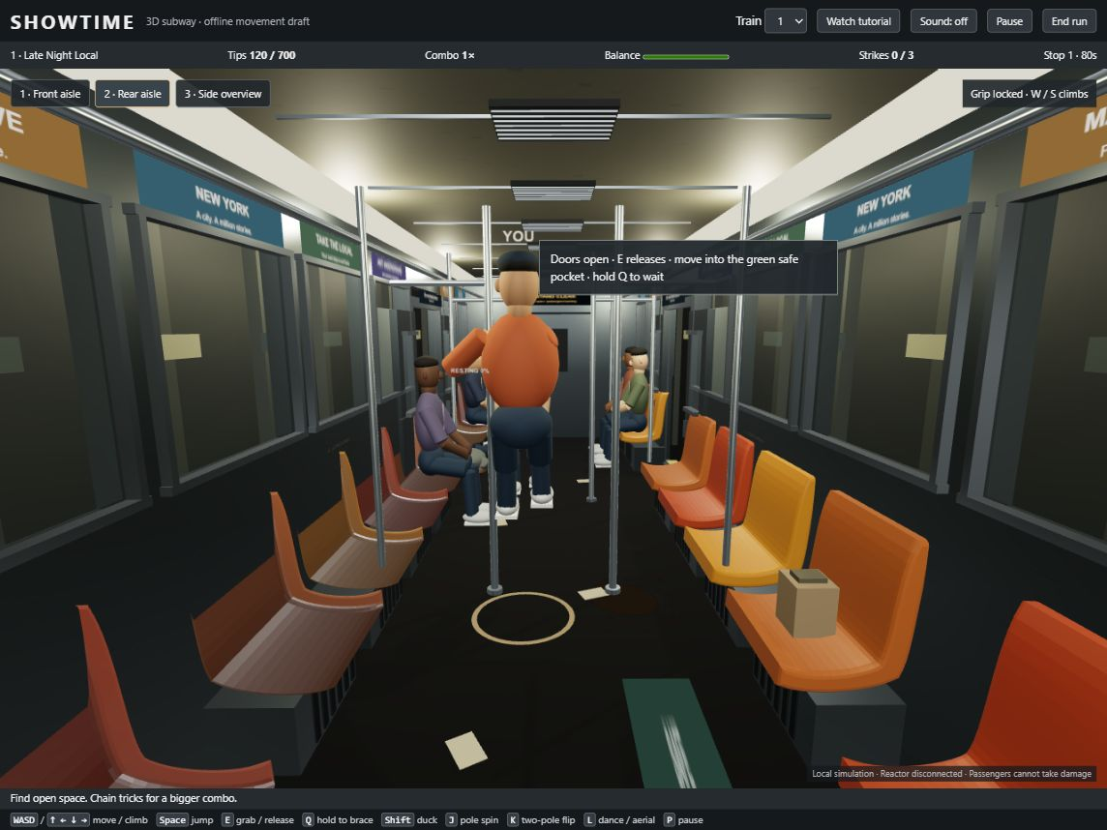
THE PREMISE
A performance game inside a moving NYC subway car
The player is a street performer working a crowded car. Every move earns attention, but every mistake costs safety.
Move through a live crowd
Use poles for fast tricks
Read turbulence before it hits
Earn tips without hitting passengers
The prototype keeps play readable first: the car, the crowd, and the rules stay visible during performance.
SHOWTIME / SUBWAY PERFORMER 02

Slide 3
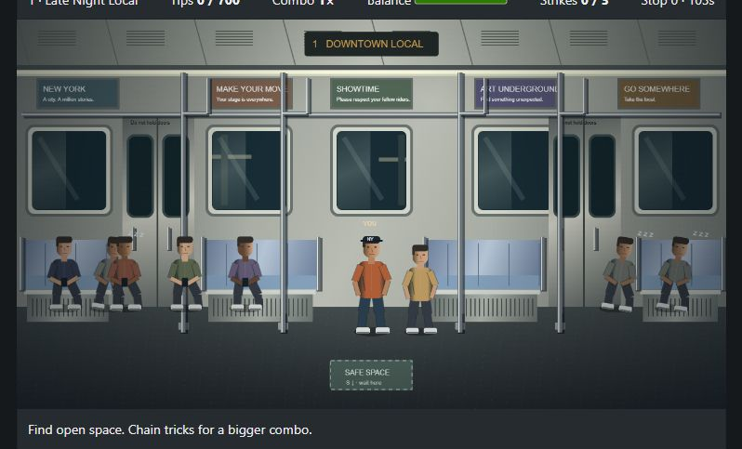
DESIGN TARGET
The target moved from flat action to a physical space
EARLY PLAYABLE DRAFT
VERSION 2 DIRECTION
Strong game loop, limited spatial depth
Enclosed train, solid obstacles, articulated riders
The visual ambition grew from a playable canvas into a contained 3D world with readable physical rules.
SHOWTIME / SUBWAY PERFORMER 03

Slide 4
BUILD PROCESS
The project grew through short, testable passes
Each pass answered one practical question before the next layer was added.
01
02
03
04
05
06
IDEA
REFERENCES
MESHY
SIMULATION
FIGMA
REACTOR
Performer fantasy and subway rules
NYC interiors, movement, crowd behavior
Rigged GLB commuter identities
Collision, balance, tricks, stations
HUD, menus, prompts, tutorial
Optional live visual enhancement
The working rule was simple: keep the game playable without Reactor, then add visual ambition around a stable simulation.
SHOWTIME / SUBWAY PERFORMER 04

Slide 5
GAME LOOP
The game loop turns attention into movement
The player constantly chooses between performance and safe positioning.
MOVE
GRIP
PERFORM
RECOVER
EARN
+
+
+
+
Find a clear pocket
Attach to a rod
Spin, flip, dance
Read the crowd and shake
Bank tips and combo
Tips are the visible reward. Strikes, noise, balance, and clearance create the pressure underneath.
SHOWTIME / SUBWAY PERFORMER 05

Slide 6
WORLD BUILDING
The train is a playable object, not a backdrop
WINDOWS
Openings show tunnel motion
POLES
Reachable contact points
BENCHES
Seats and lie-down surfaces
LIGHT
Side fluorescent strips
The renderer uses a 1280 × 832 gameplay target while the browser scales the canvas and interface to the viewport.
SHOWTIME / SUBWAY PERFORMER 06

Slide 7
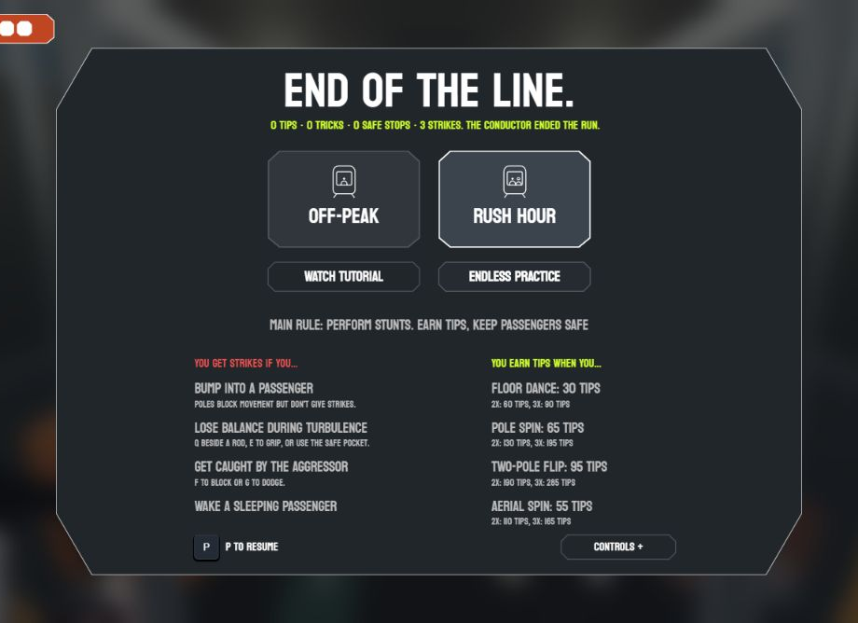
CHARACTER PIPELINE
Characters begin as roles, then become riders
MESHY AI → GLB → RIGGED RUNTIME ACTOR
18 stable identities
Showtime Acrobat as the player
Sleep Master for resting passengers
Seated, standing, commuter, and role-specific riders
Independent skeletons for every actor
Meshy supplies the base humanoid rigs. The game adds procedural poses for contact, rests, flips, falls, and pole work.
The source GLBs remain intact; runtime copies use stable web-safe names and shared loading code.
SHOWTIME / SUBWAY PERFORMER 07

Slide 8
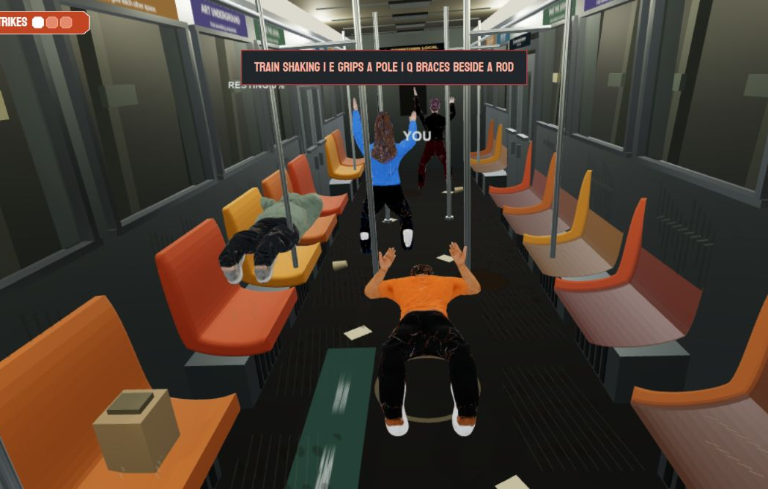
SIMULATION
Movement is built around contact and consequence
A train lurch is a test of preparation.
Unsecured grip → directional fall
Q beside a reachable rod → brace
Crowd and poles stop movement
Clearance is checked through the stunt
The simulation owns the timing, collision, balance, score, and strike. Rendering follows the result.
The visual goal is fast action that still reads clearly: hands, poles, bodies, and consequences remain legible.
SHOWTIME / SUBWAY PERFORMER 08

Slide 9
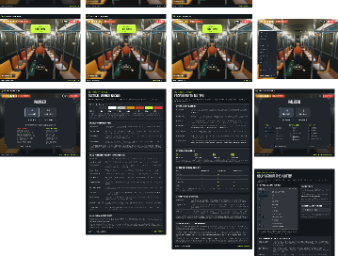
UI WORKFLOW
The interface came from Figma, then became live state
DESIGN SOURCE
Game UI.fig
HUD and cumulative tips
Pause and mode selection
Tutorial and action prompts
Turbulence and line warnings
Expanded controls and rewards
SVG surfaces and the Koulen display type were brought into the browser as editable HTML/CSS, while values stay connected to the simulation.
The Figma file defines the visual language; the game state defines what the UI is allowed to say.
SHOWTIME / SUBWAY PERFORMER 09

Slide 10
IMPLEMENTATION
A simple architecture keeps the experiment changeable
One state object drives the rules. Rendering stays downstream.
RENDER
INPUT
GAME STATE
RULES
REACTOR
HUD / UI
The same simulation can render locally, record to MP4, or feed the optional visual model.
The separation makes the offline game dependable and keeps Reactor from owning the player’s physics.
SHOWTIME / SUBWAY PERFORMER 10

Slide 11
REACTOR DIRECTION
Reactor adds a visual pass after the game is already working
LOCAL 3D RENDER
Canvas captureStream(24)
+
X2 model + NYC prompt
=
Returned main_video
geometry + gameplay truth
materials + lighting + realism
optional enhanced exhibition view
Prompt direction
STATUS
Consistent stainless-steel NYC subway car, curved orange benches, dark speckled floor, side fluorescent lights, dim aisle, worn ads, grime, fingerprints, graffiti, tunnel motion. Preserve framing, poles, players, passengers, and gameplay actions.
Wired in the local app. Stable LIVE verification remains the next technical gate.
Reactor can repaint the frames. It should not decide whether a player collides, grips, falls, scores, or wins.
SHOWTIME / SUBWAY PERFORMER 11

Slide 12
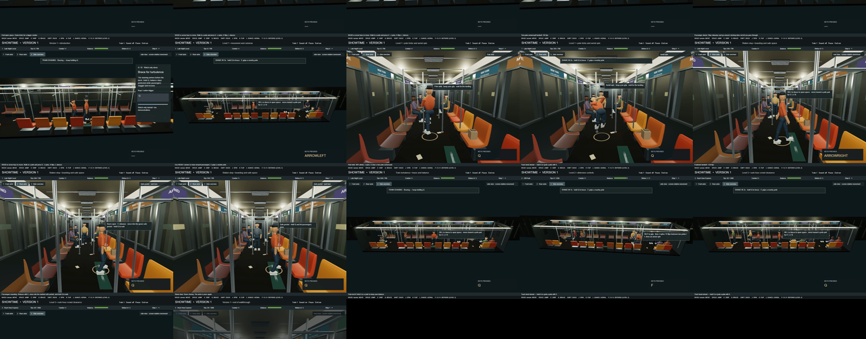
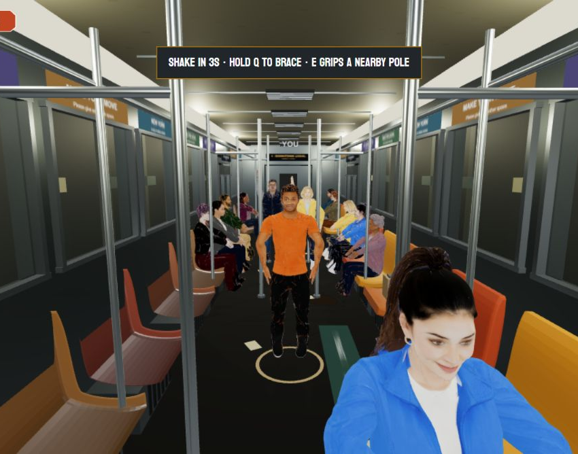
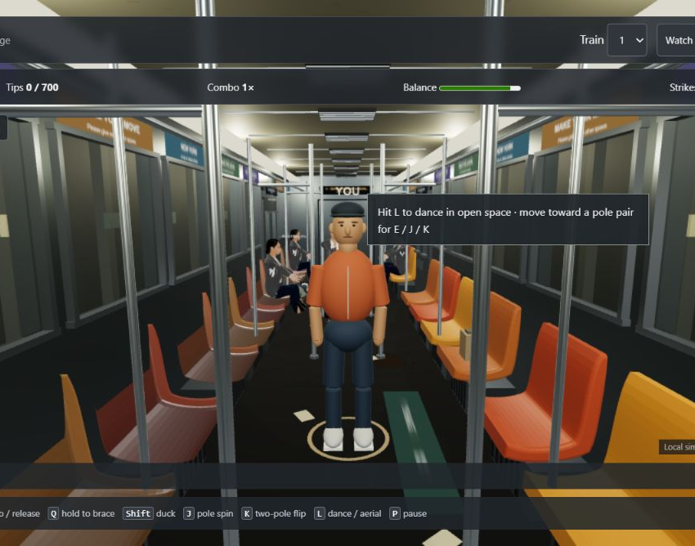
EVIDENCE
The prototype is documented as a playable system
30
18
3
10
1280 × 832
automated checks passing
stable character identities
contained camera views
watch-only tutorial scenes
gameplay render target
Evidence includes gameplay videos, contact sheets, browser captures, character loading checks, and automated regression tests.
SHOWTIME / SUBWAY PERFORMER 12

Slide 13
NEXT VERSION
The next milestone is visual consistency under pressure
NOW
Stabilize local 3D game
Responsive layout, character loading, camera framing, fast actions
NEXT
Verify Reactor in a controlled scene
Token, SDK, source publishing, prompt acceptance, returned video
THEN
Add reference conditioning
One subway interior image before a session begins
TEST
Stress the risky actions
Pole grip, flips, turbulence falls, dense crowds
DELIVER
Package the exhibition build
Clean walkthrough, source, documentation, and MP4 evidence
The exhibition version should show a reliable local game first, then make the Reactor pass visible as an enhancement rather than a dependency.
SHOWTIME / SUBWAY PERFORMER 13

Slide 14
SHOWTIME
SUBWAY PERFORMER
An exhibition-ready prototype about movement, attention, and shared space.
DELIVERY PACKAGE
Playable Vite project
Meshy GLB character cast
BUILD THE WORLD FIRST.
THEN LET THE VISUAL LAYER PUSH IT FURTHER.
Figma-derived interface
Automated gameplay tests
Walkthrough videos and screenshots
Living project documentation
Version 2 process documentation / 2026

