Slide 1








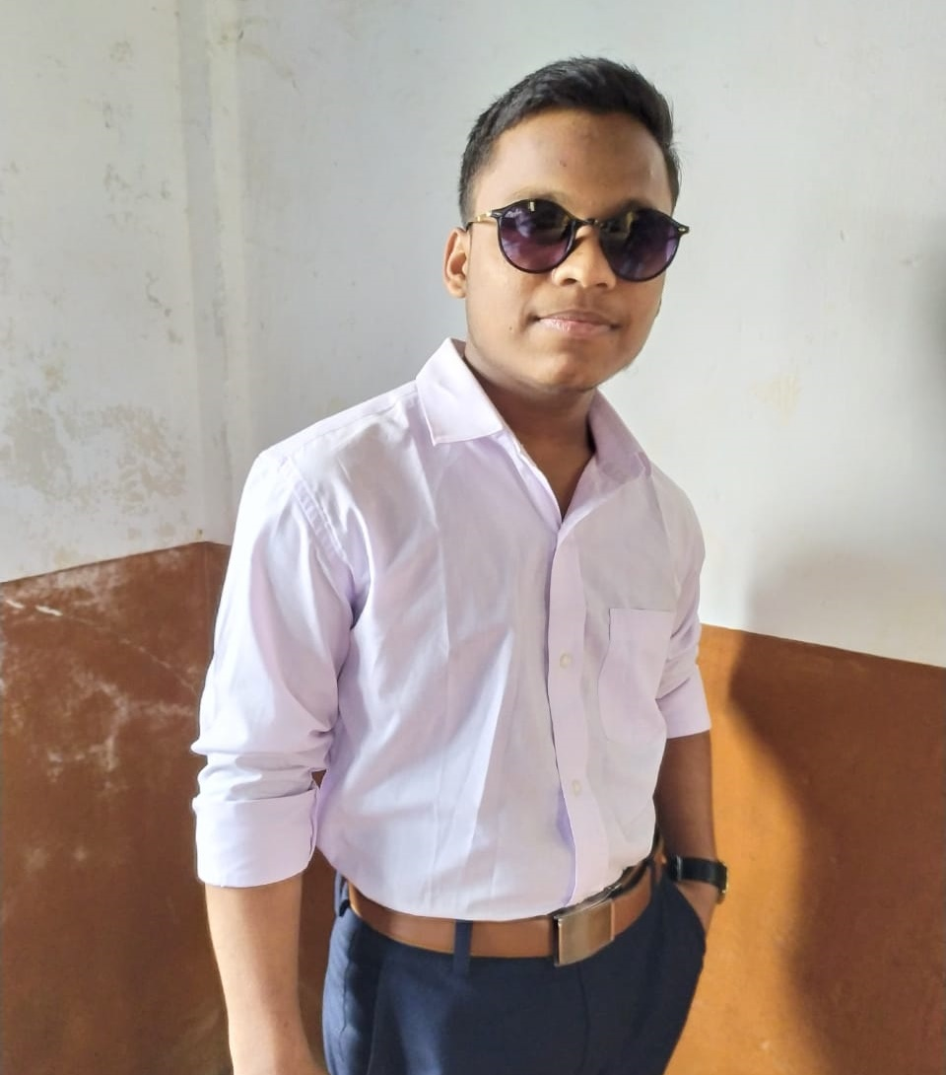








SIDDHESH
MUMBAI CITY,
BHNADUP
SHINDE
PERSONAL
INFO
EDUCATION
2007
SY CS 2022-23
BIRTH DATE
Web Designer, Developer , Photographer + editor
2 Jan 2004
2010
HSC 2020-21
NATIONALITY
2015
SSC 2089-19
INDAIN
YEARS OF EXPERIENCE
2018
5 years
ABOUT ME
CONTACT
INFO
Hi I’m a photographer
Studying in SY Computer Science at
N.E.S. Ratnam College
AGE : 19
PHONE
9119573180
EMAIL
2010
2011
2013
2016
2017
2018
2019
siddheshshinde133@gmail.com
LANGUAGES
ENGLISH
HINDI
EXPERTISE
SKILLS
13
SNAPSEED
MARATHI
50
PIXLR
LIGHTROOM
PHOTO-
EDITING
PHOTOSHOP
HOBBIES
25
CANCVA
CANVA-
DESIGNING
12
EDITING
PIXLR

