Slide 1
European Hotel Analysis
Aishwarya Gunasekar (801027901)
Alisha Gujarathi (801020254)
Dhiksha Ramkumar (800987925)
Priyanka Sawant (801024108)
Shilpa Khandelwal (801038137)
Siddhant Gokule (801017213)

Slide 2
Introduction
Problem : Hotel reviews are available in abundance today. Not all the information are relevant and easy to understand.
Objective: Analyzing huge data set of hotel reviews and creating visualizations that can communicate all the information clearly.

Slide 3
Process Followed
Process
Data Analysis
Data Preprocessing
Data Visualization
Data Modelling
Checking Shape Of Data
Null Value Removal
Created Basic Visulaization
Hypotheses formulated
Distribution of data
Handling Missing Values
Draw preliminary conclusions
Algorithm Selection
Variable Of Importance
Changing format of Features
Hypotheses Created
Algorithm Comparison
Draw preliminary conclusions
Eliminating Duplicate Values
Result

Slide 4
Data
Following are the variable of importance:
Hotel_Address
Review_Date
Average_Score
Hotel_Name
Review_Total_Negative_Word_Counts
Review_Total_Positive_Word_Counts
Positive_Review
Negative_Review
Reviewer_Score
Tags
Lat
Long

Slide 5
Data Preprocessing
Order of data preprocessing:
Found the total number of rows with missing values
Removal of Null values
Eliminated duplicate values
Uniformly format the date column to a single format

Slide 6
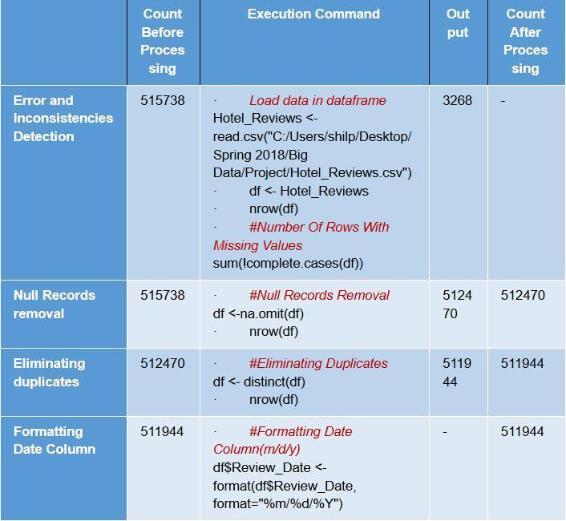
Data Preprocessing Result

Slide 7
Data Visualization
Basis visualizations were created to get better understanding of data and draw some preliminary conclusion:
Top 10 rated hotel
The range of Average score
Hotel Location with Average Score
Uniformly format the date column to a single format
Relationship between Tags and Total number of reviews
Average scores of hotels

Slide 8
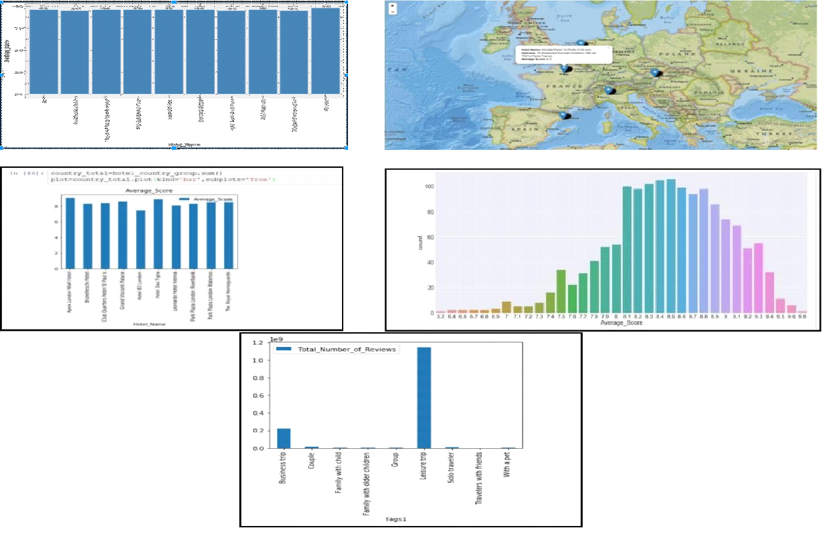
Snapshot Of Visualization

Slide 9
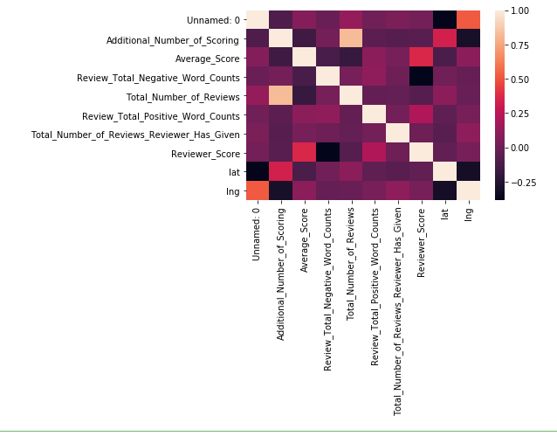
Correlation Matrix

Slide 10
Preliminary Conclusions
Some of the preliminary conclusions made from visualizing the data:
Hotel Ritz is the one with highest Average Score of 9.8
Most of the hotels have average score 8 and above. Very rare hotels have average score 7 or below
For Leisure trip we have the most number of reviews.
Hotels average score lie in the range of 5.2 and 9.8.
We see that there is a surprisingly high negative correlation between the Negative word counts and the Reviewer_score suggesting that a lot of people are tending to give positive reviews.

Slide 11
Hypotheses
Depending on the pre-processed data, few hypothesis that were formulated. These hypothesis were formed to improve the experience of both the hotel users and the hotel managers.
Co-relation between Reviewer nationality and Reviewer score.
Predicting Average score of the Hotel based on Country, Hotel and Tags.
Suggest Best Hotel based on both Average score and Re-viewer Score.
Predict recommendation based on hotel profile.
Sentiment Analysis.
Finding important words/phrases that are indicative of re-viewer score.

Slide 12
Data Modelling
Data Partitioning
Training Dataset
Testing Dataset
Data Modelling
Multiple Linear Regression
Gradient Boosting Regressor
Random Forest Model
Sentiment Prediction
Neural Network Model.
Decision tree

Slide 13
Multiple Linear Regression
Hypothesis:
Co-relation between Reviewer nationality and Reviewer score.
Idea Multiple Linear Regression:
Multiple linear regression attempts to model the relationship between two or more explanatory variables and a response variable by fitting a linear equation to observed data.
Objective:
Given a Reviewer Nationality, is there a way to predict Reviewer score.

Slide 14
Steps:
Choosing of top 5 countries
Converting categorical values to numerical values
Data partitioning
Prediction of average score
Calculation of accuracy
Results:
Reviewers with Australian nationality gave the highest scores vs Guests from United Arab Emirates who gave the lowest among the 5 countries

Slide 15
Gradient Boosting Regressor
Hypotheses :
Find important words/phrases that are indicative of reviewer score.
Idea Gradient Boosting Regressor:
Gradient boosting is a technique, which produces a prediction model in the form of an combination of weak prediction models, typically decision trees.
Advantage: It can be used for both classification and regression problems, and it predicts very fast.

Slide 16
Steps:
The hotel analysis dataset is considered and read.
Dataset being large, it is divided into train and test sets.
The regression model is trained on 20 percent of the data and validated on 80 percent of the data
The validation set is split into three parts for analysis.
Applying a Gradient Boosting Regressor yields a model that tells us the importance of words.

Slide 17
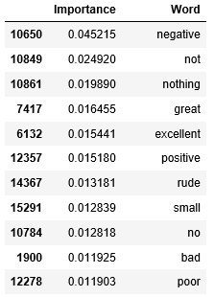
Result

Slide 18
Random Forest
Hypotheses :
Predict the recommendation based on hotel profile. Using random forest model predicted weather a hotel is recommended or not.
Idea Behind Random Forest:
Random forest builds multiple decision trees and merges them together to get a more accurate and stable prediction.
Advantage: It can be used for both classification and regression problems, which form the majority of current machine learning systems.

Slide 19
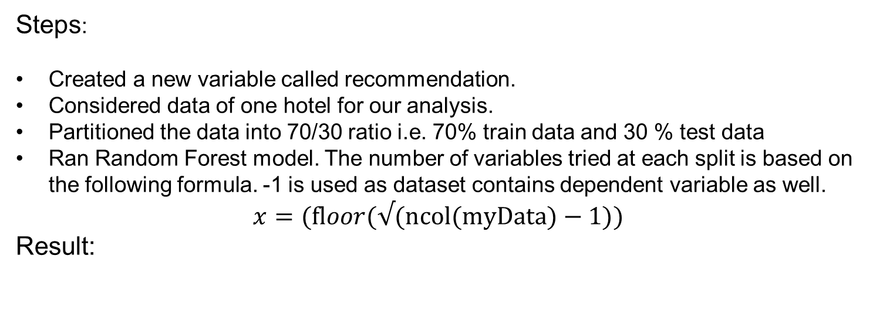
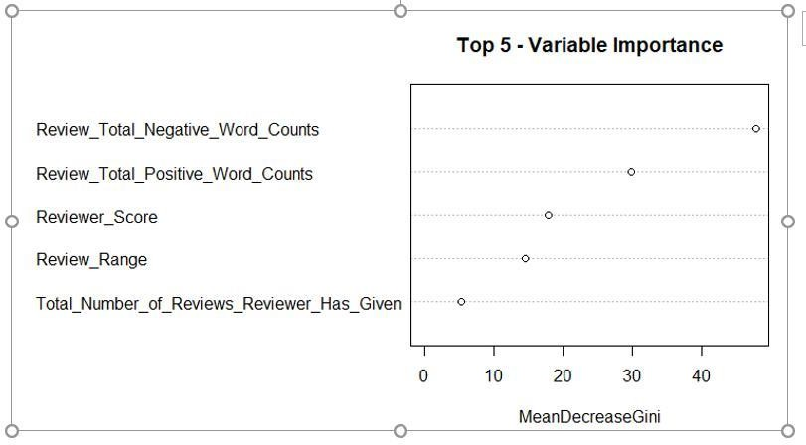

Slide 20
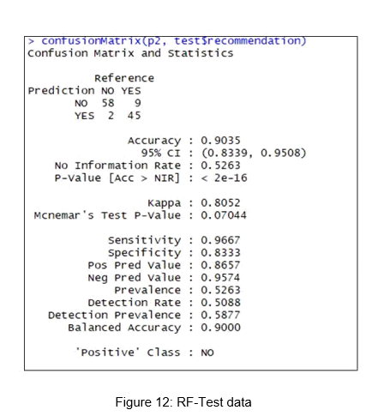
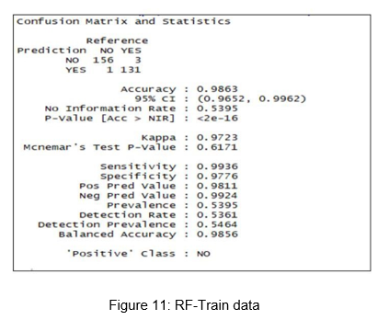

Slide 21
Neural Network Model
A model that imitates human brain processing
Require less formal statistical training and implicitly detect nonlinear relationships
Model predicts the Average Score based on
• Hotel Name
• Country of the Hotel
• Purpose of the trip
Data was partitioned as 60% train data and 40% validation data

Slide 22
Neural Network Model
Steps:
1. Select top 30 hotels based on average score and sampled the data.
2. Extract country from hotel address
3. Convert country, hotel and tags columns from string to numeric values
4. Partition data into train and test data
5. Train the neural network to predict average score of the hotel on given input parameters using XLMiner

Slide 23
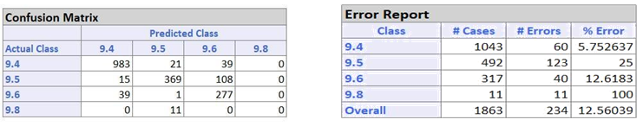
Neural Network Model
Result:
•The model correctly predicted 2462 records out of total 2794 records with an error rate of 11.88% for training data
•For validation data the model only had 234 misclassifications in total with an error rate of 12.56%

Slide 24
Decision Tree
In a decision or a classification tree each internal (non-leaf) node is labeled with an input feature and the child node gives the results of the decision
Goal: To predict the hotel, given average score and reviewer score based on the past data.
Steps:
1. Selected top 30 hotels based on average score and sampled the data.
2. Converted hotel name columns from string to numeric values
3. Partitioned data into train and test data.
4. Build classification tree using XL miner on training data

Slide 25
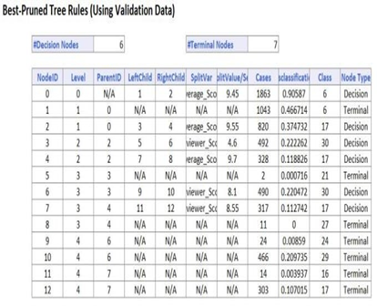
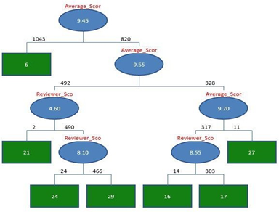
Result:

Slide 26
SENTIMENT ANALYSIS
Hypotheses :
Predict the sentiment for a given review based using natural language processing and application of support vector machines.
Idea Behind Sentiment Analysis:
Sentiment analysis helps the user understand the sentiment behind a particular review, hotel, or location.
Advantage: The user need not go through the tedious process of going through every review and understanding the sentiment the reviewer wants to convey.

Slide 27
STEPS:
The Positive and Negative reviews for each row were first separated out and their intensities were computed in the range of -1.0 to +1.0.
The resulting data consisted of each review associated with a numerical weight for it's positive review and a numerical weight it's negative review.
Changing the weights of “NO POSITIVE” and “NO NEGATIVE” each to 0.0.
This improved the performance of the model.
A new sentiment score was derived from the individual positive and negative weights to reflect the overall sentiment of the review. They were assigned into 6 categories in specific ranges: -
This data was then trained using various machine learning classifiers to choose the one with the best accuracy with train:test partitions of (80:20).
-1.0 to -0.7 - HIGHLY DISAPPOINTED
-0.7 to -0.4 - DISAPPOINTED
-0.4 to -0.1 - SAD
-0.1 to 0.2 - NEUTRAL
0.2 to 0.5 - HAPPY
0.5 to 0.8 - DELIGHTED
0.8 and above - CAPTIVATED

Slide 28
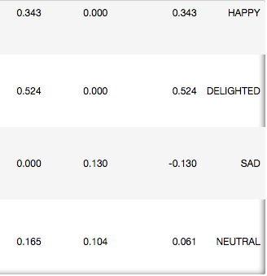
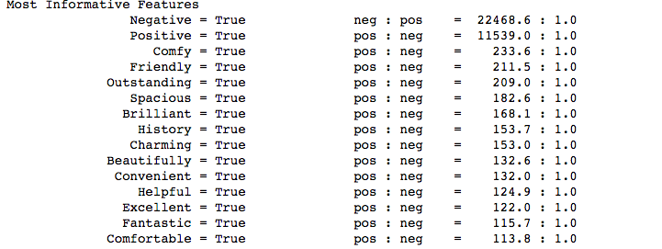
RESULTS:

Slide 29
Strategic Recommendation
Naive Bayes Algo accuracy percent: 93.24594610416219
MNB_classifier accuracy percent: 93.28399711202607
BernoulliNB_classifier accuracy percent: 92.93519620660722
LogisticRegression_classifier accuracy percent: 94.7499365816535
SGDClassifier_classifier accuracy percent: 94.4674810232794 LinearSVClassifier accuracy percent: 94.89430778613539

Slide 30
Conclusion
In conclusion our analysis can be beneficial for both owner and customer.
Hotel owners can improve the ratings and reviews of their hotels by analyzing and prevailing their shortcomings.
At the same time the customers can choose the best hotel suiting their needs from the model trained on this data that predicts a best hotel given certain inputs.

Slide 31
Thank You..

