Slide 1

PetWorld
SJSU CMPE 138 Team 2
Abhishek Madan (969)
Bhakti Shah (916)
Siddharth Gore (037)
Xiaoyu Zhou (038) (LEAD)

Slide 2

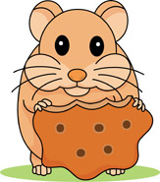






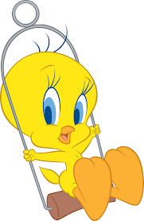

What is PetWorld?
REQUEST
Register Me
Approve Request
Registered.
Your id: XX
Organization
Register Me
I Need A Pet
PET WORLD
Organization
Customer
Donors
Adopters

Slide 3
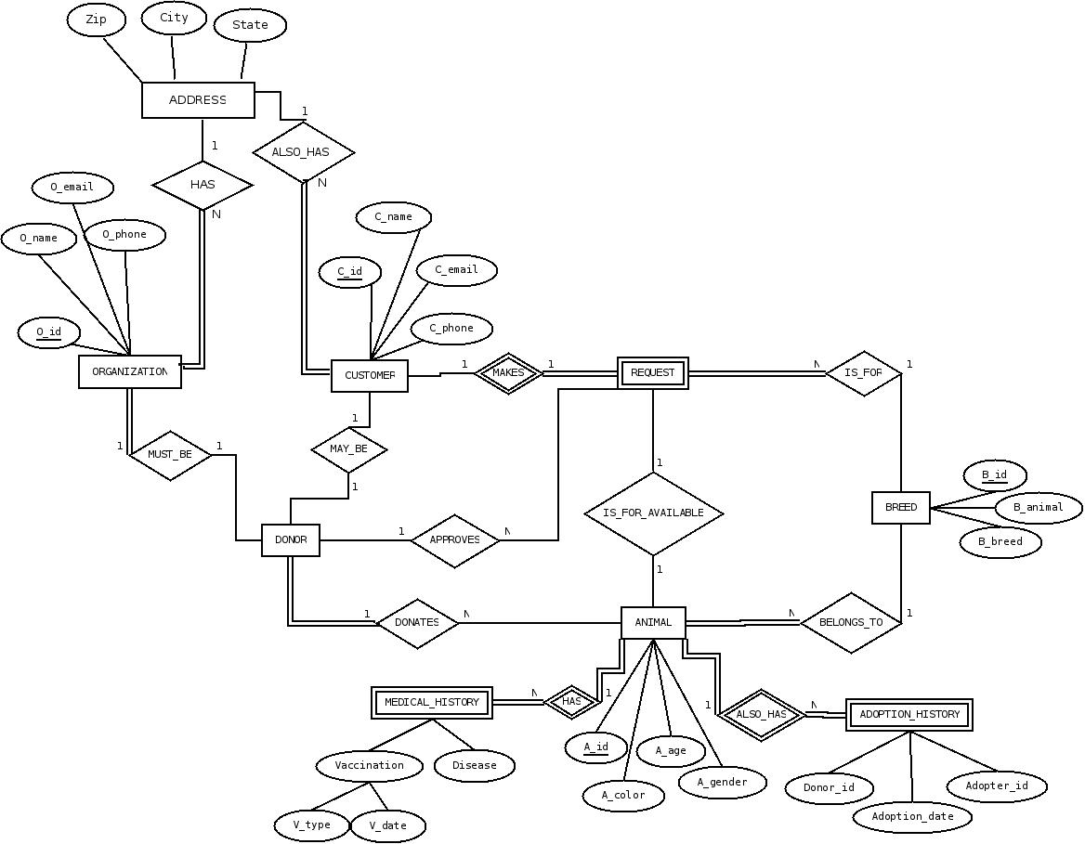
ERD
Request_id
N
N
N
N
N
N

Slide 4
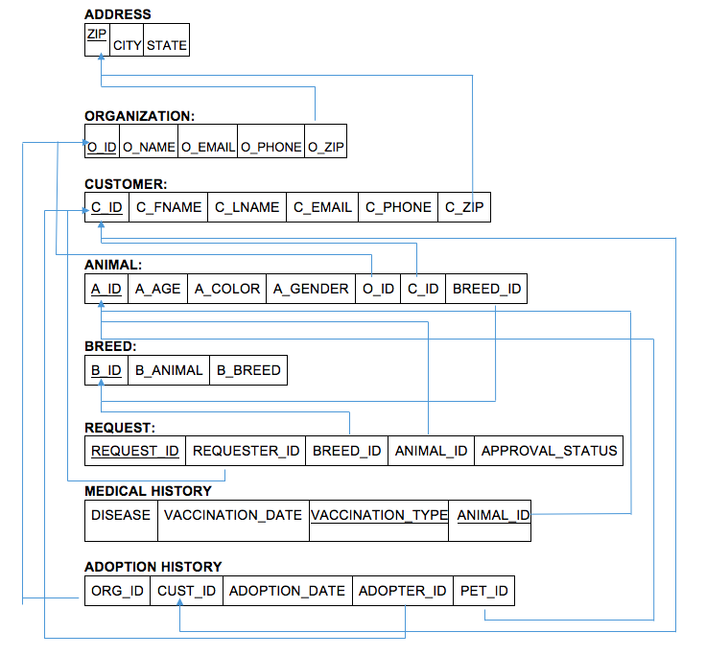
Tables

Slide 5
Normalization Discussion
ADDRESS:
1NF: YES 2NF: YES 3NF: YES
ORGANIZATION:
1NF: YES 2NF: YES 3NF: YES
CUSTOMER:
1NF: YES 2NF: YES 3NF: YES
ANIMAL:
1NF: YES 2NF: YES 3NF: YES
ZIP | CITY | STATE
O_ID | O_NAME | O_EMAIL | O_PHONE | O_ZIP
C_ID | C_FNAME | C_LNAME | C_EMAIL | C_PHONE | C_ZIP
A_ID | A_AGE | A_COLOR | A_GENDER | O_ID | C_ID | BREED_ID

Slide 6
Normalization Discussion (con’t)
BREED:
1NF: YES 2NF: YES 3NF: YES
REQUEST:
1NF: YES 2NF: YES 3NF: YES
MEDICAL_HISTORY:
1NF: YES 2NF: NO (further normalization would result into too many small tables)
ADOPTION_HISTORY:
1NF: NO (No PK. we don’t need PK here.)
B_ID | B_ANIMAL | B_BREED
REQUEST_ID | REQUESTER_ID | BREED_ID | ANIMAL_ID | APPROVAL_STATUS
ANIMAL_ID | VACCINATION_TYPE | VACCINATION_DATE | DISEASE
ORG_ID | CUST_ID | ADOPTION_DATE | ADOPTER_ID | PET_ID

Slide 7
Demo Time

Slide 8


Slide 9


