Slide 1
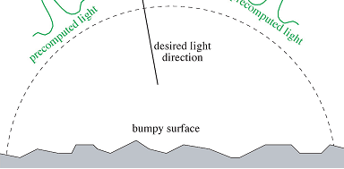
Precomputed Image
Precomputed
Image
Desired light Direction
Bumpy Surface

