Slide 1


TREGGO
CONNECT IT LABS
www.connectitlabs.in

Slide 2



About TREGGO
ADMIN
CUSTOMERS
TREGGO
KITCHEN

Slide 3
FEATURES
Take a headstart for your hotel / restaurant from others by automating it with TREGGO.
Treggo creates a digital menu card for your customers, from which your customers can order their favourite food on the device attached to your table directly to your kitchen!
Customers can track live status of the order right from their table.
Managers and kitchen users can recieve orders automatically as soon as your customer decides, what they want to have.
Manage previous orders, sales report, print bills, provide discount coupons and manage your products at realtime.

Slide 4
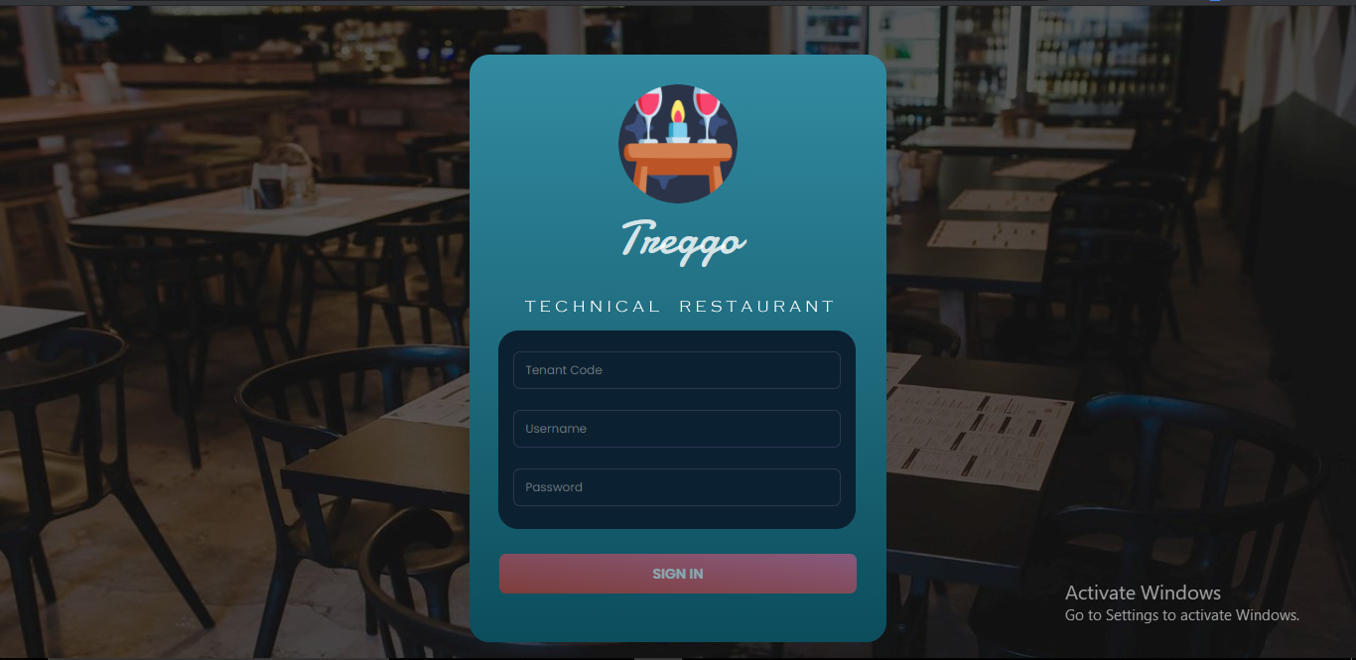
ADMIN APPLICATION

Slide 5
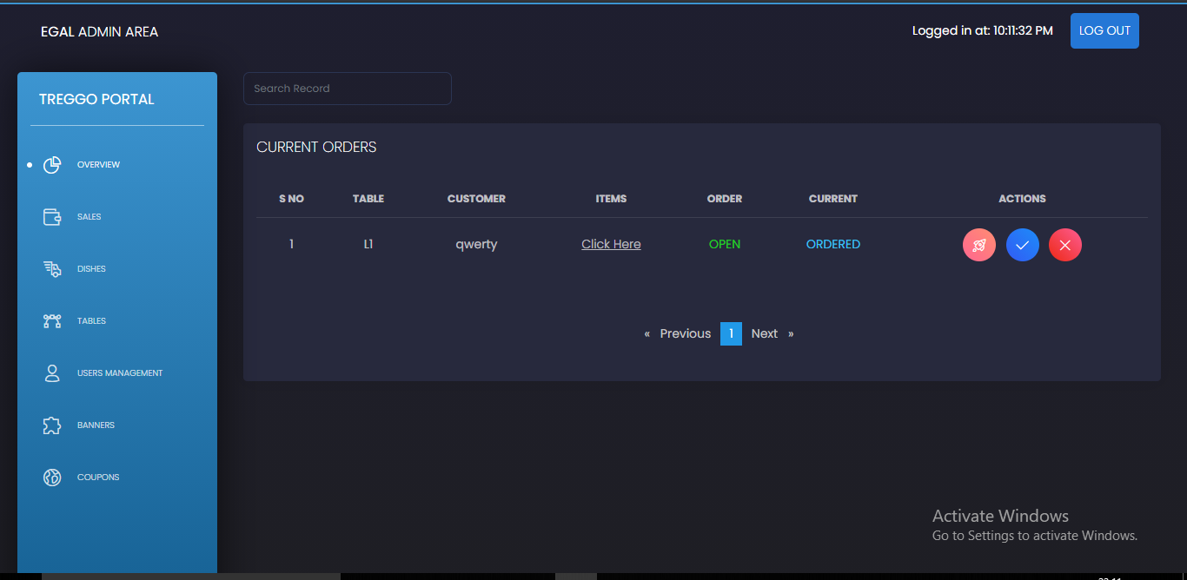
ADMIN APPLICATION

Slide 6
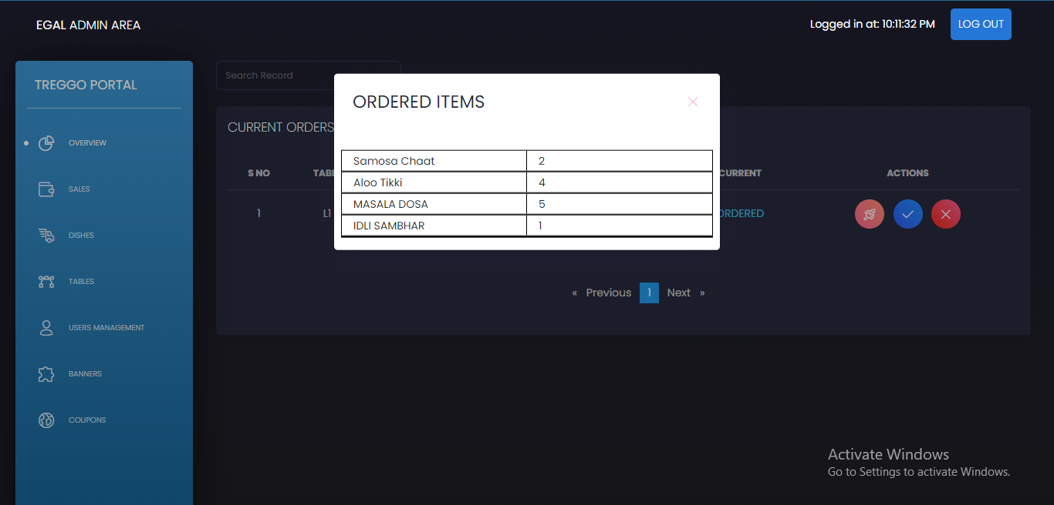
ADMIN APPLICATION

Slide 7
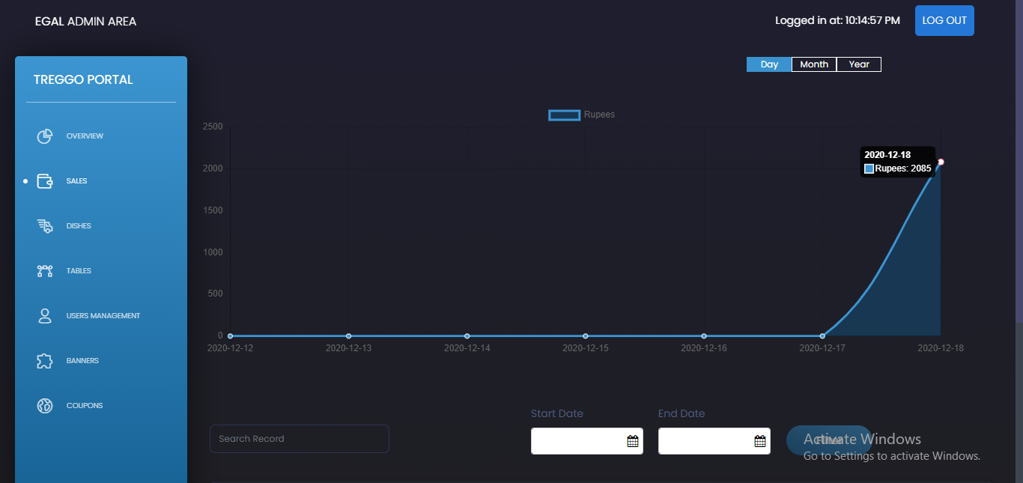
ADMIN APPLICATION

Slide 8
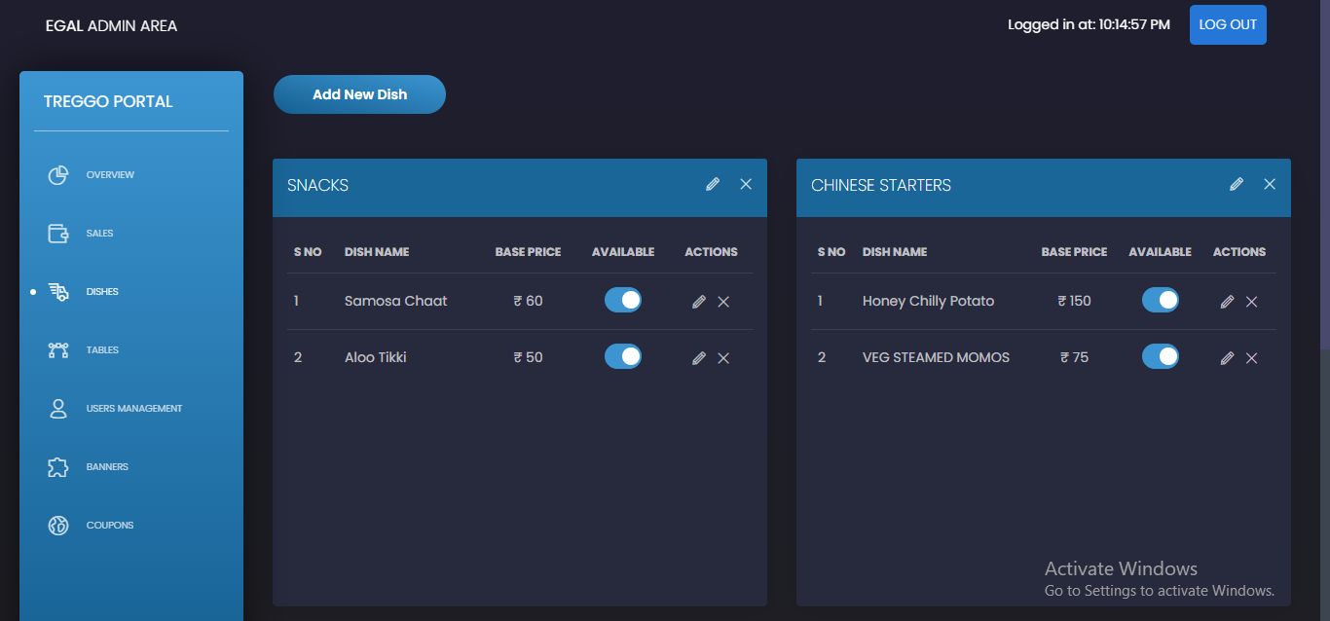
ADMIN APPLICATION

Slide 9
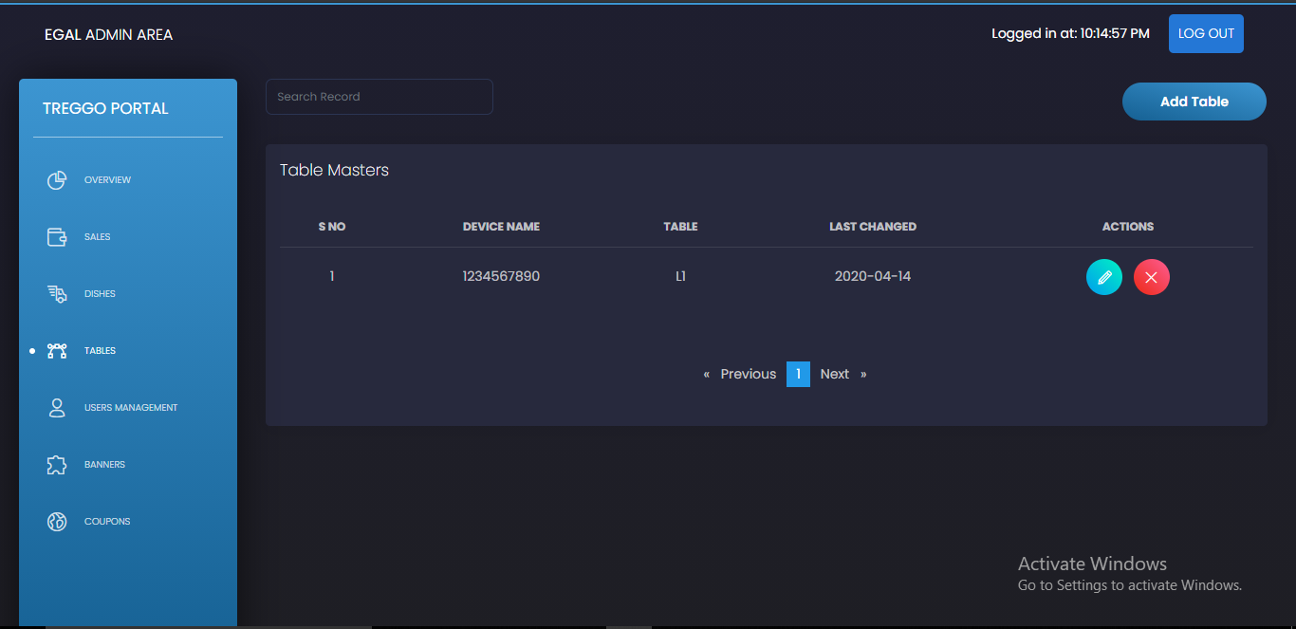
ADMIN APPLICATION

Slide 10
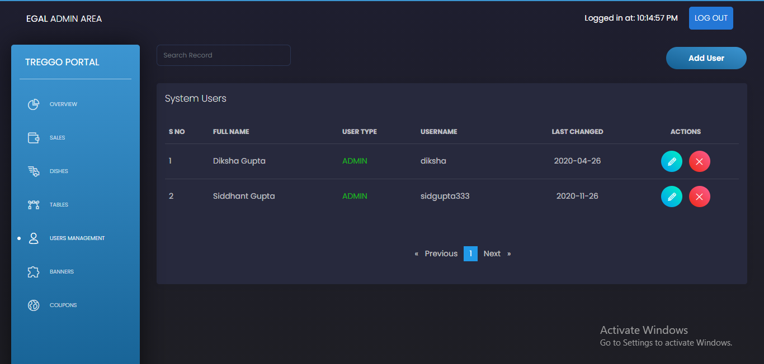
ADMIN APPLICATION

Slide 11
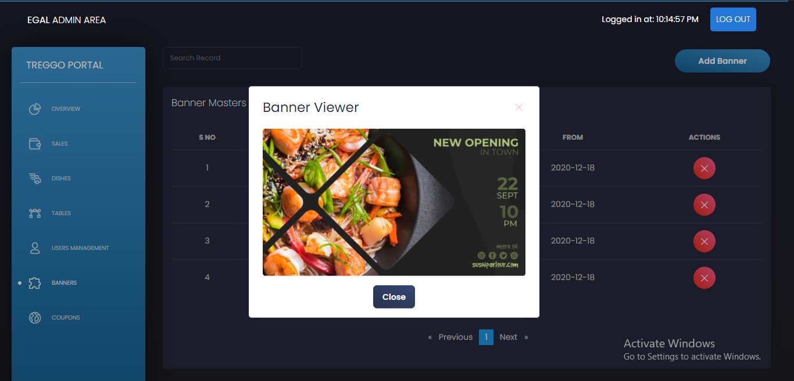
ADMIN APPLICATION

Slide 12
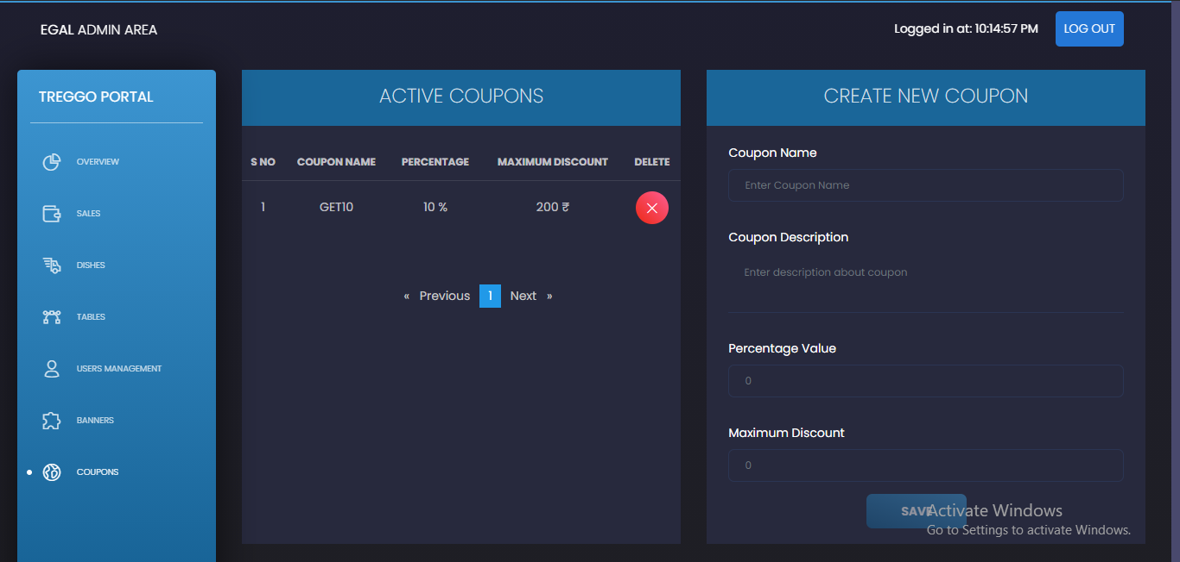
ADMIN APPLICATION

Slide 13

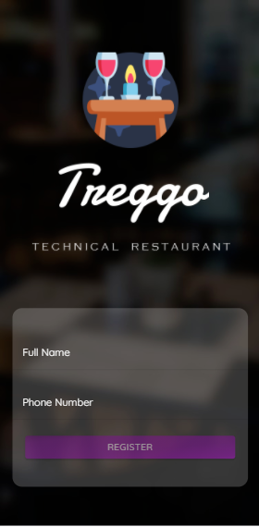
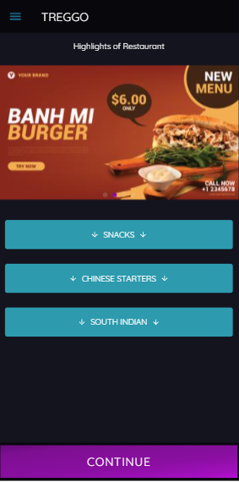
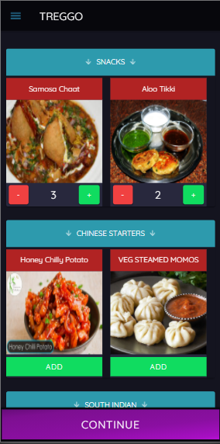
MOBILE APPLICATION

Slide 14
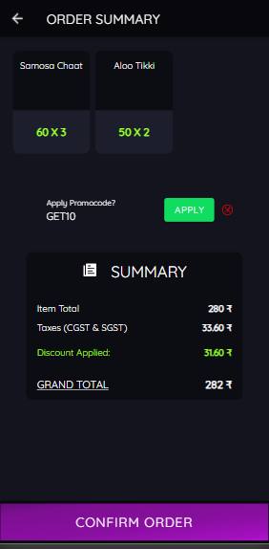
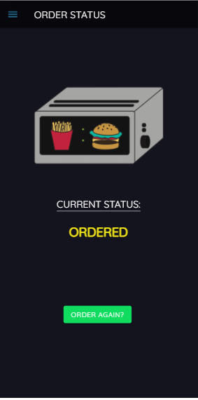
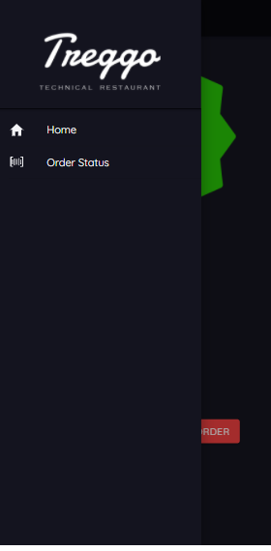
MOBILE APPLICATION

Slide 15
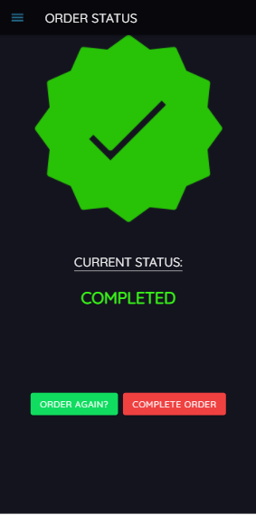
MOBILE APPLICATION

Slide 16
KEY HIGHLIGHTS
You can customize / handle dishes price, availability, display etc at runtime with direct reflect to your clients.
Reduce your workload and quality of delivering your food services to customer by automating their menu selection right on their table.
Our admin portal contains couple of users, ADMIN: to manage all orders and dishes, KITCHEN: which will be linked to your restaurant kitchen, where your staff can directly access what your customers have ordered and start preparing their meals without wasting any time.
This experience of food ordering, will separate you from other competitors.

Slide 17
ADDITIONAL DETAILS
For setting up a separate instance for your own TREGGO, we need to do below pre-requisites, which our team will coordinate with you:
Setup an additional AWS account with free tier (capping of 1GB storage) for 12 months, and other additional cost for storage and bandwidth will be handled by client.
Cost of tablets will be included in the total cost of the project.
Cost of deploying admin portal to specific domain is purely choice of client, since it adds additional cost to buy new domain, but if client don’t want to spend on this, the admin portal could be accessible at AWS instance IP address.
We’ll provide support for all the features provided in this document for 3 months. Any feature out of scope of this, will cost additional charge from client to develop / maintain.

Slide 18
THANK YOU
CONNECT IT LABS
www.connectitlabs.in

