Slide 1


CONNECT BAZAR
CONNECT IT LABS
www.connectitlabs.in

Slide 2



About connect bazar
LOCAL VENDORS
CONNECT BAZAR
CLOUD OF CUSTOMERS

Slide 3
FEATURES
Provide facilities for local vendors to reach local customers online.
Competitive pricing among vendors to provide qualitative local goods.
Provides an admin area for vendor, where vendor can manage their orders, get sales report, product management, coupons, print bill etc.
Connect to your local or global customers digitally through our mobile based solutions.
Manage your products availability at real-time with 0 downtime.

Slide 4
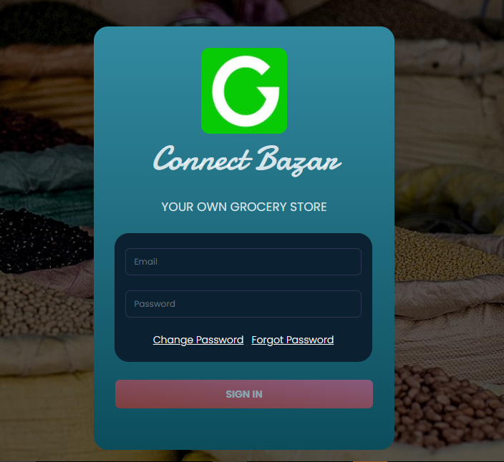
ADMIN APPLICATION

Slide 5
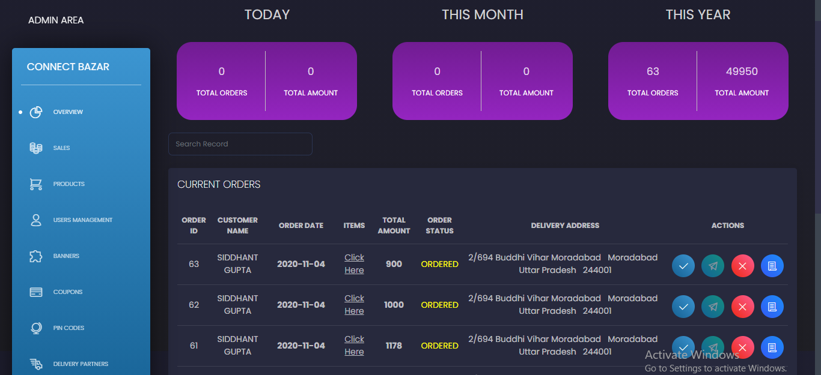
ADMIN APPLICATION

Slide 6
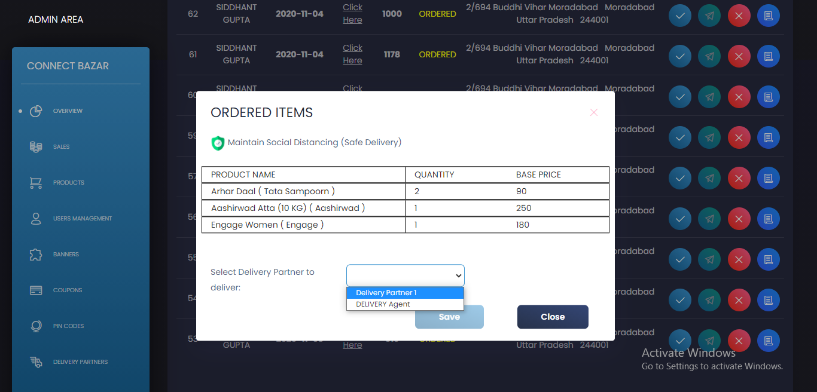
ADMIN APPLICATION

Slide 7
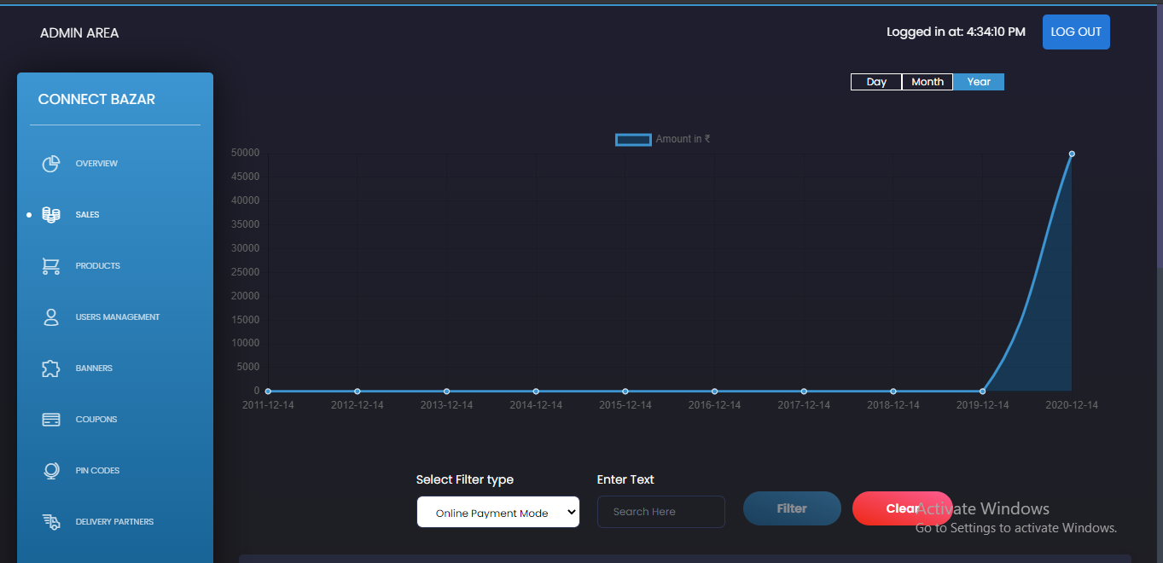
ADMIN APPLICATION

Slide 8
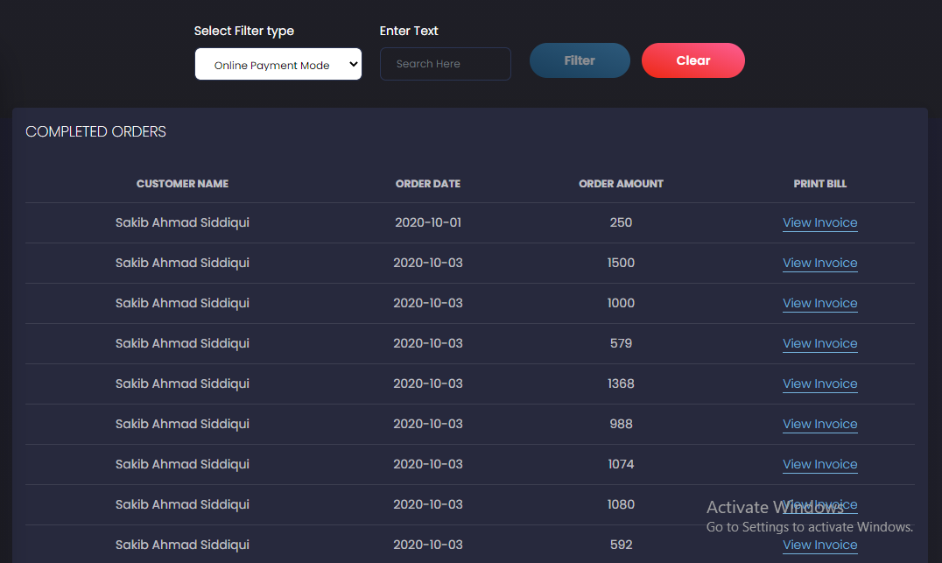
ADMIN APPLICATION

Slide 9
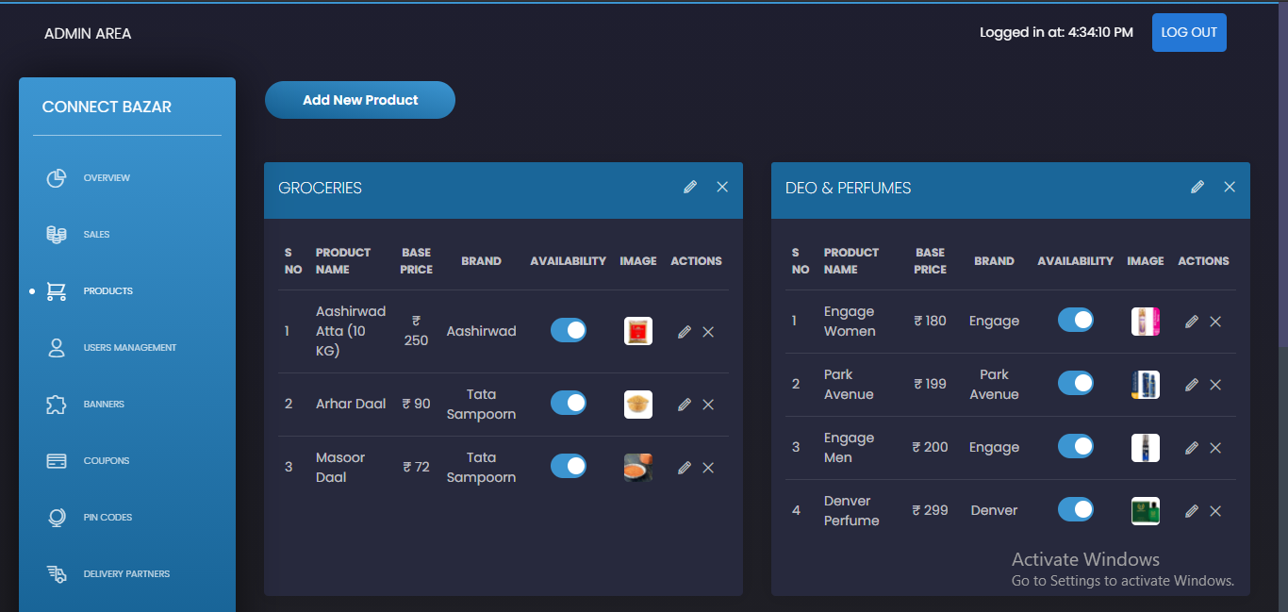
ADMIN APPLICATION

Slide 10
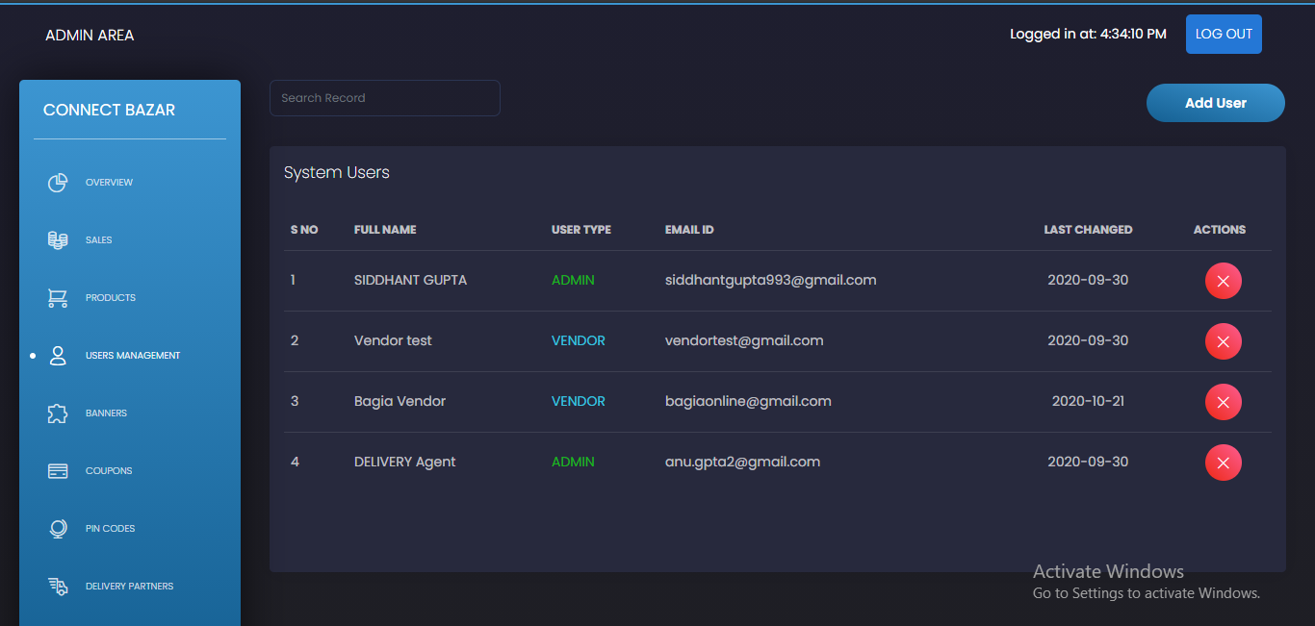
ADMIN APPLICATION

Slide 11
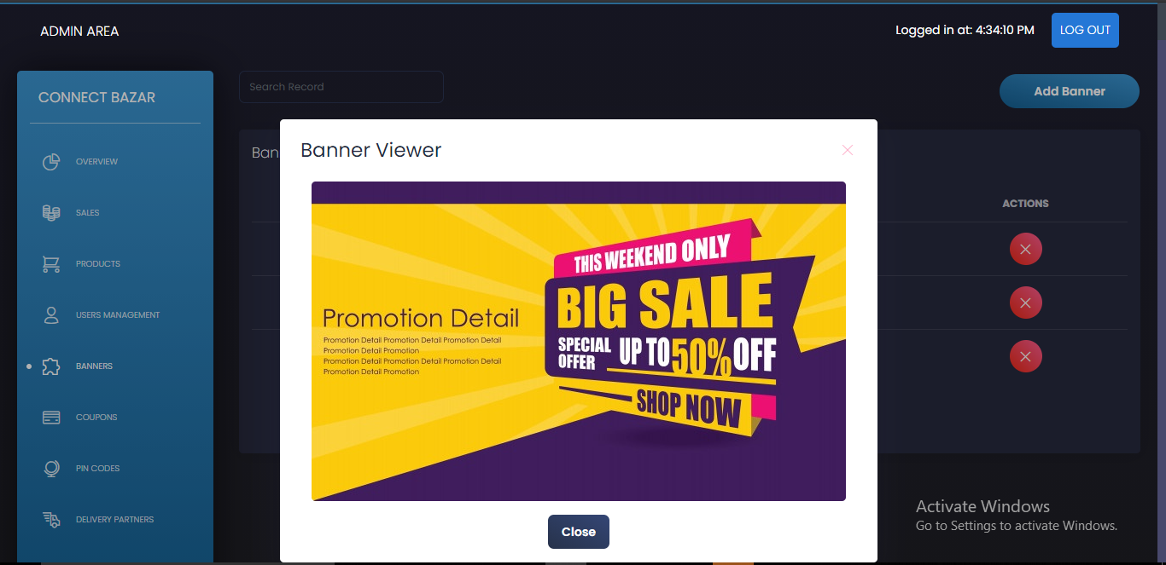
ADMIN APPLICATION

Slide 12
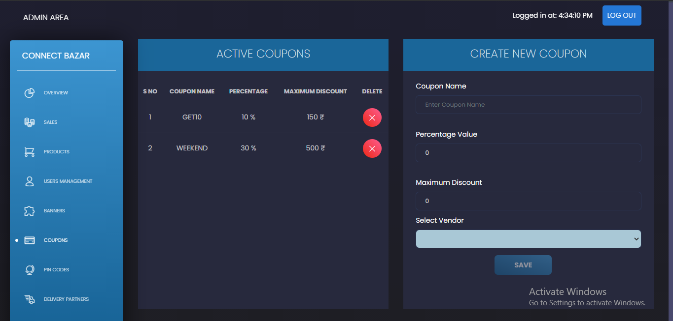
ADMIN APPLICATION

Slide 13
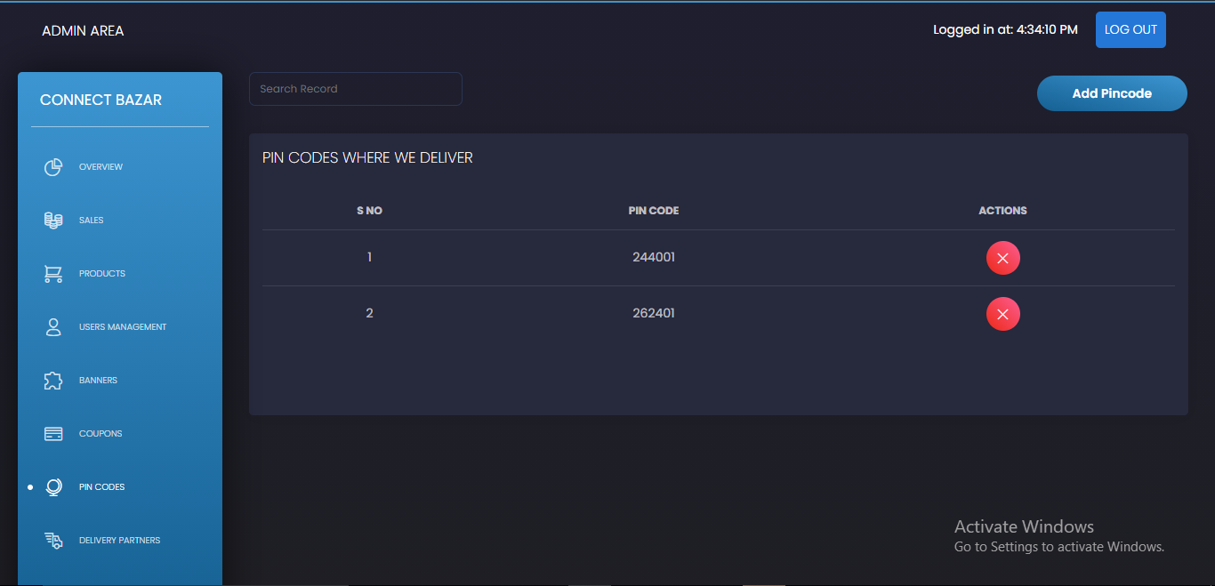
ADMIN APPLICATION

Slide 14
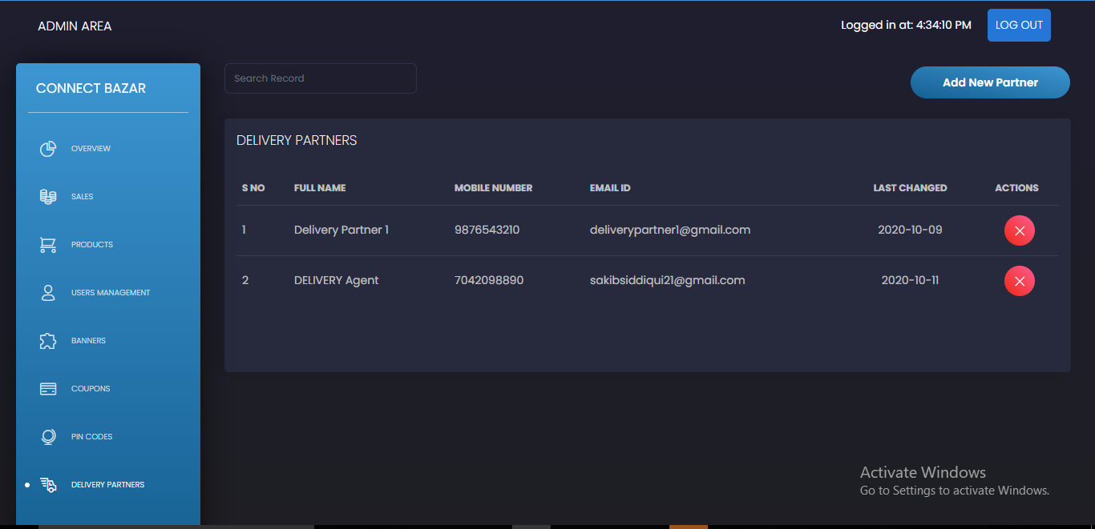
ADMIN APPLICATION

Slide 15

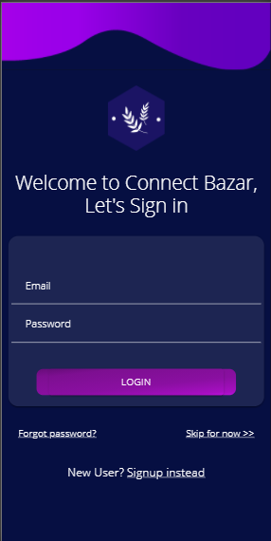
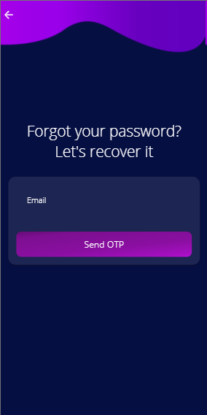
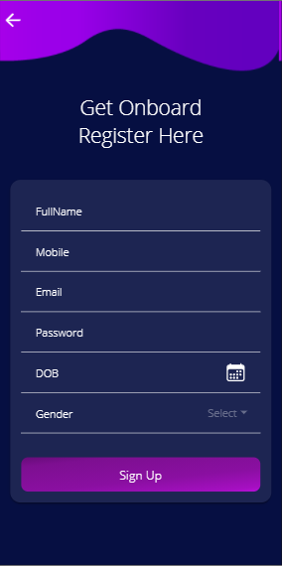
MOBILE APPLICATION

Slide 16
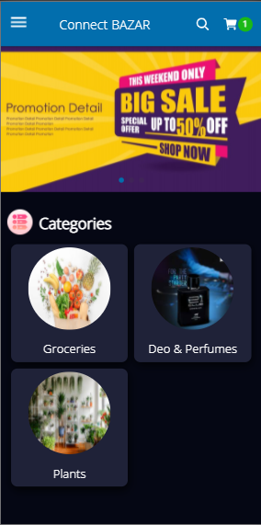
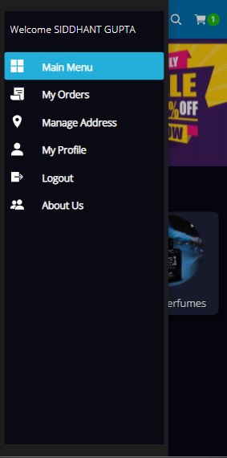
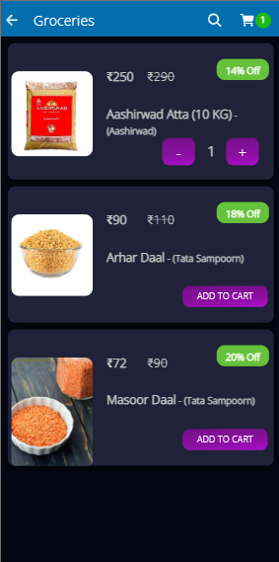
MOBILE APPLICATION

Slide 17
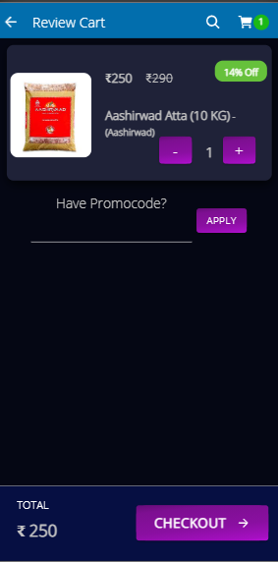
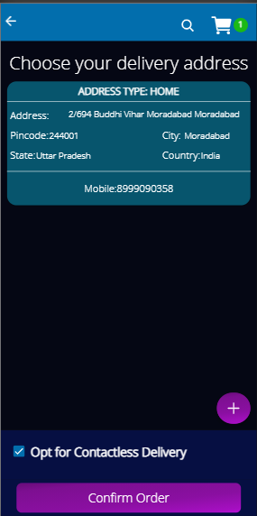
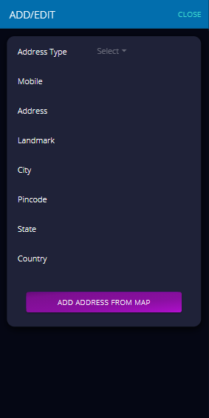
MOBILE APPLICATION

Slide 18
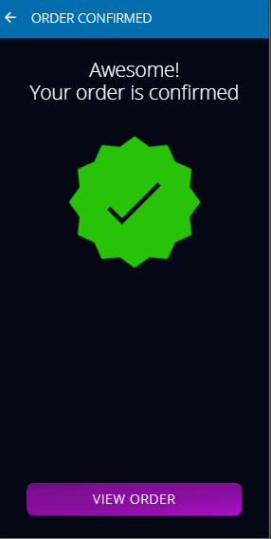
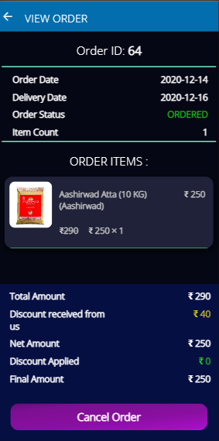
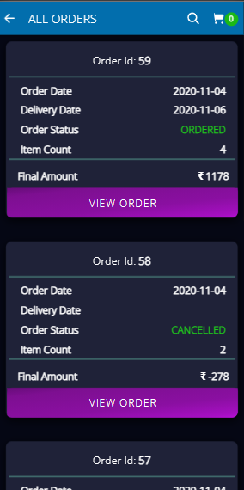
MOBILE APPLICATION

Slide 19
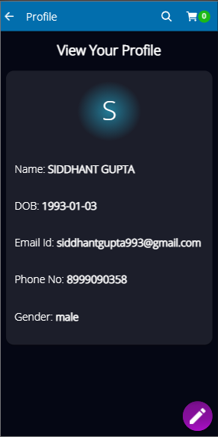
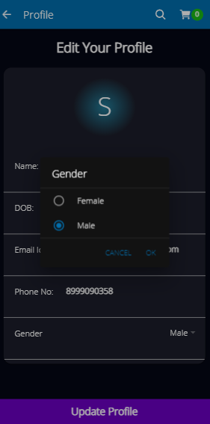
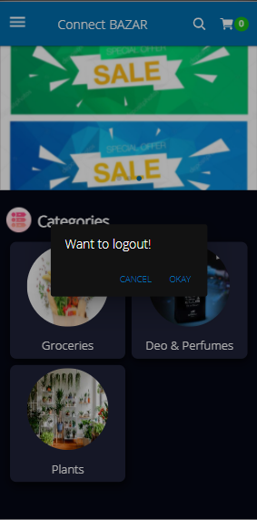
MOBILE APPLICATION

Slide 20
KEY HIGHLIGHTS
You can customize / handle products price, availability, display etc at runtime with direct reflect to your customers.
Connect Bazar comes with multi-vendor support, where you manage your vendors on the go (their products, sales analysis and their delivery partners) and they also have their own admin portal limited to managing their products.
We provide another delivery partner app, which your vendors will provide to their delivery persons which manages the order allocated to them and can track the delivery locations and update the order status.
You can create / manage customized coupon codes which you can use promoting your products.

Slide 21
ADDITIONAL DETAILS
For setting up a separate instance for your own Connect BAZAR, we need to do below pre-requisites, which our team will coordinate with you:
Setup an additional AWS account with free tier (capping of 1GB storage) for 12 months, and other additional cost for storage and bandwidth will be handled by client.
To integrate Google map API, we will need Google platform account from client side (free upto 75000 request per month), apart from that cost will be handled by client.
Cost of deploying mobile app to Play store / Apple store should be incurred by client itself, though we will help setting up the app to the stores.
Cost of deploying admin portal to specific domain is purely choice of client, since it adds additional cost to buy new domain, but if client don’t want to spend on this, the admin portal could be accessible at AWS instance IP address.
[OPTIONAL] If client wants domain specific email id for all email notifications, that cost should be handled by client, we’ll make sure to integrate and work smoothly with our application.
[OPTIONAL] If client was SMS based notifications, that cost should be handled by client, we’ll make sure to integrate and work smoothly with our application.
We’ll provide support for all the features provided in this document for 3 months. Any feature out of scope of this, will cost additional charge from client to develop / maintain.

Slide 22
THANK YOU
CONNECT IT LABS
www.connectitlabs.in

