Slide 1
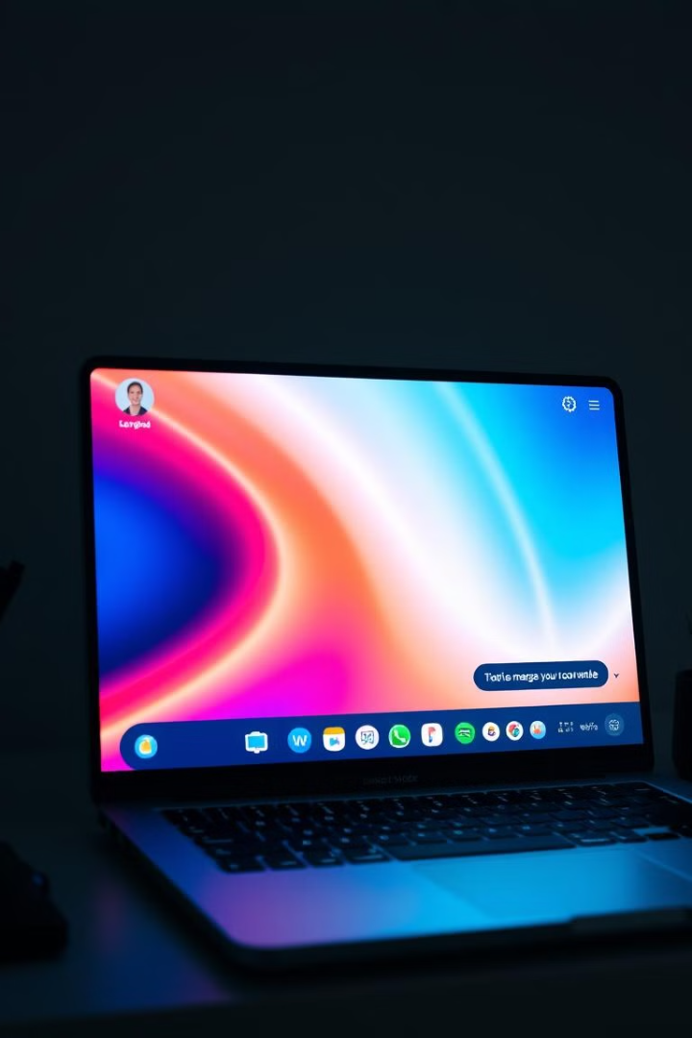
LAN Chat Messenger by Group 15
A real-time chat application designed for local network communication.

Slide 2

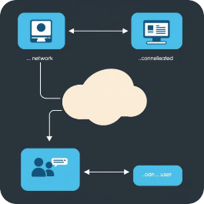
User Flow
Connect to Network
Join a Chat Room
Connect to your local network and access the application via its IP address.
Select a chat room to begin communicating with other users on the network.
1
2
3
Access the UI
Navigate the application's user-friendly interface.

Slide 3
Technical Implementation
Backend
Communication
Built using Node.js with Express framework for server-side logic.
Leverages Socket.io for real-time messaging between server and clients.
Node.js is a popular, open-source, cross-platform runtime environment that allows developers to execute JavaScript code outside a web browser. Traditionally, JavaScript was limited to the client side (running in the browser), but Node.js extended its use to the server side, enabling developers to build scalable and efficient backend applications.
Socket.IO is a powerful library that enables real-time, bidirectional, and event-driven communication between a server and clients. It’s built on top of WebSocket technology but also includes additional features like automatic reconnection, fallback support, and broadcasting, which make it more robust and developer-friendly.

Slide 4

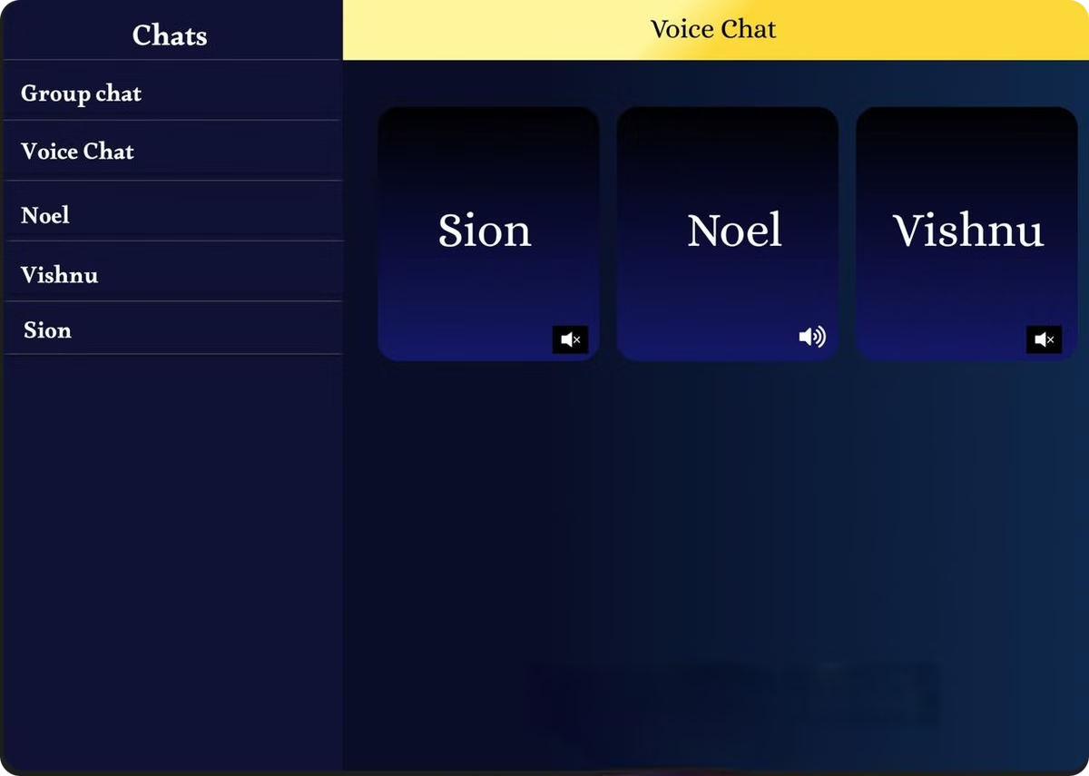
Real-time Messaging
1
Socket.io
2
WebRTC
Enables bi-directional communication, delivering messages instantly.
Facilitates real-time voice calls through peer-to-peer connections.

Slide 5
WebRTC for Voice Calls
Peer-to-Peer Connections
Session Description Protocol (SDP)
WebRTC establishes direct, peer-to-peer connections between users for smooth and efficient voice communication.
Leveraging Socket.io, the application efficiently exchanges Session Description Protocol (SDP) offers, enabling the swift and reliable setup of the voice call connection.

Slide 6

Benefits of LAN Chat
Privacy
Efficiency
Accessibility
Secure communication confined to the local network, ensuring data privacy.
Faster communication than traditional methods, eliminating internet dependency.
Easy setup and use for everyone on the network without using network, promoting collaboration.

Slide 7



Conclusion
LAN Communication
1
Provides a secure, efficient, and accessible platform for real-time communication.
Socket.io
2
Facilitates real-time messaging and data exchange.
WebRTC
3
Enables seamless voice calls and peer-to-peer connections.

