Slide 1
RESUME CLASSIFICATION
GROUP-4
TEAM MEMBERS:
Mr Harsha S
Mr Prajwal S Gondi
MS Thirumudi Nachiyar M K
MS Nirmala Machado
Mr Nachin H C
MS Pooja Rai

Slide 2
BUSINESS PROBLEM
To reduce manual effort in HRM by developing a highly accurate and automated document classification solution with minimal human intervention.

Slide 3
OBJECTIVE
The aim of this project is to develop a document classification solution that automates HRM processes, improves accuracy, and reduces the need for human intervention.

Slide 4
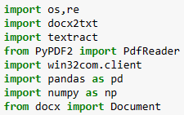
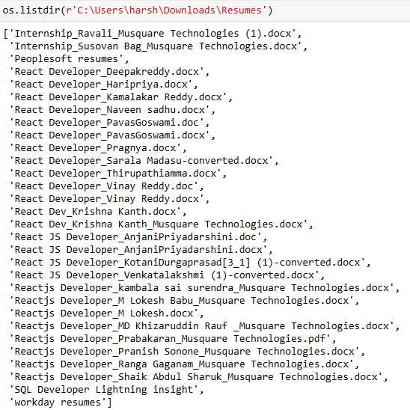
DATA EXTRACTION
Importing necessary library required.
Listing all files in file path.

Slide 5
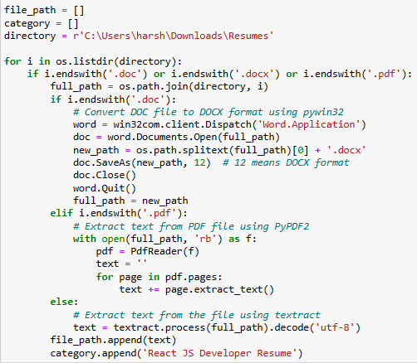
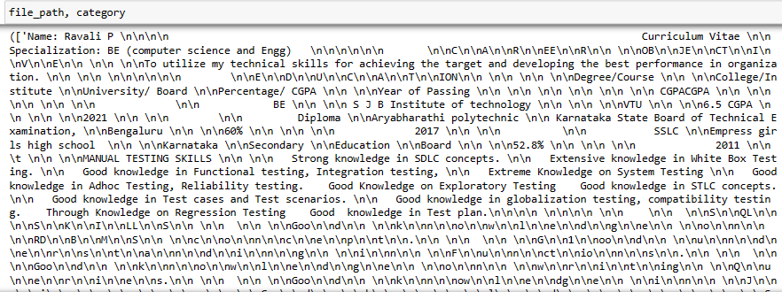
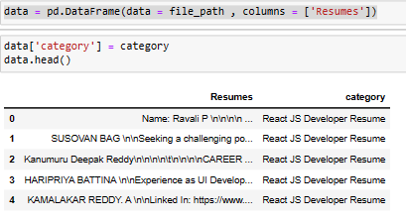
DATA EXTRACTION
Extracting data from file path for React JS Developer Resume.
Printing file path and their category.
Creating DataFrame for each category.

Slide 6
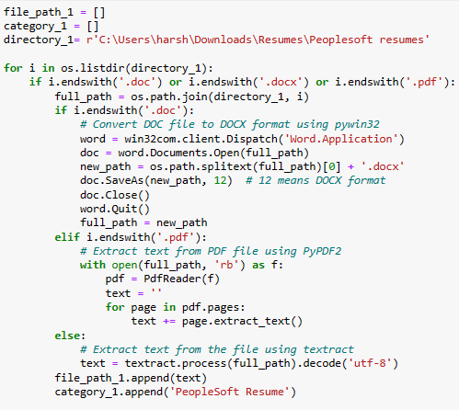
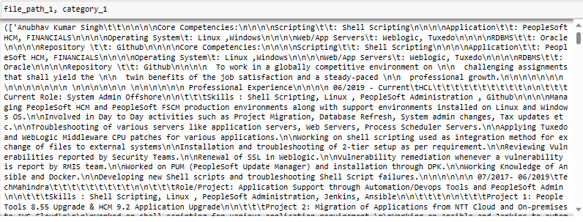
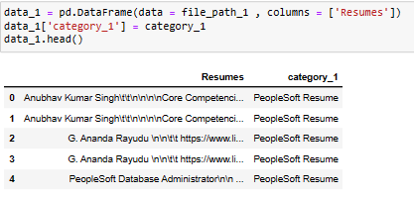
DATA EXTRACTION
Extracting data from file path for PeopleSoft Resume.
Printing file path and their category.
Creating DataFrame for each category.

Slide 7
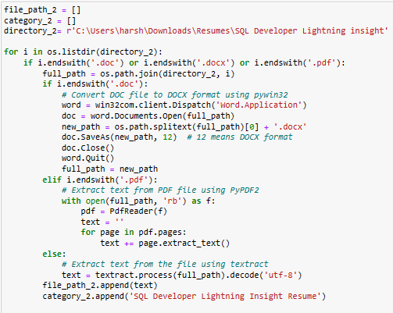
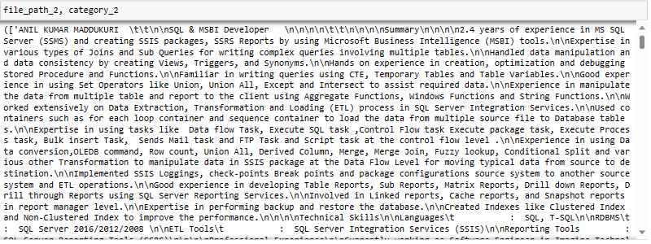
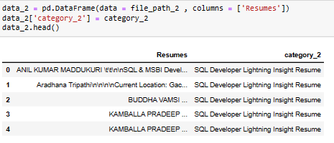
DATA EXTRACTION
Extracting data from file path for SQL Developer Lightning Insight Resume.
Printing file path and their category.
Creating DataFrame for each category.

Slide 8
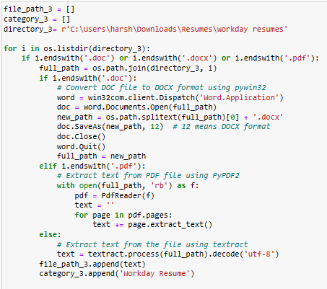
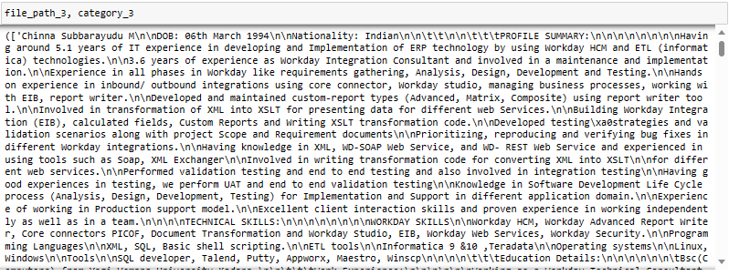
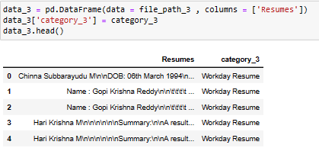
DATA EXTRACTION
Extracting data from file path for Workday Resume
Printing file path and their category.
Creating DataFrame for each category.

Slide 9
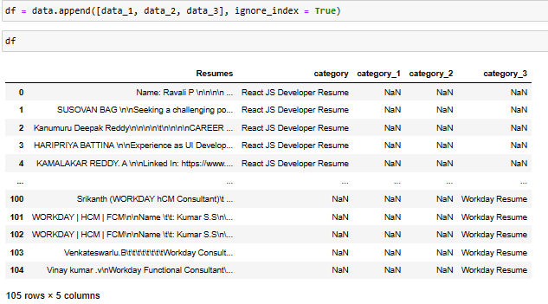
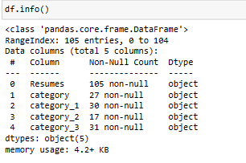
DATA EXTRACTION
Appending data_1, data_2, data_3 in data and creating single DataFrame.
Checking info() of each data type.

Slide 10
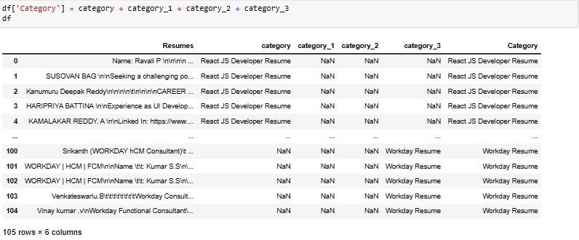
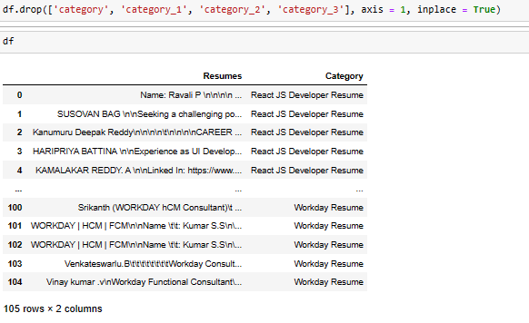
DATA EXTRACTION
Combining all category, category_1, category_2, category_3 and creating single feature.
Droping unnecessary feature.

Slide 11
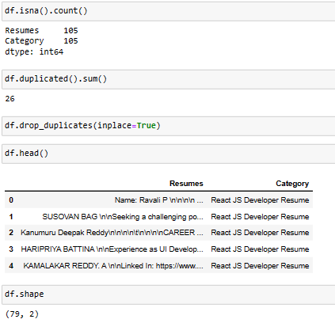
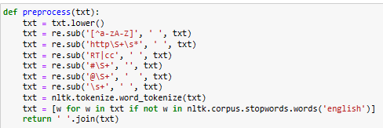
PREPROCESSING
Checking for null values.
Checking for duplicates and droping it.
Defining function for preprocessing.
Convert all characters in the string to lower case.
Remove non-alpanumeric characters such as punctuation and numbers.
Remove URLs.
Remove RT and CC.
Remove hashtags.
Remove mentions.
Remove extra whitespace.
Tokenize word.
Remove stop words.
Stemming

Slide 12
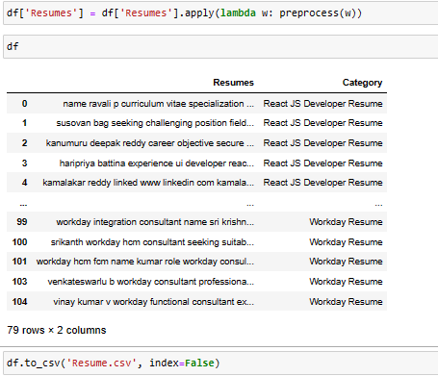
PREPROCESSING
Calling pre-defined preprocess function and preprocessing Resumes feature.
Saving it to csv file.

Slide 13
EXPLORATORY DATA ANALYSIS(EDA)

Slide 14
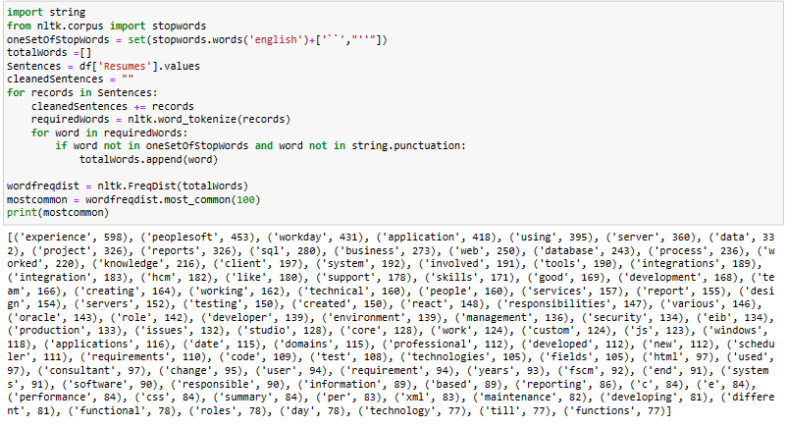
EXPLORATORY DATA ANALYSIS(EDA)
In this we are trying to record each word and printing it.

Slide 15
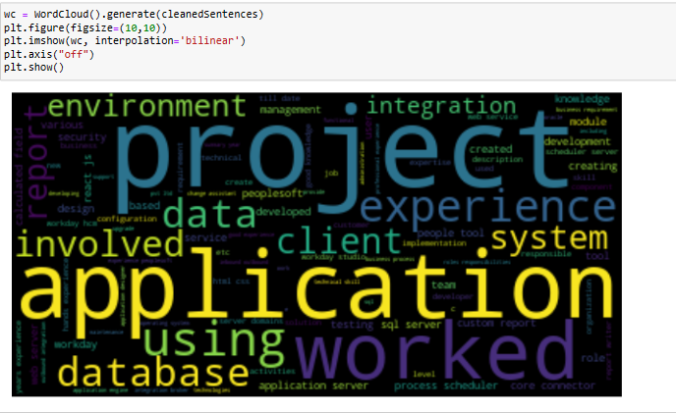
WORDCLOUD
Recorded words are Visualized using wordcloud.

Slide 16
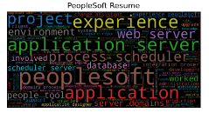
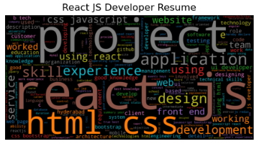
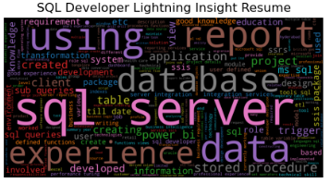
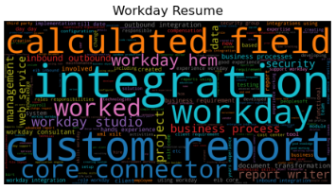
WORDCLOUD
Wordcloud plot for each Resume Category:
The most frequent used word is ‘peoplesoft’ in ‘PeopleSoft Resume’.
The most frequent used word is ‘react Js’ in ‘React JS Developer Resume’.
The most frequent used word is ‘sql server’ in ‘SQL Developer Lighting Insight Resume’.
The most frequent used word is ‘integration’ in ‘Workday Resume’.

Slide 17
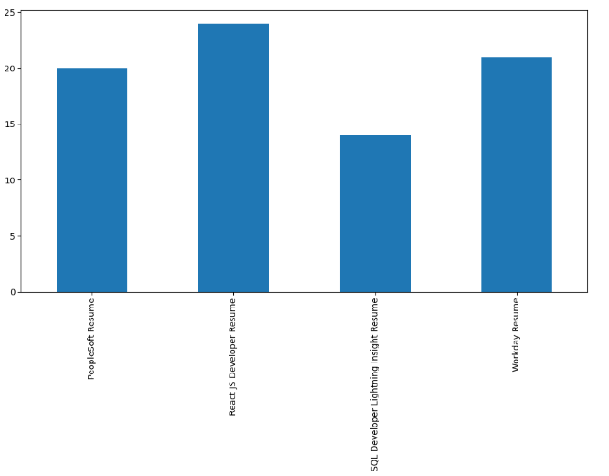
BAR PLOT
We observe that React JS Developer resume occuring more number of times.
Workday resume is second highest.

Slide 18
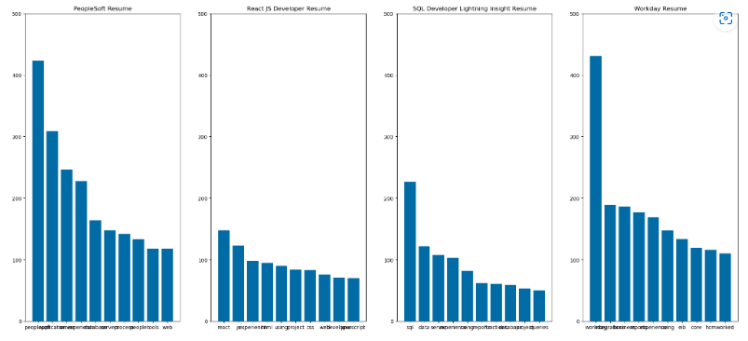
BAR PLOT
From the above graph we observe that below are highest occured word for each category.
Peoplesoft
react js
sql server
integration

Slide 19
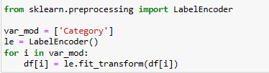
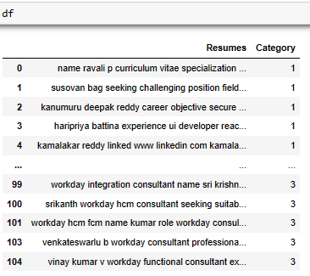
PRE-PROCESSING(LABEL-ENCODER)
Encoding the Category feature with LabelEncoder.

Slide 20
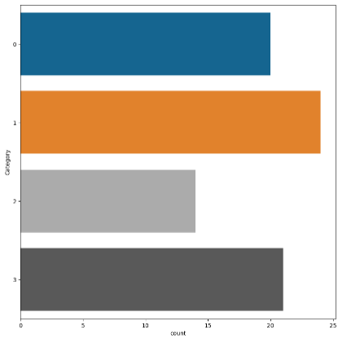
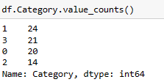
BAR PLOT
Here we observe that,
React JS Developer Resume is encoded as 1.
Workday Resume is encoded as 3.
PeopleSoft Resume is encoded as 0.
SQL Developer Lightning Insight Resume is encoded as 2.

Slide 21
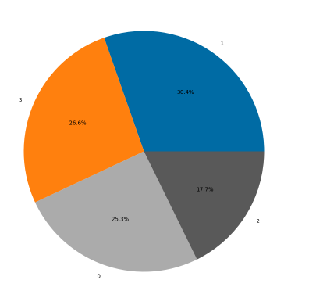
PIE PLOT
From Pie Plot we observe that,
30.4% of resume is React JS Developer Resume.
26.6% of resume is Workday Resume.
25.3% of resume is PeopleSoft Resume.
17.7% of resume is SQL Developer Lightning Insight Resume.

Slide 22
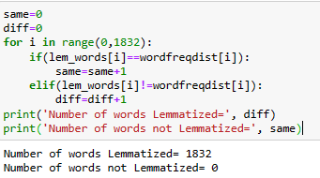
LEMMATIZING
We Observed that 1832 words got Lemmatized.

Slide 23
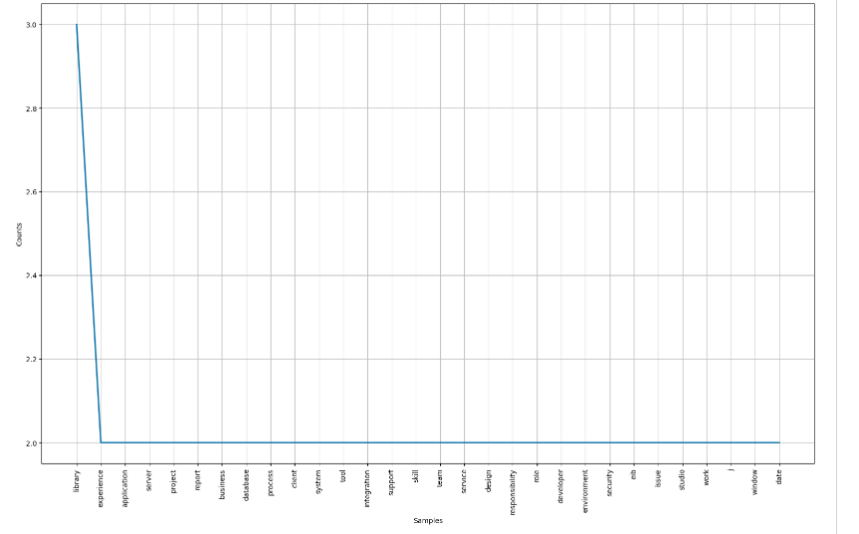
LEMMATIZING
Plotting Top 30 most frequent words in the lem_words list.

Slide 24
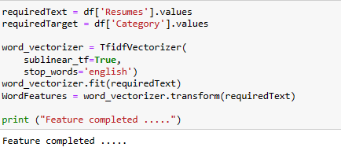
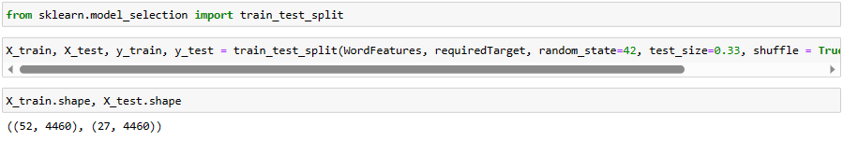
TRAIN TEST SPLIT
Applying Tfidvectorizer function
Doing Train test split and checking shape of it.

Slide 25
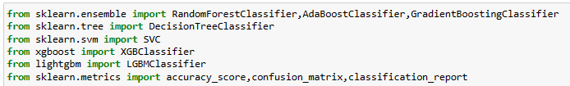
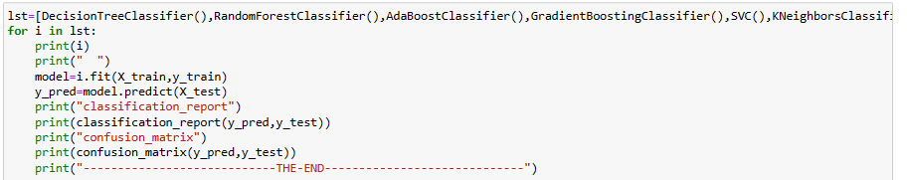
MODEL BUILDING
Importing all Required libraries.
All Algorithm is stored inside list and calling Each and Every algorithm inside list.
Checking Classification Report and Confusion matrix for each Algorithm.

Slide 26
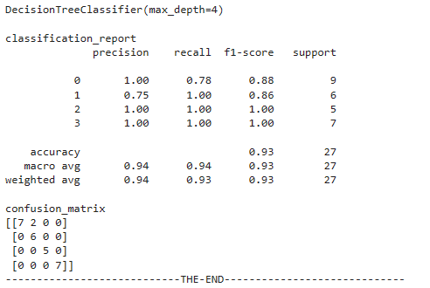
DECISION TREE CLASSIFIER
From classification Report and Confusion matrix we found that,
F1 Score is .93

Slide 27
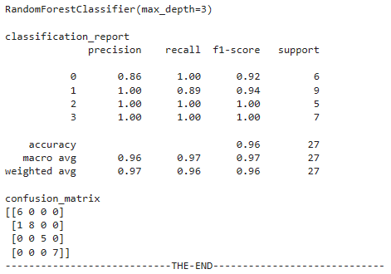
RANDOM FOREST CLASSIFIER
From classification Report and Confusion matrix we found that,
F1 Score is .97

Slide 28
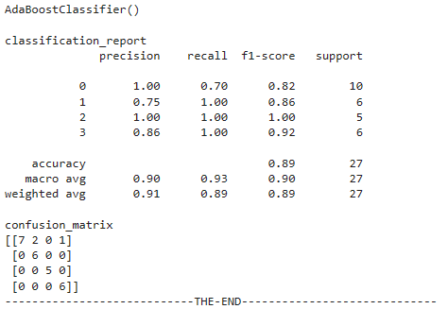
ADA BOOST CLASSIFIER
From classification Report and Confusion matrix we found that,
F1 Score is .89
We have some Miss classified data.Can also see from Confusion matrix.

Slide 29
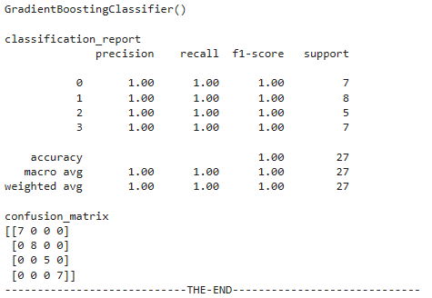
GRADIENT BOOSTING CLASSIFIER
From classification Report and Confusion matrix we found that,
F1 Score is 1(over fitting)

Slide 30
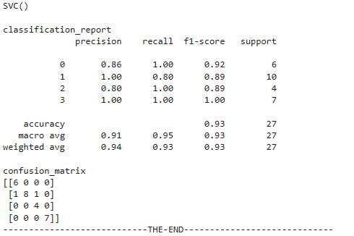
SUPPORT VECTOR CLASSIFIER
From classification Report and Confusion matrix we found that,
F1 Score is .93

Slide 31
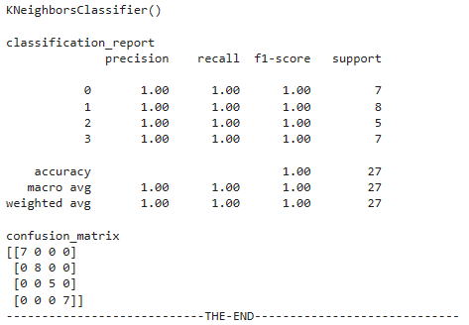
KNEIGHBORS CLASSIFIER
From classification Report and Confusion matrix we found that,
F1 Score is 1(overfitting)

Slide 32
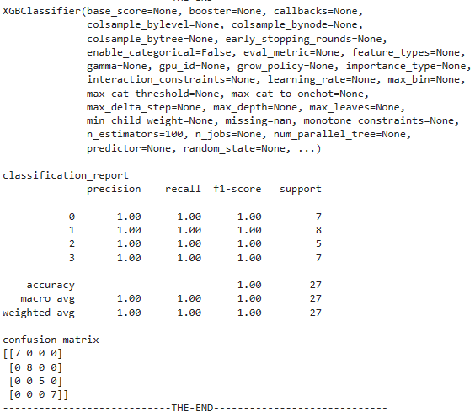
XG-BOOST CLASSIFIER
From classification Report and Confusion matrix we found that,
F1 Score is 1(overfitting)

Slide 33
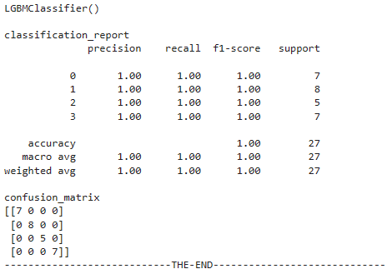
LGBM CLASSIFIER
From classification Report and Confusion matrix we found that,
F1 Score is 1(overfitting)

Slide 34
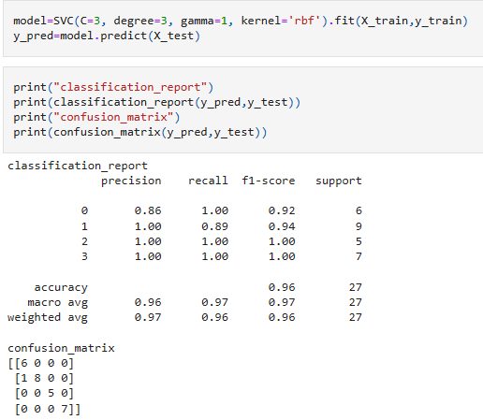
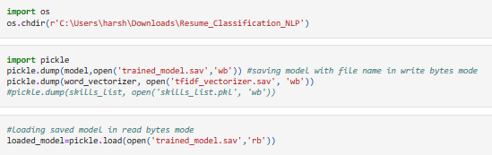
MODEL SELECTION
Random Forest and SVC gave best F1 Score.SVC gave stable stable F1 Score.so,Finalised SVC Model.
Doing Pickle file of finalised model in sav format.

Slide 35

DEPLOYMENT
Type the above code to run the file.
The generic code : streamlit run “file_path”

Slide 36

DEPLOYMENT
This is the output screen of deployment.

Slide 37
CHALLENGES FACED
The below are the few challenges we faced during this project,
Data Extraction: As we were extracting resume data for first time few faced isuues while extraction,fixed it with text extract.
Preprocessing: We removed all unnecesary data.
Word Cloud: We got to know we can visualize most frequent words using this.
Tfidvectorizer: We transformed the text data into numerical data.
Deployment: Uploading the file was a challange.We fixed it using st.file_uploader.
Prediction: We were getting 1 for any resume uploaded.Later we got to know that Resume file was not read properly and fixed it.
Decoding: We created dictonary for each category and their encoded value.Further did the maping with predicted value.

Slide 38
THANK YOU

