Slide 1
TOPIC: RAILWAY RESERVATION SYSTEM.
https://github.com/sidhant-khamankar/Railway-Reservation-System

Slide 2
Description:
This program will allow admin to generate user ids ,set Train info and see all Reservations, users and cancellations.
User can Reserve, Enquire and Cancel Ticket. Ticket fare will be calculated based upon concession category.
Every data will be written to files in binary form using file Handling. Updation of Seats after reservation and cancellation takes place as well.
PNR is generated randomly using random function.

Slide 3
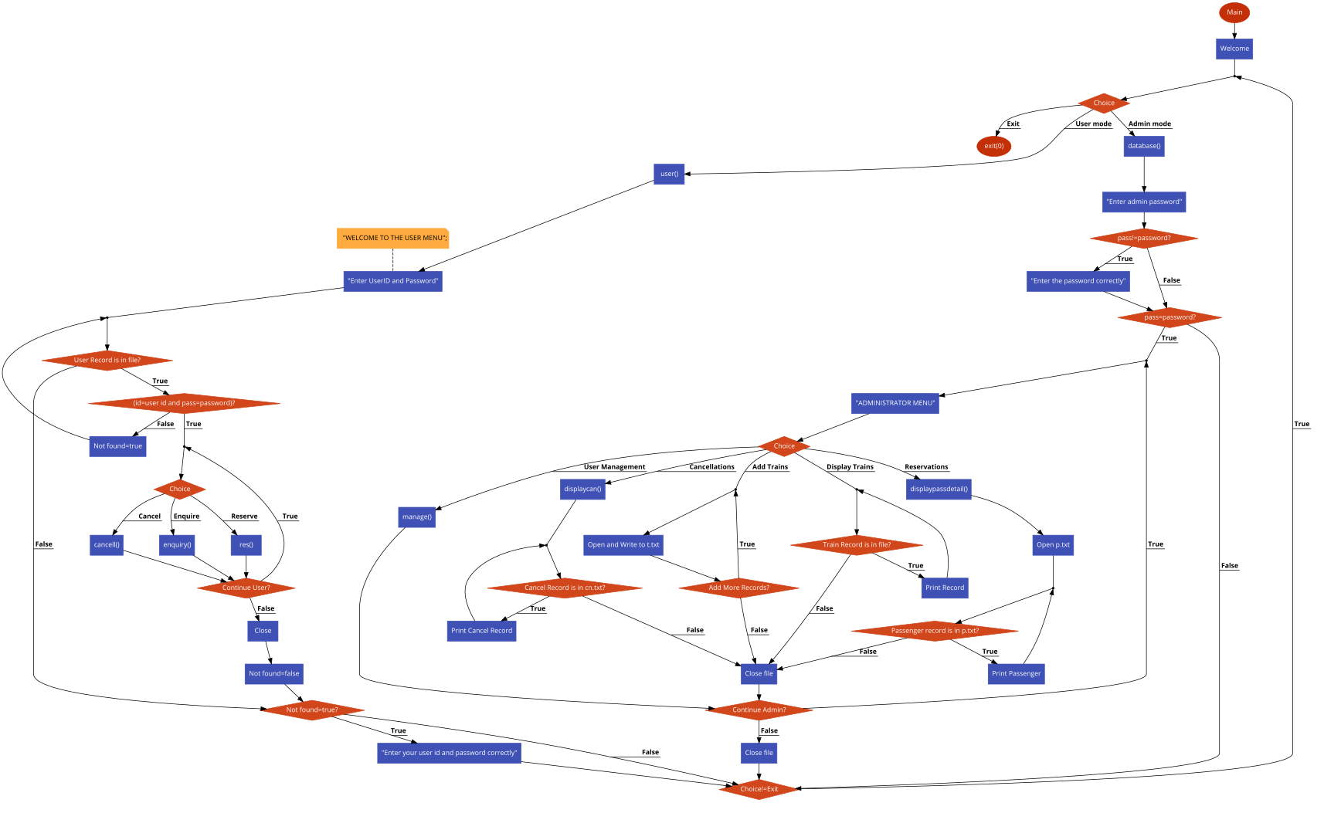
FLOWCHARTS:MAIN ADMIN AND USER:

Slide 4
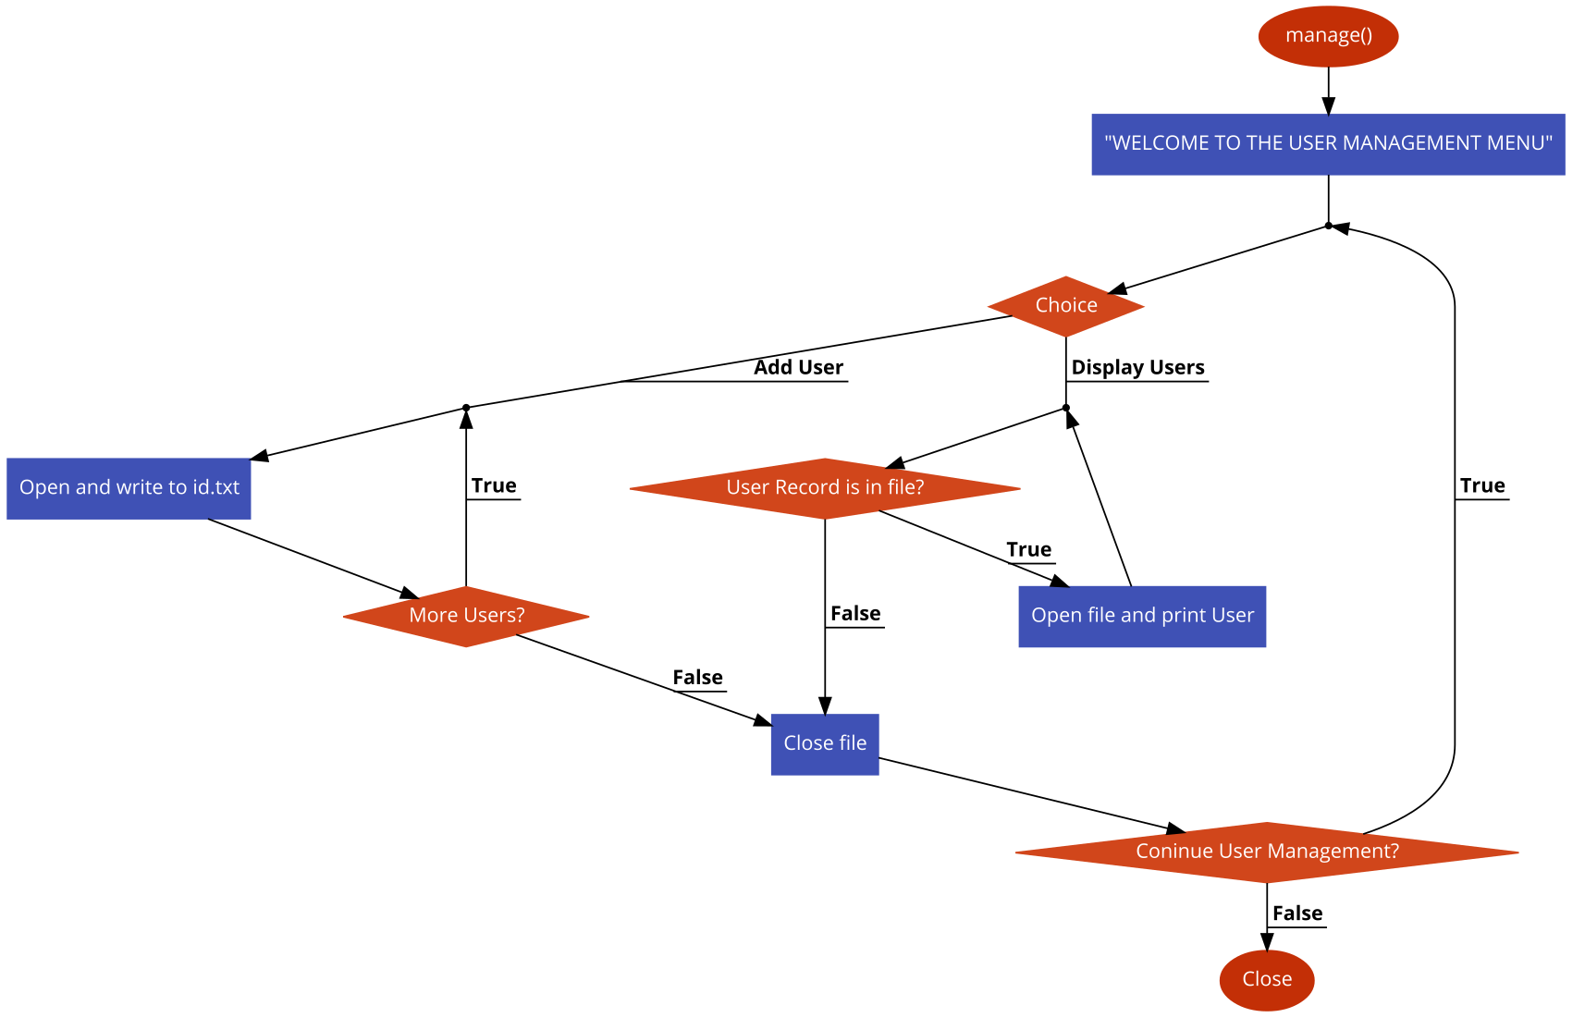
ADMIN USER MANAGEMENT:

Slide 5
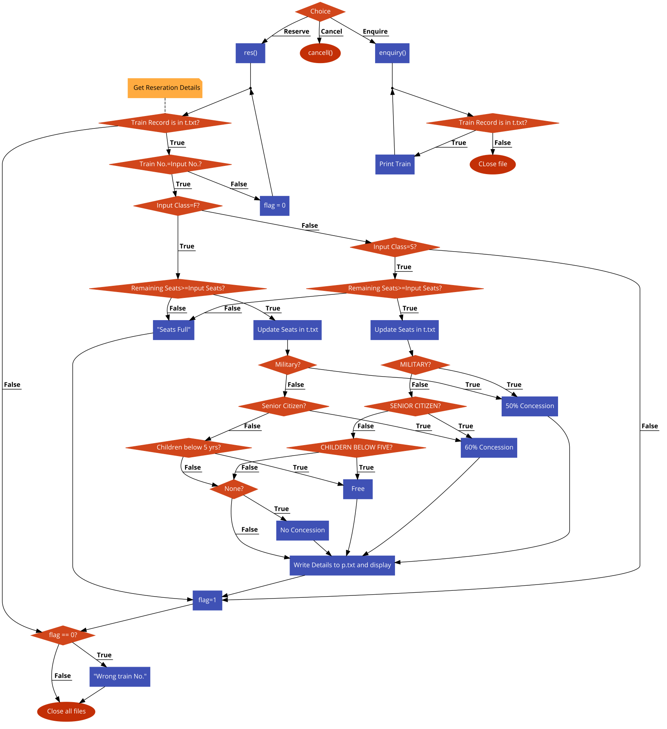
USER RESERVE AND ENQUIRE:

Slide 6
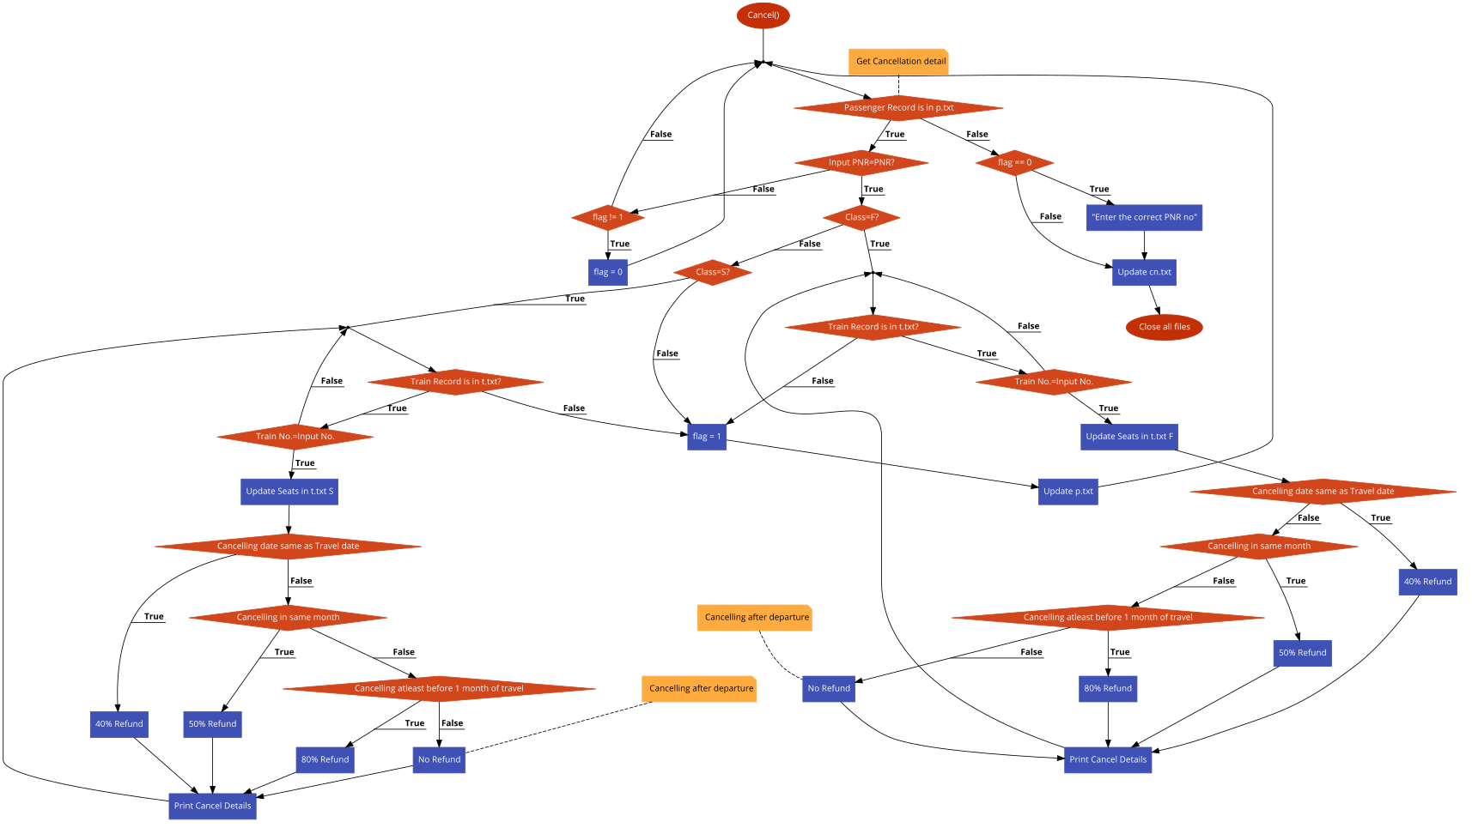
USER CANCEL:

Slide 7
CLASSES:
Train
Reserve
Cancel
User

Slide 8
Functions:
Admin
User Management
Display Reservations
Display Cancellations
User
Reserve
Cancel
Enquiry

Slide 9
FILES USED:
id.txt:
THIS FILE STORES THE ID’S AND PASSWORDS OF THE USERS.
t.txt:
THIS FILE STORES THE AVAILABLE TRAINS NAME,TRAIN NO AND OTHER DETAILS ABOUT EACH TRAIN.
p.txt:
THIS FILE STORES THE DATA OF EVERY PASSENGER.
cn.txt:
THIS FILE STORES THE DETAILS OF EACH CANCELLED TICKET.
temp.txt:
THIS FILE IS USED FOR TEMPORARY STORAGE OF DATA WHILE CANCELLATION OF THE TICKET.

Slide 10
Applications:
Bus, airline reservations,
Theatre ticket booking
Library Management
Conclusion:
Encapsulation
File Handling
Abstraction

Slide 11
THANKYOU

