Slide 1
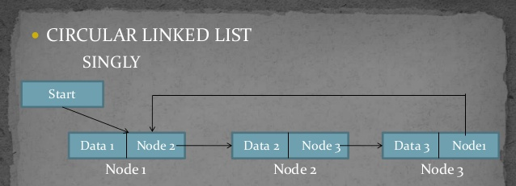
SKILL COMPETENCY EXAM (SCE) FUNDAMENTALS OF DATA STRUCTURES Real Time Applications of Linear Data Structure Circular Linked List(CLL)

Slide 2
Introduction
Playing games is always fun. So is the programming of games. This Project, Guessing game is a result of the implementation of data structure, circular linked list.
In this game, a random number will be generated between 1 and 10 by the system and the players will be asked to guess that number. The more your guess is close to the generated number the least is your score. This will go on four times. The player with least score at the end of four rounds will be the winner in this game.
Suppose the system generated number is 10 and a player guessed it as 7, then his score will be calculated as 10-7=3.

Slide 3
Rules
1) This game will generate number in range 1...10 in each round.
2) Every player should guess the number.
3) Any numbers of player can play the game(Atleat 2 players)
4) Each player will play 4 rounds in total.
5) In each round all players will get chance to guess the random generated number one by one.
6) After every round, score board will be displayed.
7) At the end of game final leaderboard will be shown and the winner will be announced.
8) There can be more than one winner in case of tie score between the players.

Slide 4
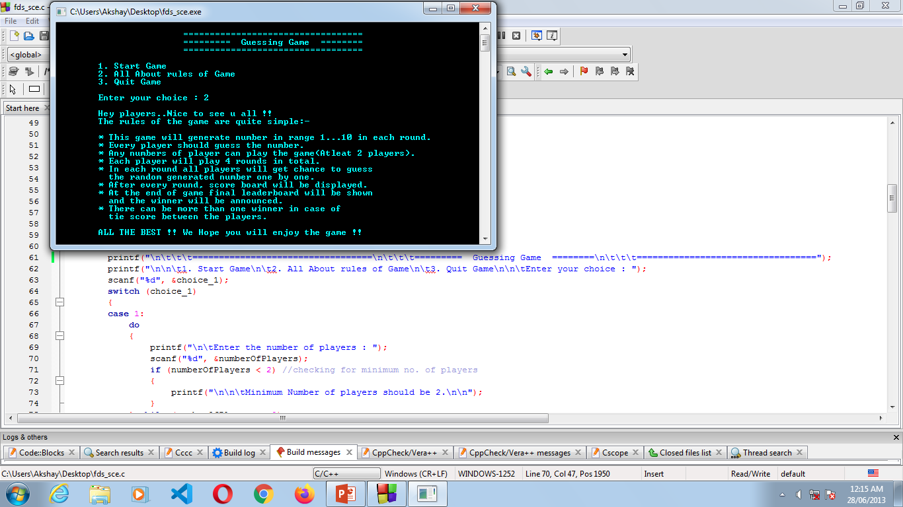
Interface of the game :

Slide 5
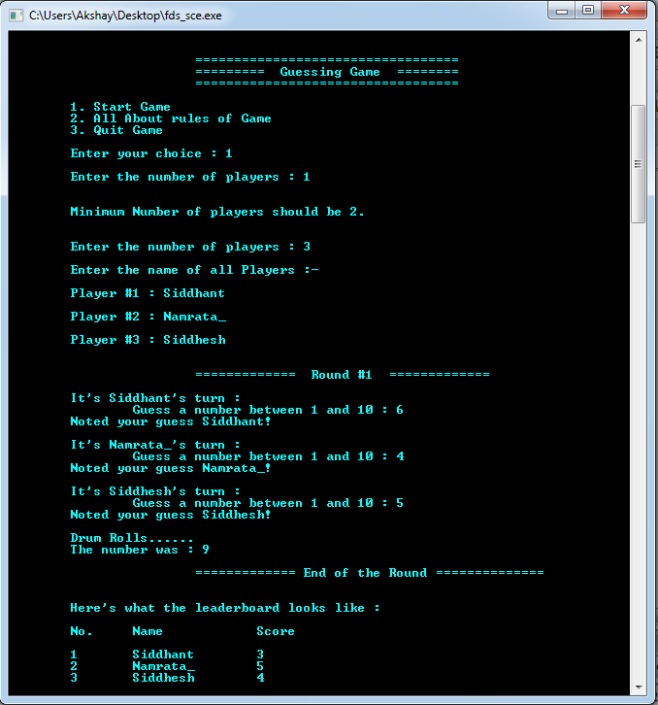

Slide 6
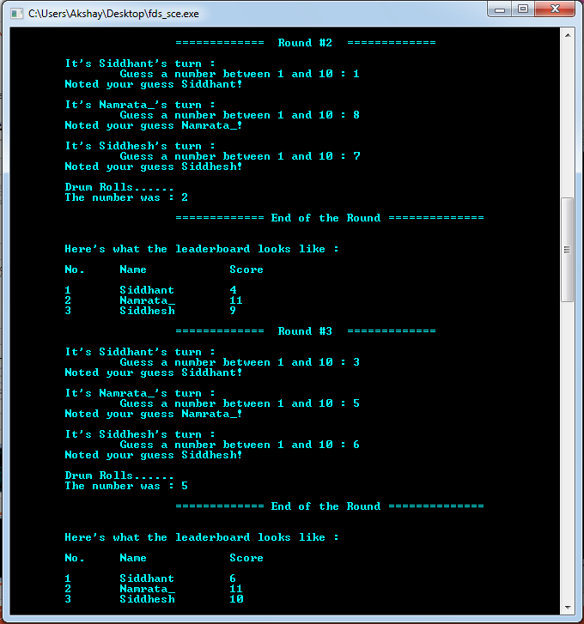

Slide 7
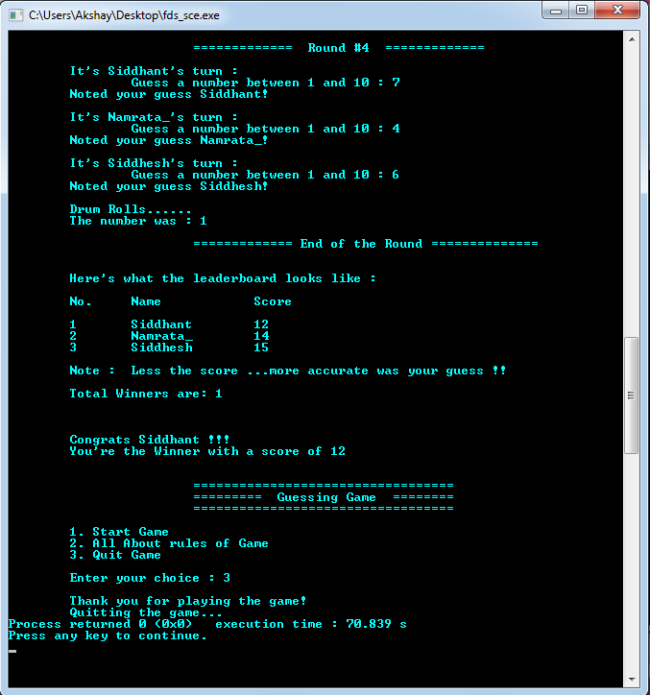

Slide 8
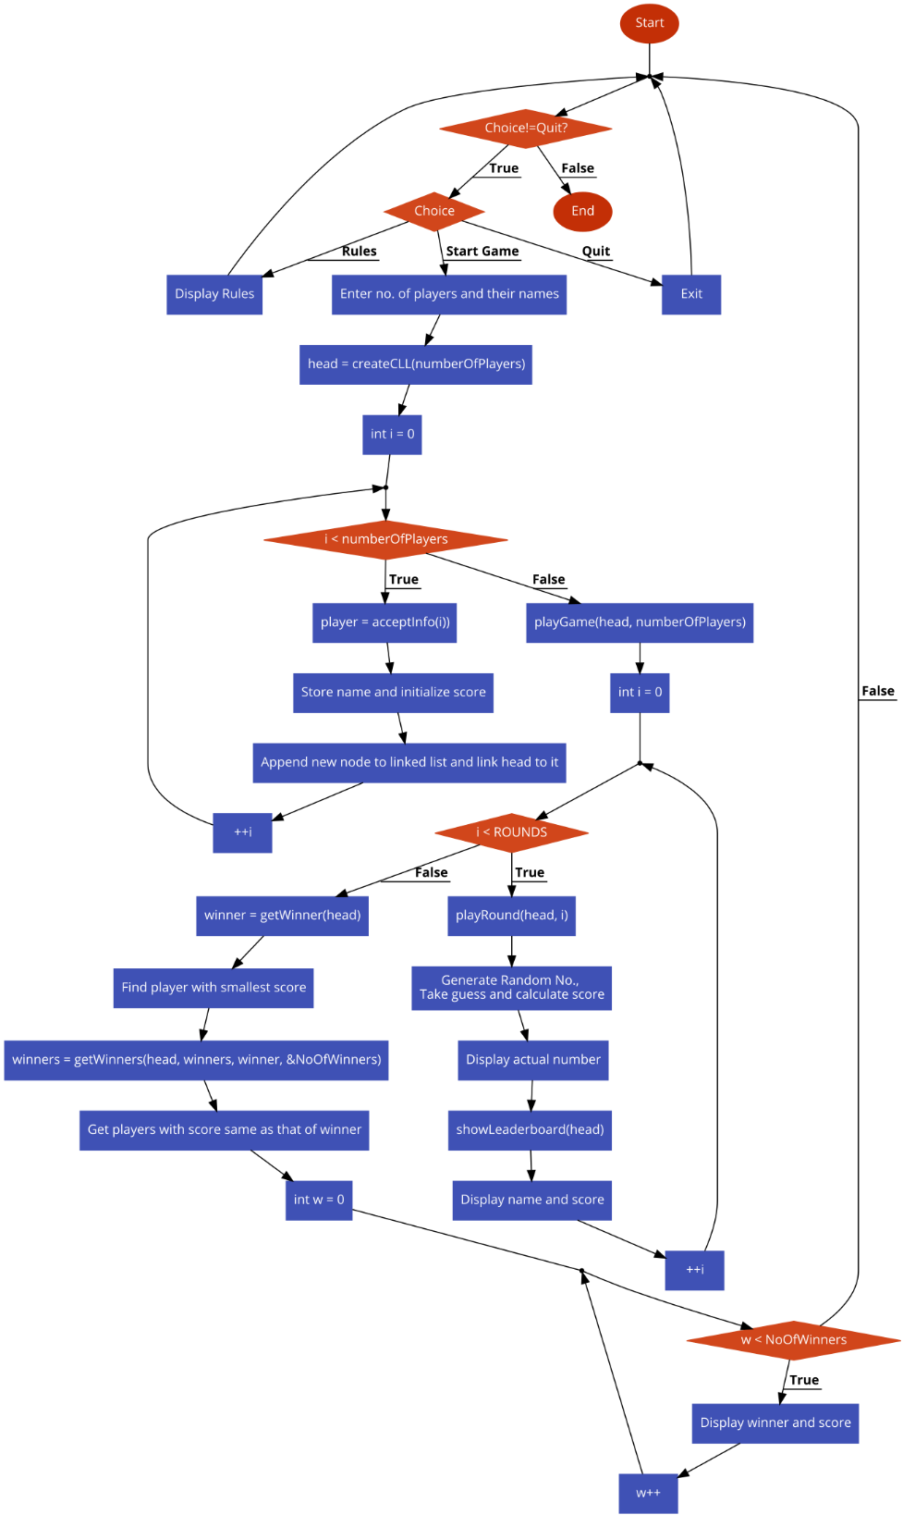
Flow Chart of the program

Slide 9
Implementation of circular linked list in code
In this code , we have created a CLL in which each node represents a player.
In the form of data, information of player is stored and 'next' pointer is pointing to the next player(generating link).
In playGame function we are passing CLL and number of players(nodes) as arguments.
Here, total 4 rounds are played among players and after every round as soon as all players complete their first round(when current pointer points to head again) , 2nd round begins with same repetitive players sequentially. In this way, CLL helps to perform repetitive rounds in the game.
A structure is created to represent information of players of different data types.
A function is defined to accept the above player’s Information :-
Player *acceptInfo(int playerNumber);

Slide 10
FUNCTIONS
Return type | Function | What function does ?
int | generateRandomNumber(int lowerLimit, int upperLimit); | Returns the random number within the given range using ‘rand’ inbuilt function.
void | showLeaderboard(Player *head); | display the leaderboard after each roundNo
void | playRound(Player *head, int roundNo); | Called to perform each round
Player* | getWinner(Player *head); | Returns the winner at the end of the game
void | playGame(Player *head, int numberOfPlayers); | Root function to start the game
Player ** | getWinners(Player *head, Player **winners, Player *winner, int *NoOfWinners); | Returns Winners with same score
Player* | createCLL(int numberOfPlayers); | Create circular linked list as per the number of players entered by user.

Slide 11
conclusion
Through this project we learnt real time implementation of circular linked list .We got hands on knowledge of implementation of various concepts of C like typedef , pointers, user defined functions, structures and much more. During the joruney of project, we explored many new concepts like 'rand' function and also Different header files likes time.h ,string.h

Slide 12
THANK YOU!

