Slide 1

INTRODUCTION TO MACHINE LEARNING
Lecture – 1, 09-01-2020

Slide 2



TEACHING STAFF
GAURAV BANSAL
FINAL YEAR
ECE
ANUJ TIWARI
3rd YEAR
PIE
SIDDHANT
2nd YEAR
IT

Slide 3
ABOUT THE COURSE
Classes will be of 2-2.30 hour long.
2-3 Classes per week.
4-6 hour self study per week will be required to fully understand the concepts.
Classes will be more based on concepts and reasoning rather than just using libraries.
It is compulsory to complete and submit the assignments.
Required Language – Python
Classes will always start on the time.

Slide 4
Today’s Timeline
Let’s Clear All the Big Terms
What is AI?
What is Machine Learning?
What is Deep Learning?
What is Data Science?
Let’s Understand About the Data
Labelled vs Unlabeled Data
Types of Machine Learning
Supervised Learning
Unsupervised Learning
Reinforcement Learning
Semi-Supervised Learning
Types of Supervised Learning Algorithm
Classification
Regression
KNN Algorithm
Linear Regression

Slide 5
Let’s Clear All The Big Terms
What is AI?
The term AI was first introduced in 1956 but why it is so popular now?
We did not have the data.
We did not have the computational power.
And we did not have the storage devices.
Artificial Intelligence is a technique which enables the machines to mimic human behavior.
But how can you enable machine to mimic human behavior?
By Writing rules
For example:-
Adding or subtracting 2 numbers
Finding the shortest path in a maze
Enabling robot to walk
Machine Translation
But What is the problem?

Slide 6
What is Machine Learning?
First introduced in 1952
Machine learning is the science of getting computers to act without being explicitly programmed.
Machine learning is an application of artificial intelligence (AI) that provides systems the ability to automatically learn and improve from experience without being explicitly programmed.
ML
ALGORITHM
MODEL
WAY TO GET THE DESIRED OUTPUT
DATA
So in machine learning instead of writing the rules by humans we design an algorithm that takes the data and finds how to find the desired output.

Slide 7
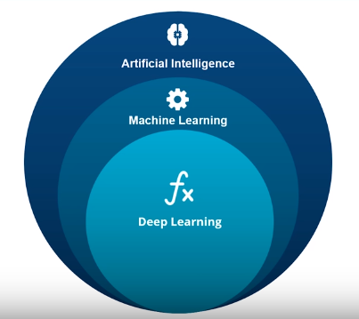
What is Deep Learning?
Deep Learning is a subfield of machine learning concerned with algorithms inspired by the structure and function of the brain called artificial neural networks.
It consists of very large neural networks which is based on structure of our brain.
Example:
Image Classification
Chatbot
Object Detection
Face Recognition
Machine Translation
Image segmentation
Pose estimation
Sentiment Analysis
But why people use neural networks over other ML algorithms?

Slide 8
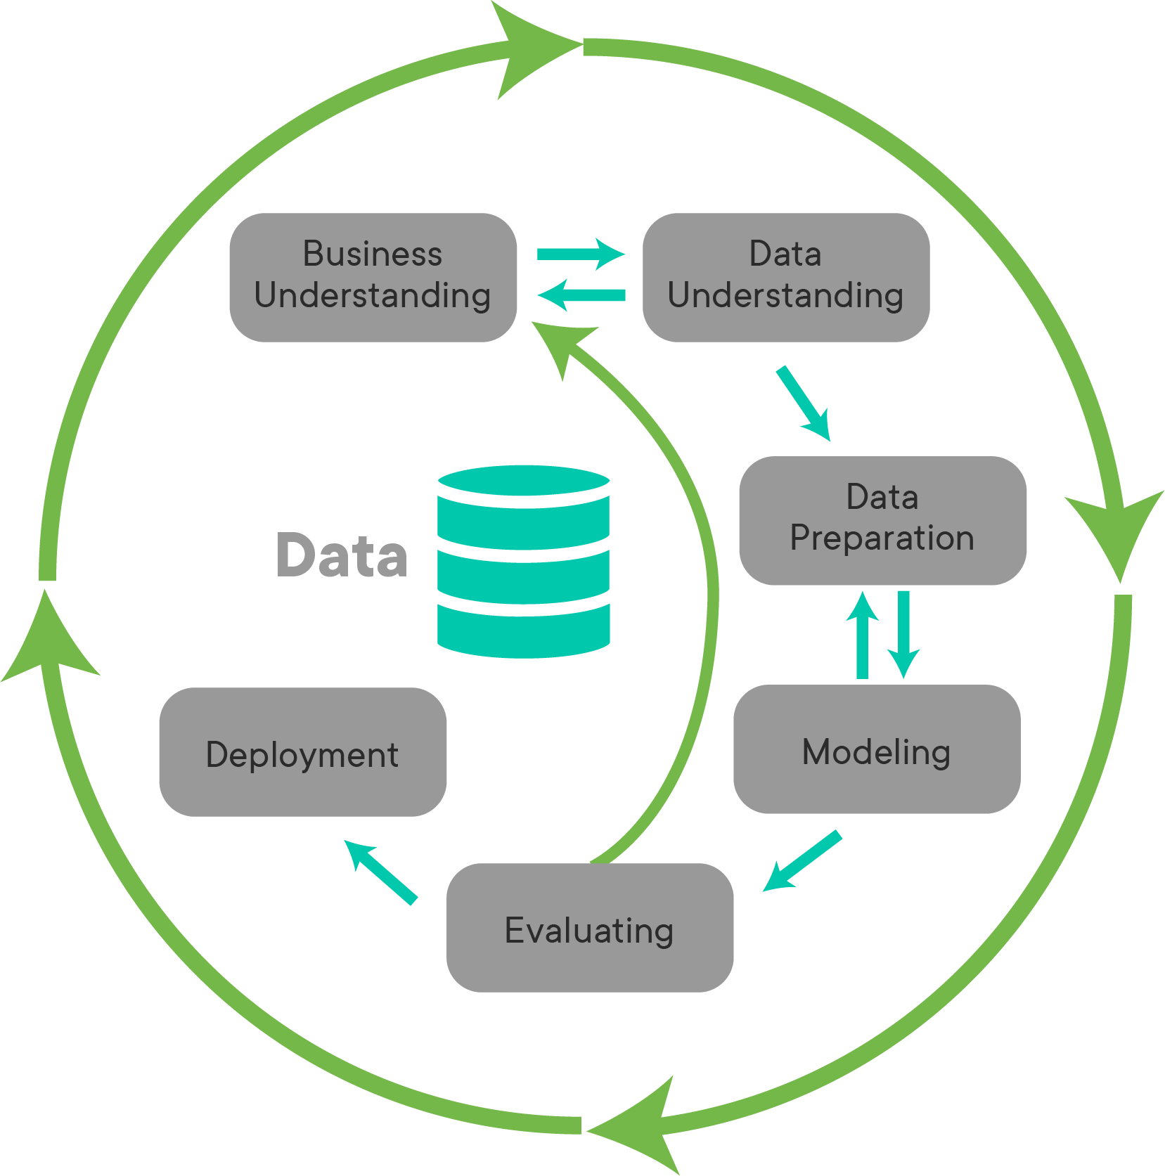
What is Data Science
Data Science is the analysis and study of data
Data Scientist is someone who combines the skills of software programmer, statistician and storyteller slash artist to extract the nuggets of gold hidden under mountains of data.
Only the modelling part uses AI/ML algorithms rest all consist of data collection, data cleaning, data visualization etc.

Slide 9
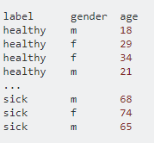

Let’s Understand about the data
Labelled vs Unlabeled Data
In the labelled data we have a target variable while in the unlabeled data we do not have target variable
Labelled Data
Unlabeled Data
More Examples:
House Price Prediction
Movie recommendation
Defining groups in a class
Classifying cat and dog
Labelled data
Unlabeled data
Unlabeled data
Labeled data

Slide 10
Types of Machine Learning
Supervised Learning
Here we have labelled data and we try to predict the desired output on the unlabeled data.
Example:
Spam E-mail detection
Sentiment Analysis
Self driving car
Face Recognition
Unsupervised Learning
Here we have only unlabeled data and we try to find some relation in that data.
In this we try to make clusters based upon the features of the data and then give useful information about the data.
Example:
Clustering of movies
Clustering of customers
Defining groups in a class
Anamoly detection
PCA

Slide 11
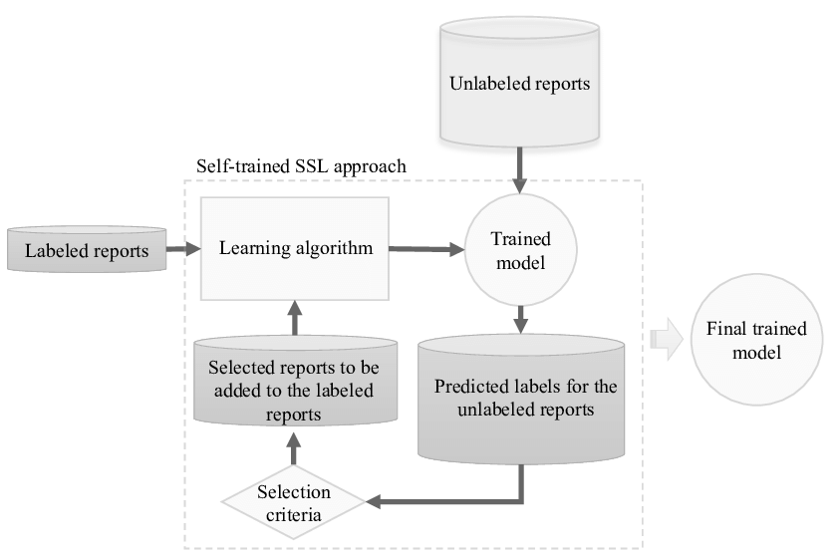
Semi-Supervised Learning
Here we have both labelled and Unlabeled data
We first train the model on labelled data and then use that model to predict on unlabeled data. Then we select those prediction which passes a selection criteria and mix it with the previous labelled data to increase its size.
And finally train the model on the whole labelled data.
Reinforcement Learning
Bahut jyada ho rha h kbhi aur btaenge

