Slide 1

Lecture – 2, 16-01-2020

Slide 2
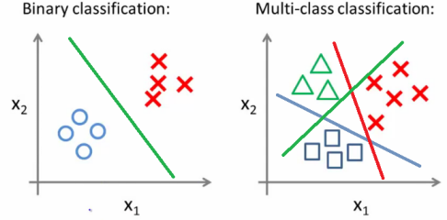
Logistic Regression (Classification Algorithm)?
Classification Problems?
This is just like the regression problem,except that the values Y we now want to predict take on only a small number of discrete values.
It is mainly two types -
Binary Classification
Multi-class Classification
Examples-
Medical Diagnosis - Binary
Spam Detection - Binary
Face detection - Multi-class
ML
ALGORITHM
MODEL
WAY TO GET THE DESIRED OUTPUT
DATA

Slide 3
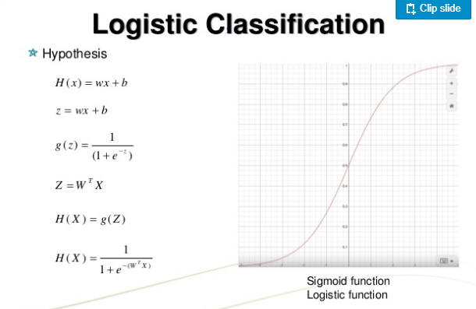
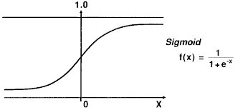
Example:
Image Classification
Chatbot
Object Detection
Face Recognition
Logistic Regression (Classification Algorithm)?
Logistic Regression is used for the classifcation problems,it is a predictive analysis algorithm and based on the concept of probability.
Logistic Function OR Sigmod Function

Slide 4
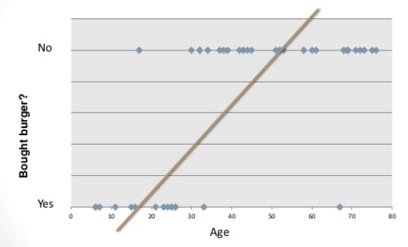
Why not linear regression?
Only the modelling part uses AI/ML algorithms rest all consist of data collection, data cleaning, data visualization etc.

Slide 5
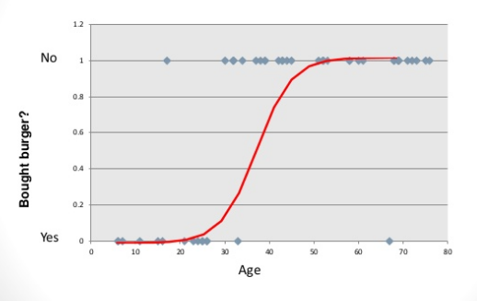
Anything else?
Sigmoid function
g(z) = 1/(1-e^-z)
at z = -∞
g(z) = 0
at z = ∞
g(z) = 1

Slide 6
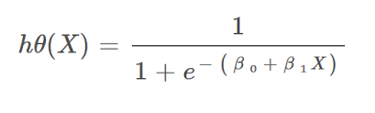
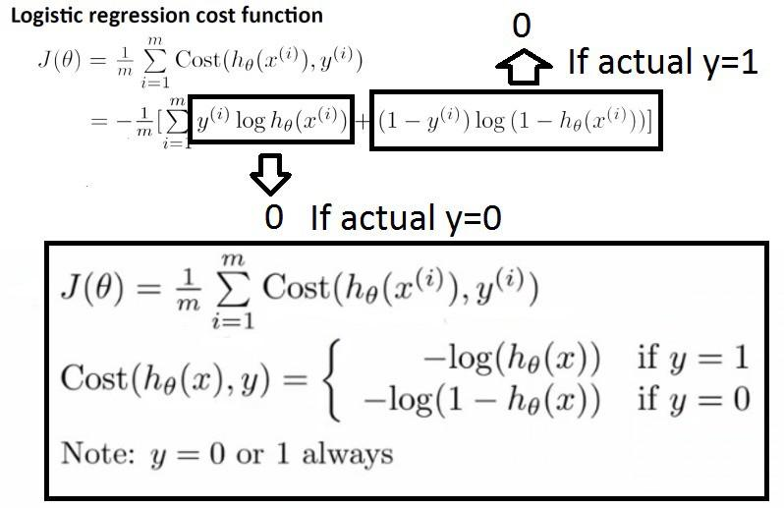
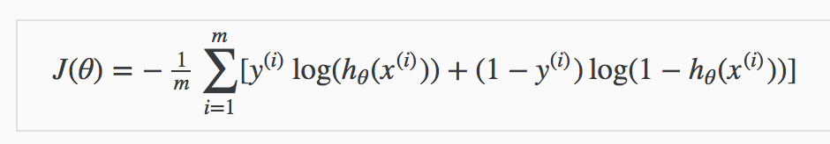
Hypothesis Function-
Cost Function -

Slide 7
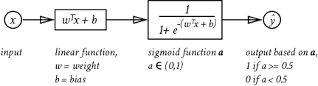
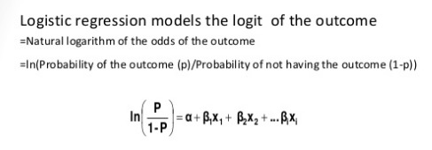

Slide 8
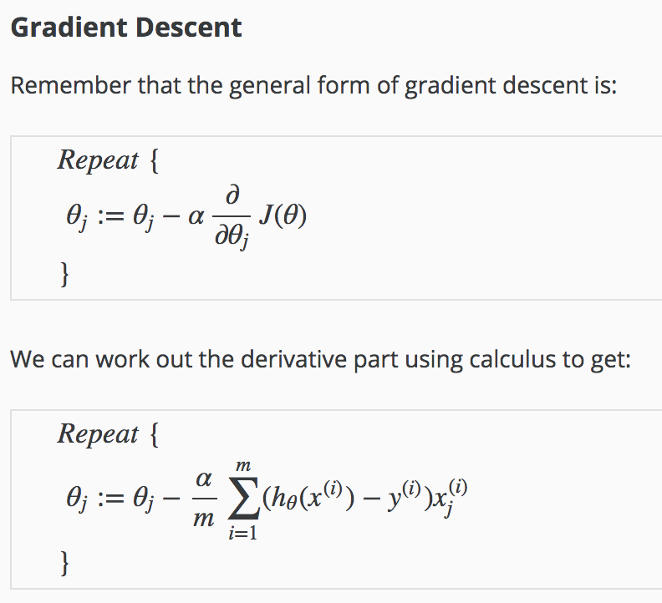
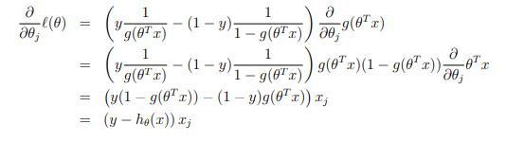
Update-
Final update function-

Slide 9
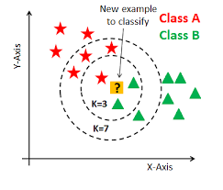
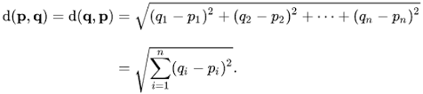
K-Nearest Neighbors(KNN)
It is a type of supervised learning.
It is used for both classification as well as regression problems.
It works based on minimum distance from the query instance to the training samples to determine the K-nearest neighbors.
Advantages of KNN
Simple Implementaion.
Makes no prior assumption of the data.
Disadvantages of KNN
The prediction time quite high as it finds the distancebetween every data point.

