Slide 1

Lecture – 3, 19-01-2020

Slide 2
Logistic Regression (Classification Algorithm)?
What we have covered up till now?
Till now we have discussed various types of supervised learning algorithms.
KNN (K – nearest neighbors)
Linear Regression
Logistic Regression
Uses :
Such algorithms are mainly used in areas where we kind of already know what kind of output we want in a sense we already know the right answer. Today we will learn something different.

Slide 3
What we will cover today?
Today we will study our first unsupervised machine learning algorithms for representation learning!
K – means
EM models
Hierarchical clustering
Uses :
Vector Quantization: Used for finding representatives
Finding meaningful structure.
Examples:
HGP(human genome project)
Movie / News recommendation and classification

Slide 4
How does K – means work?
It tries to classify the data into ‘k’ various groups.
The question is that given k centres , where should they be placed so as to minimise the cost function.
The cost function is given by the of Euclidean distance of any given point from its closest centre summed over all data points.
Finding all such k points is an NP-hard (isko abhi lite lena :P) problem thus we can never be sure if the centres we find are the most optimal.
For initialization we randomly assign some k centres. More advanced initialization techniques will be told later.
The decision boundaries thus formed are linear/planar in shape.

Slide 5
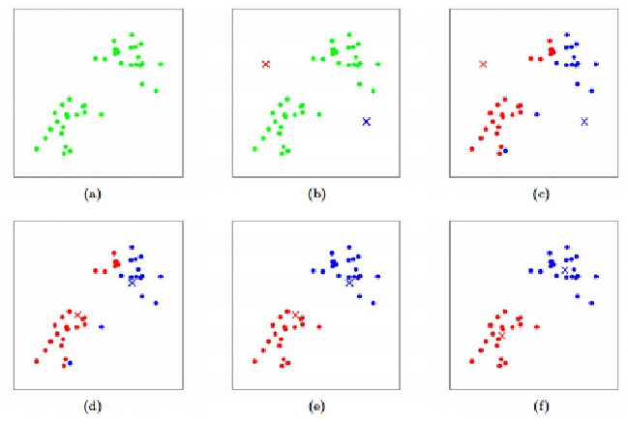
K – means in action:

Slide 6
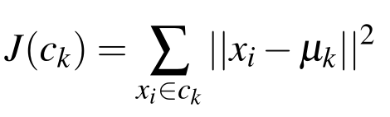
Cost Function for K – means:
The cost function is simply the sum of the squared distance of each of point from the assigned centre.
The assigned centre is the distance with the least distance from the point.
The cost function is also non-convex.

Slide 7
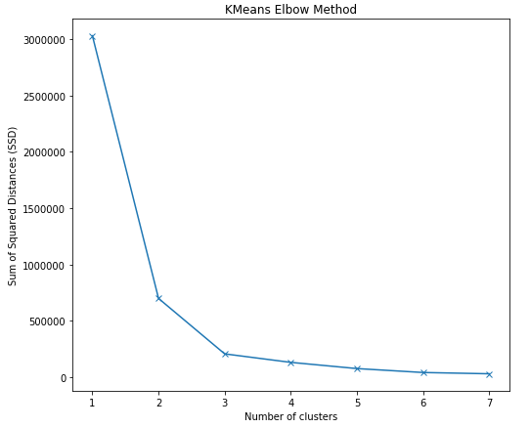
How to decide the value of ‘K’
One of the easiest ways of deciding the value of k is “pruning”(Discussed later).
Other immensely popular method is the elbow method.
In this method we calculate the cost function for different ‘K’.
Then we take the value of ‘K’ nearest to the elbow which then becomes the most optimal value for ‘K’
What is the elbow method:

Slide 8
Update function for K- means :
In order to reduce the cost , the following steps are repeated until convergence:
Assign each point to its closest centre.
Update the centres to move to the mean of the points it was assigned until it converges.
Note : After each iteration the cost function is guaranteed to reduce and the and thus the algorithm is guaranteed to converge at some point.

Slide 9
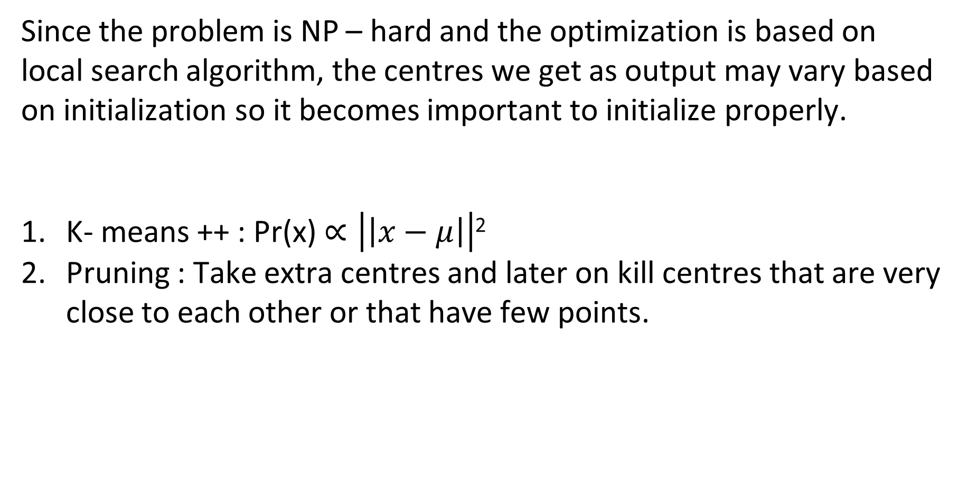
Initialization in K- means :
Since the problem is NP – hard and the optimization is based on local search algorithm, the centres we get as output may vary based on initialization so it becomes important to initialize properly.
K- means ++ : Pr(x) $∝\left|\left|x−μ\right|\right|$²
Pruning : Take extra centres and later on kill centres that are very close to each other or that have few points.
Some other initialization in K- means :

Slide 10
Pros and Cons of K- means :
Pros :
Easy to understand and implement.
Relatively fast.
Can also be applied on huge amounts of continuous data using methods such as sequential K – means. (Ab ye kabhi aur padhaenge yaar!)
1. The clusters formed are only spherical in shape and relatively of the same radius.(This is solved using Expectation maximization models which are based on gaussian probability distributions)
(Iske liye pehle bahut kuch padhana padega to ye round 2 me.)
Cons :

