Slide 1

Lecture – 5, 24-01-2020

Slide 2
Hierarchical Clustering
Hierarchical Clustering technique is divided into two types:
Agglomerative
Divisive
Agglomerative Hierarchical clustering starts by treating each observation as a separate cluster.Then, it repeatedly executes the following two steps:
Identify the two cluster that are closest together,
merge the two most similar clusters.
This continues until all the clusters are merged together.

Slide 3
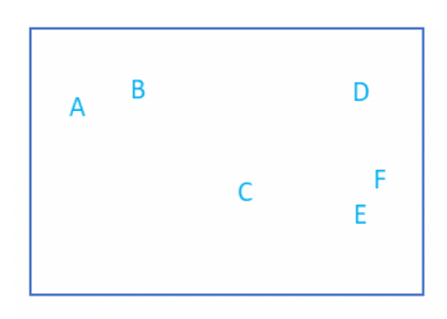
Let’s take an example of 6 observations(A,B,C,D,E,F) with two features.

Slide 4
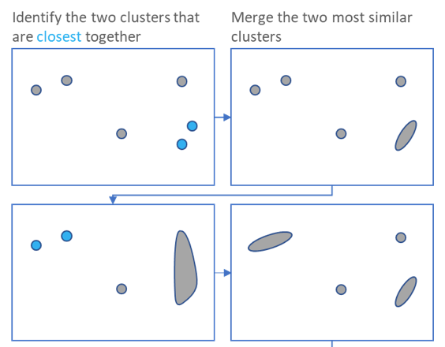

Slide 5
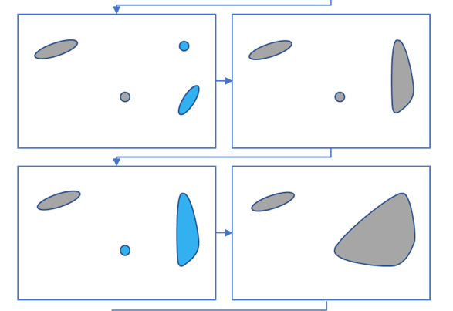

Slide 6
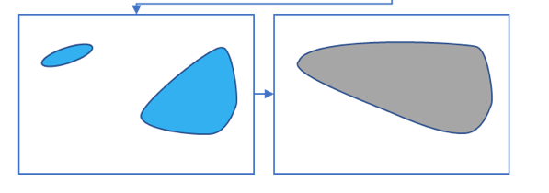
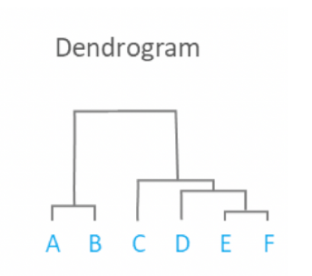
Result:

Slide 7
Divisive Hierarchical clustering:
It is exactly the opposite of the Agglomerative Hierarchical clustering.
In this clustering,we consider all the data points as a single cluster and in each iteration ,we separate the data points from the cluster which are not similar.
Divisive Clustering is rarely done in practice.

Slide 8
Difference between K-Means and Hierarchical Clustering
Hierarchical clusternig can’t handle big data well but K means clustering can.
K means clustering is found to work well when the shape of the clusters is hyper spherical
K means requires prior knowledge of K(no. of clusters you want to divide your data into),but you can stop at whatever no. of clusters you find appropriate in hierarchical clustering by interpreting the dendrogram.

Slide 9
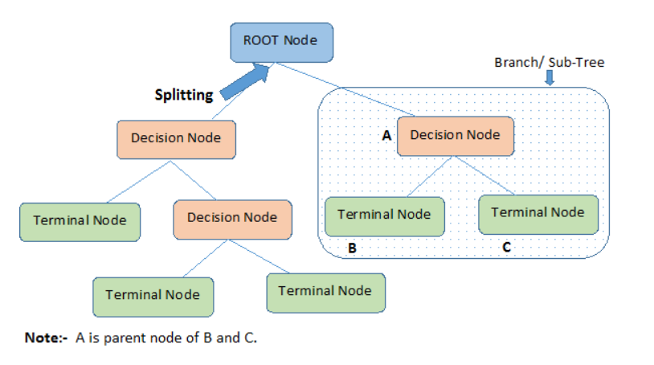
Decision Tree:
Decision tree builds classification or regression models in the form of a tree structure.
It breaks down a dataset into smaller subsets with increase in depth of tree.
The final result is a tree with decision nodes and leaf nodes.

Slide 10
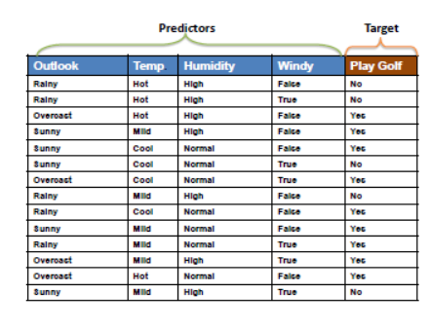

Slide 11
Types of decision trees:
Categorical Variable Decision Tree
Continuous Variable Decision Tree
Algorithm used in decision trees
ID3
Gini Index
ID3:
This algorithm employs a top-down ,greedy search through the space of possible branches.
ID3 uses Entropy and Information Gain to construct a decision tree.

Slide 12
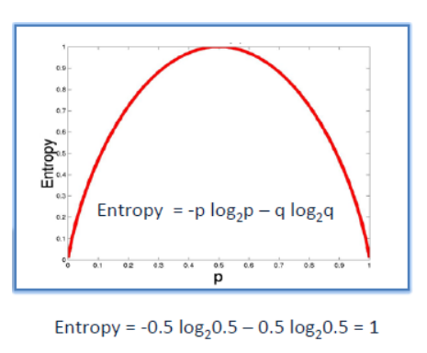
Entropy:
If the sample is completely homogeneous the entropy is zero and if the sample is equally divided then it has entropy of one.

Slide 13
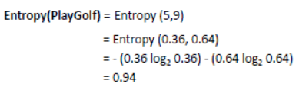
Information Gain:
The information gain is based on the decrease in entropy after a data-set is split on an attribute. Constructing a decision tree is all about finding attribute that returns the highest information gain(i.e., the most homogeneous branches).
Step 1: Calculate entropy of the target.

Slide 14
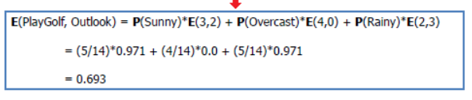
Step 2:
The dataset is then split on the different attributes.
The entropy for each branch is calculated.
Then it is added proportionally, to get total entropy for the split.
The resulting entropy is subtracted from the entropy before the split.
The result is the Information Gain,or decrease in entropy.

Slide 15
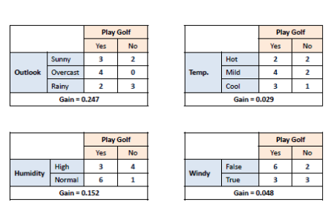

Slide 16

Step 3:
Choose attribute with the largest information gain as the desicion node, divide the dataset by its branches and repeat the smae process on every branch.

Slide 17
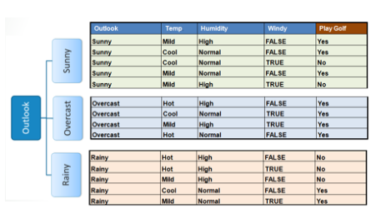

Slide 18
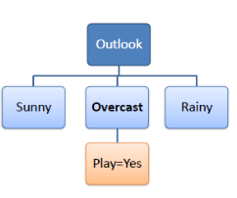
Step 4(a): A branch with entropy of 0 is a leaf node.
Step 4(b): A branch with entorpy more than 0 needs further splitting.

Slide 19
