Slide 1

Lecture – 6, 28-01-2020

Slide 2
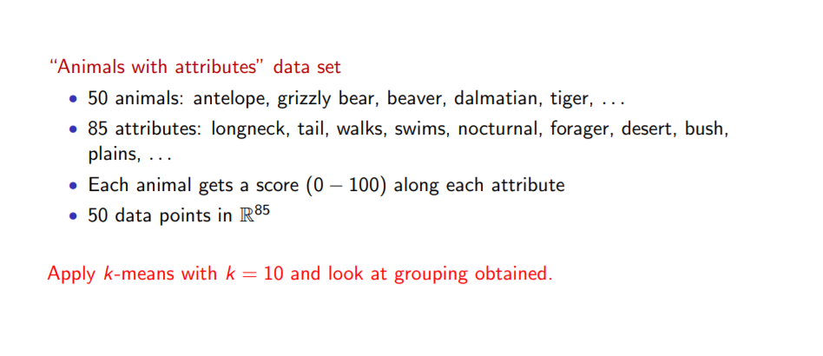

Slide 3
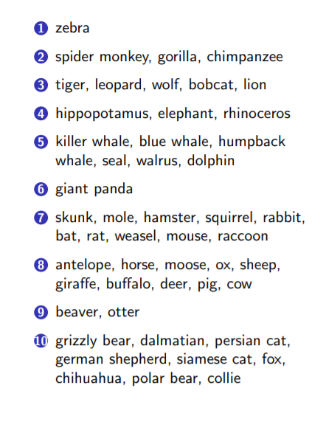
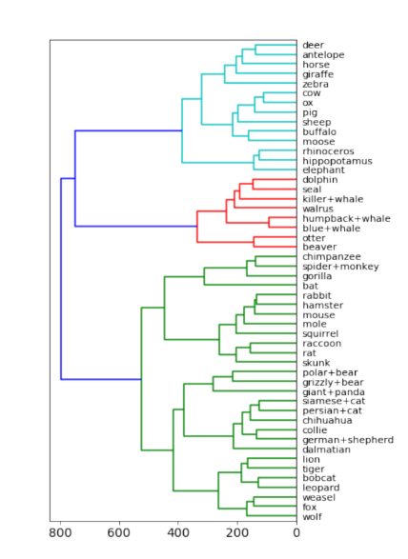

Slide 4

Gini Index:
It is calculated by subtracting the sum of squared probabilities of each class from one.
It favors lager partitions and easy to implement whereas information gain favors smaller partitions with distinct values.
A feature with a lower Gini Index is chosen for a split.

Slide 5
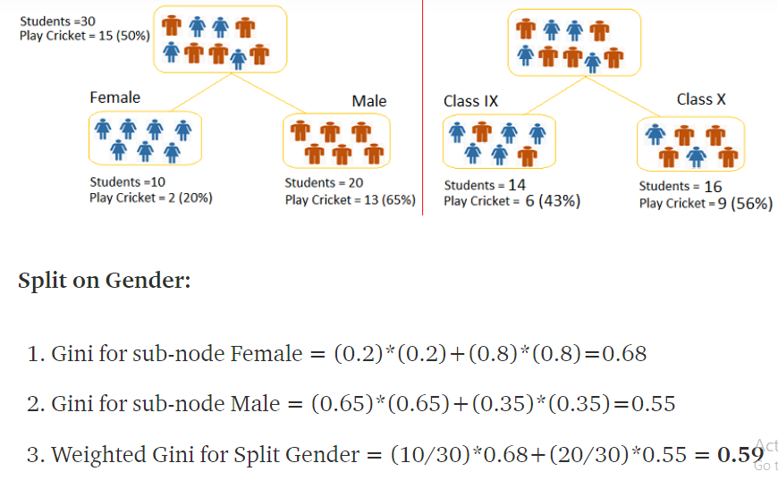

Slide 6
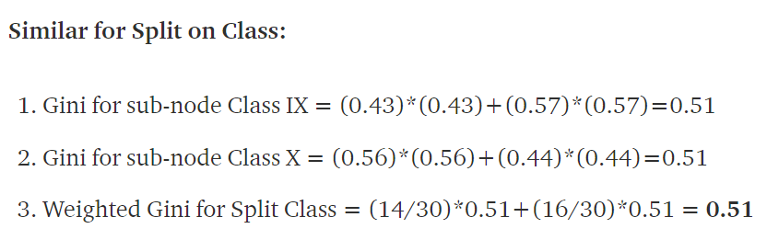

Slide 7
Feature Selection And Feature Extraction:
Feature Selection:
removal the irrelevant feature.
select m feature from N (m<N)
forward selection - start with empty set of features
backward selection - start with all features
Feature Extraction:
dimensionality reduction of features vector.
N dimensional features vector convert into m dimensional features vector.

Slide 8
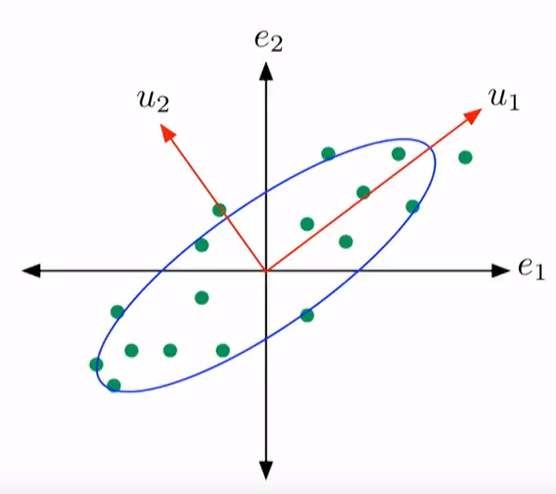
Principal component analysis:
It is a statistical procedure that uses and orthogonal transformation to convert a set of observations of possibly correlated variables into a set of values of linearly uncorrelated variables called principal components.
It is used to reduce the dimensionality of the data to a lower dimension.
In the figure the directions e1 and e2
can be decomposed into u1 and u2
where u1, u2 are independent and
variance along u1 is maximum.

Slide 9
Why do we want to reduce the dimensionality ?
Reducing the number of dimensions in the data can significantly speed up algorithms that we apply to it.
It makes the interpretation of data easier (sometimes).
A data in lower dimensions takes up less memory this makes a huge effect specially when data is in millions.
There is lower variance in data. Variance can in a way be seen as the amount of information that can be used to make predictions in the data.
So the main objective of PCA is to reduce the dimensionality in the data without causing a significant loss in the variance.
What is the penalty thus incurred ?

Slide 10

So how do we reduce dimension using PCA?
For example consider that I have a two dimensional data and I want to reduce it to one dimension while also maintaining as much variance as possible.
To do so I can simply take the direction along which the variance is maximum.
In k dimensions we can do the same thing by taking the top k eigen vectors of the covariance matrix.
The covariance matrix tells us the stretch of the distribution along each direction.
Eigen Vectors

Slide 11
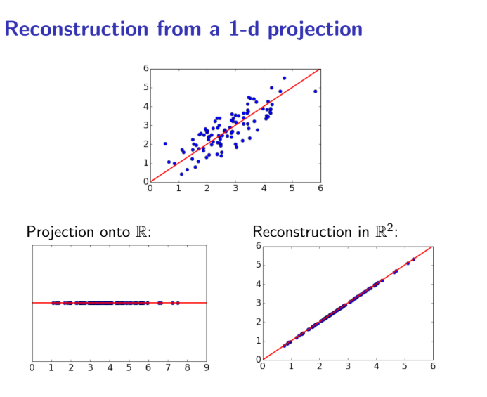

Slide 12
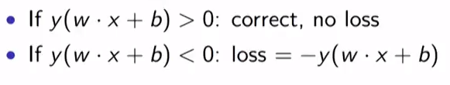
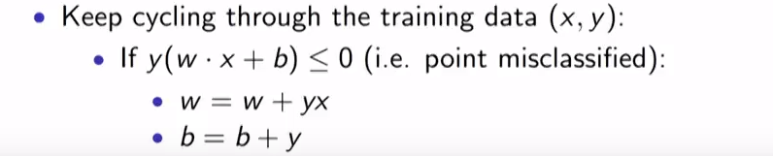
Perceptron algorithm:
Coming back to classification we take a look onto the perceptron algorithm.
It is an algorithm that is applied on linearly separable data.
In this we define a loss function :
Update function:

Slide 13
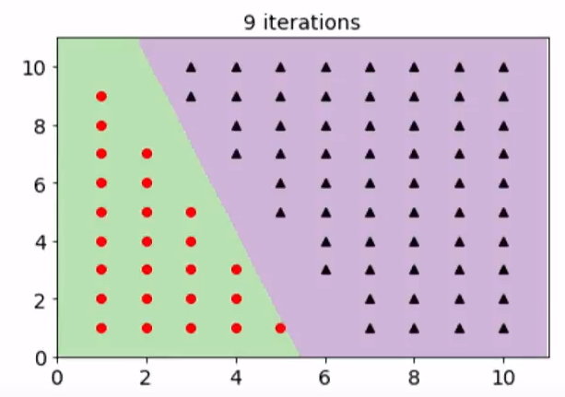
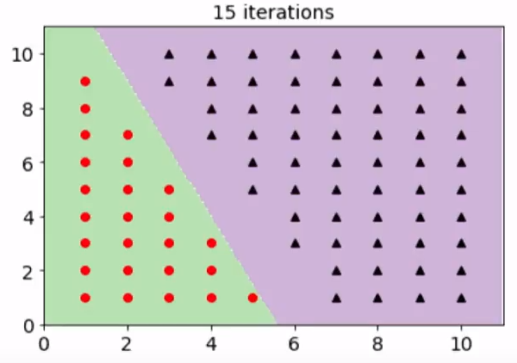
Perceptron example :

Slide 14
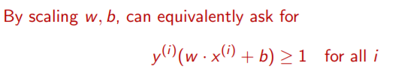
Support vector machines:
The SVM algorithm is an improvement upon the perceptron algorithm.

Slide 15
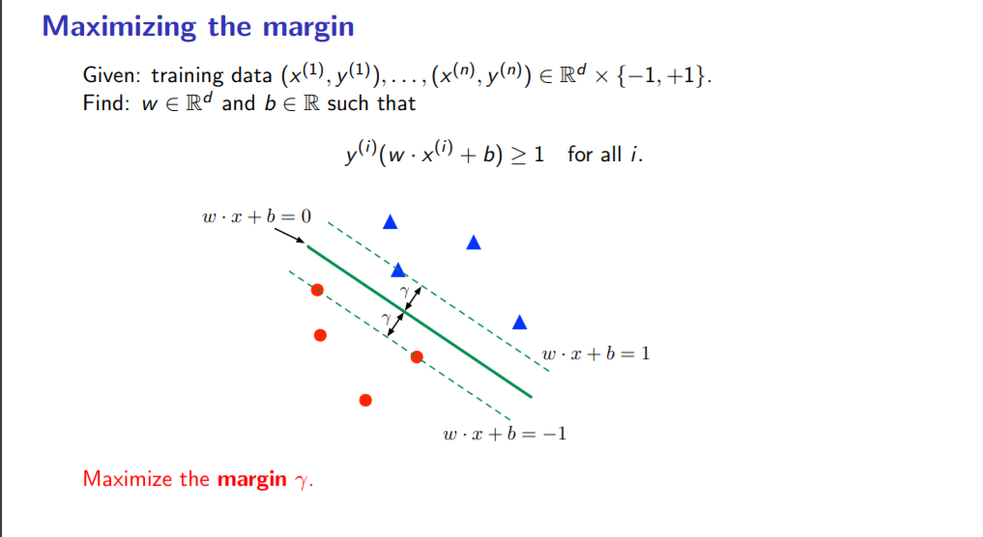

Slide 16
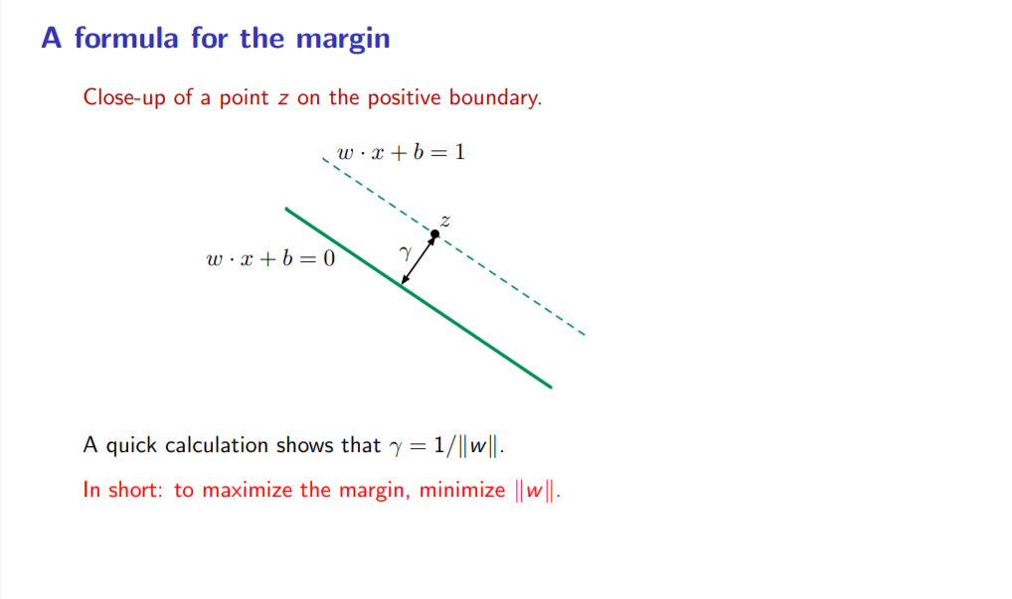

Slide 17
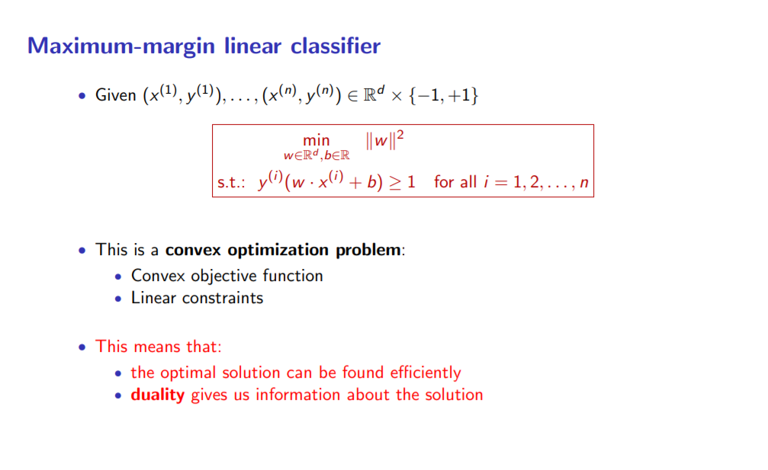
(Isse lite lena abhi)

Slide 18
