Slide 1
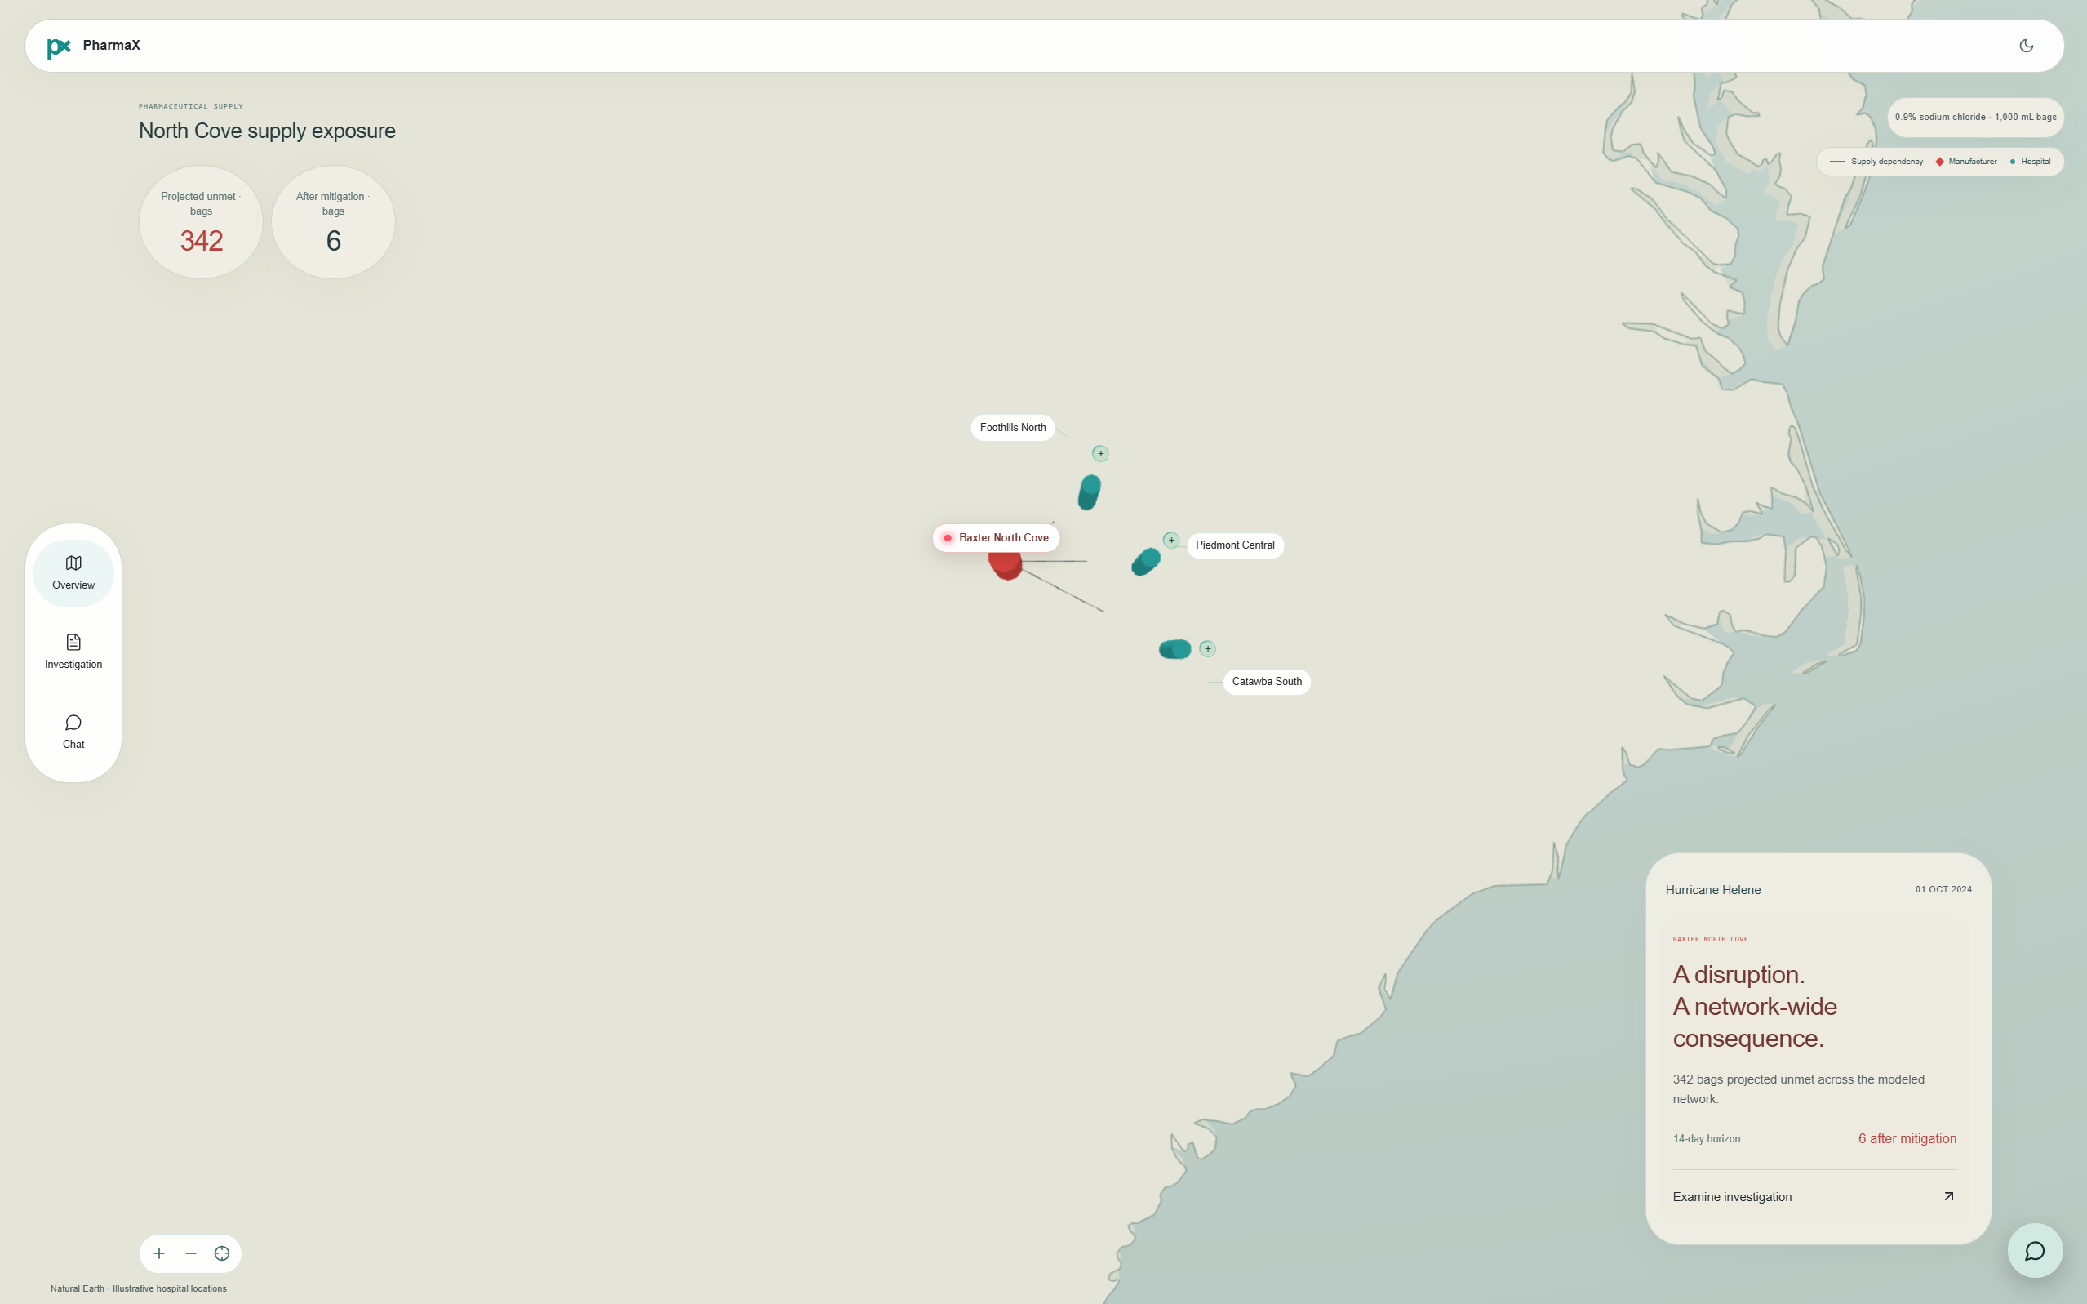
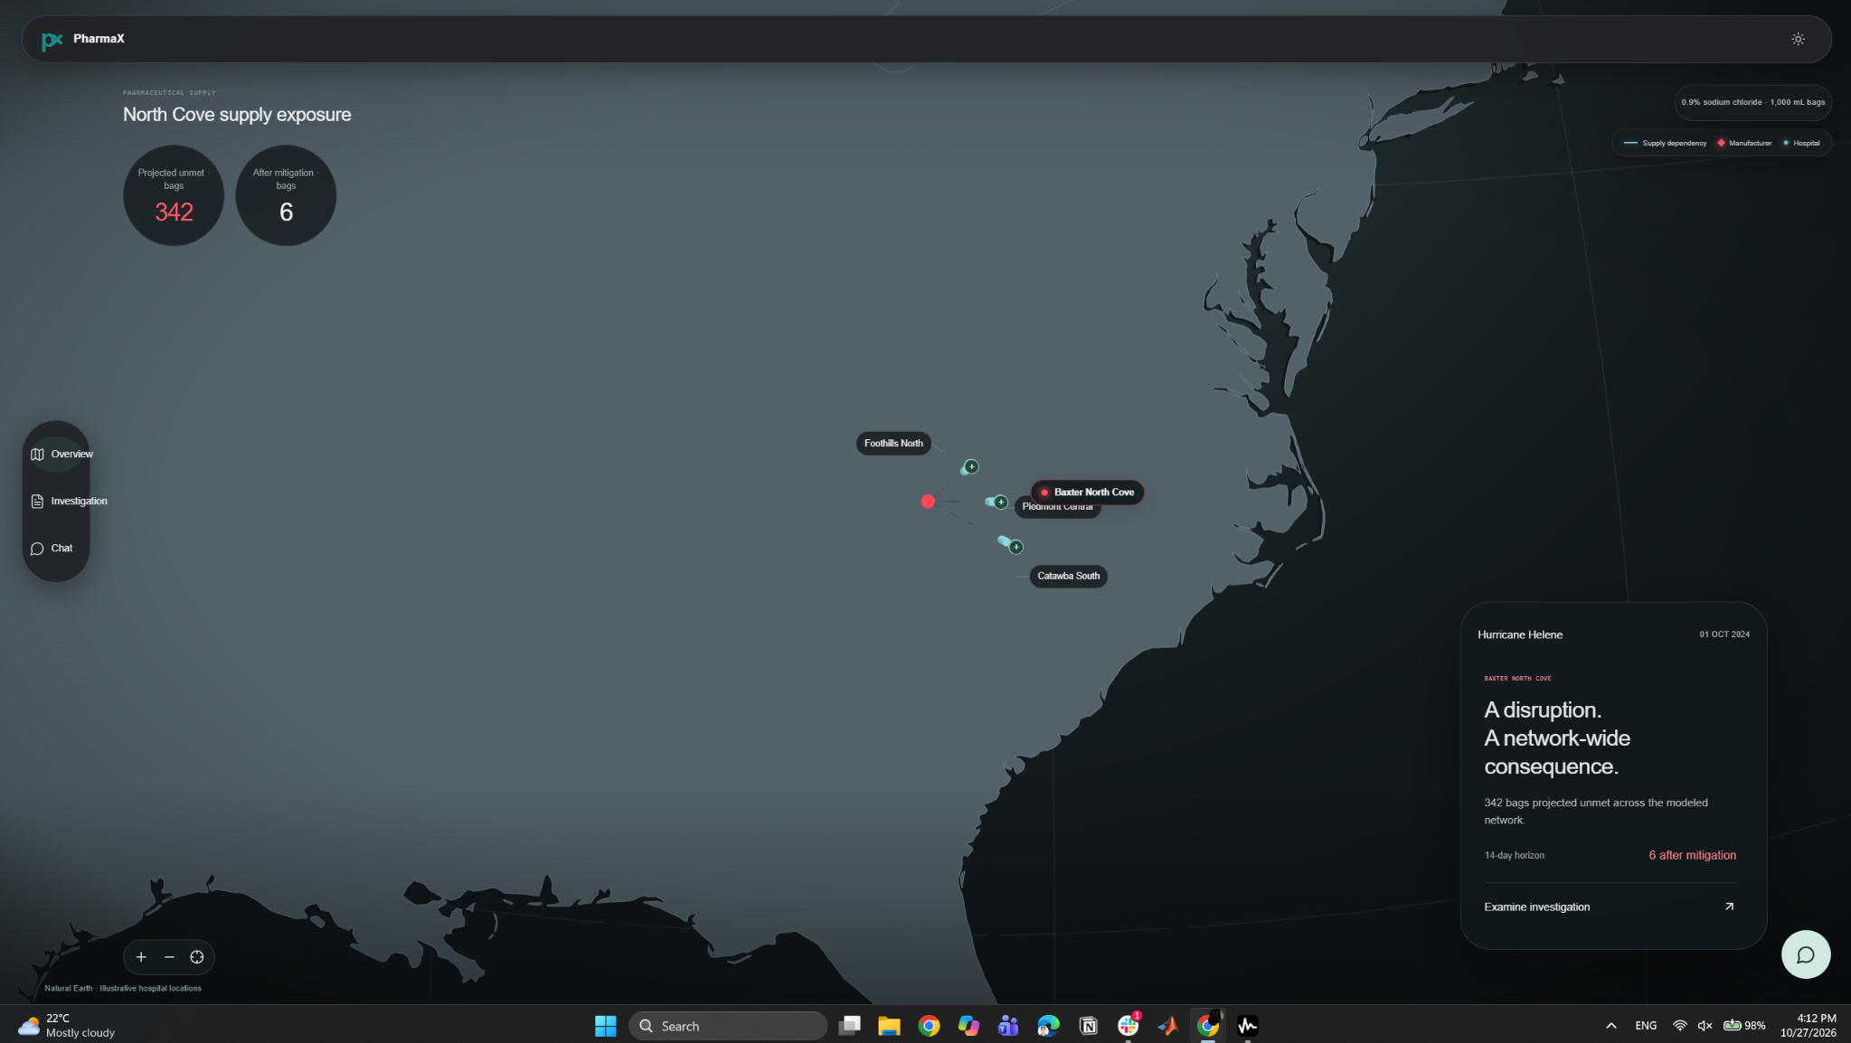
PHARMAX / OPEN AGENT HACKATHON
01 · PROBLEM & USERS
PharmaX
Spot medicine shortages early.
Get essential supplies where they are needed.
Reasoning Architecture
For pharmacy supply teams: connect manufacturer notices, shipment claims and hospital inventory to predict shortages and recommend reviewed transfers.
01

Slide 2
PX / PHARMAX
02 · PROBLEM
When supply breaks, hospitals run short.
A factory disruption can leave one hospital short while another has spare stock. Teams need to find the gaps and evaluate safe transfers before supplies run out.
1 Supply disrupted
2 Deliveries fall short
3 Hospitals face shortages
Manufacturing slows or stops.
Fewer saline bags enter the network.
Orders may be delayed or partially filled.
Available supply becomes uncertain.
Some hospitals risk running out;
others may have transferable stock.
PharmaX maps the disruption, predicts unmet demand and identifies feasible transfers that protect both receiving and donating hospitals.
02

Slide 3
PX / PHARMAX
03 · SOLUTION
Solution
A single investigation links evidence to a shortage forecast and an actionable review draft.
01
02
03
04
05
Connect records
Match medicines
Check claims
Predict shortages
Propose transfers
342
→
6
modeled unmet saline bags after evaluated transfers
Scenario forecast · three synthetic hospitals · human pharmacy review required
03

Slide 4
PX / PHARMAX
04 · AGENT WORKFLOW
Agent architecture
12 coordinated roles share evidence, challenge proposals and validate what can safely be recommended.
Coordinator
Evidence & context
Assessment
Memory & delivery
Review
loop
Delegates tasks; synthesizes results
News · Verification · Trade
Dependency · Disruption
Hospital · Clinical
Mitigation · Feasibility
Memory · Actions
Retain constraints; draft review
Evidence → assessment → critique → revised/blocked decision. Recalled failures constrain proposals; only supported findings reach the coordinator.
12 roles executed · 11 findings validated · Hospital finding rejected and excluded downstream
04

Slide 5
PX / PHARMAX
05 · TECHNICAL STACK
Technical architecture
From data retrieval to constrained decisions: one traced investigation pipeline.
Zetaris
Join manufacturer allocation notices with hospital inventory and receipt records; normalize product codes.
01 SOURCE DATA
Nemotron
Coordinator and 11 specialists use Nightshift model calls and tools to examine evidence and draft decisions.
02 AGENT SYSTEM
H-MEM
Recall rejected candidates; validate evidence, recalculate shortages and require pharmacy review.
03 MEMORY + GUARDS
Python orchestration + typed API → Zetaris source queries → Nemotron via Meterless Nightshift → FEFO forecast + review
05

Slide 6
PX / PHARMAX
06 · DISTINCTIVE SPONSOR USE
Why the integrations matter
The data, model and memory layers constrain the same operational decision.
Zetaris
Cross-system product matching
Manufacturer item → NDC → local item code
1
Evidence verification
Shipping claim versus hospital receipt
800 shipped / 500 received → 300 unconfirmed
2
Memory limits proposals
Previously rejected options stay flagged
5 recalled records constrain subsequent review
3
Feasibility checks
Only reviewable options are proposed
Reject options that create donor shortages or assume unconfirmed supply
4
Distinctive: validated claims + inter-agent constraints, not 12 independent summaries
06

Slide 7
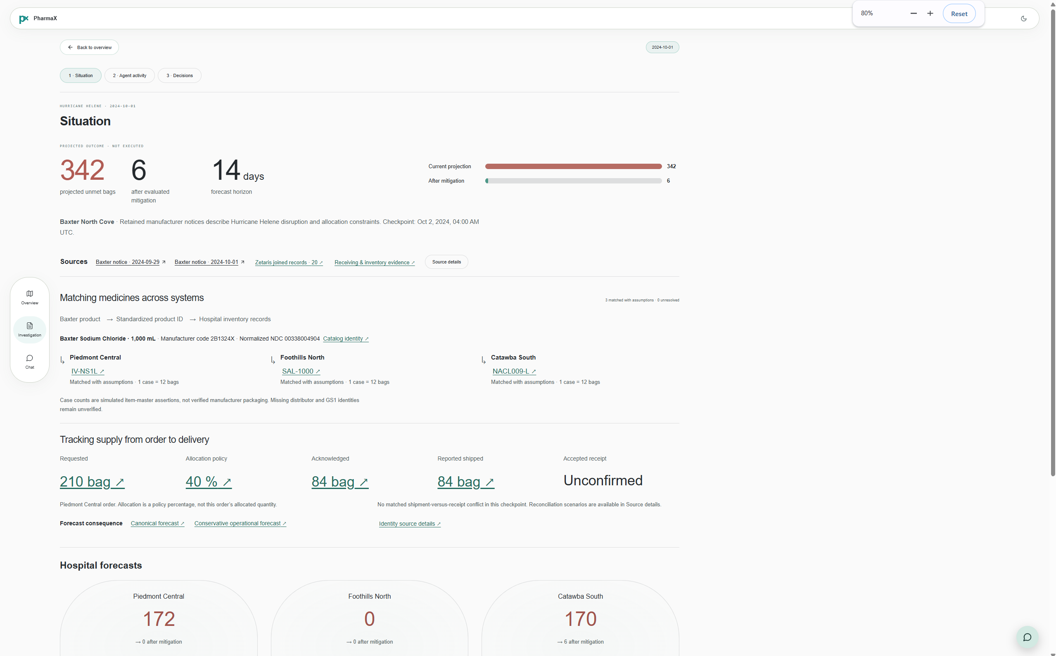
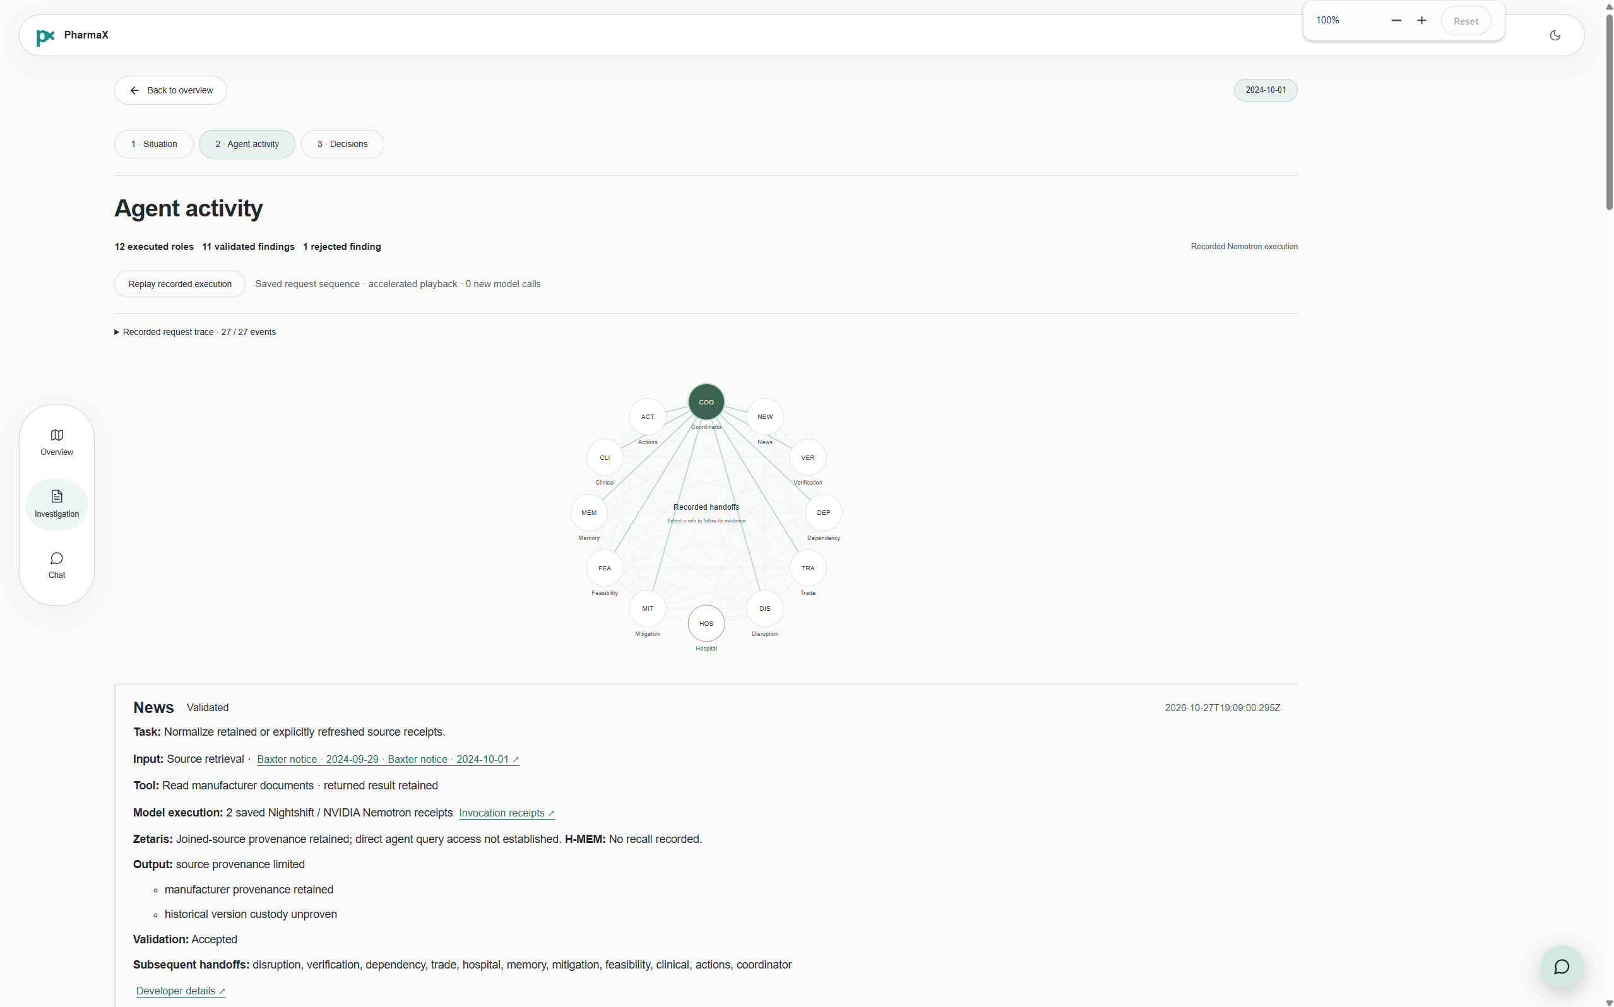
PX / PHARMAX
07 · PRODUCT VISUALS
One case, three interfaces.
Judges can reproduce the narrative from overview to evidence to action.
01 Overview
02 Investigation
03 Agent execution
Dedicated sourced chat and review drawers complete the operator workflow.
07

Slide 8
PX / PHARMAX
08 · FEEDBACK & ITERATION
Built from operational feedback
Industry advisor Kulathusarma highlighted the hardest deployment problem: linking records across organizations and verifying what was actually delivered. Feedback shared by Robbie Harris.
01
Connect systems
Join manufacturer availability and hospital demand records.
02
Check claims
Distinguish reported shipping from hospital-confirmed receipt.
03
Match medicine IDs
Match manufacturer product codes to hospital item codes, quantities and lots.
04
Review decisions
Test transfer feasibility and require pharmacy review before any action.
What we built in response: joined data sources, product matching, shipment-versus-receipt checks and feasibility-gated transfer drafts.
08

Slide 9
PX / PHARMAX
09 · FUTURE
Future development
Next steps for turning a validated prototype into an operational tool.
Authorized hospital connectors
Connect real inventory, purchasing and receiving systems with permission.
01
Continuous monitoring
Refresh evidence and forecasts when supply or demand changes.
02
03
Stronger operational validation
Validate real approval roles, transfer ownership and confirmed delivery events.
Current scope: public Baxter documents, synthetic hospital data and simulated transfer proposals.
09

