Slide 1
COVID-19 PNEUMONIA PREDICTION USING CHEST X-RAYS
PADMINI RAMESH
SIDHANT NAVERIA
INSTITIUTE FOR INFOCOMM RESEARCH
QIAN PEISHENG
qian_peisheng@i2r.a-star.edu.s
:

Slide 2
Agenda
Company Introduction
Problem Background
IAP Project
Solution & Design
Implementation
Performance & Validation
Findings & Recommendation

Slide 3

COMPANY BACKGROUND
The primary operation of A-STAR is to advance the economy and improve lives by amplifying proficiency in the fields of intensive biomedical, research, scientific and engineering.
I2R in Fusionopolis One was established on 17 th October 2008.
Their principle work can be extended to the following fields:
Machine intellection, Cyber security ,Aural and Language Intelligence, Robotics and Autonomous System, healthcare and medtech, Neuromorphic Computing.
Experimentations undertaken under the machine intellection department involves learning with 10x fewer labeled samples.
They also incorporate knowledge graphs into deep learning, online learning, white-box learning and transfer learning.
Their exercises also embody data driven optimization, and deep learning on encrypted data.

Slide 4
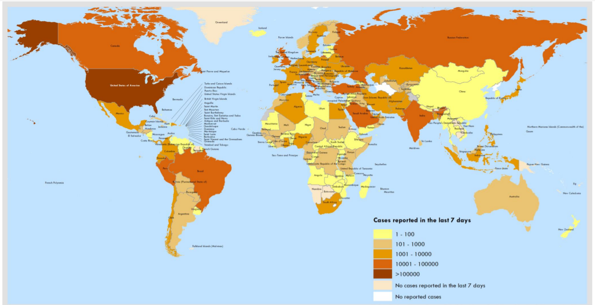
PROBLEM BACKGROUND
COVID-19 is an infectious disease caused by SARS-CoV2 which is closely related to the SARS virus.
The first patient was discovered on December 30 ,2019 by Dr.Li examined a patient’s report which showed a positive result with a high confidence level for SARS coronavirus tests.
According to the statistics provided by WHO, globally 3,588,773 confirmed cases have been reported as on ,May 6 2020.
The total number days for incubation as prescribed for suspected patients is 14.
The above mentioned virus can spread asymptomatically.

Slide 5
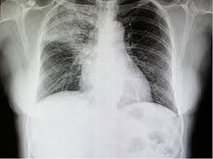
PROBLEM BACKGROUND
Chest X-Ray/CT scan are considered as routine imaging tool for COVID-19 diagnosis.
Following are the challenges faced while examining the X-ray images:
Everyday clinicians are exposed to reading high volumes of images during each shift.
Tiredness , distractions are few factors that might lead them to miss important details in an image.
This is when the idea of using an automated image analysis tools comes into picture.
This project proposes to develop a model to detect covid-19 from chest radiographs.

Slide 6
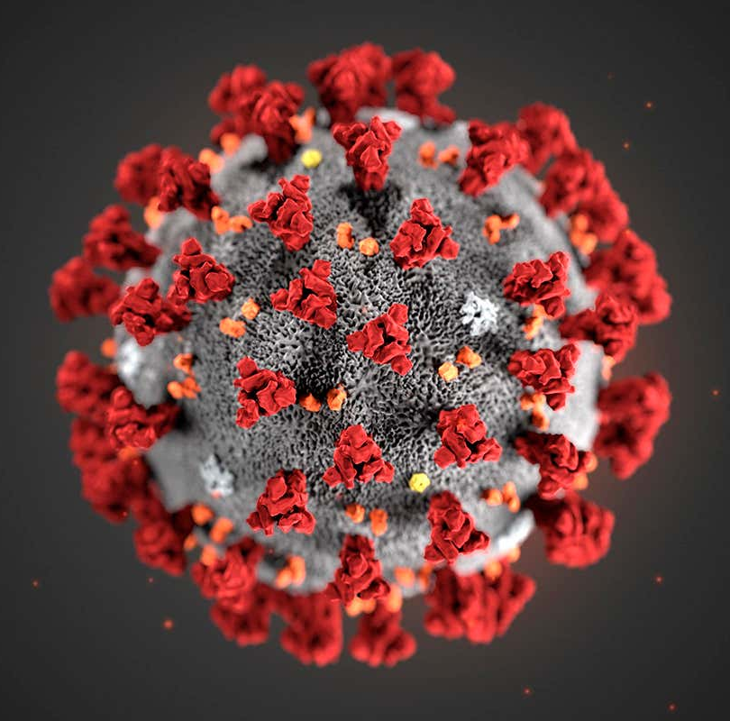
COVID-19 PNEUMONIA PREDICTION USING CHEST X-RAYS
Prediction can be done using CT images or X Rays. Our project focuses on X Rays image only
Main objective of this project is to facilitate healthcare workers in analyzing X Ray images and prioritize the cases according to the prediction.
Project can be divided in 2 parts: lungs detection and covid 19 classification
We have experimented with different classification models and done the comparison to get the best accuracy
Models are compared for full lung images and left- right split of lungs

Slide 7
COVID-19 PNEUMONIA PREDICTION USING CHEST X-RAYS conti.
Challenges and Issues
Biggest challenge was the small size and unbalanced dataset.
At first place mean and standard deviation of image net was used as we were trying transfer learning for some case, but results were not promising.
As dataset was very small, overfitting became big headache. To overcome it, we saved the best model according to the accuracy on validation set.

Slide 8
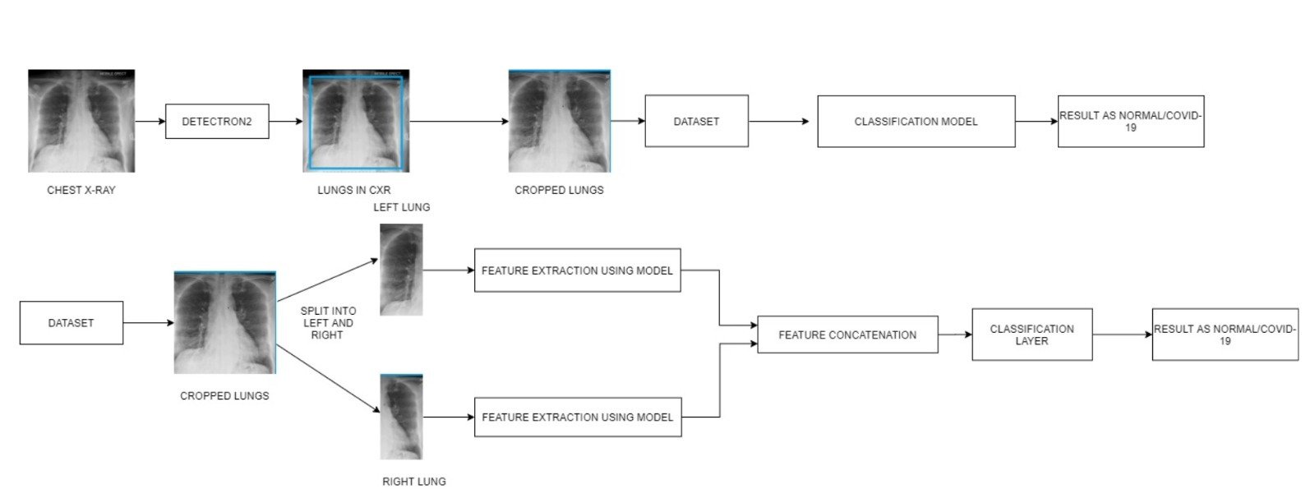
Solution & Design
Solution is divided in 2 parts:
Lungs detection
Covid-19 classification.

Slide 9
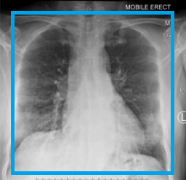
Solution & Design
Lungs detection
First step is do the lungs detection
For the object detection part, we have used Facebook AI’s Detectron2 with a backbone as Faster RCNN.
Detectron2 is Facebook AI Research's next generation software system that implements state-of-the-art object detection algorithms
It can be used as a library to support different projects on top of it
It trains much faster.

Slide 10
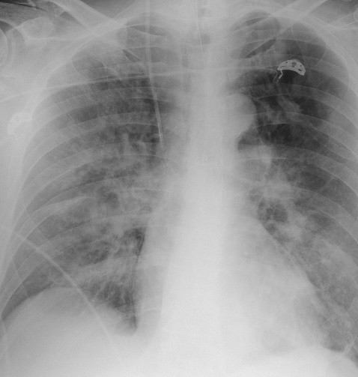
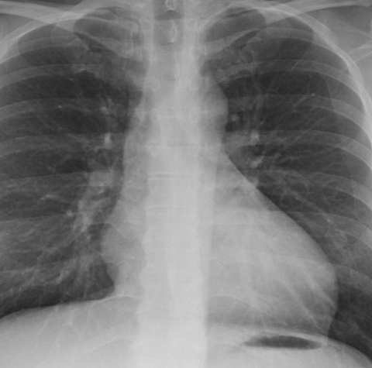
Solution & Design
Covid-19 classification
Using the dataset having output from previous stage, classification is done
For classification 3 different models are used and results are compared.
Resnet18 , Residual Attention network, Inception V3.
For each model 2 approaches are followed. First feeding the full images to the classification model and second splitting the image into right lung and left lung, then feed both the images to the model.

Slide 11
Solution & Design
Issues and challenges
Biggest issue was the size of the dataset. To solve it augmentation and public dataset was used
First time we worked with medical images
As dataset was very small, overfitting became big headache. To overcome it, we saved the best model according to the accuracy on validation set.

Slide 12
Solution & Design
Scope of work
Sidhant was responsible for implementation of object detection model and Residual attention model
Padmini was responsible for implementation of Resnet18 and Inception V3.
Both worked together in researching past research papers on PNEUMONIA detection and classification
Both worked together in familiarizing with medical imaging and analysis

Slide 13



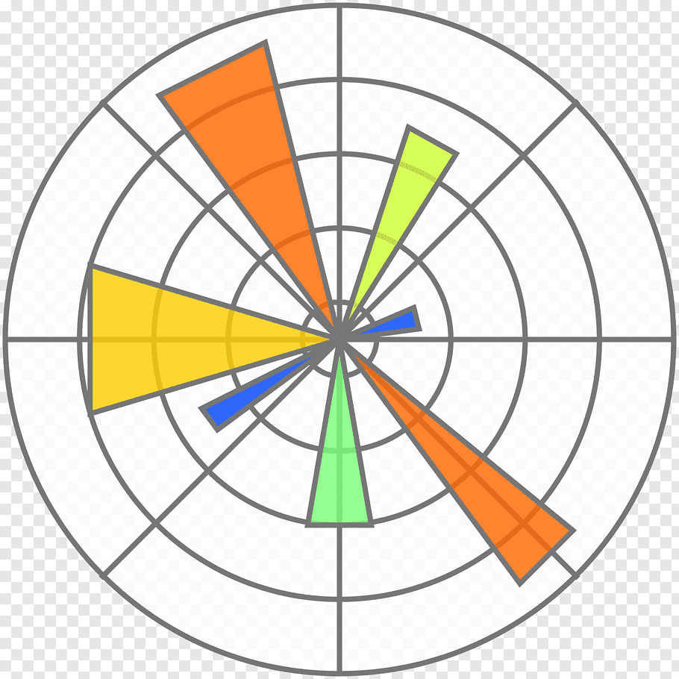
Implementation
Pytorch (Python) is used to implement the code for the models.
Matplotlib is used for graphs, numpy is used for mathematical operations and PIL is used for reading the images
Different research papers were used for implementation purposes eg-for splitting the images we refer “Automated chest x-ray screening: can lung symmetry help detect pulmonary abnormalities”.

Slide 14
Performance & Validation
The model was tested on a set of normal and covid-19 images.
The metrics used for evaluation are as follows:
Accuracy
Precision
Recall
F1-score
ROC curve

Slide 15
METRICES
 | FULL LUNGS |  |  |  | SPLIT LUNG IMAGES
MODELS | ACCURACY | PRECISION | RECALL | F1-SCORE | ACCUARCY | PRECISION | RECALL | F1-SCORE
RESIDUAL ATTENTION NETWORK | 83.3 | 0.88888 | 0.8275 | 0.857 | 91.6 | 0.9595 | 0.88 | 0.928
RESNET-18 | 70.83 | 0.6522 | 0.7143 | 0.6818 | 79.17 | 0.7826 | 0.7826 | 0.7826
INCEPTION -V3 | 56.2 | 0.5217 | 0.5455 | 0.5333 | 66.67 | 0.3478 | 0.8889 | 0.5

Slide 16
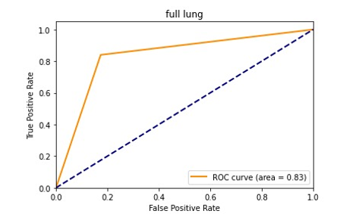
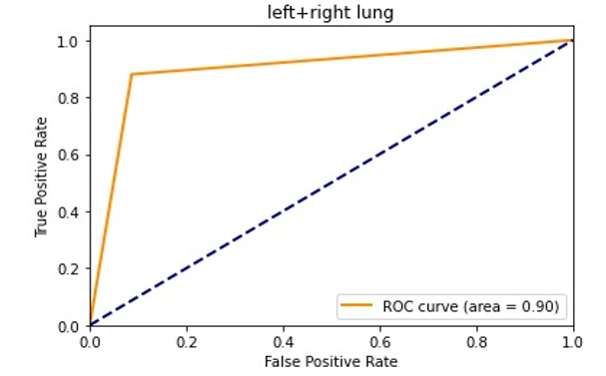
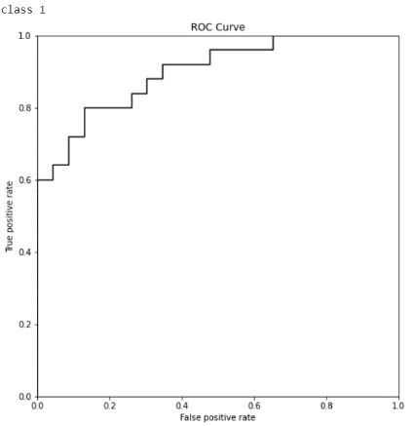
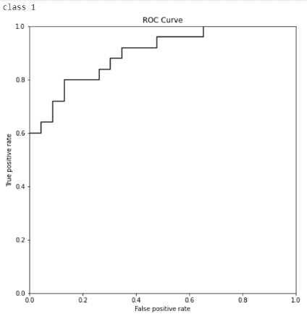
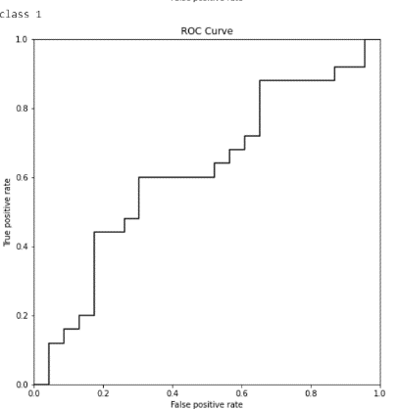
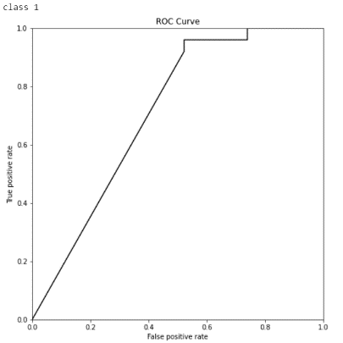
ROC CURVES
RESIDUAL ATTENTION NETWORK
RESNET 18
INCEPTION V3

Slide 17
Findings & Recommendations
It is observed that when the lungs were split using bi-lateral symmetry, performances were observed to be better.
Residual attention networks proved to give good performance in both the cases.
Thus, the project successfully classifies the image and puts out the probability of the image to contain covid-19.
Conclusively it can be stated that this model can be used by radiologists to prioritize the suspected cases.

Slide 18
CONTINUED…
Uniqueness involves usage of bilateral symmetry(splitting of lungs into two parts) which has achieved good metrics.
Little changes has been done to Residual attention network, by making 2 separate branches for left- right lung and concatenate the output from both branches
This Mtech program has provided basic knowledge required by any organization in order to undertake any Machine learning/AI projects.
Guidance provided by professors has helped us in grasping the industrial requirements quickly and thus this project was completed successfully on time.
Graduate certificate programs such as Pattern recognition system and Intelligent Sensing systems has laid the foundation of processes such as detection , classification and other major deep learning models.

Slide 19
FUTURE WORK
Given the availability of more data, the model can be trained to improvise the accuracy.
The classification model usage can be extended to CT scan images as well.
Explore few other classification models such as Inception v4, ResNeXt etc.,.

Slide 20
DEMO + Q&A

