Slide 1

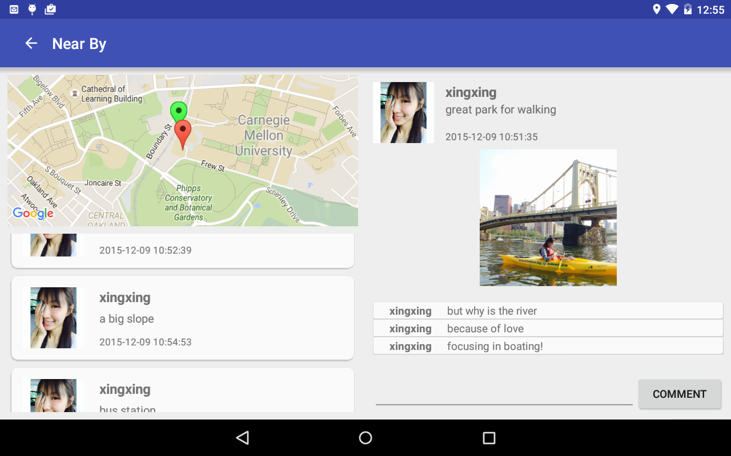
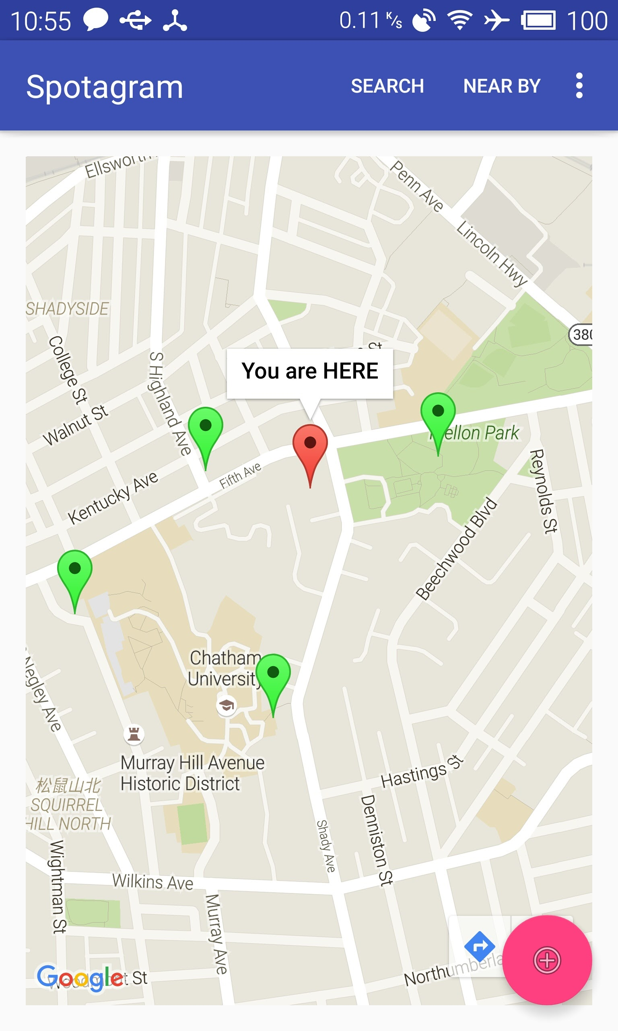
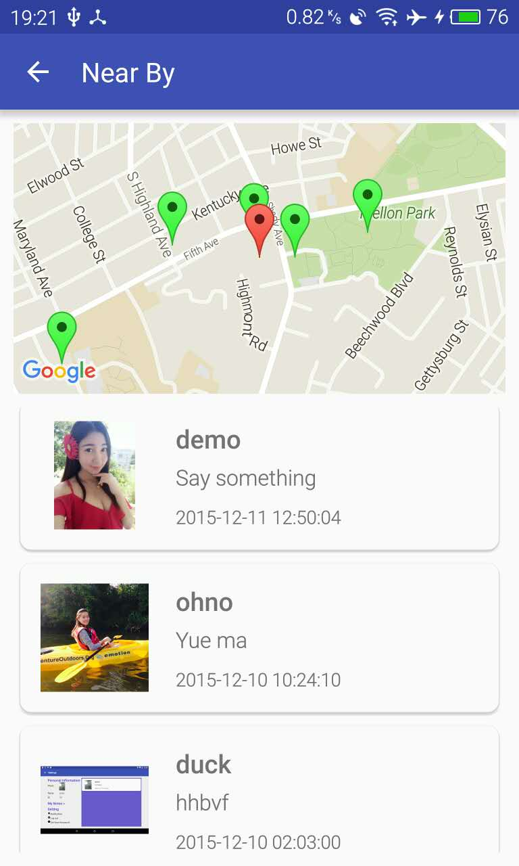
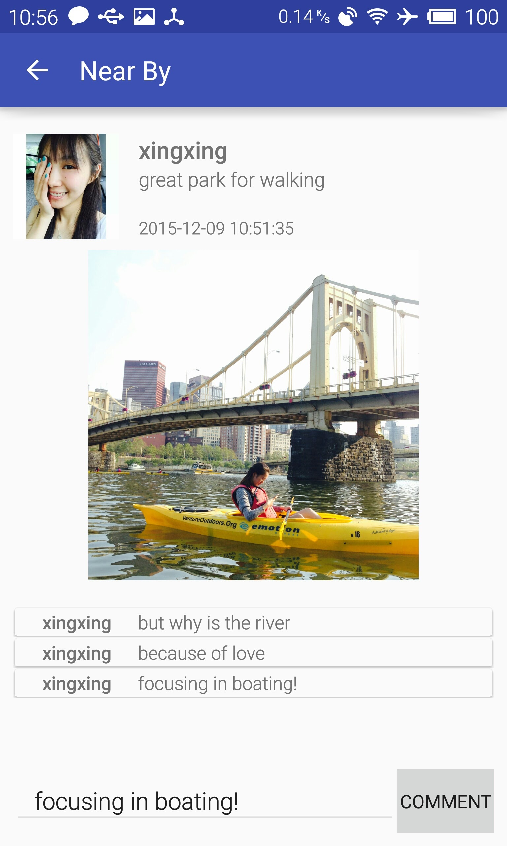
Spotagram leiyu miaojunl dawang
The idea
Share Your Location
See What’s Going on Near By
No follow/unfollow relationship
Location Based Social Apps
Challenges
Support Two Resolutions
Real-time Update UI
Uploading media files
Notable Features
Explore the world near your position
Meet new friends visiting the same place
Share everything with the whole world

