Slide 1
FreshGuard
GEEK ROOM GLOBAL AI HACKATHON · BIFROST × TAVILY
Freshness checks for LLM answers, at the AI gateway. Outdated claims caught, re-checked on the live web, and reported with sources.
Sidharth C S
Problem statement #4 (Bifrost) + #5 (Tavily)
Notes:
FreshGuard is a plugin for the Bifrost AI gateway. It catches claims in LLM answers that may have gone out of date, re-checks them against the live web with Tavily, and attaches a verdict, the current value and sources to the response. One project, both tracks: Bifrost problem statement 4 as primary, Tavily problem statement 5 integrated.

Slide 2
Models state outdated facts with full confidence
THE PROBLEM
ASKED IN NOVEMBER 2026
WHAT THE LIVE WEB SAYS
“Who is the current Prime Minister of the United Kingdom?”
Andy Burnham has been Prime Minister since 20 July 2026
Gemini: “The current Prime Minister is Keir Starmer.”
Source: House of Lords Library, found by FreshGuard
Same for prices, API versions, laws, and anything “latest”. Users can’t tell which sentences are stale.
Notes:
This is a real exchange from our demo. Gemini answered from its training data and was confidently wrong about a head of government. The same happens with prices, API versions, laws and anything described as the latest. Users cannot tell which sentences are stale.

Slide 3
The gateway sees every answer first
WHY THE GATEWAY
01
02
03
Training data ages every day
Every app fixes it alone
The gateway already sits in the path
Versions, prices, leaders and laws change after the cutoff.
Per-app retrieval or fact-checking, built again for each product.
Bifrost routes every model call, so one plugin covers every app.
Notes:
Teams increasingly run all model traffic through a gateway like Bifrost for routing, fallbacks and budgets. That makes it the natural place for a shared answer-quality check: operators turn it on once instead of asking every app team to build retrieval.

Slide 4
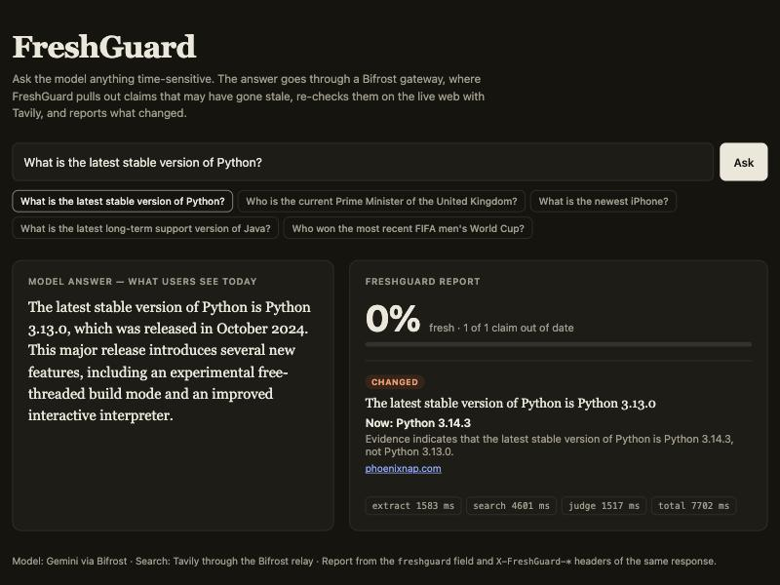
FreshGuard, a Bifrost plugin
THE SOLUTION
Every checked answer comes back with a verdict per claim, the current value, and the sources it rests on.
X-FreshGuard-Score: 0.00
X-FreshGuard-Stale: 1
"freshguard": { claims: [ … ] }
No change to the calling app.
Notes:
The answer reaches the user unchanged, plus two response headers and a freshguard block in the JSON. Here the model said Python 3.13.0 is the latest stable release; FreshGuard marked the claim changed, gave the current value and linked its source. Apps can show the warning, log it, or ignore it.

Slide 5

Four steps after the answer is ready
ARCHITECTURE
1 · EXTRACT
2 · SEARCH
3 · JUDGE
4 · ATTACH
Up to 5 time-sensitive claims, each with a query and its official site
Open web plus the official site, last 12 months, in parallel
Supported, changed or unverifiable, from evidence only
Score headers and a freshguard block in the JSON
Tavily through the Bifrost relay
Same response, no app change
Model call through Bifrost
Model call through Bifrost
Go plugin · PostHook + StreamChunkHook · streaming or not · verified claims cached 1 h · opt-in per virtual key
Notes:
FreshGuard hooks Bifrost's HTTP transport after the model has answered. Step one asks a small model, through Bifrost itself, to list time-sensitive claims and a search query for each. Step two searches Tavily for every claim in parallel, restricted to the last year, once on the open web and once on the official site the extractor named, so official pages win when sources disagree. Claims verified in the last hour skip steps two and three. Step three asks the model to judge each claim using only that evidence. Step four writes the report into the same response. Its own model calls are tagged so it never checks itself.

Slide 6
Bifrost does the plumbing, Tavily does the knowing
BOTH TECHNOLOGIES
Bifrost
Tavily
Hosts the plugin in the request path
Runs the model calls, with fallbacks
Holds the Tavily key in a relay, not in the plugin
Bills every check to the caller’s virtual key
Live web search per claim
Recency filter: results from the last year
Readable page snippets the judge can cite
The only evidence a verdict may rest on
POST /relay/tavily/search · x-bf-vk: <caller’s key>
Bifrost adds the Tavily credential, checks the key’s relay grant, and records the spend.
Notes:
Neither technology is a token integration. Without Bifrost there is no place to run the check, no governed model access and no per-key billing. Without Tavily there is no evidence. Searches go to /relay/tavily on the gateway, so Bifrost injects the Tavily credential, enforces the virtual key's relay grant and records the spend.

Slide 7
Built to sit in production traffic
DESIGN CHOICES
Fails open
Evidence only
No recursion
A failed search or bad model reply never breaks the user’s answer.
Cited URLs not in the search results are dropped: no invented sources.
Its own model calls carry a marker header and are never checked.
No key leaks
Operator control
Tested
A virtual key is forwarded only to this gateway, never to a third party.
On for chosen virtual keys, for all traffic, or per request by header.
Unit tests for the pipeline, eligibility rules and key forwarding.
Notes:
These choices are what make it safe to switch on for real traffic. The gateway must never be the reason an answer fails, and the report must never point at a page nobody fetched. The key-forwarding rule has its own test that fails if a virtual key is ever sent to a non-gateway URL.

Slide 8
Every stale claim caught, nothing true flagged
RESULTS · 37 HAND-LABELLED ANSWERS
18/18
0/19
5/5
2.5 s
outdated claims caught (target ≥ 70%)
current or timeless claims wrongly flagged (target ≤ 15%)
stale prices, wages and laws caught, with the current value
one uncontended check (target < 3 s)
Gemini 3.5 Flash-Lite, Tavily basic search via the Bifrost relay. 18 stale, 12 current, 7 timeless. One check hit a model timeout and passed on re-run. Full tables in eval/.
Notes:
The eval set now has 18 answers that are outdated by November 2026, including prices, wages and laws, 12 that are time-sensitive but still true, and 7 timeless facts that should never be flagged. All 18 were caught, each with the current value: the stamp is 82 cents, Netflix Standard is 19.99, the UK living wage is 12.71 pounds, and the EU AI Act has passed. Nothing true was flagged. Honest caveat: latency depends on the model provider. A single check takes about 2.5 seconds; on a slow Gemini day one check timed out and passed on re-run. Search itself stays under 3 seconds.

Slide 9
First run: 77% caught, 1 wrong, 3 errors
WHAT THE EVAL FIXED
What went wrong | Fix
Gemini free-tier rate limits and one timeout | Bifrost provider retries with backoff
A raw line break broke the model’s JSON | Model calls request JSON mode
“Starmer became PM in 2024” rewritten as “is PM” | Claims keep their tense; dated past events skipped
2023 blog posts used as evidence | Year in the query; Tavily limited to the last year
After the fixes: 13/13 caught, 0/17 wrong, 0 errors, at both search depths.
Notes:
Measuring first paid off. All three errors were infrastructure, so retries in Bifrost fixed them. The one wrong flag was a real bug: the extractor turned a true statement about a past event into a present-tense claim, which the live web then contradicted. After the fixes both search depths reached 13 of 13 caught and 0 of 17 wrong.

Slide 10
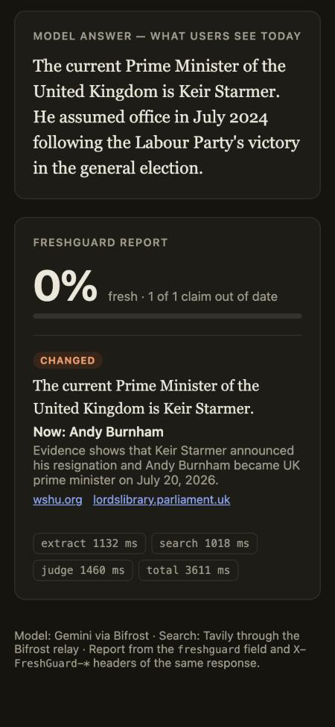
Live demo: answer on the left, report on the right
WORKING PROTOTYPE
Ask anything time-sensitive, or pick a preset.
Each claim shows its verdict, current value, sources and per-step timing.
The demo server keeps the virtual key server-side.
./dev.sh run · python3 demo/serve.py · http://localhost:8000
Notes:
Walk through two presets. Python: the model says 3.13, FreshGuard says changed with the current release and a source. UK Prime Minister: the model says Keir Starmer, FreshGuard says changed, now Andy Burnham, with the House of Lords Library as a source. Point at the timing strip: extract, search and judge each take about a second.

Slide 11
What is left
LIMITS AND NEXT STEPS
Known limits
Next
About 2.5 s per new claim; repeats come from the cache
Latency follows the model provider
Stream reports ride in raw_response
Needs the dynamic build; Docker does it
Upstream proposal to maximhq/bifrost
A plugin-metadata field on chunks
Cache shared across gateway replicas
A larger, shared eval set
Every verdict ships with its sources, so any call FreshGuard makes can be checked.
Notes:
Since the first version: verified claims are cached, so repeats skip search and judging; each claim is also searched on its official site, which fixed the run that cited a page a release behind; streamed answers are checked on the final chunk; and Docker builds everything in one command. What is left: Bifrost stream chunks have no field for plugin output, so the report rides in raw_response, which is one of the questions in the upstream proposal. The cache is per process; sharing it across replicas is next.

Slide 12
FreshGuard
RUN IT
Stale answers caught at the gateway, with sources.
cp .env.example .env
docker compose up --build
open http://localhost:8000
Live: freshguard-demo.onrender.com
Code: github.com/sidharth-cs/freshguard
Sidharth C S · Apache-2.0
Notes:
Three commands on any OS with Docker: add a Gemini and a Tavily key, build and start Bifrost with the plugin, then open the demo page. There is also a one-click Render deploy. The repository has the README, tests, the eval set and results. Thank you.

