Slide 1

HOUSE PRICE PREDICTION
Submitted by:
SIDHARTH DAS
Batch : Internship 16

Slide 2
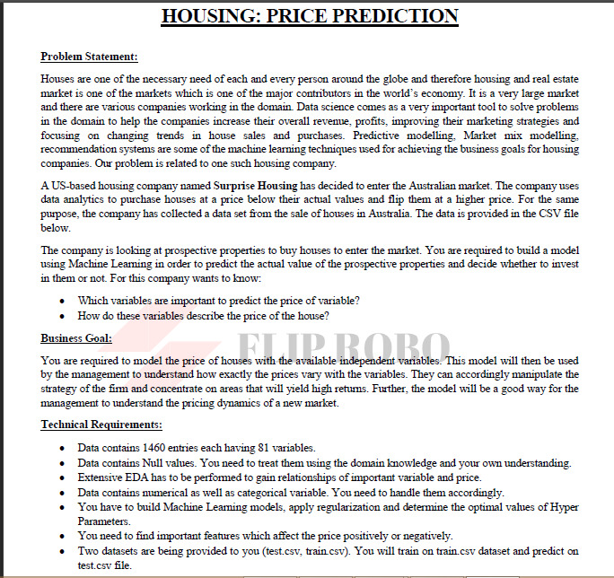

Slide 3
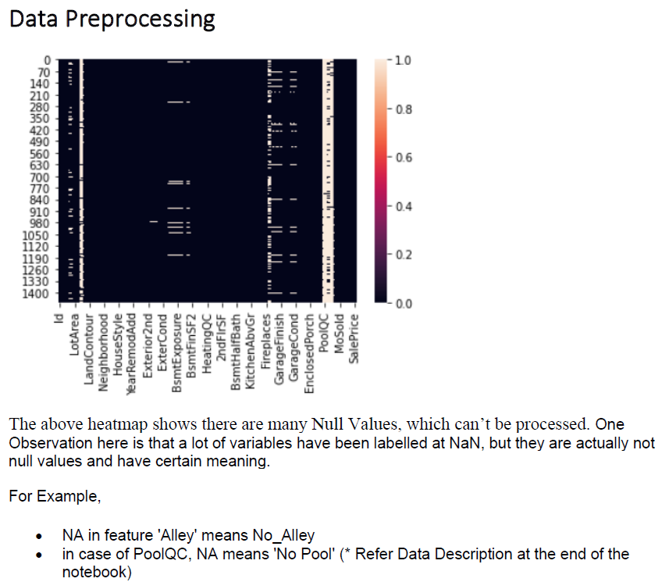
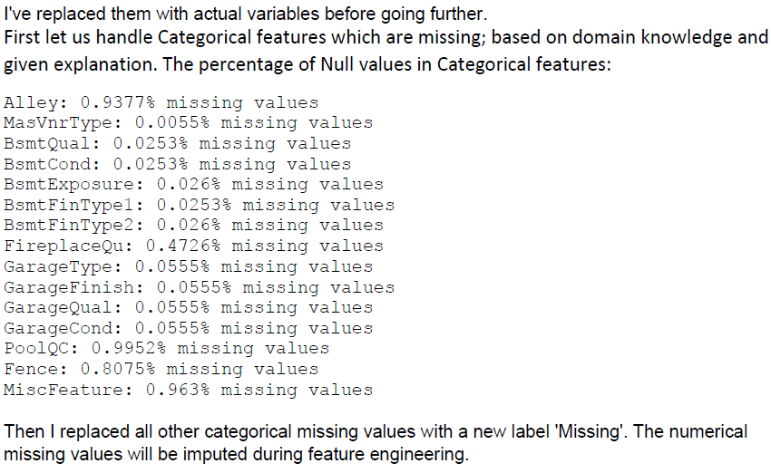
EDA Steps & Visualizations

Slide 4

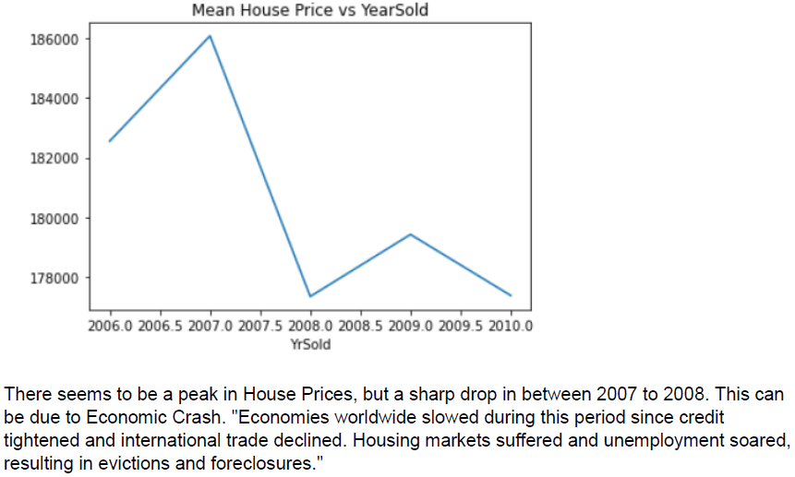
Classifying Features - Numerical
Identified all numerical features.
Out of 79, there were 37 numerical features
First Found out Temporal values (Year Features)

Slide 5
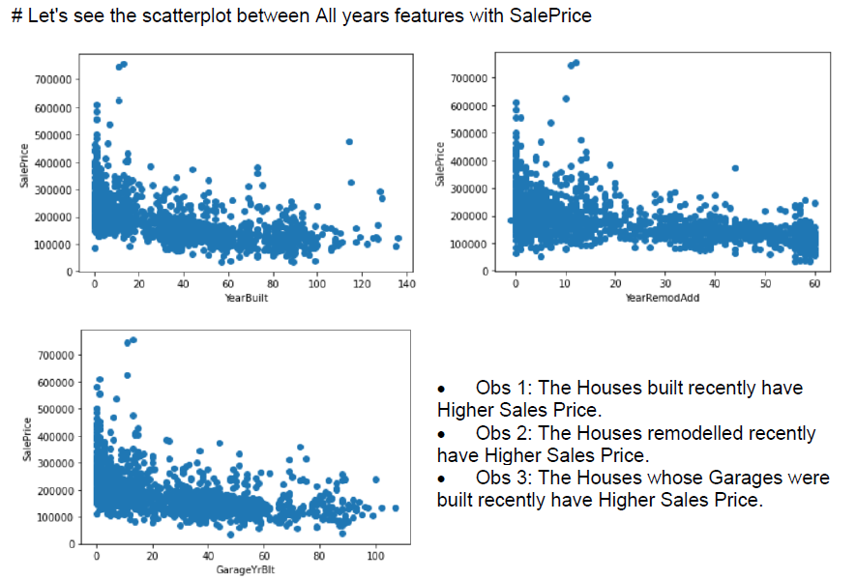
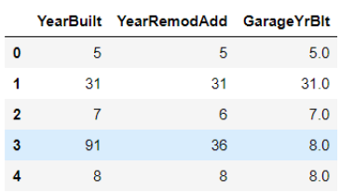
Scatterplots of Year Features vs Sales Price
Above features were created by finding difference from Year of Sale

Slide 6
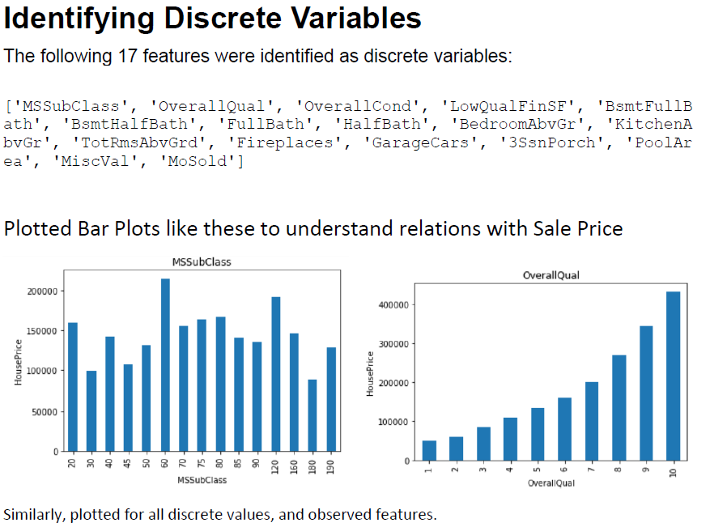
Out of 37 Numerical Features, identified 17 discrete features.

Slide 7
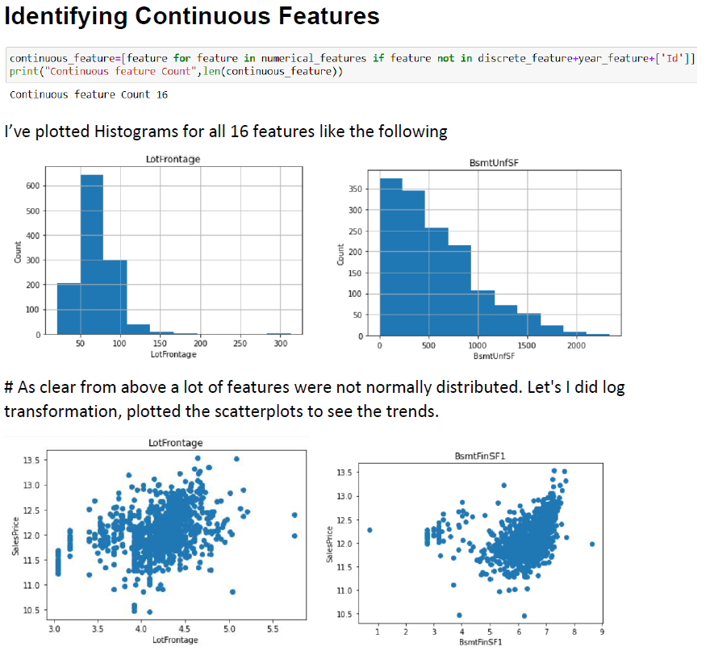
16 Continuous features out of 37 numerical features

Slide 8
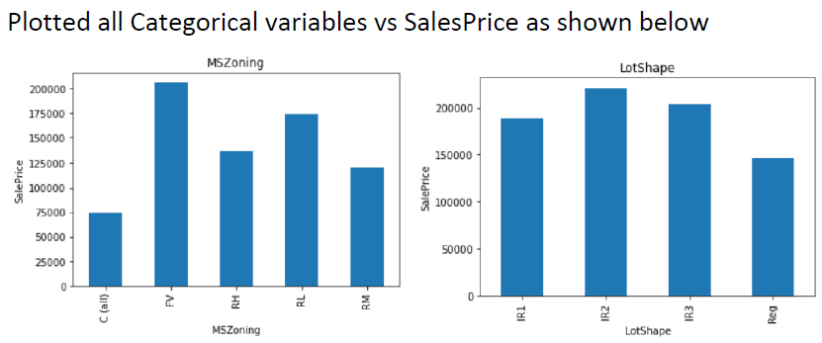
Categorical Features
Total 43 categorical Features were identified.

Slide 9


Feature Engineering Steps

Slide 10
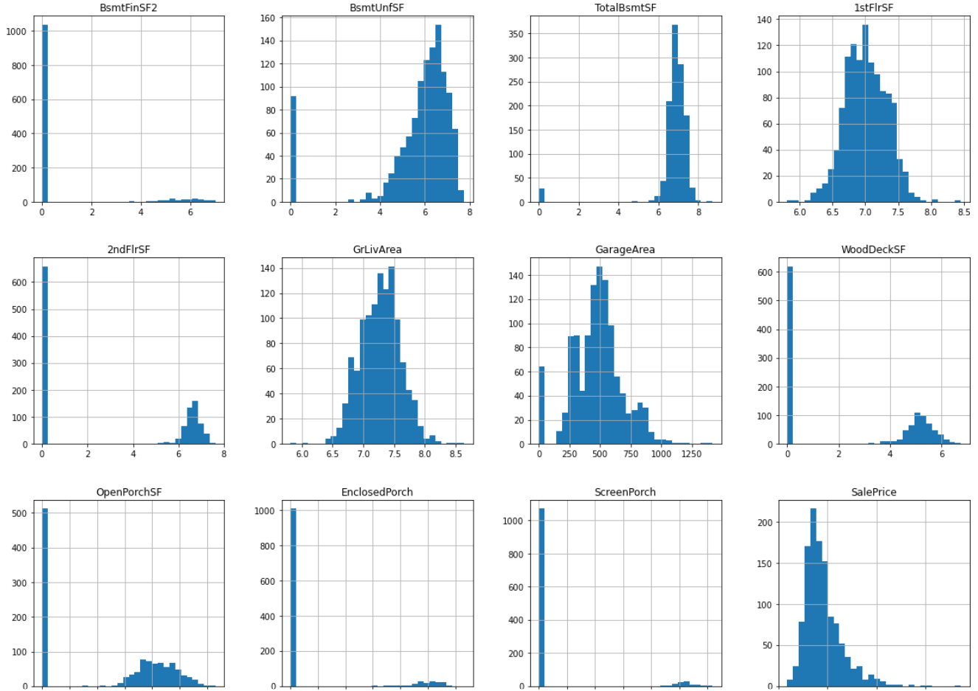
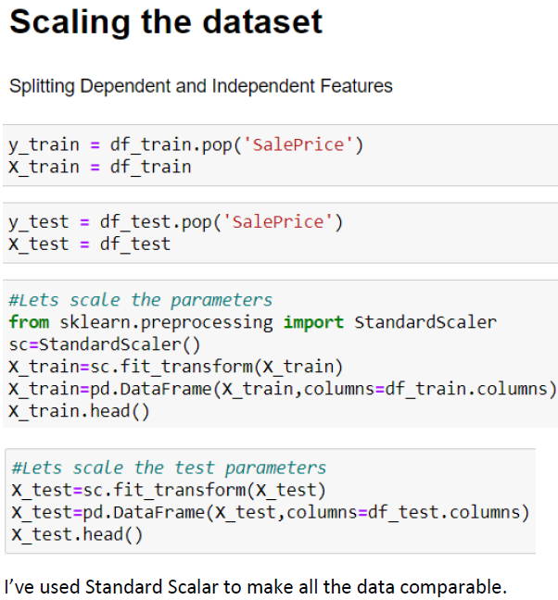
Examples of Distributions after Skewness Treatment

Slide 11

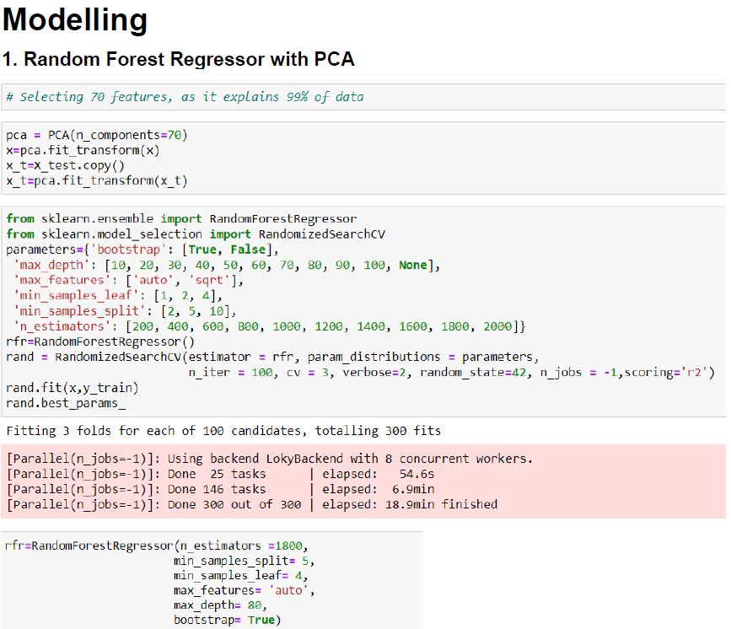

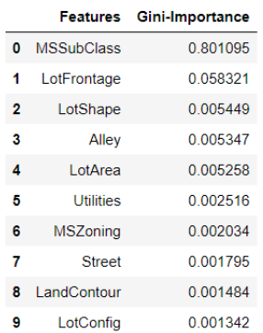
I have tried these Models :1. Random Forest Regressor 2. XGBoost 3. Lasso Regressor 4. Ridge Regressor

Slide 12
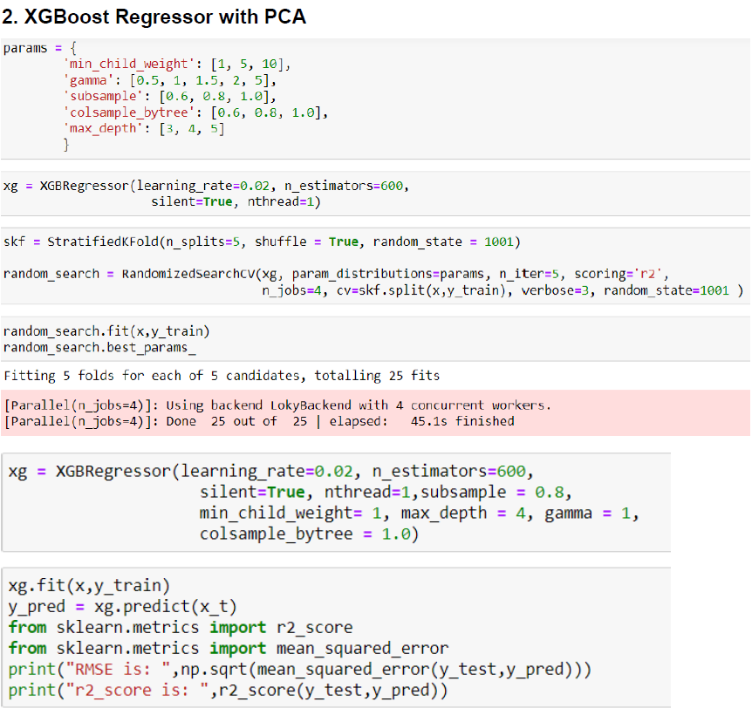


Slide 13
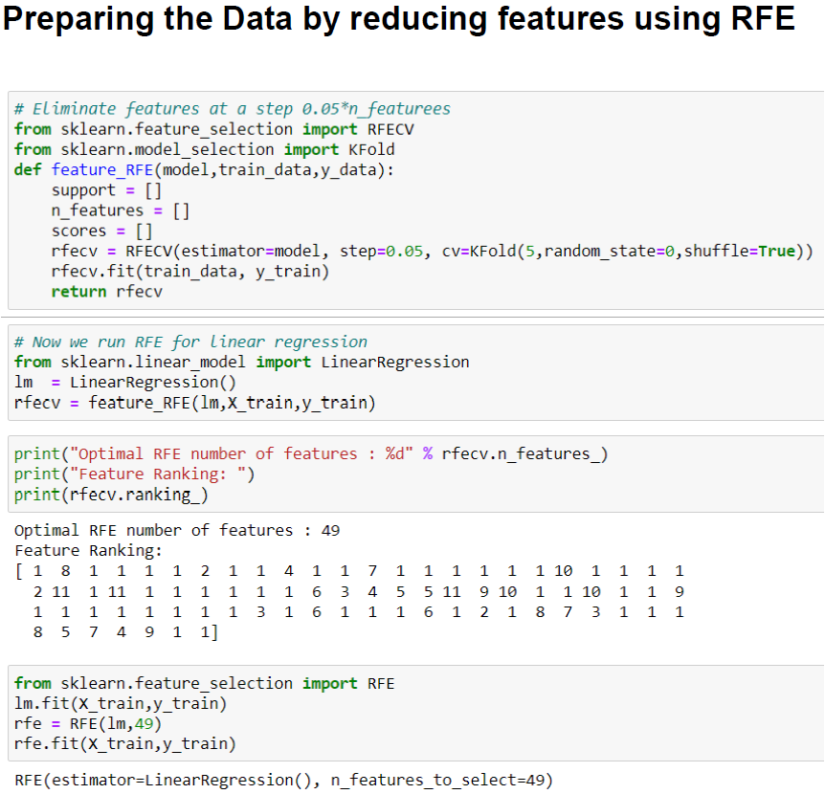
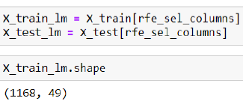

Slide 14
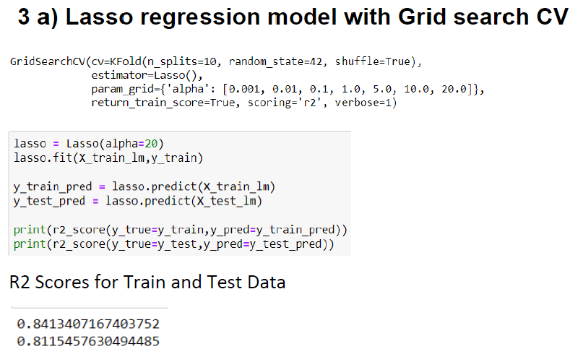
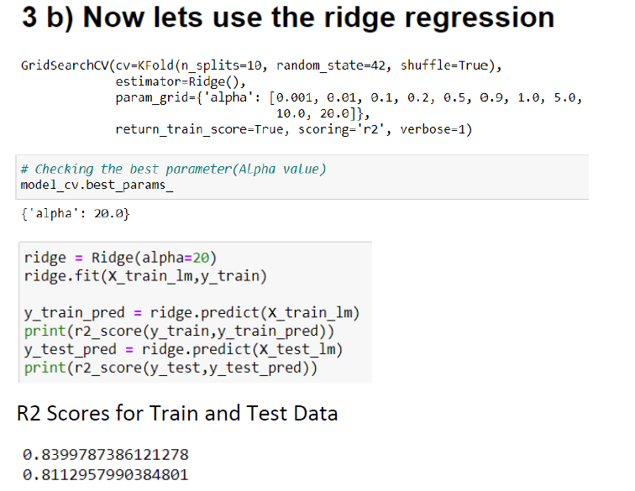
Comparing Lasso and Ridge

Slide 15
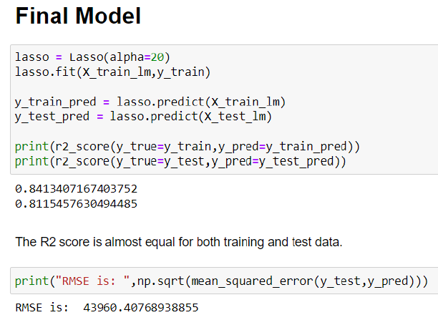
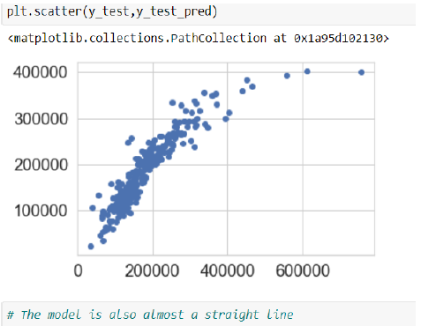
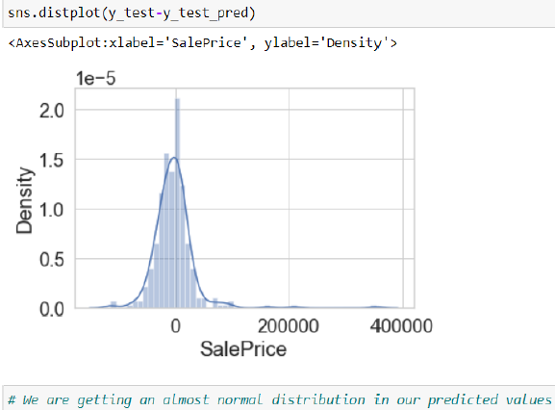

Slide 16
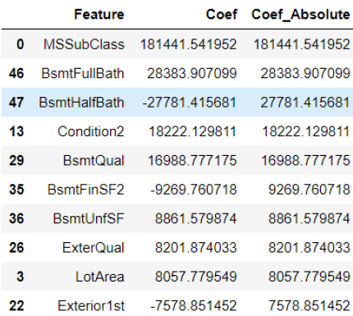
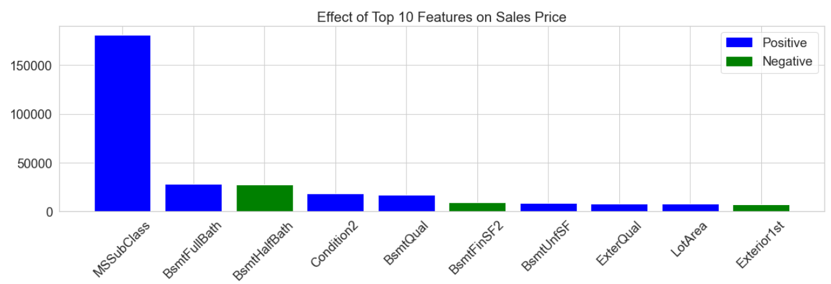
Effect of Top 10 Features Effecting Sales Price

Slide 17
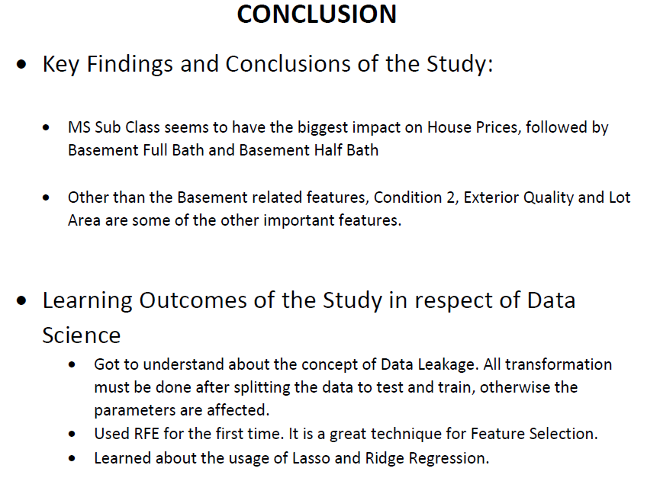

Slide 18
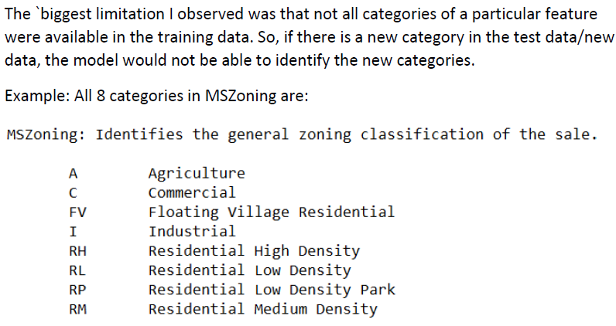

Limitations & Assumptions

