Slide 1

Developing an Autonomous Agent Framework Integrating LLM-based Reasoning with RL for Task Execution
Sidharth Ganesan (250739055)
MSc FT Advanced Computer Science
Supervisor Name:
Prof. Arumugam Nallanathan

Slide 2
Agenda
Introduction
Literature
Architecture
Experiment
Demonstration
Results & Findings
Limitations
Conclusion
Future Work

Slide 3
INTRODUCTION
Autonomous agents require both reasoning and reliable task execution
LLMs provide strong high-level reasoning and planning, but can struggle to ground decisions in environment constraints and action consequences
Reinforcement Learning learns from environment feedback and consequences, but can require substantial exploration to learn effective sequential behaviour
This project investigates combining LLM procedural reasoning with PPO-based Reinforcement Learning
Application domain: a controlled finance sandbox involving invoice validation, approval, budget checking and payment workflows
Research objective: determine whether LLM-generated procedural guidance can improve the learning and execution behaviour of PPO agents

Slide 4
LITERATURE
Proximal Policy Optimization Algorithms by Schulman et al., 2017
A Study on Overfitting in Deep Reinforcement Learning by Zhang et al., 2018
Do As I Can, Not As I Say: Grounding Language in Robotic Affordances by Ahn et al., 2022
Grounding Large Language Models in Interactive Environments with Online Reinforcement Learning by Carta et al., 2023
LLM-Planner: Few-Shot Grounded Planning for Embodied Agents with Large Language Models by Song et al., 2023
Reward Shaping for Reinforcement Learning with an Assistant Reward Agent by Ma et al., 2024
Notes:
Schulman et al. (2017) — PPOIntroduced PPO, which improves policy-gradient training using clipped policy updates for stable optimisation.
“PPO provides the RL foundation for my executor because it offers comparatively stable and simple policy optimisation.”
Zhang et al. (2018) — Overfitting in Deep RL Showed that RL agents can achieve similar/high training performance but have drastically different test performance.
“This motivated me not to judge the agents only from training success, but also to evaluate unseen scenarios and repeat experiments across seeds.”
Ahn et al. (2022) — SayCanCombined an LLM's high-level task knowledge with learned value functions that ground actions in what a robot can actually execute.
“SayCan demonstrated the key grounding problem: an LLM may know what should be done, but environment-aware execution is still required.”
Carta et al. (2023) — GLAM Used online RL/PPO to adapt an LLM policy through direct interaction with an environment and thereby improve functional grounding.
“This shows that environmental interaction and RL can ground language-model knowledge through actual consequences.”
Song et al. (2023) — LLM-Planner Used an LLM for high-level planning while a separate low-level planner executed primitive actions, with replanning from environmental observations.
“This is particularly close to my architecture: I also separate high-level LLM planning from low-level execution, but I use PPO as the learning executor.”
Ma et al. (2024) — ReLara Added an assistant reward agent that generates auxiliary dense rewards to guide the main RL policy in sparse/delayed reward tasks.
“This supports the idea that additional guidance through reward shaping can improve how an RL policy learns, which motivated my LLM reward-guidance experiment.”
Together, these studies show three useful ideas: LLMs can provide high-level procedural knowledge, RL can ground behaviour through environmental consequences, and reward shaping can guide learning. However, there is still a question of how these mechanisms should be integrated. My project therefore investigates using LLM procedural guidance with PPO through both policy input and reward shaping

Slide 5
ARCHITECTURE (Planner-Tracker-Executor)
LLM Planner: generates a high-level finance procedure and prerequisites
Procedure Tracker: tracks progress and provides the next procedural recommendation
PPO Executor: learns and selects the actual environment actions
Reward Processor: combines environment feedback with optional LLM reward guidance
Dual Guidance: LLM recommendation can be used as policy input, reward shaping, or both
Finance Sandbox: executes actions and returns state transitions, rewards and task outcomes

Slide 6
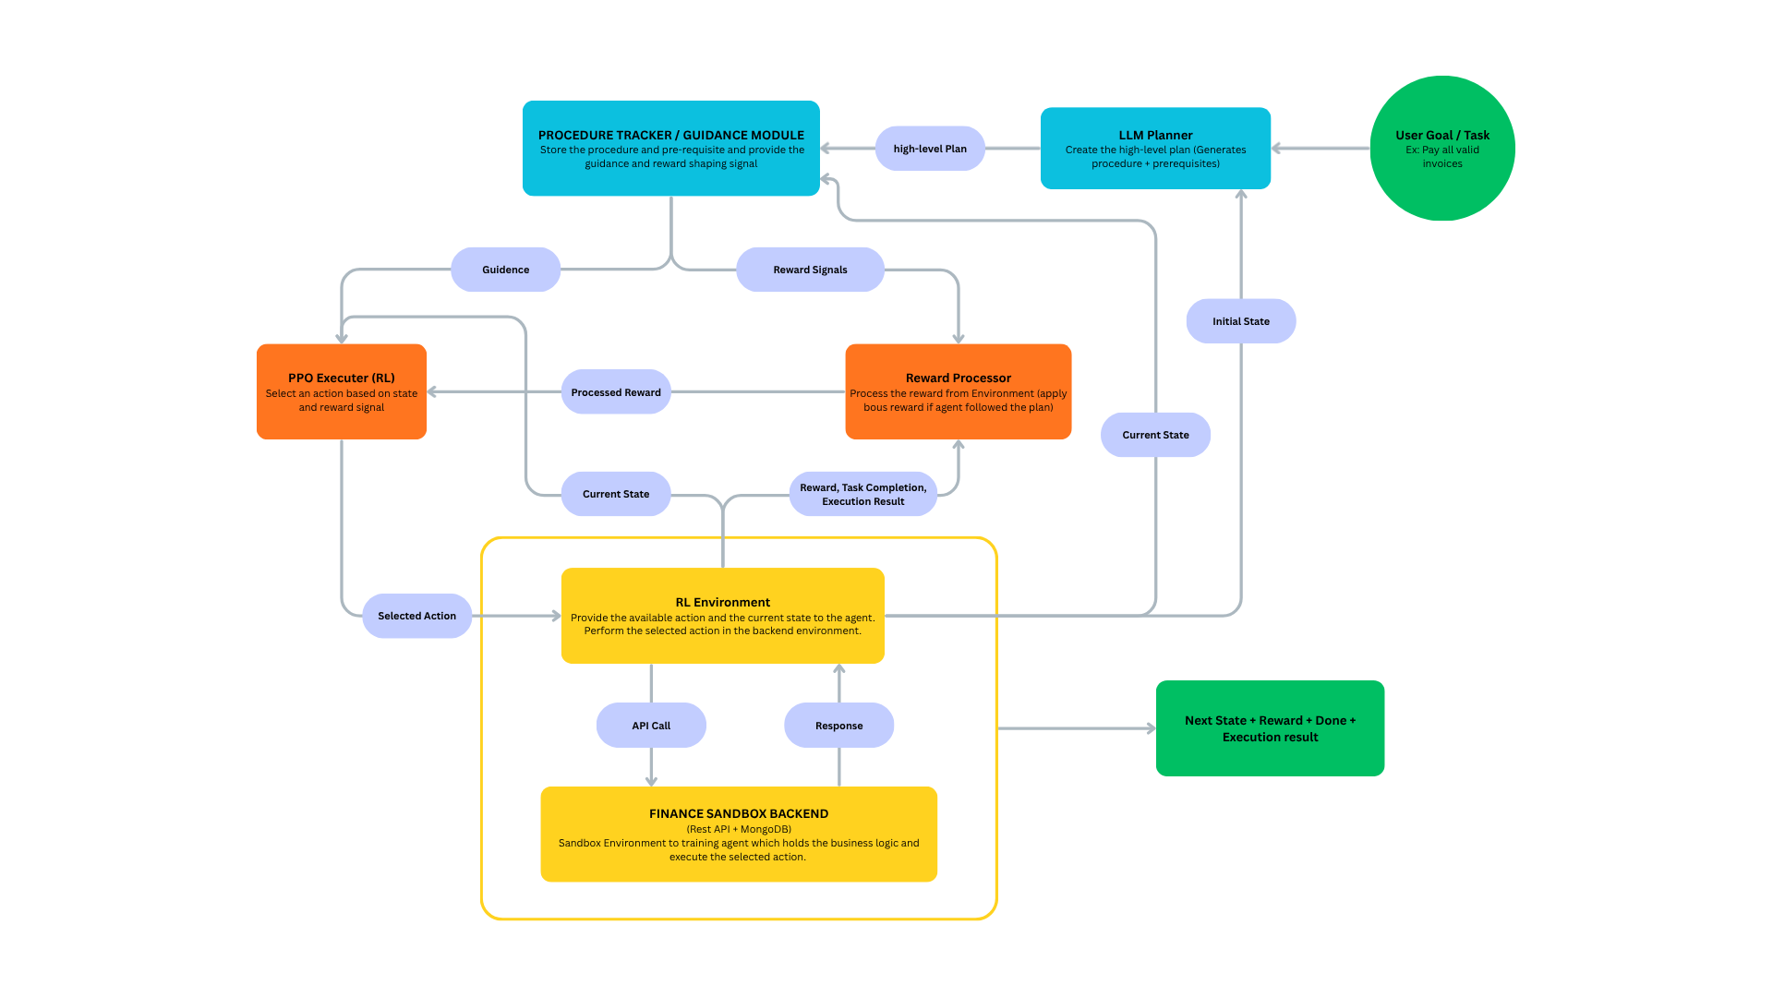

Slide 7
EXPERIMENT
4 agent configurations: PPO, LLM Input, LLM Reward, LLM Input + Reward
5 independent random seeds per configuration
1,000 training episodes + 100 deterministic evaluation episodes per run
Same PPO hyperparameters and finance environment across all conditions
Evaluation on unseen finance scenarios to assess policy generalisation and reliability

Slide 8
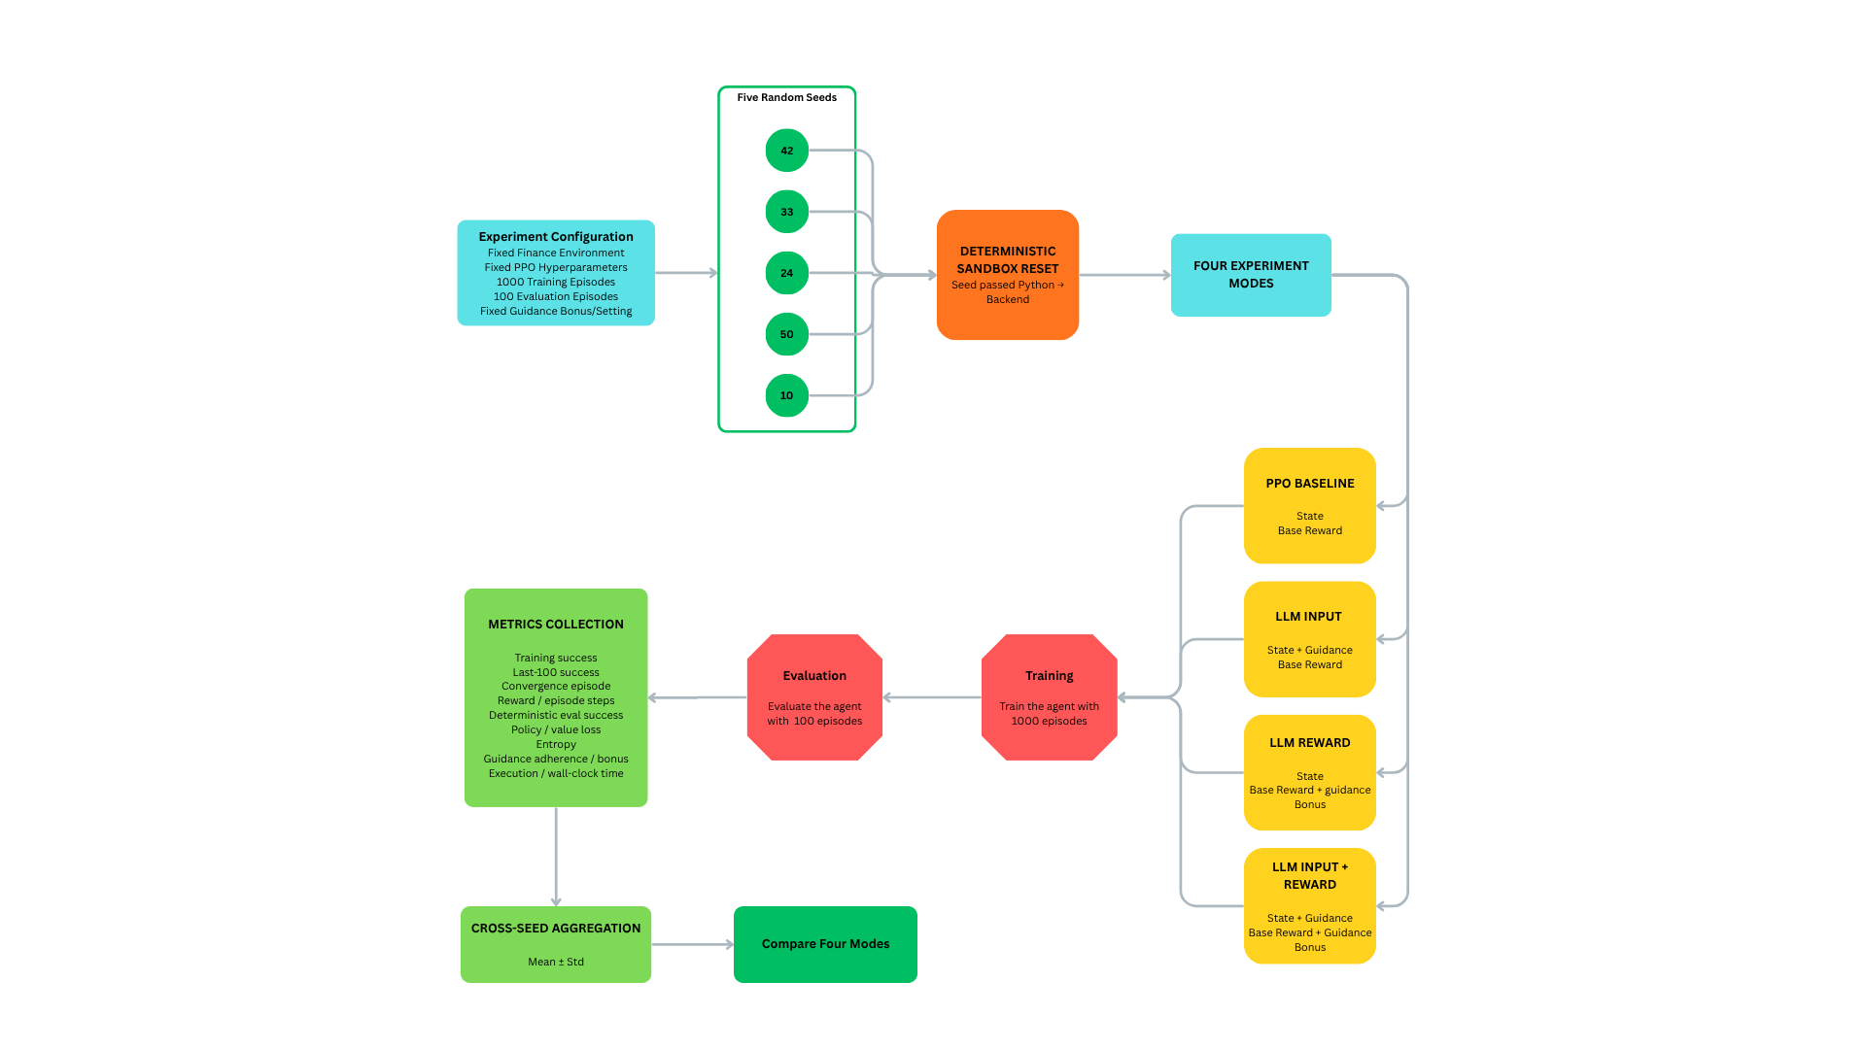

Slide 9
DEMONSTRATION
Start Finance Backend
node index.js
Launch Full Experiment Suite
python main.py run-all
Observe agent–environment interaction
environment reset → LLM procedure → PPO actions → rewards → episode completion
Generated outputs
trained models, logs, metrics, Excel summaries and comparison graphs

Slide 10
Demonstration deleted for GitHub file size limitation download the source from one Drive or google drive for complete source code and ppt.

Slide 11
RESULTS & FINDINGS
Configuration | Final-100 Train Success (%) | First Conv. Ep. | Eval. Success (%) | Eval. Base Reward | Eval. Steps | Eval. Procedure Adherence (%) | Train Time (s)
PO Baseline | 88.2 ± 1.6 | 183.8 ± 34.3 | 36.8 ± 41.9 | 18.55 ± 15.3 | 15.43 ± 5.15 | - | 1231.4 ± 28.8
LLM Input | 88.8 ± 1.3 | 166.2 ± 13.2 | 21.8 ± 34 | 13.05 ± 12.22 | 17.15 ± 4.45 | 9.27 ± 2.32 | 1301 ± 45.4
LLM Reward Shaping | 86.6 ± 2.8 | 179 ± 6.3 | 51 ± 39.7 | 24.39 ± 13.98 | 14.13 ± 4.58 | 34.29 ± 19.01 | 1333.8 ± 58.4
LLM Input + Reward | 87.6 ± 0.5 | 176 ± 9.1 | 87.6 ± 1 | 38.03 ± 0.55 | 9.58 ± 0.37 | 64 ± 2.87 | 1334.8 ± 63.6
Notes:
Training performance was similar across all four configurations
Around 83–85% training success
Final-100 episode success was also very close
LLM guidance did not produce a major improvement in training success
The main difference appeared only during evaluation
Deterministic evaluation showed the strongest result
PPO: 36.8% ± 41.9%
LLM Input: 21.8% ± 34.0%
LLM Reward: 51.0% ± 39.7%
LLM Input + Reward: 87.6% ± 1.0%
Combined Input + Reward was much more consistent across seeds
PPO performance varied heavily between seeds
Combined guidance stayed around 86–89% across all five seeds
Input guidance alone was not enough
It did not improve deterministic evaluation
Reward guidance alone helped somewhat
Better average evaluation than PPO
But still showed high variability
Best performance came from combining both guidance mechanisms
Policy could observe the LLM recommendation
Reward signal reinforced procedurally appropriate behaviour
Combined guidance improved execution efficiency
PPO: about 15.4 evaluation steps
Input + Reward: about 9.6 steps
Procedure adherence was highest for the combined approach
Suggests PPO made better use of the procedural information when both guidance channels were present
Convergence improvement was limited
PPO: about 184 episodes
Combined: about 176 episodes
Therefore, the results do not support a major convergence-speed improvement
Main benefit was reliability and generalisation, not faster learning
Similar training performance
Very different deterministic evaluation performance
Training success alone would have been misleading
Agents that looked similar during training produced very different final policies
Results suggest reduced sensitivity to random training trajectories
Combined LLM guidance produced much lower cross-seed variance
Evidence suggests improved generalisation
Better performance on unseen evaluation scenarios
Avoid claiming that LLM guidance completely “prevents overfitting”
Overall finding
LLM guidance was most effective when procedural information was provided both as policy input and reward guidance, producing a more reliable, consistent and efficient PPO policy.

Slide 12
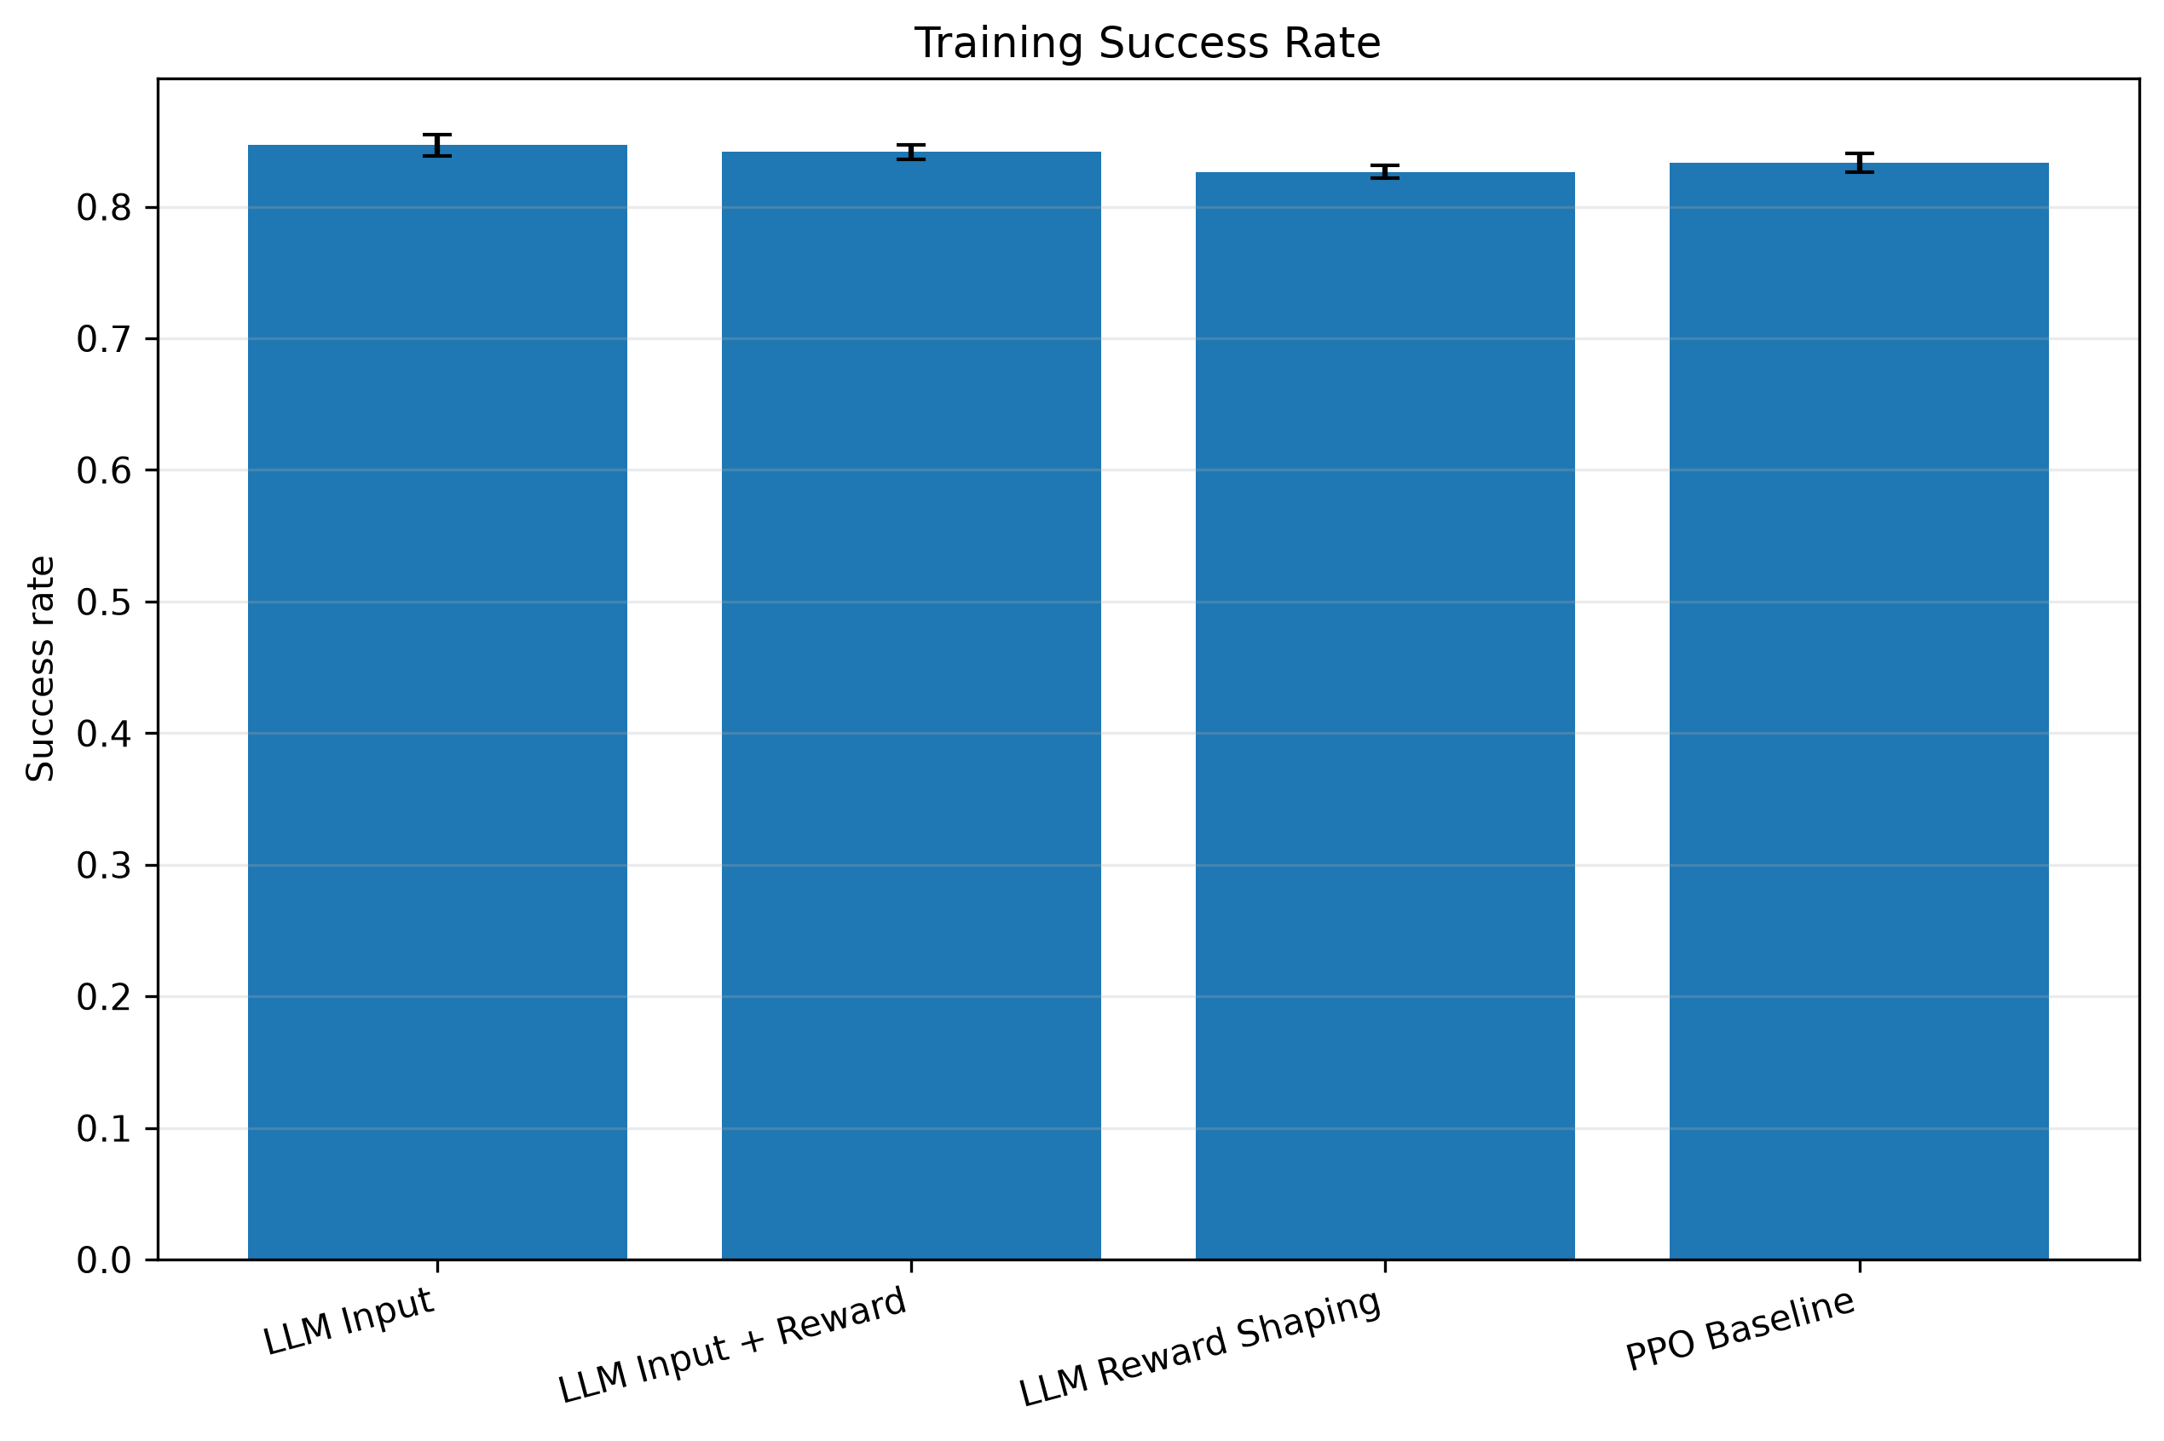
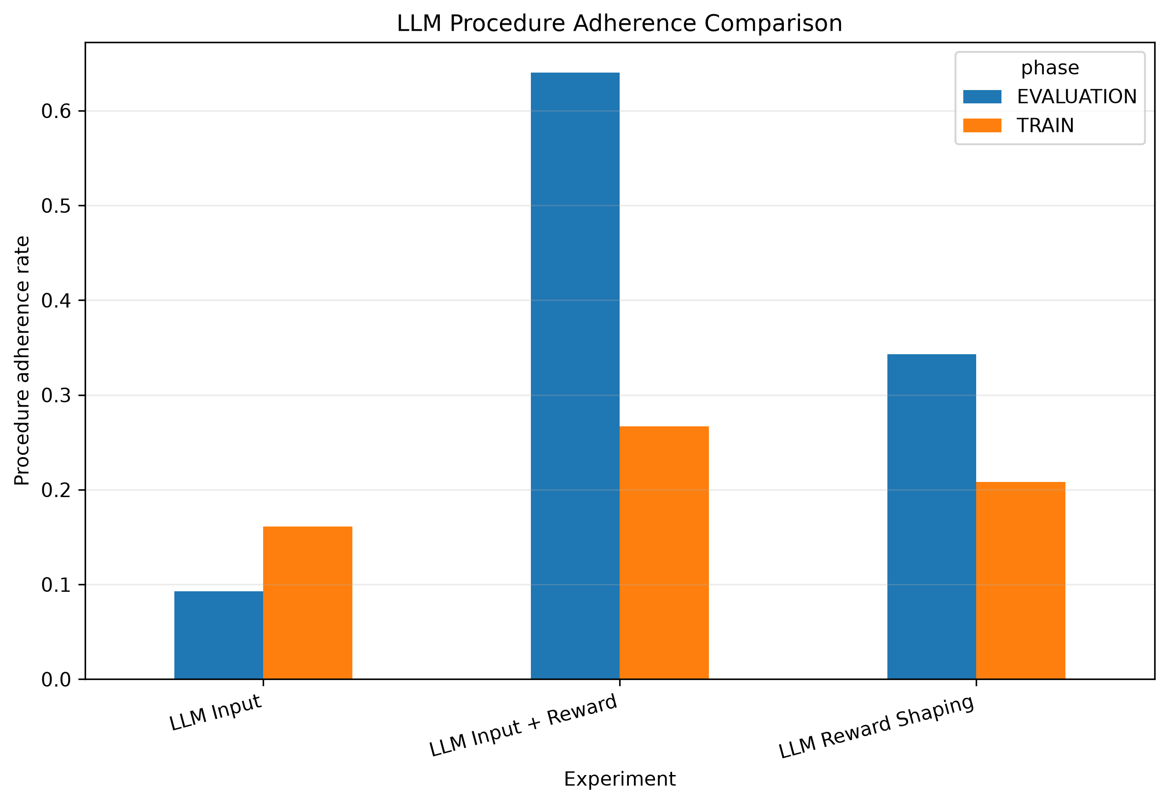
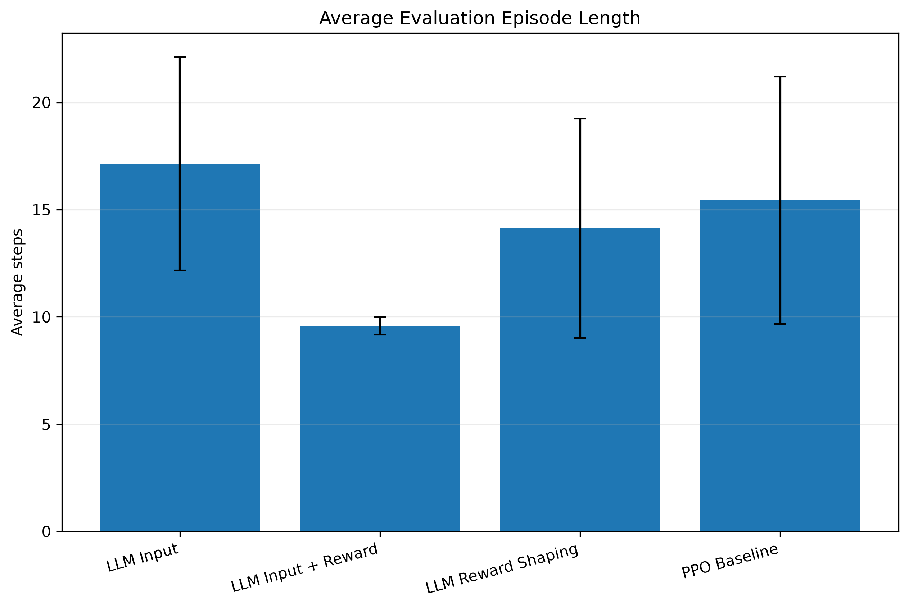
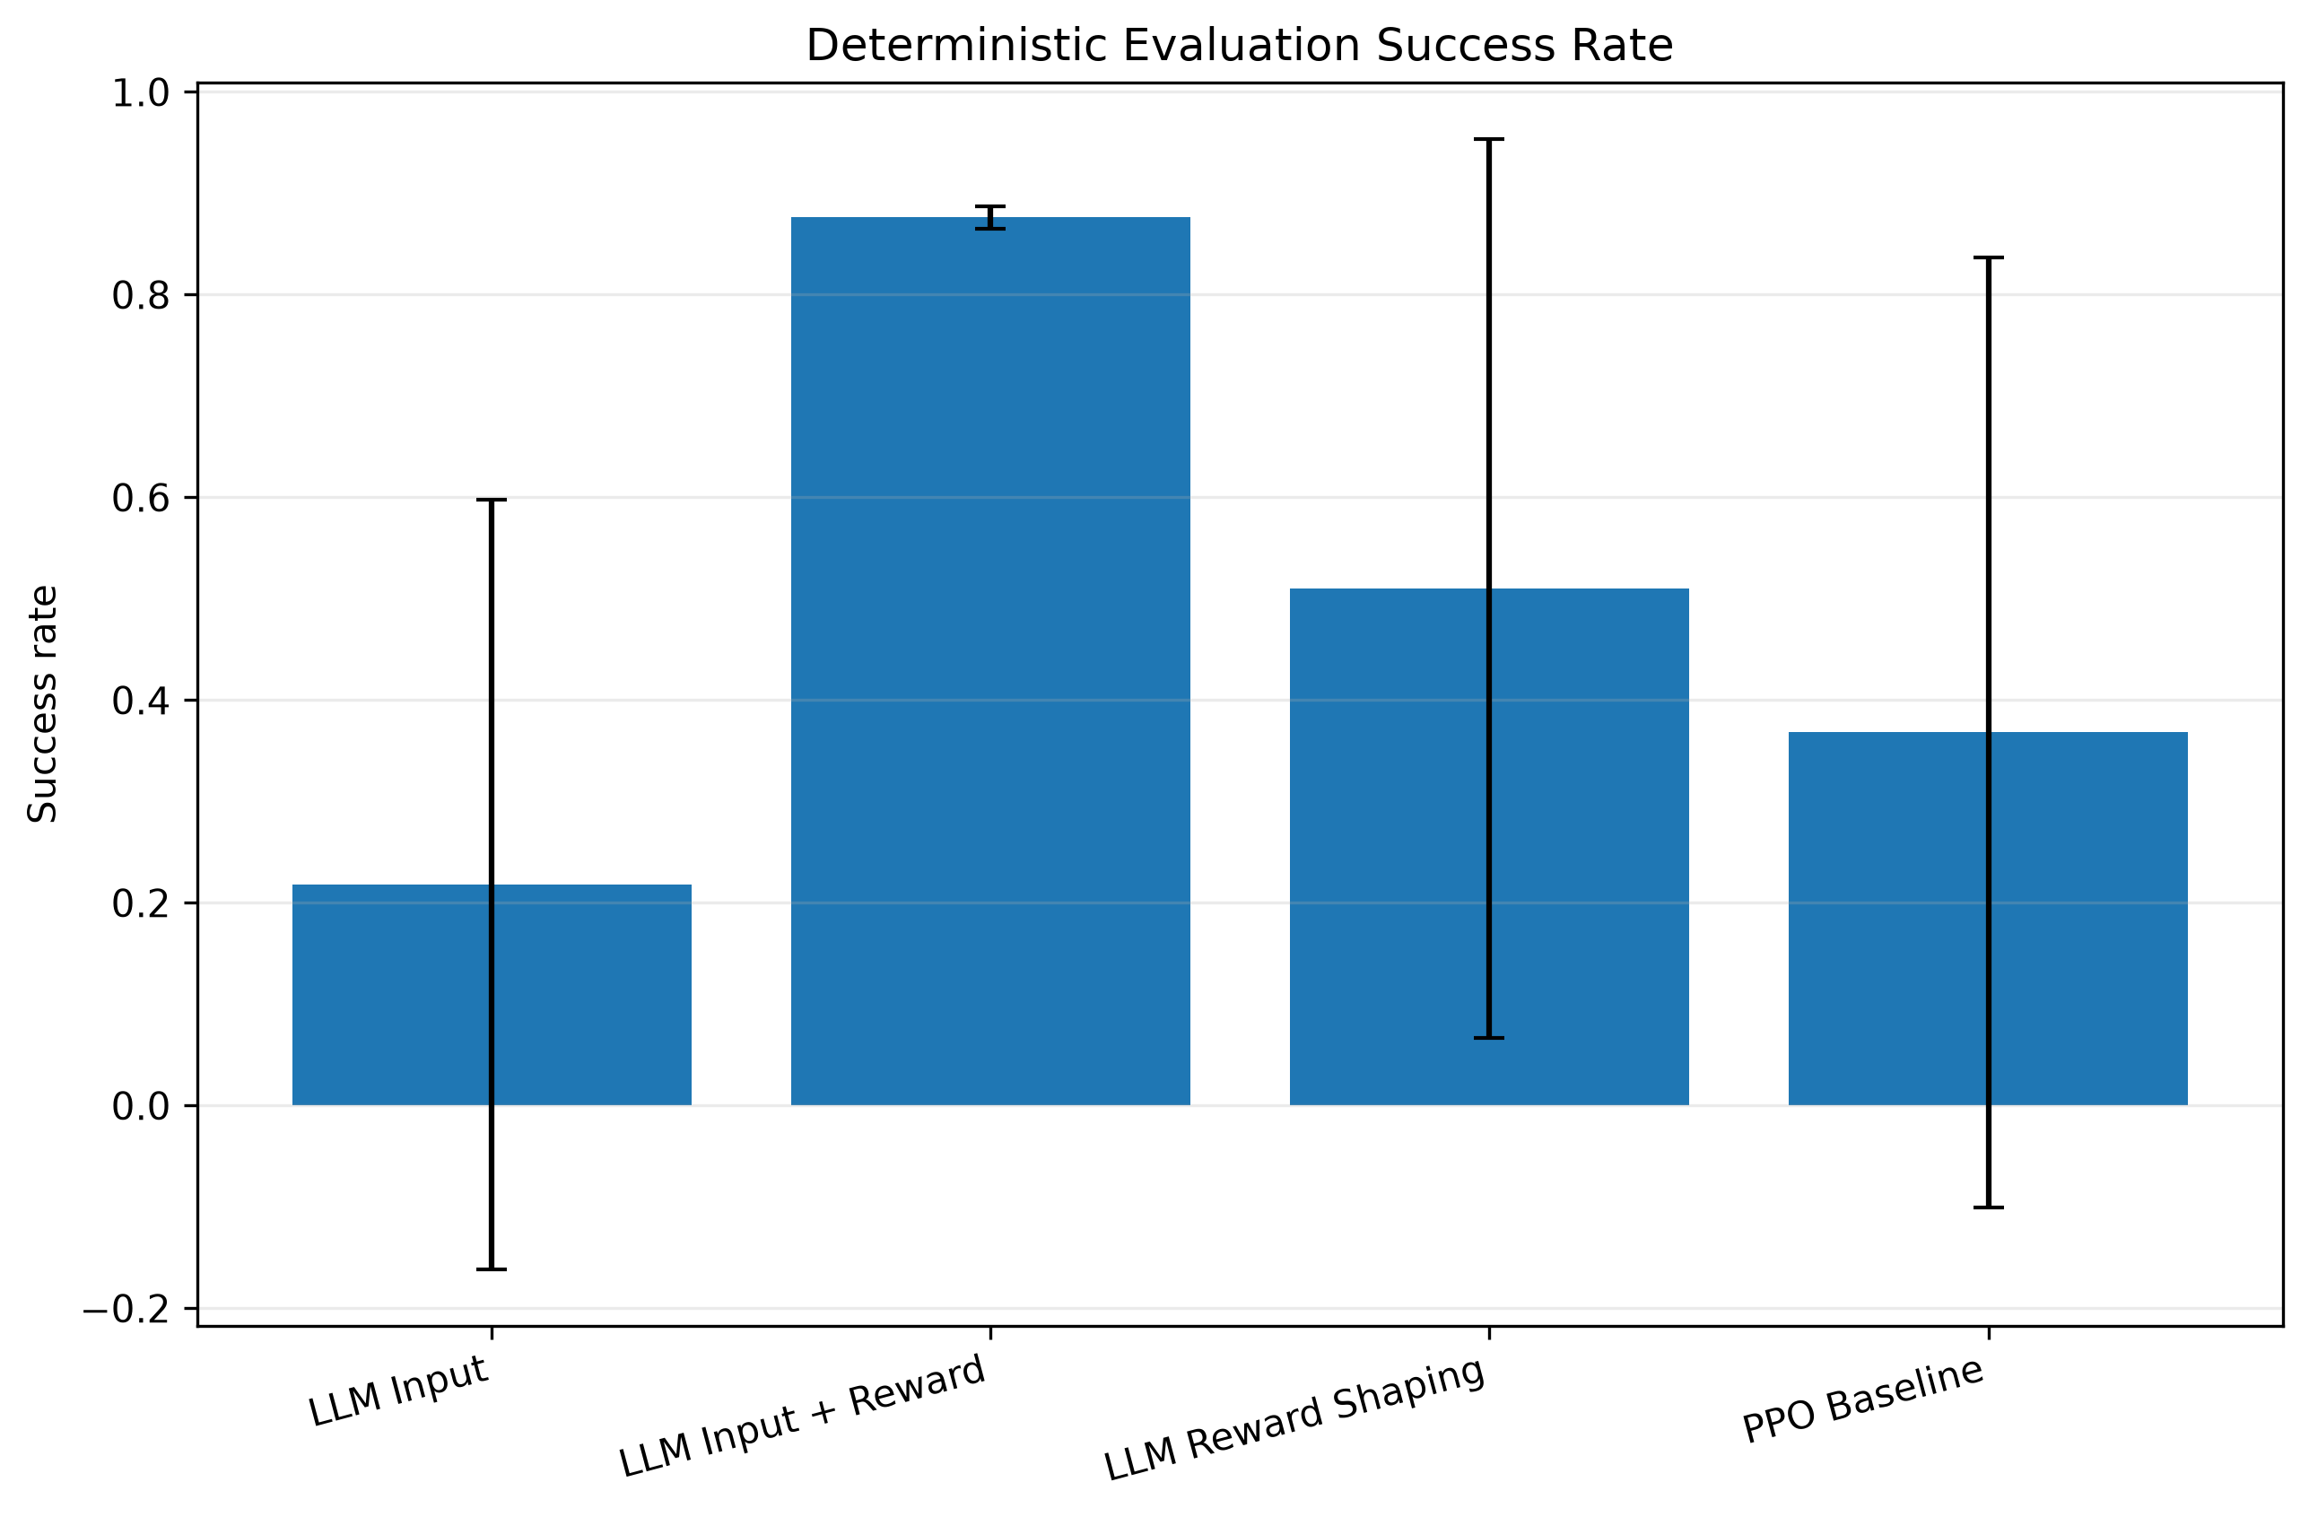
Notes:
Training performance was similar across all four configurations
Around 83–85% training success
Final-100 episode success was also very close
LLM guidance did not produce a major improvement in training success
The main difference appeared only during evaluation
Deterministic evaluation showed the strongest result
PPO: 36.8% ± 41.9%
LLM Input: 21.8% ± 34.0%
LLM Reward: 51.0% ± 39.7%
LLM Input + Reward: 87.6% ± 1.0%
Combined Input + Reward was much more consistent across seeds
PPO performance varied heavily between seeds
Combined guidance stayed around 86–89% across all five seeds
Input guidance alone was not enough
It did not improve deterministic evaluation
Reward guidance alone helped somewhat
Better average evaluation than PPO
But still showed high variability
Best performance came from combining both guidance mechanisms
Policy could observe the LLM recommendation
Reward signal reinforced procedurally appropriate behaviour
Combined guidance improved execution efficiency
PPO: about 15.4 evaluation steps
Input + Reward: about 9.6 steps
Procedure adherence was highest for the combined approach
Suggests PPO made better use of the procedural information when both guidance channels were present
Convergence improvement was limited
PPO: about 184 episodes
Combined: about 176 episodes
Therefore, the results do not support a major convergence-speed improvement
Main benefit was reliability and generalisation, not faster learning
Similar training performance
Very different deterministic evaluation performance
Training success alone would have been misleading
Agents that looked similar during training produced very different final policies
Results suggest reduced sensitivity to random training trajectories
Combined LLM guidance produced much lower cross-seed variance
Evidence suggests improved generalisation
Better performance on unseen evaluation scenarios
Avoid claiming that LLM guidance completely “prevents overfitting”
Overall finding
LLM guidance was most effective when procedural information was provided both as policy input and reward guidance, producing a more reliable, consistent and efficient PPO policy.

Slide 13
LIMITATIONS
Controlled and simplified finance sandbox
Limited task and scenario diversity, Tested only with PPO and Llama 3
Forward-only procedural progression with limited backtracking/replanning
LLM behaviour depends on manually engineered prompts
LLM guidance introduces additional computational overhead

Slide 14
CONCLUSION
LLM guidance was most effective when used through both policy input and reward shaping
Training success was broadly similar across all configurations, Main improvement appeared during deterministic evaluation, not during training. LLM Input + Reward achieved the most reliable performance
Combined guidance also reduced unnecessary evaluation steps
LLM guidance did not produce a major convergence-speed improvement
Main benefit was improved reliability, consistency and generalisation of the learned PPO policy
Notes:
The main finding is therefore not that LLM guidance makes PPO learn dramatically faster, but that appropriately integrating procedural knowledge can make the final learned policy considerably more reliable and consistent.

Slide 15
FUTURE WORKS
Dynamic replanning and backtracking
Adaptive LLM guidance
Identify where Input vs Reward guidance is most useful
Systematic prompt optimisation
Evaluate more complex environments, LLMs and RL algorithms
Develop and evaluate a real-world autonomous finance agent

Slide 16
REFERENCES
Ahmad, A. et al., 2024. Accelerating Proximal Policy Optimization Learning Using Task Prediction for Solving Environments with Delayed Rewards, s.l.: s.n.
Ahn, M. et al., 2022. Do As I Can, Not As I Say: Grounding Language in Robotic Affordances, s.l.: s.n.
Carta, T. et al., 2023. Grounding Large Language Models in Interactive Environments with Online Reinforcement Learning. s.l., PMLR, pp. 3676-3713. 9
Grattafiori, A. et al., 2024. The Llama 3 Herd of Models, s.l.: s.n.
Lidayan, A., Dennis, M. & Russell, S., 2025. BAMDP Shaping: a Unified Framework for Intrinsic Motivation and Reward Shaping. s.l., ICLR, pp. 19005-19034.
Liu, X. et al., 2025. AgentBench: Evaluating LLMs as Agents, s.l.: s.n.
Ma, H. et al., 2024. Reward Shaping for Reinforcement Learning with An Assistant Reward Agent. s.l., s.n.
Minoshima, Kota; Arai, Sachiyo, 2026. Autonomous Reward Shaping via Self-Generated Trajectories for Sparse-Reward Reinforcement Learning. IEEE Access, Volume 14, pp. 33890-33907.
Peng, J. et al., 2026. HiPER: Hierarchical Reinforcement Learning with Explicit Credit Assignment for Large Language Model Agents. s.l.:s.n.
Schulman, J. et al., 2017. Proximal Policy Optimization Algorithms, s.l.: s.n.
Song, C. H. et al., 2023. LLM-Planner: Few-Shot Grounded Planning for Embodied Agents with Large Language Models. s.l., s.n., pp. 2998-3009.
Wang, L. et al., 2024. A survey on large language model based autonomous agents. Frontiers of Computer Science.
Zhang, C., Vinyals, O., Munos, R. & Bengio, S., 2018. A Study on Overfitting in Deep Reinforcement Learning, s.l.: s.n.
Zhou, S. et al., 2024. WebArena: A Realistic Web Environment for Building Autonomous Agents, s.l.: s.n.

Slide 17
THANK YOU

